Slide 1
ICIP
2020
IEEE International Conference on Image Processing

Slide 2


Transductive Prototypical Network for Few-shot Classification
Xinyue Liu, Pengxin Liu, Linlin Zong
Dalian University of Technology
Notes:
Hi, every one, I’m Pengxin, and today let’s talk about “Transductive Prototypical Network for Few-shot Classification”, this work is done in collaboration with Xinyue, Linlin.

Slide 3
Outline
Motivation
Proposed Framework
Experiment
Conclusion
Notes:
This is outline, first I’ll talk about the motivation of our paper. Then I’ll introduce our proposed framework. Next I’ll talk about experiment. And final is a conclusion.

Slide 4
Motivation
Notes:
Motivation.

Slide 5



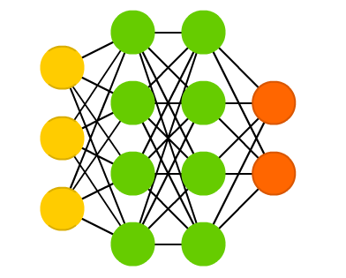
Motivation
Elephant
Elephant
? ? ?
Notes:
Humans can learn new concepts from only one or few instances. For example, a child can generalize the concept of “elephant” after observing the given picture in a book. However, deep learning needs large amounts of available labeled data to gain the ability to classify an image. This obvious gap motivates the research interest on few-shot learning.

Slide 6
Motivation
Problem of prototypical network
It only uses one or few labeled instances to represent the corresponding class.
Inspiration of transductive inference
Transductive propagation network shows the power of transductive inference for few-shot classification.
Notes:
Prototypical Network is a promising approach to address the key issue of over-fitting for few-shot learning. However, the original Prototypical Network only uses one or few labeled instances to represent the corresponding class, which easily deviates from the real class distribution leading to the imprecise classification results. On the other hand, Transductive Propagation Network firstly introduces the transductive inference into few-shot classification, which makes its performance greatly improved. Nevertheless, this network requires a specific graph struture, resulting in it less universal.

Slide 7
Proposed Framework
Notes:
Proposed freamework.

Slide 8
Proposed Framework
Transductive Prototypical Network (Td-PN)
Notes:
This figure is our Transductive Prototypical Network framework, which is also called Td-PN. It consists of four modules: feature embedding, prototype initialization, contrastive loss and prototype refining. Feature embedding module adopts an encoder to embed features of examples from the support set S and the query set Q. Prototype initialization module computes the mean vector of embedded features per class from the support set as the corresponding prototype representation. Contrastive loss module is designed to obtain a classifying-friendly feature embedding space. Prototype refining module refines the prototype representation by selecting the top k confident embedded features of the query set for each class.

Slide 9
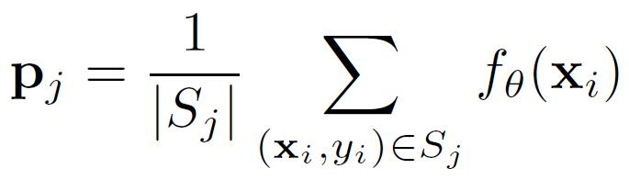
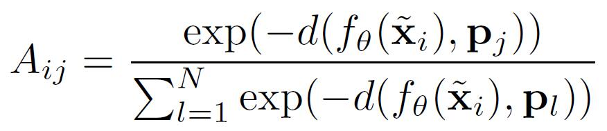
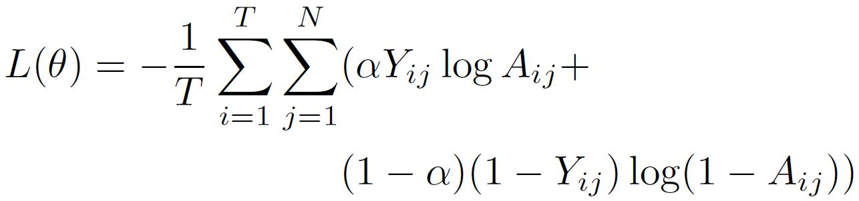
Proposed Framework
Weighted contrastive loss
Prototype initialization
Soft assignment
Loss computation
Notes:
In this page, I’ll introduce our weighted contrastive loss. Prototype initialization defines the original prototype. In this formulation, P j denotes the prototype of the class j, S j denotes the set of the class j in the support set and f theta x i denotes the embedded feature of the support sample i. Then we calculate a soft assignment A i j of embedded features in the query set to each class prototype, where d denotes the euclidean distance. Finally, we compute the weighted contrastive loss as L theta, where the first part of this parentheses is the similarity loss, the last part is the dissimilarity loss, and alpha is a parameter that controls the degree of the similarity loss.

Slide 10
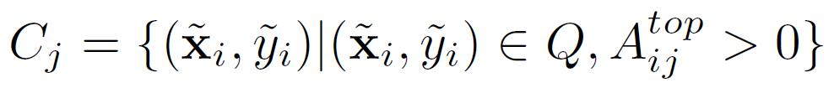
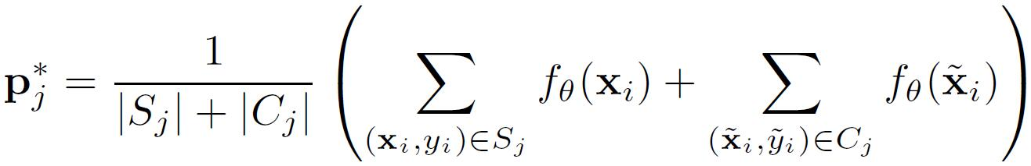
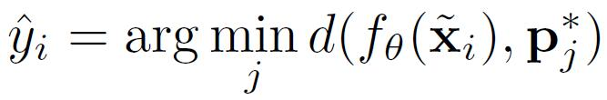
Proposed Framework
Prototype refining
Candidate sets
Representative prototype
Label prediction
Notes:
Prototype refining module first select the top k confident embedded features of the query set for each class as candidate sets. In this formulation, C j is the candidate set of the class j, and A top denotes the top k larger values of each column are reserved in the assignment matrix A, while the rest are set to
zero. After that, the prototype representation is refined by choosing examples of the corresponding candidate set, and P star j is the refined prototype of the class j. Hence, the label y hat I is predicted by finding the nearest class prototype under the euclidean distance.

Slide 11
Experiment
Notes:
Experiment.

Slide 12
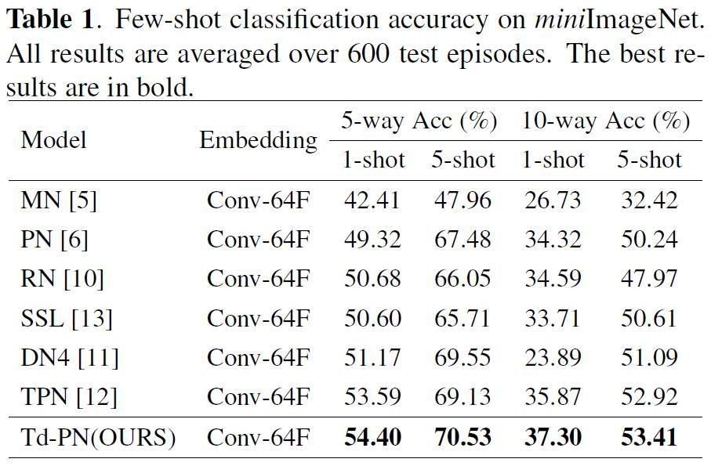
Experiment
Notes:
In Table one, we shows the compared experimental results on miniImageNet dataset, and our method has better classification performance than the related algorithms.

Slide 13
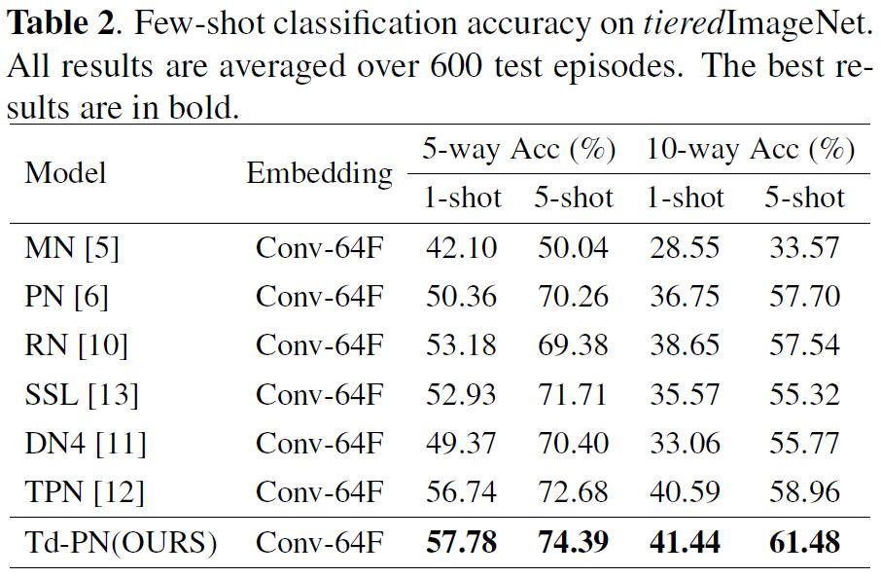
Experiment
Notes:
Our proposed Td-PN also achieves the state-of-the-art results on tieredImageNet dataset and exceeds Prototypical Network with a large margin. These experimental results are shown Table two.

Slide 14
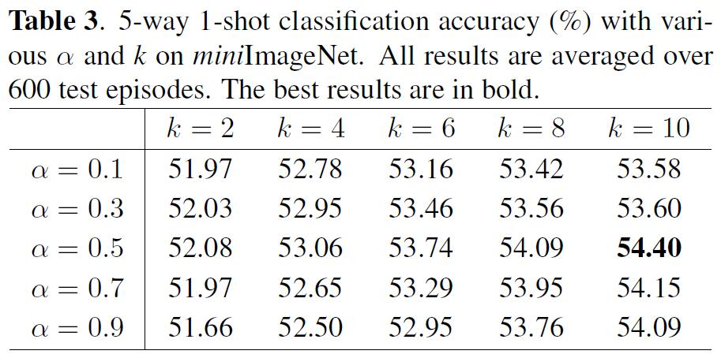
Experiment
Notes:
To further investigate hyper-parameters’ effects, we perform five-way one-shot task based on a grid search strategy on miniImageNet dataset. Table three shows the experimental results of the hyper-parameters.

Slide 15
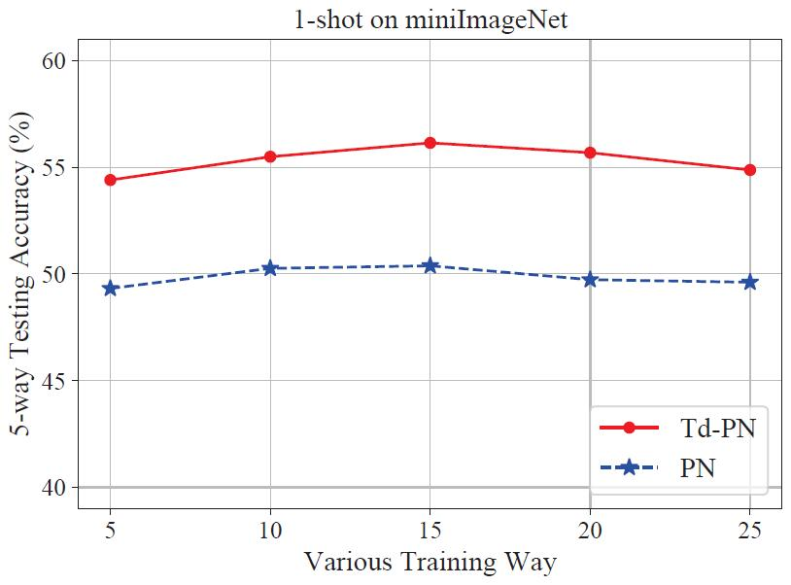

Experiment
Notes:
Following Prototypical Network, we study the effect of various training way on the performance of our Td-PN model. Experimental results in Figure two show that properly larger training way can improve the
generalization performance of them, and our Td-PN performs consistently better than Prototypical Network with varying training way.

Slide 16
Conclusion
Notes:
Conclusion.

Slide 17
Conclusion
We propose a universal Transductive Prototypical Network (Td-PN) framework for few-shot classification.
We adopt a weighted contrastive loss to generate classifying-friendly features, and design a transduction-based approach to obtain the powerful prototypes.
Our experiment on miniImageNet and tieredImageNet datasets verifies the effectiveness of our proposed Td-PN framework.
Notes:
We propose a universal Transductive Prototypical Network (Td-PN) framework for few-shot classification, which don’t need a specific graph structure. We adopt a weighted contrastive loss to generate classifying-friendly features, and design a transduction-based approach to refine the prototype representation of each class by choosing the top k high-confidence query samples. Extensive experiments on miniImageNet and tieredImageNet datasets demonstrate that our method has better classification performance than the related state-of-the-arts.

Slide 18
Thanks
Notes:
Thank you for your listening.

