Slide 1
InsightBot: Knowledge Creation & User Intention Understanding for IT System Support

Slide 2
Task: End-to-end solution for automated ticket handling
Need hours or
days to process
Provide solution in minutes
Traditional Ticket Handling
Expensive in time & money!
Automated Ticket Handling
Streamlined and efficient!
Effective ticket handling ensures seamless customer support and issue resolution
Ticket handling by human: expensive and error prone, long delay of response
AI Chatbot for automated ticket handling and troubleshooting: streamlined and efficient
The key is on retrieving relevant knowledge to generate correct answers (RAG)
Build Knowledge based AI chatbot to streamline ticket handling

Slide 3
Challenges of RAG on IT ticket data
Complex Data: Multi-round dialogues between user and system admin, long text with lots of noises, comprehensive user requests
Domain specific solution: A minor change on some key fields may lead to different solution, e.g., the service time for VIP customer vs. standard customer
Incomplete background information in user’s initial request, e.g., the user forget to mention the OS version in request, which is critical for solution
Standard RAG cannot address the unique challenges of IT ticket data

Slide 4
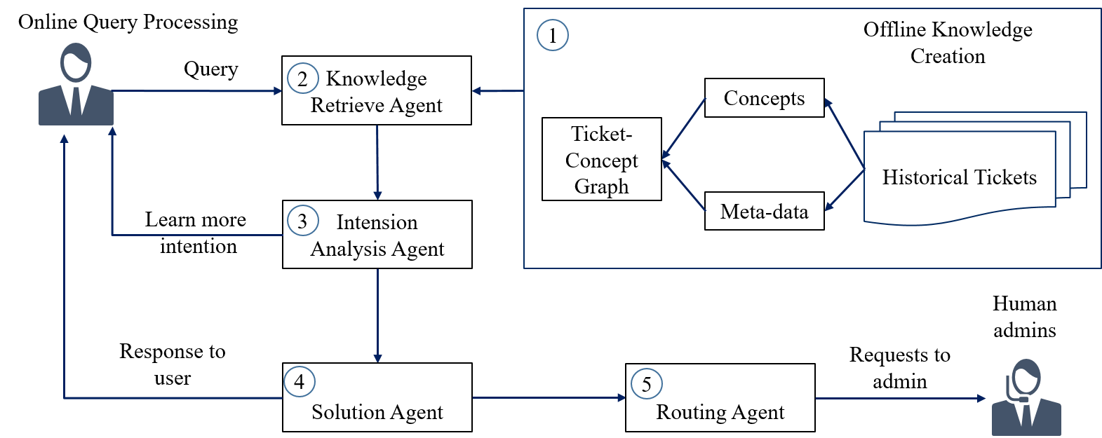
Technical contributions of InsightBot
Extract concepts and meta-data from historical tickets
Generating ticket-concept graph as the knowledge base to summarize complex data
Multi-round clarification chat with users to fill in the missing information
Agent based routing: analysis the generated solution and routing to human if necessary
Knowledge creation and user intension learning for effective ticket handling

Slide 5
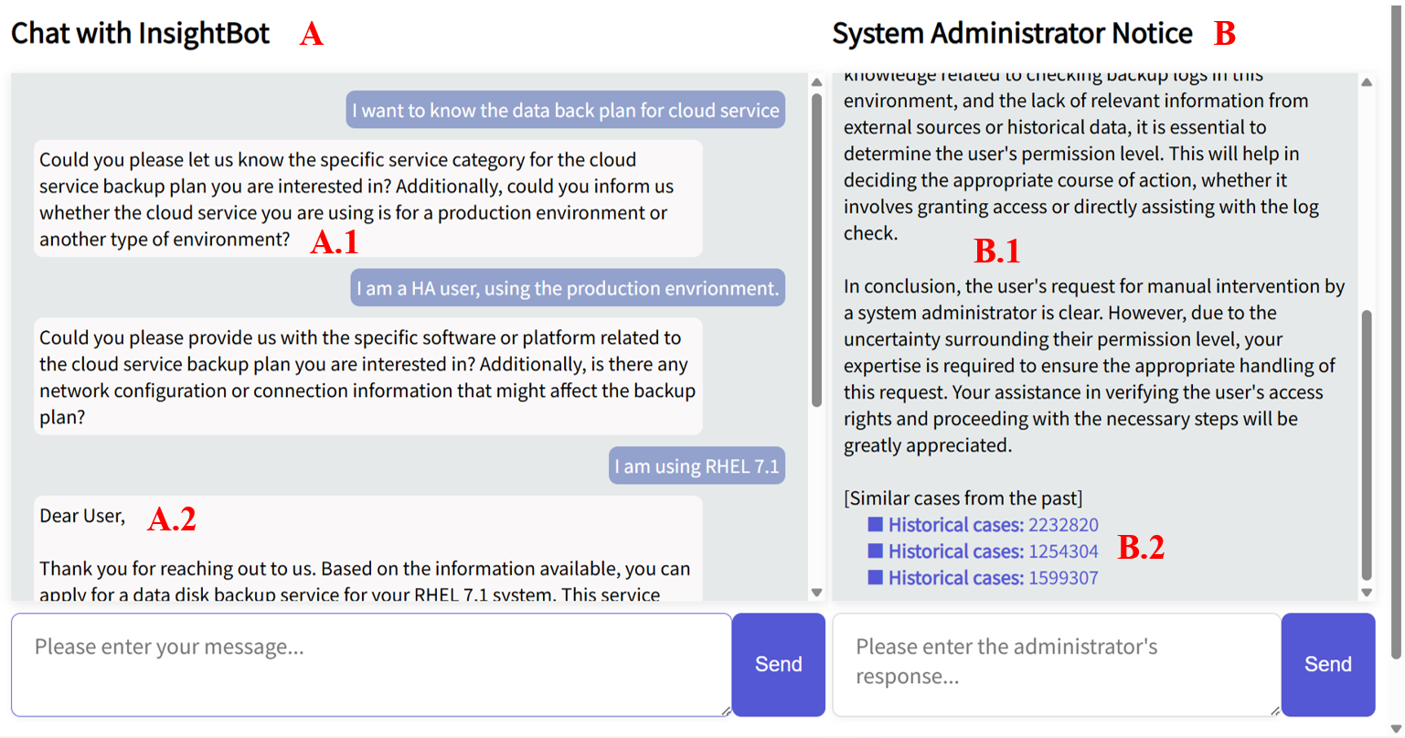
Demo Scenario
InsightBot understand user intention by multi-round communication and provide solutions

Slide 6


