Slide 1
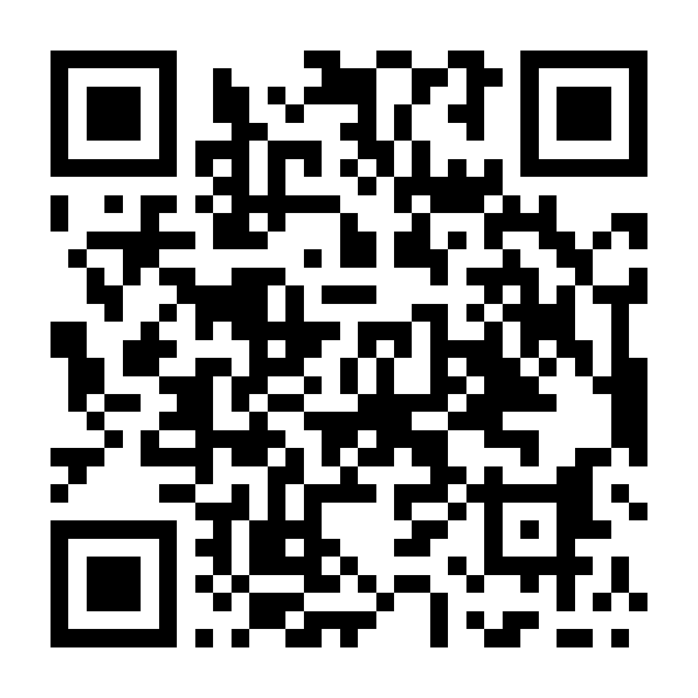
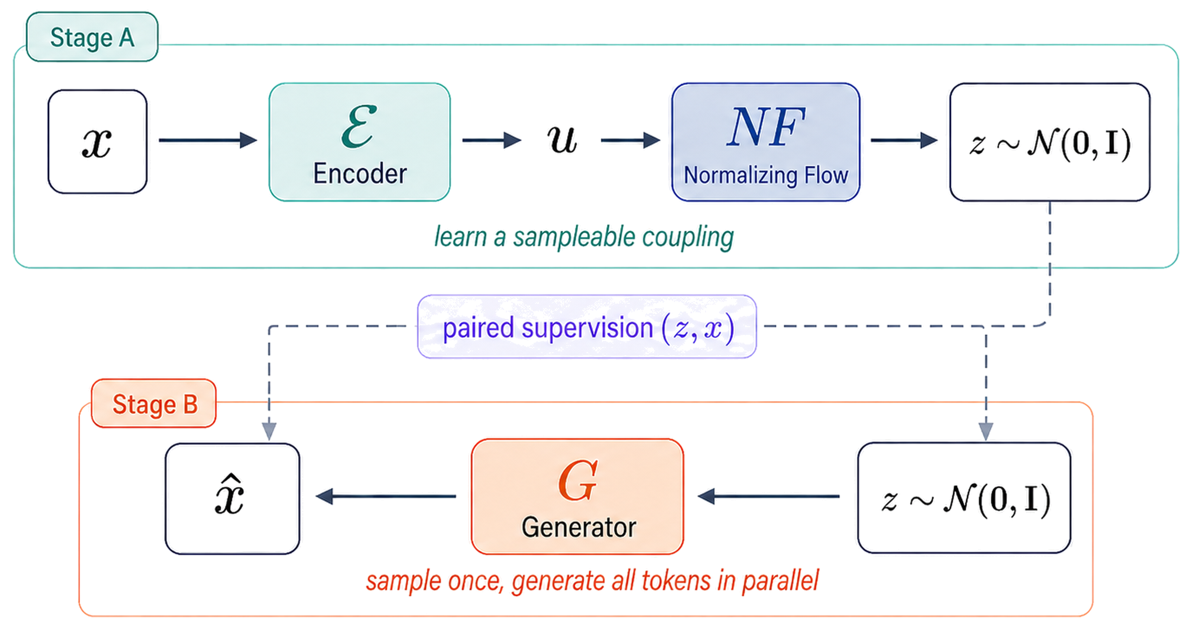
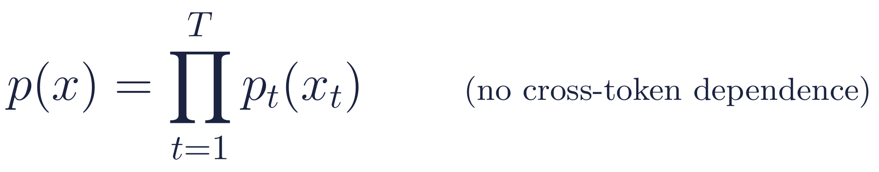
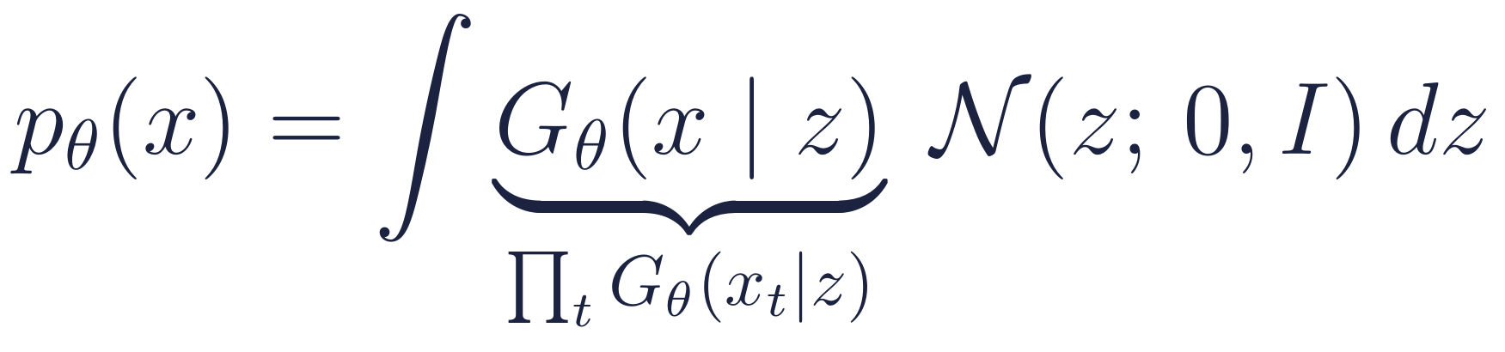
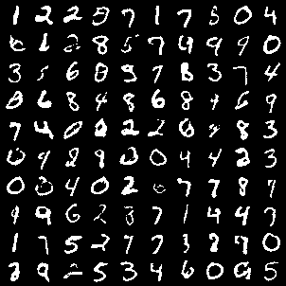
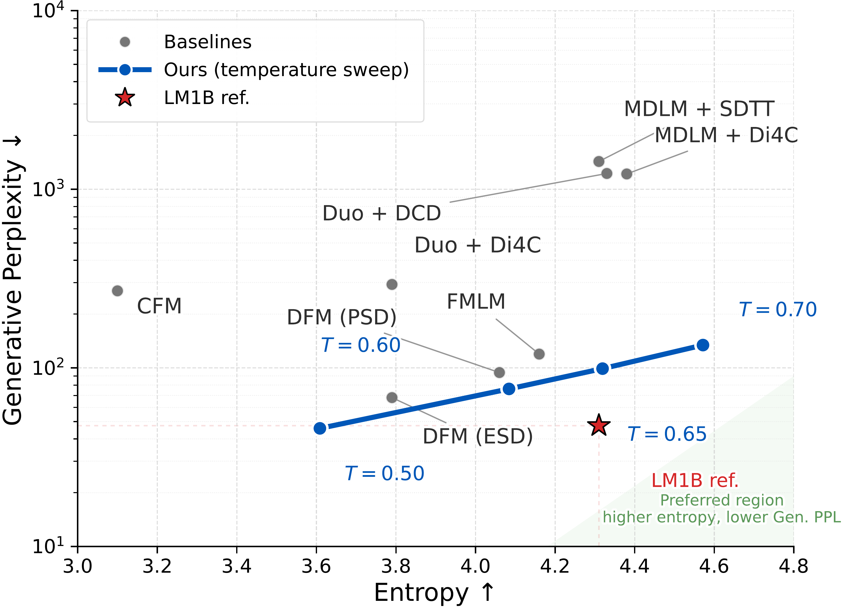
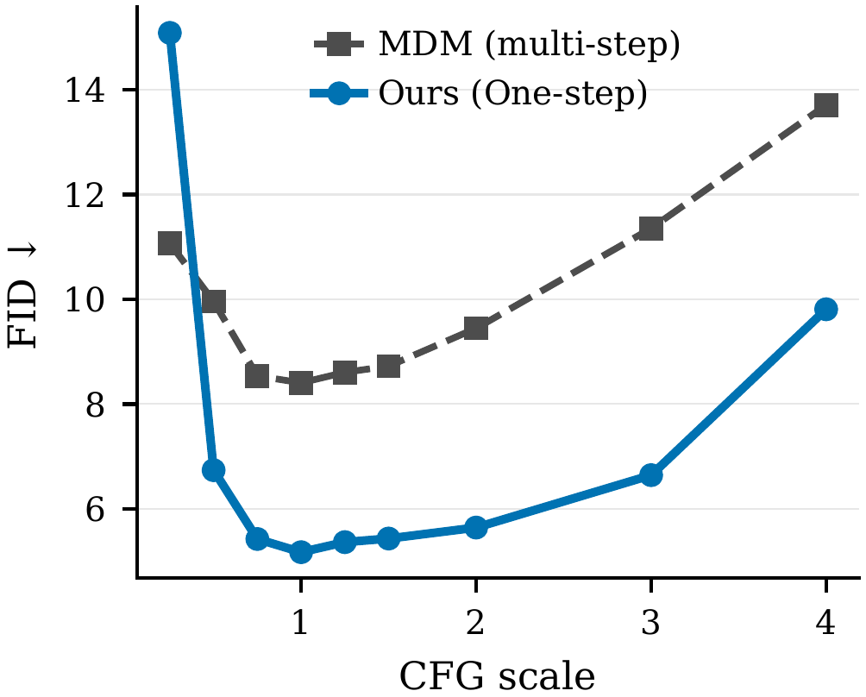
Coupling Models for One-Step Discrete Generation
Fred Zhangzhi Peng¹ Avishek Joey Bose² Anru R. Zhang¹ Alexander Tong³
¹Duke University ²Imperial College London ³AITHYRA NeurIPS 2026 Workshop
github.com/pengzhangzhi/Coupling-Models
TL;DR One Gaussian draw + one parallel forward pass gives a full discrete sequence. Instead of compressing a multi-step sampler, we first learn how sequences couple to Gaussian noise, then train a decoder to invert that coupling. Improves the strongest one-step baselines on binary images, DNA enhancers, and LM1B text.
1
Why is one-step discrete
generation hard?
2
Coupling Models: learn a Gaussian coupling, then invert it
Autoregressive models need T sequential passes; diffusion / masked refinement needs many parallel passes to build coherence.
A direct one-step decoder must emit every token at once. Without a shared variable it factorizes:
Prior route: compress a multi-step trajectory (distillation, consistency, flow maps). The one-step map inherits that trajectory.
Our view: this is a representation problem, not only an optimization one. What should carry global structure into a single parallel emission?
Stage A — learn the coupling
Stage B — invert it
Inference — one step
Encode x → u; a normalizing flow maps u → z so that z ≈ N(0, I). Loss: reconstruction + KL + flow likelihood. Output: pairs (z, x).
Freeze Stage A. Train a parallel decoder Gθ(x | z) on the pairs with cross-entropy; tokens are independent given z.
Draw z ~ N(0, I), run one forward pass, sample all tokens in parallel. Stage A is never run at test time.
3
Why it works: one shared latent
Prop. 3.1 Latent matching controls the one-step error
Tokens are independent given z, but marginalizing over z gives a latent mixture of parallel decoders, which can express cross-token dependence. The latent, not a trajectory, carries the global structure.
The decoder is trained on the latents Stage A produces, but sampled from N(0, I). If these two distributions differ, it runs off-distribution at test time. The normalizing flow exists to minimize this mismatch term, aligning the training latents with the sampling prior; a VAE-style encoder alone yields (z, x) pairs but does not enforce this alignment. A KL version of the bound gives the same conclusion.
4
Results: one draw + one forward pass improves over the strongest prior one-step baselines in three domains
MNIST-Binary · 28×28 binary images
Fly Brain DNA enhancers · length 500
LM1B text · quality vs. diversity
FID 5.50
FBD 12.9
Gen-PPL 45.8
1 step. Best prior one-step: 10.10 (CFM) → −46%
1 step. Best prior one-step: 15.8 (distilled Dirichlet FM) → −18%
1 step, at the lowest-perplexity point of the sweep.
Best prior one-step: 68.1 (DFM-ESD) → −33%
Method | Steps | FID ↓
One-step
MDLM | 1 | 204.64
UDLM | 1 | 130.57
PAIRFLOW | 1 | 40.58
UDLM + ReDi | 1 | 18.44
PAIRFLOW + ReDi | 1 | 12.90
CFM | 1 | 10.10
Coupling Model (ours) | 1 | 5.50
Multi-step
MDLM | 64 | 7.01
PAIRFLOW | 64 | 5.17
UDLM | 64 | 5.01
Method | Steps | FBD ↓
Random sequences | – | 876
One-step
Dirichlet FM (distilled) | 1 | 15.8
Coupling Model (ours) | 1 | 12.9 ± 0.3
Multi-step
Linear FM | 100 | 15.0
Dirichlet FM | 100 | 15.2
SLM | 100 | 4.4 ± 0.2
Fisher-Flow | 100 | 3.8 ± 0.3
Autoregressive | 500 | 25.2
one-step samples
Competitive with 64-step samplers using a single model evaluation.
Transfers to structured biological sequences, but 100-step simplex diffusion / flow methods (SLM, Fisher-Flow) still lead: one-step DNA design remains open.
Lower perplexity without collapsing diversity: the temperature sweep traces a frontier below every prior one-step point and reaches the real-data entropy (4.31) at T = 0.65.
5
One-step generation makes guidance cheap
6
Same latent, few-step refinement
Guidance acts on the final logits (CFG), on the latent z (classifier guidance), or on θ (reward fine-tuning); no credit assignment through a long stochastic trajectory. MNIST-Binary, class-conditional, vs. a 3× larger masked diffusion model (MDM).
Swap the one-step decoder for a latent-conditioned masked denoiser and keep z fixed across steps. LM1B Gen-PPL ↓ (lower is better).
Model | Guidance | FID ↓ | Acc. ↑ | NFE ↓ | Sec / 1k ↓
MDM (73.7M) | CFG | 8.72 | 99.8 | 512 | 356.8
MDM (73.7M) | Classifier | 7.95 | 97.2 | 256 | 244.7
MDM (73.7M) | Reward FT | 8.82 | 99.7 | 256 | 203.0
Ours (24.1M) | CFG | 5.64 | 99.1 | 2 | 1.72
Ours (24.1M) | Classifier | 5.26 | 98.5 | 6 | 13.2
Ours (24.1M) | Reward FT | 5.09 | 99.5 | 1 | 0.63
FID vs. CFG scale: one-step (blue) beats multi-step MDM (grey) for scales ≥ 0.5
Takeaways
Learn the coupling, then invert it. No trajectory to distill or rectify: a normalizing flow makes the latent sampleable, a supervised decoder maps it back.
One draw, one pass, three domains. Improves the strongest one-step baselines on MNIST-Binary FID, DNA-enhancer FBD, and LM1B Gen-PPL, shifting the quality–diversity frontier.
A latent interface that extends. Guidance runs in 1–6 NFEs instead of 256–512, and the same latent supports few-step masked refinement. Limitation: moderate-scale models only.

