Slide 1

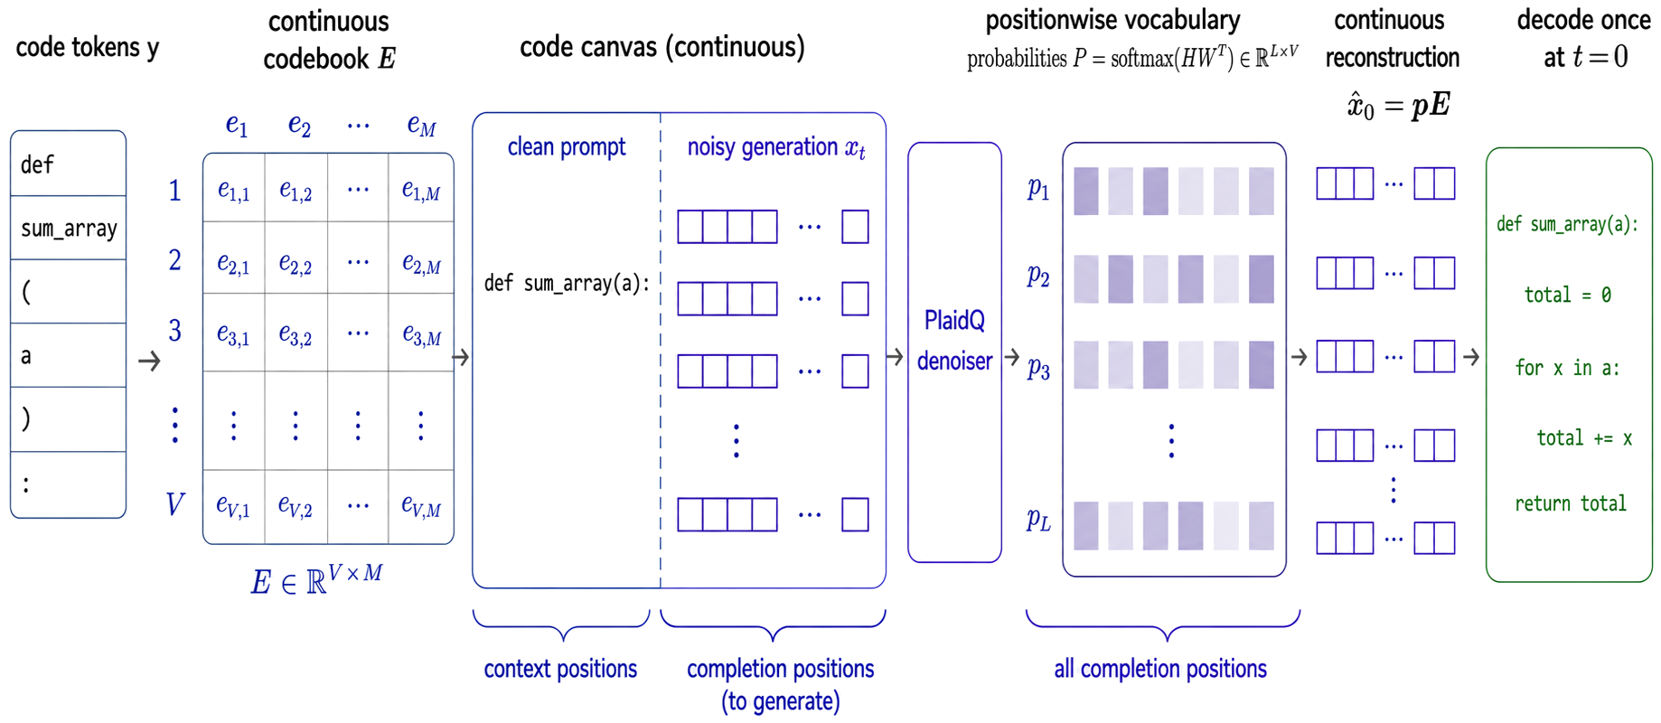
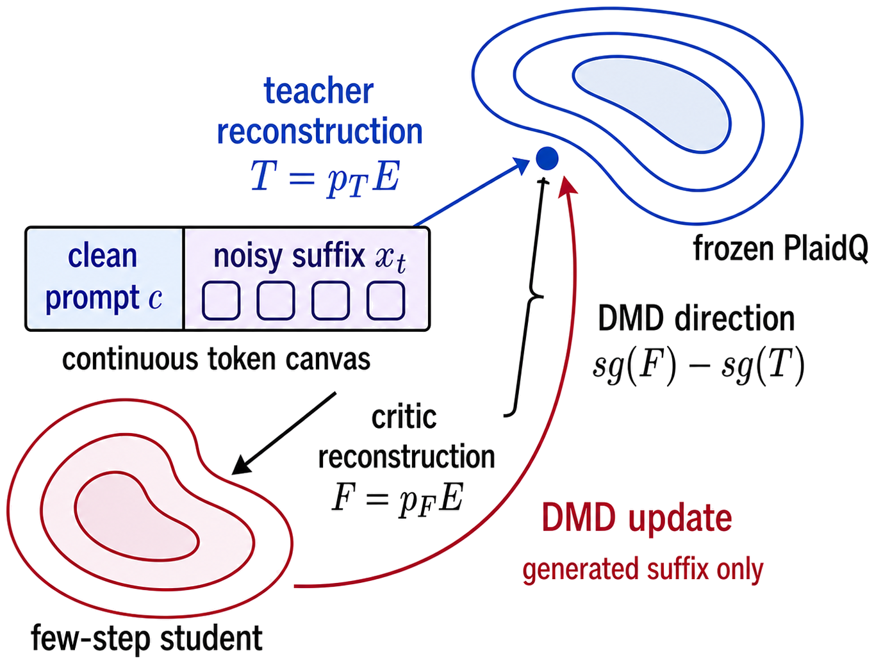
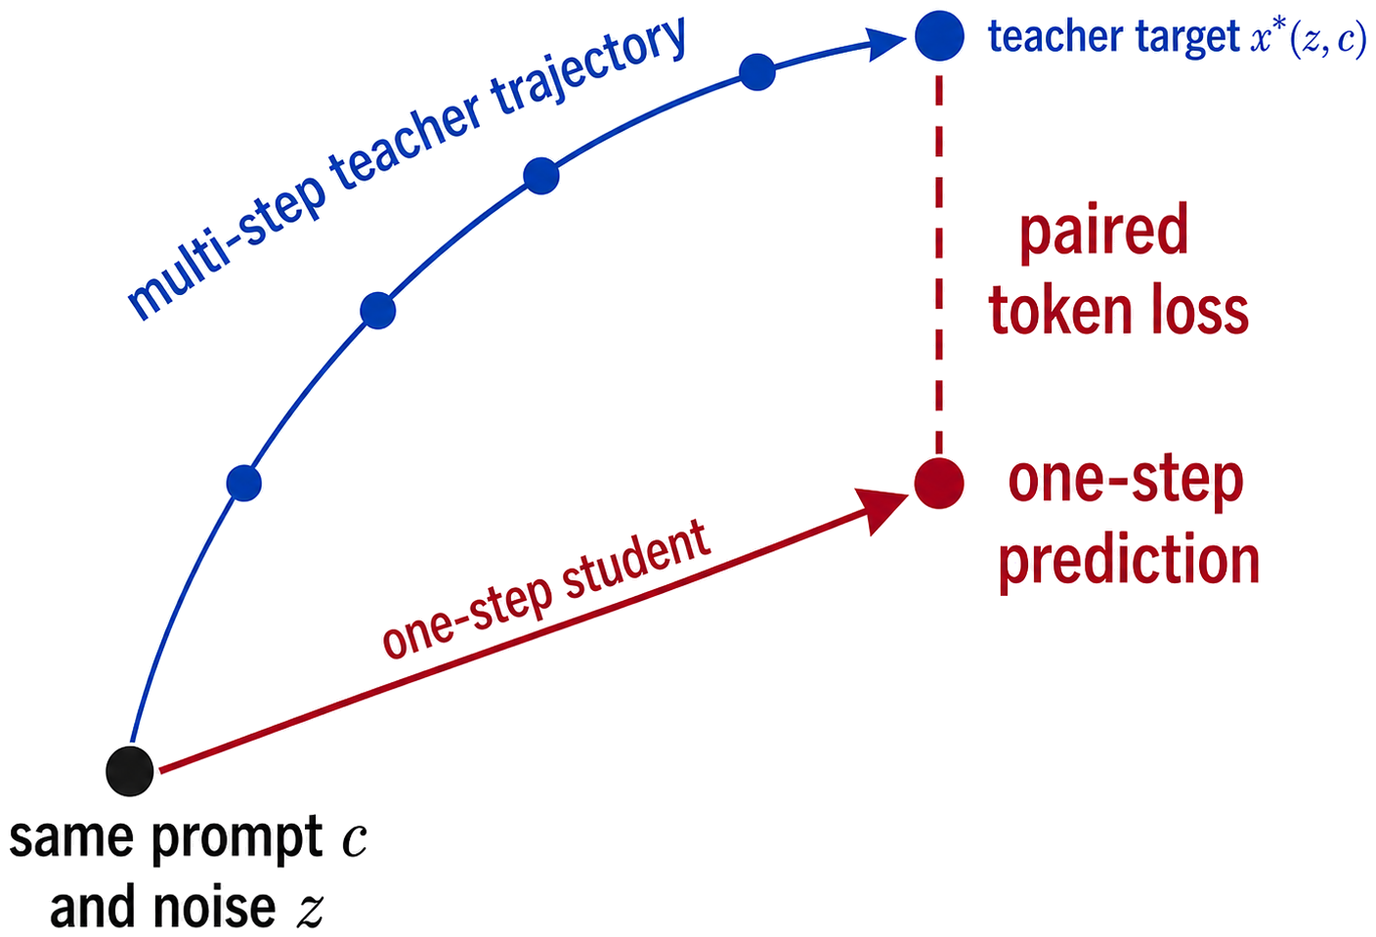
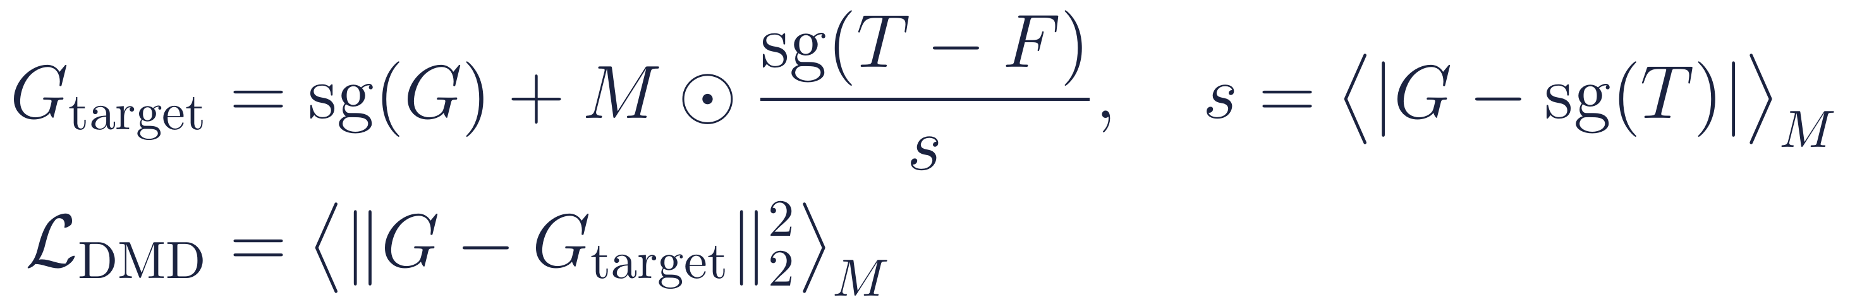
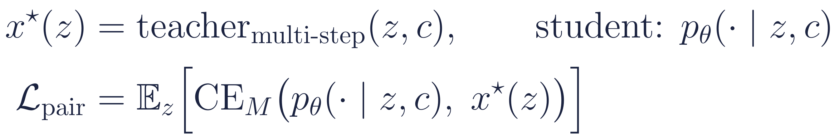
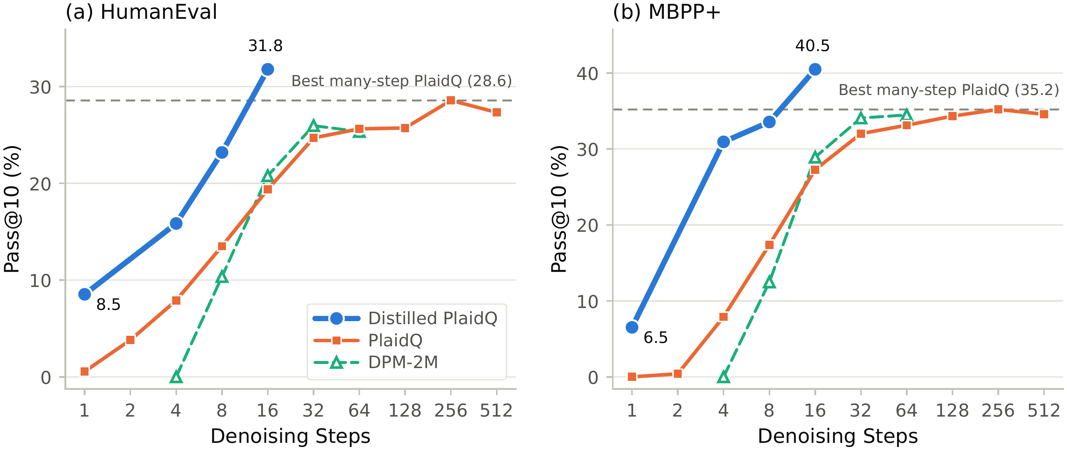
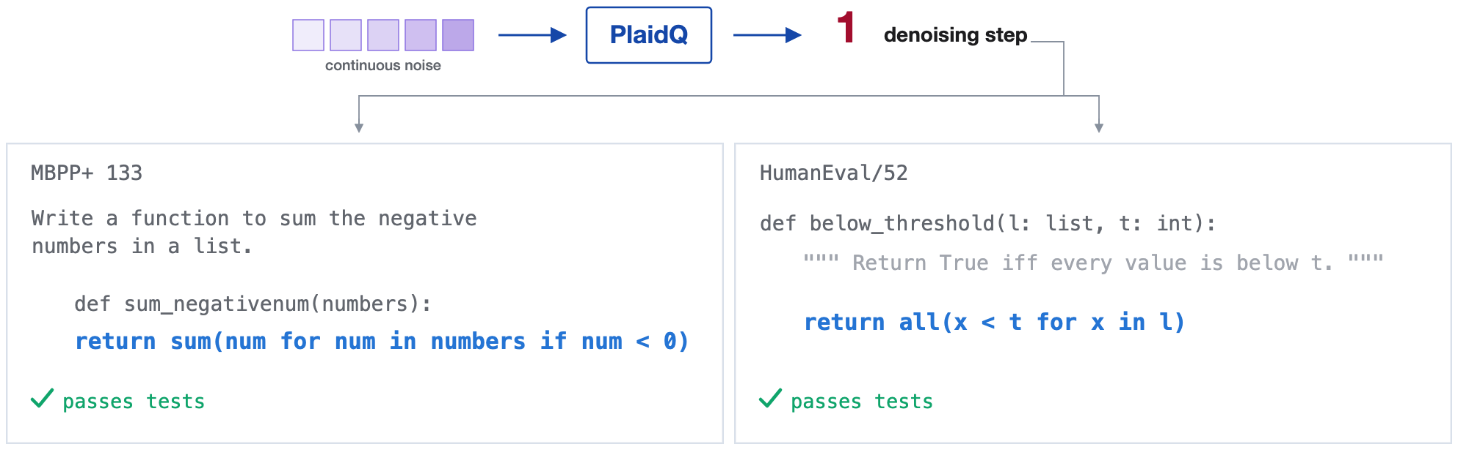
Distilled Continuous Diffusion Language Models Can Write Code in Few Steps — or One
Fred Zhangzhi Peng¹ Kaiwen Zheng² Anru R. Zhang¹
¹Duke University ²Tsinghua University NeurIPS 2026 Workshop
github.com/pengzhangzhi/plaidq
TL;DR PlaidQ is a 0.7B continuous diffusion language model for code, built by turning a pretrained autoregressive model into a bidirectional denoiser over token embeddings. Its long denoising trajectory can be distilled into 16, 8, or 4 steps (distribution matching) or a single step (paired trajectories). A 16-step student beats the 512-step teacher on pass@10; one step already yields executable programs.
1
Why is few-step code
generation hard?
2
PlaidQ: a pretrained AR model repurposed as a continuous denoiser
Autoregressive decoding emits one token per step; the dependency chain grows with output length.
Discrete diffusion updates many positions per step, but samples them independently from the same context. Coordination comes from many rounds of unmasking; cutting steps removes exactly that.
Continuous text diffusion has been compressed to few or one steps, but mostly on unconditional text judged by generative perplexity, a proxy that can reward degenerate output.
Code is the honest test: a program either passes its unit tests or it does not (pass@k).
Build from Qwen3-0.6B
Denoise in embedding space
Train at scale
Q. Can continuous diffusion write code in a few steps, or even one?
Reuse Qwen3-0.6B's trunk and vocabulary head; causal → bidirectional attention; adaLN noise conditioning; the head is shifted one position to keep its pretrained role. 0.7B parameters.
Only completion embeddings are noised; the prompt stays clean. Each step predicts vocabulary probabilities and reconstructs the clean embedding as their expectation; decode once at t = 0.
380k steps, 0.40T positions, 50% code. SWVR streams softmax(hWᵀ)E over vocabulary chunks (exact, 29.6% less activation memory). Hybrid Muon–AdamW optimizer.
3
Few steps: distribution matching (DMD)
4
One step: paired-trajectory distillation
Student = same architecture, K ∈ {4, 8, 16} steps. It runs its full sampler as at inference; gradients flow through one random step. The prediction G is re-noised and scored by the frozen teacher T and a critic F that tracks the student. The teacher-minus-critic direction pulls the student toward the teacher distribution. No reference completions are needed.
DMD alone is too weak at K = 1: noise must map straight to a program with no later step to correct it. Fix: run teacher and student from the same prompt c and the same noise z. The teacher's multi-step output x*(z) becomes a pointwise target for the one-step student (completion-masked cross-entropy). A step-dependent score temperature keeps the large-step reverse map stable.
5
Results: distillation shifts the quality–compute frontier
pass@10 vs. denoising steps · each blue point is a separately trained PlaidQ-DK student
One denoising step → executable code
7.07 pass@1
HumanEval with a single denoising step (PlaidQ-D1), up from 0.09 for the undistilled model; 8.53 pass@10.
Selected PlaidQ-D1 outputs; grey = prompt, blue = generated completion; all pass their tests.
6
Competitive with same-scale discrete diffusion LMs
7
Zero-shot code infilling
Model | Params | HE p@1 | HE p@10 | HE+ p@1 | HE+ p@10 | MBPP p@1 | MBPP p@10 | MBPP+ p@1 | MBPP+ p@10
Mask DFM | 1.3B | 9.1 | 17.6 | 7.9 | 13.4 | 6.2 | 25.0 | – | –
Edit Flow | 1.3B | 12.8 | 24.3 | 10.4 | 20.7 | 10.0 | 36.4 | – | –
Open-dCoder | 0.63B | 20.8 | 38.4 | 17.6 | 35.2 | 16.7 | 38.4 | 23.9 | 53.6
oDLM | 0.6B | 17.87 | 35.98 | 16.4 | 31.1 | 15.7 | 37.0 | 22.99 | 49.47
PlaidQ | 0.7B | 19.02 | 25.72 | 18.05 | 24.03 | 12.19 | 21.44 | 22.18 | 34.33
PlaidQ + CFG | 0.7B | 22.04 | 39.87 | 19.70 | 36.74 | 15.53 | 32.48 | 24.58 | 44.79
Model | HE-Infill | SantaCoder
LLaDA-8B | 48.3 | 35.1
Dream-7B | 39.4 | 40.7
DiffuCoder-7B | 54.8 | 38.8
Dream-Coder-7B | 55.3 | 40.0
Open-dCoder-0.63B | 32.5 | 29.6
PlaidQ-0.7B | 37.91 | 22.86
PlaidQ: 128 steps; +CFG: stronger guided setting (zero-shot classifier-free guidance, ≈ 2× NFE). Bold = best among ≤ 1.3B models. CFG lifts pass@10 at every matched budget: +12.3 / +7.7 points at 16 steps and +11.2 / +10.2 at 512 steps (HumanEval / MBPP+).
Bold = best among sub-1B models. Trained only on prefix completion; clean context on both sides of a noisy span is never seen in training, yet the bidirectional denoiser transfers (no-oracle protocol).
8
Recipe: each part independently effective
3.65 → 3.59
−29.6%
Muon + AdamW
validation NLL from AR initialization + head alignment (scratch 3.65, AR init 3.62; the shift alone without pretraining does not help: 3.67)
peak activation memory with SWVR at 2048 tokens (40.2 → 28.3 GB), while matching the dense loss and gradients
hybrid assignment (Muon on hidden 2-D weights, AdamW elsewhere) gives consistently lower validation loss than AdamW alone
Takeaways
Continuous diffusion is a viable interface for code. An AR model becomes a bidirectional embedding-space denoiser that is competitive with same-scale discrete DLMs and transfers zero-shot to infilling.
A 16-step student beats the teacher. PlaidQ-D16 reaches 31.78 / 40.49 pass@10 (HumanEval / MBPP+), above the 128–512-step teacher (28.57 / 35.21) with ≥ 8× fewer steps.
One step can already produce correct programs. Paired-trajectory distillation lifts one-step HumanEval pass@1 from 0.09 to 7.07. Limitation: 0.7B scale; one-step quality still trails many-step sampling.

