Slide 1

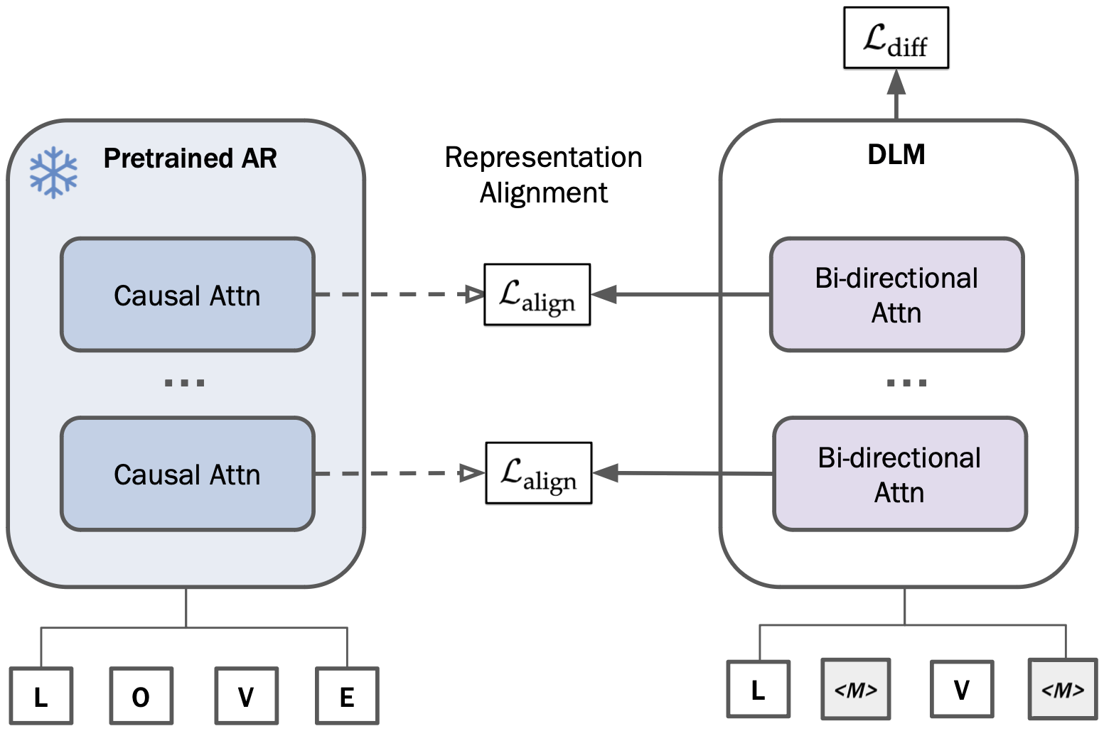
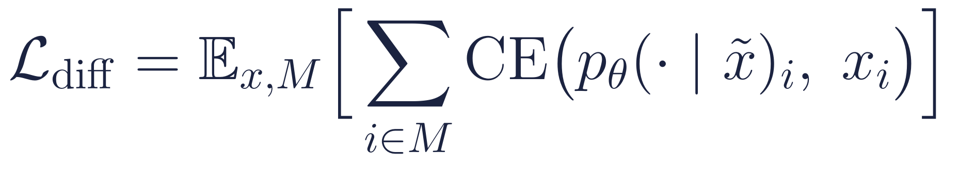
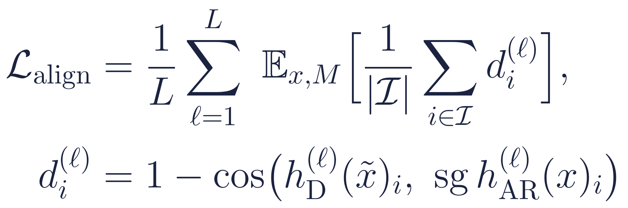
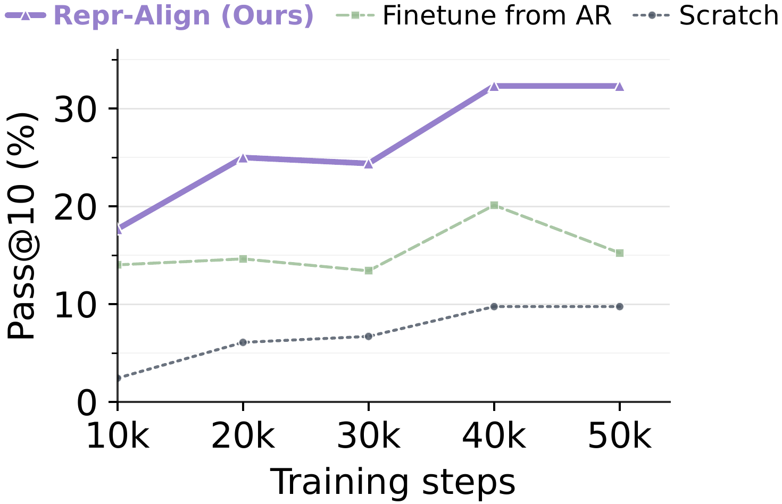
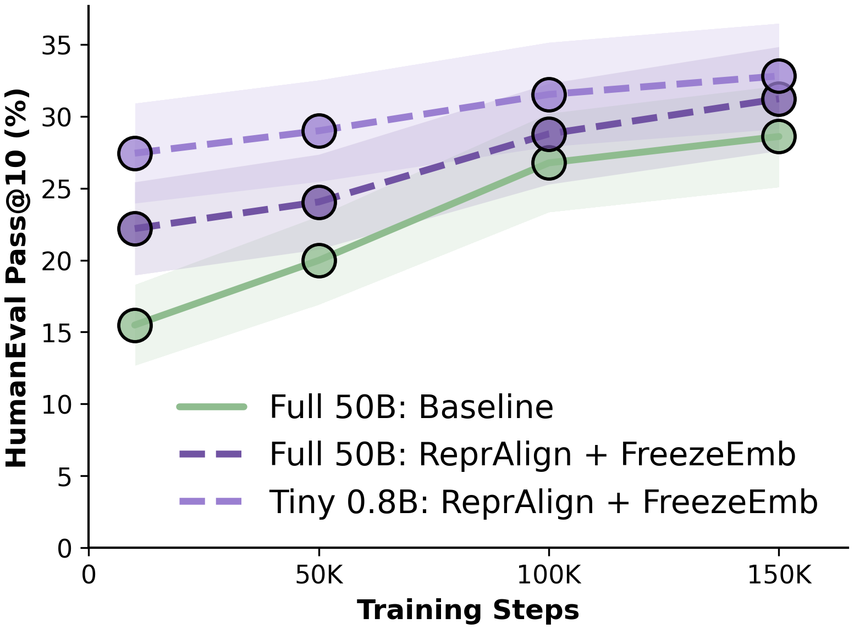
Don't Retrain — Align: Adapting Autoregressive LMs to Diffusion LMs via Representation Alignment
Fred Zhangzhi Peng¹ Alexis Fox¹ Anru R. Zhang¹ Alexander Tong²
¹Duke University ²AITHYRA NeurIPS 2026 Workshop
github.com/pengzhangzhi/Open-dLLM
TL;DR The hard part of language generation is learning representations, not the decoding order. Repr-Align turns a pretrained AR model into a masked diffusion LM by switching attention to bidirectional and anchoring every layer's hidden states to the frozen AR model with a cosine loss. No adapters, no new parameters. Up to 4× faster adaptation in our setting, larger gains at larger scale, and a 0.8B-token subset beats 50B tokens at matched steps.
1
Why is training a diffusion
LM so expensive?
2
Repr-Align: same architecture, two attention masks, one alignment loss
A diffusion LM learns any-order decoding: L! generation paths instead of one left-to-right path, so in theory it needs L× the compute of an AR model.
Starting from a pretrained AR checkpoint helps, but existing recipes largely reuse the parameters: nothing constrains the converted model to preserve the AR model's internal representation geometry.
Hypothesis: AR pretraining has already learned the semantic and syntactic geometry of language. Conversion should relearn the decoding mechanism, not the representations.
Student: masked denoising on the corrupted x̃ (bidirectional attention)
Teacher: frozen AR model on the clean x (causal attention); align every layer
Total loss
Q. Are representations learned by next-token prediction sufficient for masked denoising generation?
Recipe. Initialize the student from the AR weights; the only architectural change is causal → bidirectional attention. Train with L = L_diff + λ·L_align (λ = 10) while the teacher stays frozen. Shift convention and PAPL loss are used in all runs (baseline and aligned); decoding uses P2-self with 128 steps.
3
What matters in the alignment loss (HumanEval; bold = best per column, tint = default)
Distance
Weight λ
Layers
Metric | pass@1 | pass@10
L2 | 12.00 | 25.00
Cosine (default) | 18.00 | 31.00
λ | pass@1 | pass@10
1 | 7.50 | 22.60
5 | 9.90 | 26.80
10 (default) | 18.00 | 31.00
20 | 11.30 | 29.30
Aligned layers | pass@1 | pass@10
Lower third | 11.28 | 25.00
Middle third | 15.73 | 31.10
Upper third | 8.96 | 31.71
All (default) | 18.00 | 31.00
Direction matters, not scale: hidden-state norms vary across layers and tokens.
Anchor vs. adapt: too weak underuses the teacher, too strong constrains the student.
The transferable signal is distributed across depth; all layers give the best pass@1.
4
Results: align, don't retrain
Faster adaptation
Gains grow with model size
Tiny data is enough
up to 4×
+9.4 pass@10
0.8B > 50B
training acceleration in our setting, vs. fine-tuning from AR or training from scratch (HumanEval pass@10 during early conversion).
HumanEval at 1.7B (31.1 → 40.5) vs. +6.1 at 0.6B (24.9 → 31.0), same 200k-step budget.
tokens: with alignment, a 0.8B-token random subset beats the full 50B-token stream at matched steps (HumanEval pass@10).
At the 200k-step cutoff, alignment adds +6.1 pass@10 at 0.6B and +9.4 at 1.7B over the same conversion without it.
Once representations are anchored, what remains is mechanism adaptation, which needs remarkably little data under a fixed step budget. Both aligned runs also freeze token embeddings.
5
oDLM reaches the public DLM frontier on pass@10
6
Freeze more, train faster
Model | HE p@1 | HE p@10 | HE+ p@1 | HE+ p@10 | MBPP p@1 | MBPP p@10 | MBPP+ p@1 | MBPP+ p@10
LLaDA (8B) | 35.4 | 50.0 | 30.5 | 43.3 | 38.8 | 53.4 | 52.6 | 69.1
Dream (7B) | 56.7 | 59.2 | 50.0 | 53.7 | 55.4 | 56.2 | 71.5 | 72.5
Mask DFM (1.3B) | 9.1 | 17.6 | 7.9 | 13.4 | 6.2 | 25.0 | – | –
Edit Flow (1.3B) | 12.8 | 24.3 | 10.4 | 20.7 | 10.0 | 36.4 | – | –
oDLM (0.6B) | 17.87 | 35.98 | 16.40 | 31.10 | 15.70 | 37.00 | 22.99 | 49.47
oDLM (4B) | 30.49 | 61.59 | 26.95 | 56.10 | 14.42 | 37.00 | 20.24 | 47.35
~2× throughput
with token embeddings and MLP blocks frozen, at equal or better HumanEval pass@10 (1.7B, same training protocol and budget).
Frozen blocks | pass@10 | M tok / s
Baseline | 31.1 | 0.071
Freeze embeddings | 40.5 | 0.071
Freeze embeddings + MLP | 37.6 | 0.140
Bold numbers = best per column. oDLM (4B) improves HumanEval / HumanEval+ pass@10 over Dream-7B by 2.39 / 2.40 points with a smaller backbone and a substantially lighter data-and-compute budget; pass@1 and MBPP still favor the larger models. Baselines: reported numbers.
Once representations are anchored, the learning signal concentrates in the denoising mechanism, so large blocks can stay frozen.
Takeaways
Representations transfer across generation orders. Anchoring a bidirectional student to its frozen AR twin turns AR → DLM conversion into mechanism adaptation rather than relearning language.
Cheaper to convert. Up to 4× faster adaptation, ~2× training throughput with frozen embeddings and MLPs, and a 0.8B-token subset that beats 50B tokens at matched steps.
It scales. Gains grow from 0.6B to 1.7B, and a 4B oDLM tops Dream-7B on HumanEval and HumanEval+ pass@10. Limitation: evaluated on code generation with Qwen3 backbones.

