Slide 1
Restaurant Predictive Modeling - Yelp Data Science Challenge
Danlu Liu
Peng Zhao
5/9/2017

Slide 2
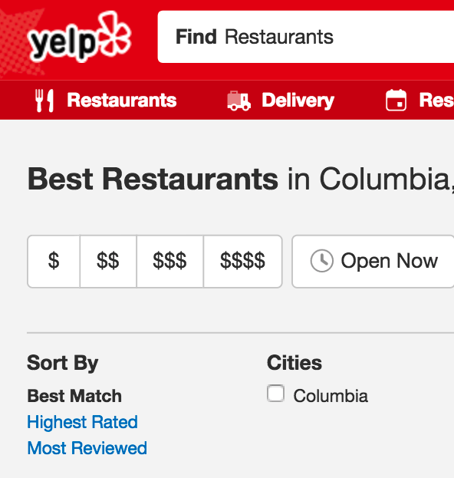
Background
Yelp is a popular local business review publisher.
Users can only sort businesses by the relevance to search keywords, by star-rating, and by the total number of reviews.
Star-rating: biased for new business.
Total number of reviews: a bad business can receive many complaint reviews.

Slide 3
Aims
Build a model to predict a restaurant’s popularity.
Build a model to predict if a restaurant will be closed in the future.

Slide 4
Data
2017 Yelp Dataset Challenge
4.1M reviews and 947K tips by 1M users for 144K businesses
1.1M business attributes, e.g., hours, parking availability, ambience.
Aggregated check-ins over time for each of the 125K businesses
200,000 pictures from the included businesses
https://www.yelp.com/dataset_challenge

Slide 5
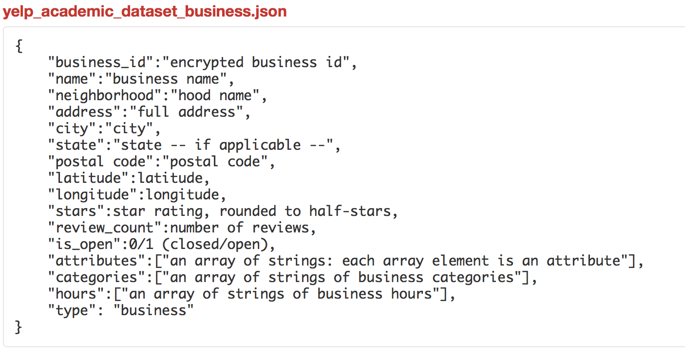
Data
Retrieve restaurant information from the business dataset.
Unfold the array of attributes to get a sparse matrix
AmericanNew
FastFood
Alcohol
GoodForKids
……
Extract and generate the class labels
Is_open
Popularity
https://www.yelp.com/dataset_challenge

Slide 6


Create a “Popularity” Attribute as Class Label
Popularity = Normalize (review count) * Normalize (star count)
Normalize (X) = $\frac{\underline{X}−Min(\underline{X})}{Max\left(\underline{X}\right)−Min(\underline{X})}$
Review count (0 - $∞$)
Star count (1 - 5)
Popularity

Slide 7
Data Preprocessing
Tools : pandas (Python), Weka
Remove instances with missing value
Feature selection with Information Gain
Expected reduction in entropy by partitioning the dataset with respect to an attribute and it measures the importance of the variable in discriminating different classes ^{[1]}
[1] Kullback S, Leibler RA. On Information and Sufficiency. The Annals of Mathematical Statistics 1951 Mar;22(1):79–86.

Slide 8
Predictive Modeling
Tool: scikit-learn (Python)
Algorithms:
Naïve Bayes: A probabilistic classifier based on Bayes' theorem.
Decision Tree:
Each internal (non-leaf) node denotes a test on an attribute.
Each branch represents the outcome of a test.
Each leaf (or terminal) node holds a class label.
Random Forest: Operate by constructing a multitude of decision trees.
Evaluation:
train : test = 4 : 1
AUC : measures model’s ability of discrimination (0.5 – 1.0)
AUC: Area under the receiver operating characteristic curve. https://en.wikipedia.org/wiki/Receiver_operating_characteristic

Slide 9
Model 1: Predict a restaurant’s popularity

Slide 10
Model 2: Predict if a restaurant will be closed in the future.

Slide 11
Summary
Naïve Bayes model can predict a restaurant’s popularity with the best AUC of 0.7.
Random Forest model can predict if a restaurant will be closed in the future with the best AUC of 0.75.
Perform data mining to find frequent attribute patterns in popular restaurants.
Create a restaurant recommendation system for users.
Future work

