Slide 1
Social Media Sentiment Analysis – An Overview of Current Techniques
Peng Zhao
MU Informatics Institute
Nov-17-2015

Slide 2
Outline
Background
Current techniques
VADER
Conclusion
VADER test
Image source: https://datafloq.com/read/sentiment-analytics-no-brainer-organisations/145

Slide 3
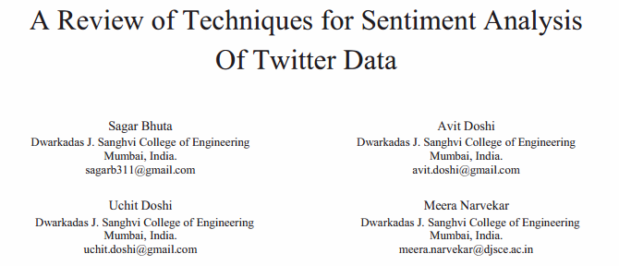
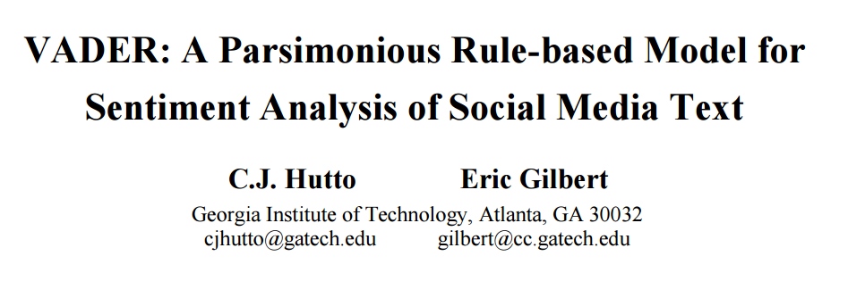
Papers used in this presentation

Slide 4
Why do we care about social media sentiment analysis?

Slide 5
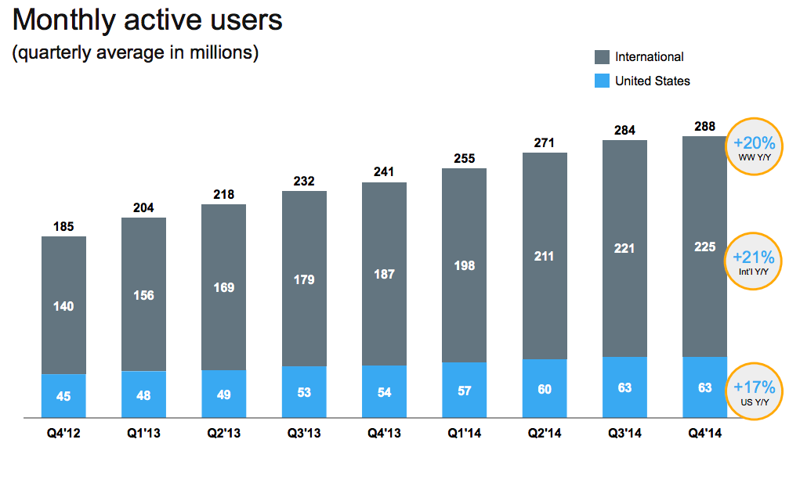
Social media gives everyone a voice
6000 tweets per second
500 million tweets per day
200 billion tweets per year
39% users voice their opinions on social media
Source: http://www.internetlivestats.com/twitter-statistics/
http://venturebeat.com/2015/02/05/twitter-now-has-288m-monthly-active-users-but-growth-is-slowing/
http://wersm.com/the-10-top-reasons-why-we-use-social-networks
Notes:
Take twitter as an example. Survey done by global web index, a data science company. Social media is a valuable source to gain opinions of a population

Slide 6

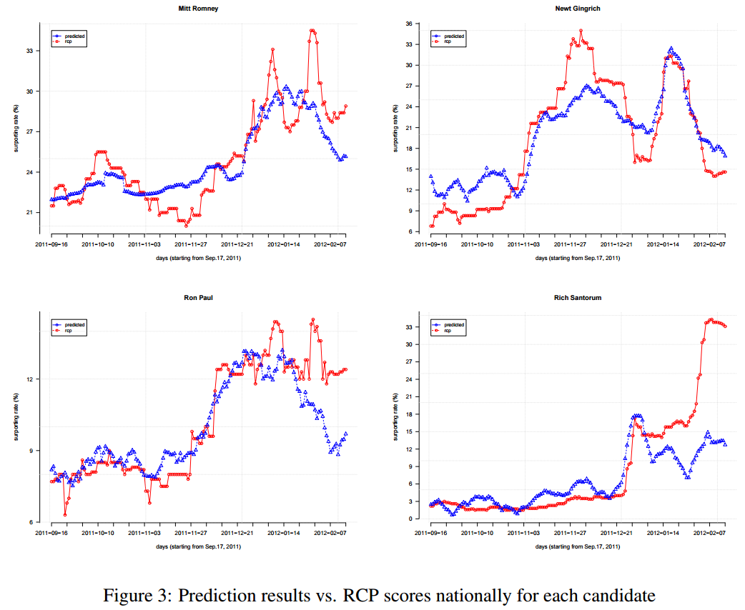
Sentiment analysis is useful
Political Analysis – 2012 Republican Presidential Election Prediction
Mitt Romney
Y – Supporting rate (%)
X – Time window (2011.9.16 – 2012.2.17)
Newt Gingrich
RCP score:
the average of poll results from several popular media and independent survey institutes
Ron Paul
Rich Santorum
Source: Shi, L et al. Predicting US primary elections with Twitter. In Proceedings of the workshop social network and social media analysis:
Methods, models and applications, Lake Tahoe, Nevada, 2012 December 7.

Slide 7
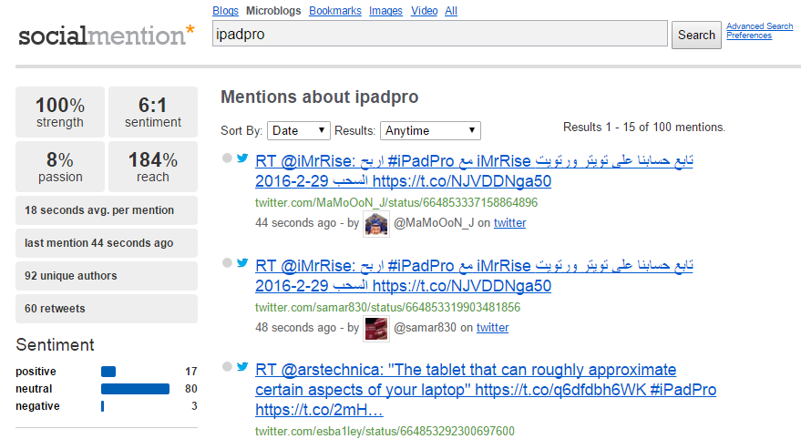

Sentiment analysis is useful
Marketing Research
Determine the feasibility and efficiency of promotional campaigns
Analyze how the public is reviewing products and how their perception changes over time
Screenshot taken on 11/12/2015, one day after iPad Pro’s release
In their FAQ
Source: Bugeja, R. Twitter Sentiment Analysis for Marketing Research
http://www.socialmention.com
Notes:
Otherwise we will need to send surveys to get the opinions
Strength is the likelihood the keyword is being discussed in social media
Sentiment is the ratio of positive to negative mentions
Passion is the measure of the likelihood that individuals talking about the keyword will do so repeatedly
Reach is the measure of the range of influence

Slide 8
How social media text differs from other texts?

Slide 9
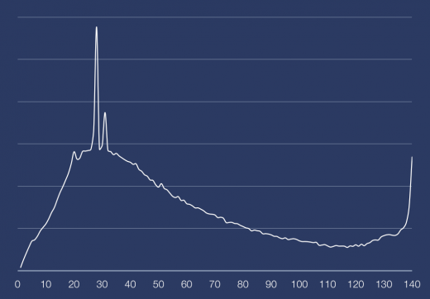
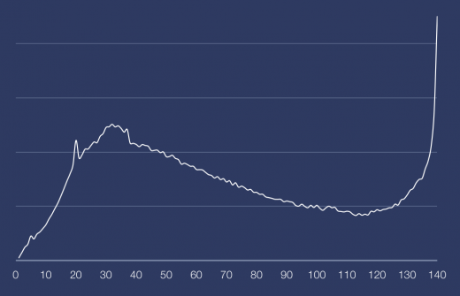
Features of social media text
Shortness of text
Twitter only allows 140 characters in maximum
Most tweets are around 28 characters long
Average length of English word: 5.1 letters
Sampling 1 million tweets excluding retweets:
Overall tweets
From desktop web-client
Source: Hutto, CJ et al. VADER: A Parsimonious Rule-based Model for Sentiment Analysis of Social Media Text, Eighth International
Conference on Weblogs and Social Meida (ICWSM-14). Ann Arbor, MI, June 2014
http://thenextweb.com/twitter/2012/01/07/interesting-fact-most-tweets-posted-are-approximately-30-characters-long/
http://www.wolframalpha.com/input/?i=average+english+word+length
Notes:
Sentiment analysis of social media text is never easy. 140 characters contains letters, punctuations, white spaces, emojis, links

Slide 10
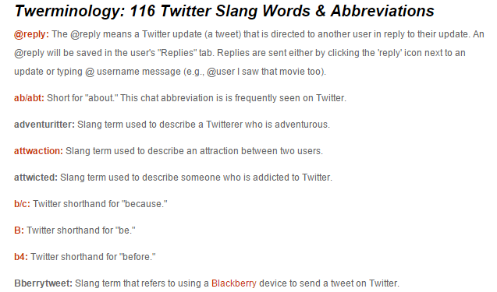
Features of social media text
Tendency to use sentiment-bearing lexical items such as emoticons, acronyms, initialism and slang to express sentiments
Twerminology = Twitter Terminology
Source: Hutto, CJ et al. VADER: A Parsimonious Rule-based Model for Sentiment Analysis of Social Media Text, Eighth International
Conference on Weblogs and Social Media (ICWSM-14). Ann Arbor, MI, June 2014
http://www.webopedia.com/quick_ref/Twitter_Dictionary_Guide.asp
Notes:
Sentiment analysis of social media text is not easy

Slide 11
How can we do the analysis?

Slide 12
Current social media sentiment analysis techniques
Learning-based Approach
Lexicon-based Approach
Source: Bhuta, S et al. A review of techniques for sentiment analysis of Twitter data. ICICT, 2014, 583-591

Slide 13
Learning-based Methods
“Learn” the sentiment-relevant features of text
Methods | Description | Features
Naïve Bayes classifier | Calculates the probability of a term/document belonging to a class based on Bayesian theorem | Supervised Probability-based Independence assumption
Maximum Entropy | Estimate the conditional distribution of the class label based on the Principle of Maximum Entropy | Supervised Probability-based Accounts for information entropy (feature weightings)
Support Vector Machine | Finds hyperplane which separates data and the margin between the classes as high as possible | Supervised Non-probability-based
Source: Bhuta, S et al. A review of techniques for sentiment analysis of Twitter data. ICICT, 2014, 583-591
Hutto, CJ et al. VADER: A Parsimonious Rule-based Model for Sentiment Analysis of Social Media Text, Eighth International
Conference on Weblogs and Social Media (ICWSM-14). Ann Arbor, MI, June 2014
Notes:
Relies Bayesian probability and the naïve assumption that feature probabilities are independent of one another

Slide 14
Lexicon-based Methods
Classify sentiments based on the occurrence of sentiment lexical features in text
Sentiment lexicon: a list of lexical features labeled according to their sentiment benchmarks
A model/scoring function is required
There are 2 types of well-established sentiment lexicon:
Sentiment Lexicon
Sentiment Orientation
Binary polarity:
positive vs. negative
Sentiment Intensity
Valence of sentiment:
continuous score
Source: Bhuta, S et al. A review of techniques for sentiment analysis of Twitter data. ICICT, 2014, 583-591
Hutto, CJ et al. VADER: A Parsimonious Rule-based Model for Sentiment Analysis of Social Media Text, Eighth International
Conference on Weblogs and Social Media (ICWSM-14). Ann Arbor, MI, June 2014

Slide 15
Lexicon-based Methods
Sentiment Orientation (Polarity-based) Lexica
Lexica | Fact | Pros | Cons
LIWC (Linguistic Inquiry and Word Count) | ~ 4500 words organized into one or more of 76 categories, 406 positive and 499 negative | 1. Well-established and validated for more than a decade 2. Widely used | 1. No emoticons, slang, acronyms, initialism 2. Not account for sentiment intensity
GI (General Inquirer) | ~ 11000 words classified into one or more of 183 categories, 1915 positive and 2291 negative | 1. Developed and refined since 1966 2. Widely used | 1. No emoticons, slang, acronyms, initialism 2. Not account for sentiment intensity
Hu-Liu04 (Hu and Liu Sentiment Lexicon) | ~ 6800 words, 2006 positive and 4783 negative | 1. Evolved over the past decade 2. Attuned to social media and product reviews | 1. No emoticons, slang, acronyms, initialism
Source: Hutto, CJ et al. VADER: A Parsimonious Rule-based Model for Sentiment Analysis of Social Media Text, Eighth International
Conference on Weblogs and Social Media (ICWSM-14). Ann Arbor, MI, June 2014
Notes:
sentiment bearing lexical items Does not capture sentiment from emoticons or acronyms and initialism
LIWC: a company
GI: Harvard University
HL: Liu Bing and Hu Mingqing, University of Illinois at Chicago

Slide 16
Lexicon-based Methods
Sentiment Intensity (Valence-based) Lexica
Lexica | Fact | Pros | Cons
ANEW (Affective Norms for English Words) | 1304 words with sentiment valences range from 1–9. 1-4: unpleasant/negative, 5: neutral, 6-9: pleasant/positive | 1. Helps to measure the intensity of expressed sentiment | 1. No emoticons, slang, acronyms, initialism
SentiWordNet | 147306 synsets (groups of synonyms) annotated with 3 numerical scores relating to positivity, negativity, neutrality. Each score 0.0-1.0 | 1. Useful for a wide range of tasks 2. Available in NLTK | 1. Calculated by semi-supervised algorithms. Not a gold standard. 2. Many synsets have no positive or negative polarity 3. No emoticons, slang, acronyms, initialism
SenticNet | 14244 common sense concepts with the concept’s sentiment polarity on a continuous scale ranging from -1 to 1 | 1. Concept level 2. Has online API | 1. No emoticons, slang, acronyms, initialism
Source: Hutto, CJ et al. VADER: A Parsimonious Rule-based Model for Sentiment Analysis of Social Media Text, Eighth International
Conference on Weblogs and Social Media (ICWSM-14). Ann Arbor, MI, June 2014
Notes:
ANEW: University of Florida
SentiWordNet: Institute of National Research Council of Italy
SenticNet: SenticNet, a company run by Nanyang technological University in Singapore
SenticNet:

Slide 17
Learning-based VS Lexicon-based Methods
Pros:
Save human effort
Generable models, can be used in other languages
Cons:
Requires extensive training data
Depends on the training set to represent as many features as possible
May suffer from over/under fitting problems
Often computationally expensive
Derives features in black box
Pros:
Empirically-validated gold standard
Generally has high precision
Cons:
Trouble with coverage, often ignores important lexical features
Construct a lexicon is a time-consuming and labor-intensive process
Generally has low recall
Language-dependent
Source: Bhuta, S et al. A review of techniques for sentiment analysis of Twitter data. ICICT, 2014, 583-591
Hutto, CJ et al. VADER: A Parsimonious Rule-based Model for Sentiment Analysis of Social Media Text, Eighth International
Conference on Weblogs and Social Media (ICWSM-14). Ann Arbor, MI, June 2014

Slide 18

VADER
Valence Aware Dictionary and sEntiment Reasoner
A lexicon and rule-based sentiment analysis tool
Specially attuned to sentiments expressed in social media
7500 lexical features
Manually constructed based on LIWC, ANEW and GI lexica
Incorporates numerous lexical features common to sentiment expression in social media, including:
Western-style emoticons, such as :-)
Sentiment-related acronyms and initialisms, such as LOL
Commonly used slang with sentiment value, such as nah
Validated valence scores indicating both sentiment polarity and sentiment intensity
Darth Wader
Source: https://github.com/cjhutto/vaderSentiment
Image: http://villains.wikia.com/wiki/Darth_Vader
Notes:
VADER lexicon is both sensitive to polarity and intensity of sentiments

Slide 19
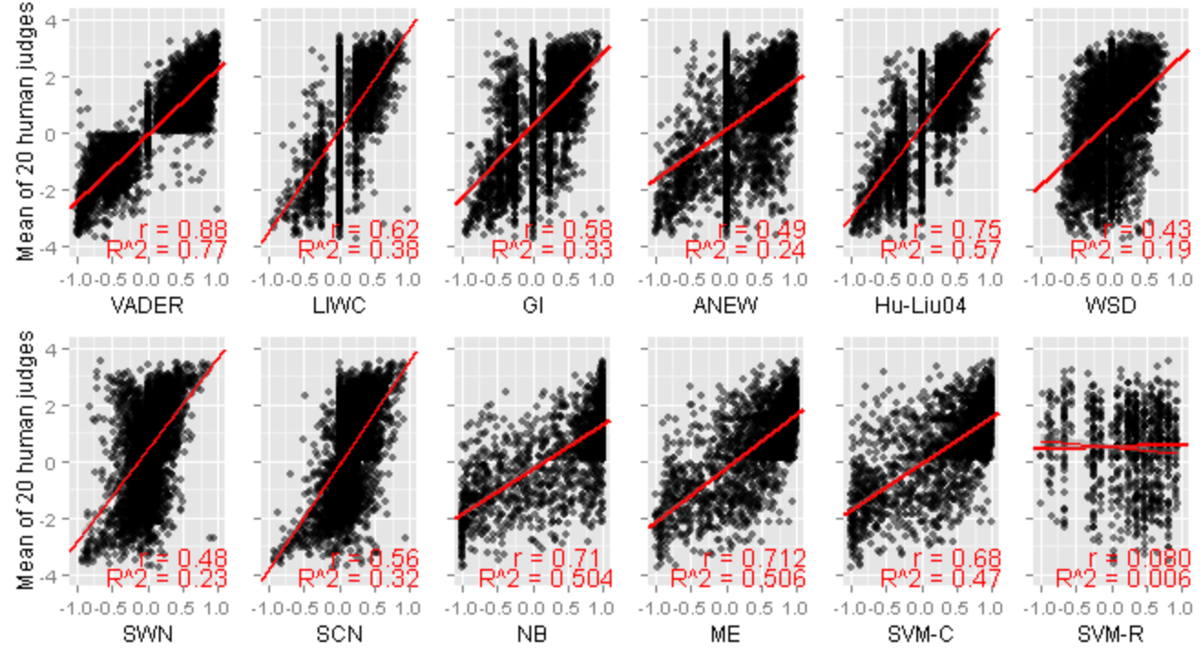
VADER Performance
Sentiment scores from VADER and 11 other tools on 4000 tweets
The mean of sentiment scores given by 20 trained and screened human raters was used as ground truth
VADER has highest correlation with ground truth r = 0.881
Source: Hutto, CJ et al. VADER: A Parsimonious Rule-based Model for Sentiment Analysis of Social Media Text, Eighth International
Conference on Weblogs and Social Media (ICWSM-14). Ann Arbor, MI, June 2014

Slide 20
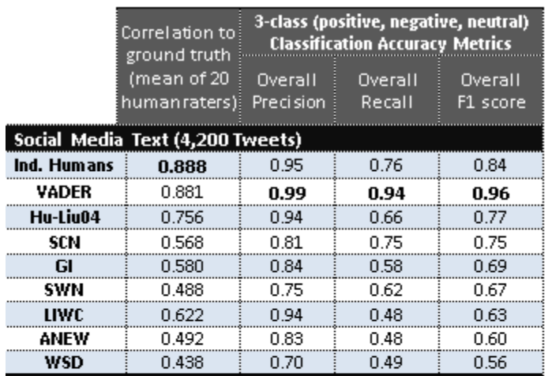
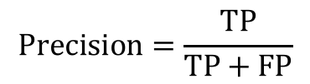
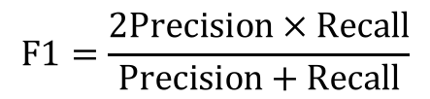
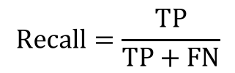
VADER Performance
VADER has higher overall precision, recall, F1 score than other well-established tools/techniques
Even higher than individual human raters
$$Precision=\frac{TP}{TP+FP}$$
$$Recall=\frac{TP}{TP+FN}$$
$$F1=\frac{2Precision × Recall}{Precision+Recall}$$
Source: Hutto, CJ et al. VADER: A Parsimonious Rule-based Model for Sentiment Analysis of Social Media Text, Eighth International
Conference on Weblogs and Social Media (ICWSM-14). Ann Arbor, MI, June 2014

Slide 21
Conclusion
Sentiment analysis of social media is important but never easy
Sentiment analysis methods can be categorized into learning-based approach and lexicon-based approach
All methods have pros and cons and not all of them are suitable for social media sentiment analysis
VADER is a lexicon-based method which has been built based on several well-established lexicons
VADER Lexicon accounts for both sentiment orientation and intensity and is attuned to social media text
VADER has better performance than other well-established tools even human in terms of performance metrics

Slide 22
VADER test

