Slide 1
論文解析
論文：鳥兒們為了保持不亂（獲得一起飛的好處），振翅的頻率會變多；
加速規（accelerometers）
陀螺儀（gyroscopic instruments）
跑步參數分析
振翅頻率
總結

Slide 2
論文-論文結果-pair flight
As expected, paired individuals benefitted from improved homing route accuracy, which reduced flight distance by 7% and time by 9%. 飛行距離減少了7%，時間減少了9%；
Paired flight provides improved homing accuracy。
One key benefit commonly ascribed to flocking is the ability to pool navigational knowledge. Because this is expected to improve homing accuracy [7,8], we calculated our birds’ route accuracy flying solo and in pairs, using a weighted mean cosine of the angle between the birds’ heading and destination.
路徑效率的計算方式是：計算cos，飛行的heading與終點的cosine；
（也就是說：cos越大越高，cos越小越低；這個計算計算方式和轉向效率的算法類似；）

Slide 3
論文-論文結果-pair flight
However, realising these navigational gains involved substantial changes in flight kinematics and energetics. Both individuals in a pair increased their wingbeat frequency by 18% by decreasing the duration of their upstroke. This sharp increase in wingbeat frequency caused just a 3% increase in airspeed but reduced the oscillatory displacement of the body by 22%, which we hypothesise relates to an increased requirement for visual stability and manoeuvrability when flying in a flock or pair.
振翅頻率增加了18%，相應的滑翔減少了；

Slide 4
論文-論文結果-pair flight
Paired flight provides improved homing accuracy
One key benefit commonly ascribed to flocking is the ability to pool navigational knowledge. Because this is expected to improve homing accuracy [7,8], we calculated our birds’ route accuracy flying solo and in pairs, using a weighted mean cosine of the angle between the birds’ heading and destination. Flying in a pair resulted in a 7% increase in route accuracy relative to both the Phase 1 and Phase 4 solo releases (0.06, 95% credible interval [0.01, 0.10]; Fig 1), and a concomitant 6% decrease in route length (S2 Table). This improved homing accuracy when flying in pairs is consistent with previous empirical studies [5,6] and with theoretical expectations [7,8] but presumably requires each member of the pair to attend closely to the other. This will in turn require a high degree of visual stability, and we therefore hypothesise (and, in the next section, test) that a potential function of the increased wingbeat frequency and decreased oscillatory displacement of the body in paired flight is to enhance visual stability when attending to nearby conspecifics.
通過共享導航知識，可以提升回家的準確性；
通過提升振翅的頻率，來減少身體的震盪位移，這樣就可以加強視覺上的穩定性；

Slide 5
論文-論文結果-振翅和視覺穩定
Increased wingbeat frequency is associated with decreased head displacement in paired flight
To test directly whether visual stability is enhanced in paired flight, we conducted a second experiment using head-mounted accelerometers on 6 homing pigeons on short-range flights (950 m), flying solo and in pairs (see Materials and methods). In close agreement with the first experiment, birds flying in pairs increased their median wingbeat frequency by a mean of 1.10 Hz ± 0.26 relative to flying solo (6.6 ± 0.42 Hz mean ± SD for pairs; 5.5 ± 0.46 Hz for solo). More importantly, however, our results also show that the median peak-to-peak head displacement simultaneously decreased by 5.3 × 10−3 m ± 6.6 × 10−4 m between solo and paired flight, representing a 30% reduction in the amplitude of oscillatory head displacement and the retinal slip this causes (Fig 3). This improvement in translational head stability will directly reduce the retinal slip of nearby objects for which motion parallax is significant (e.g., for a pair of birds flying at 1 m spacing, the motion parallax associated with the oscillatory head displacement is of order 1°). Any improvement in translational head stability is expected to be associated with a corresponding improvement in rotational head stability, which will reduce the retinal slip of objects at any distance.
提升振翅頻率的話，可以讓頭部的位移變少，這樣視覺上比較穩定；

Slide 6
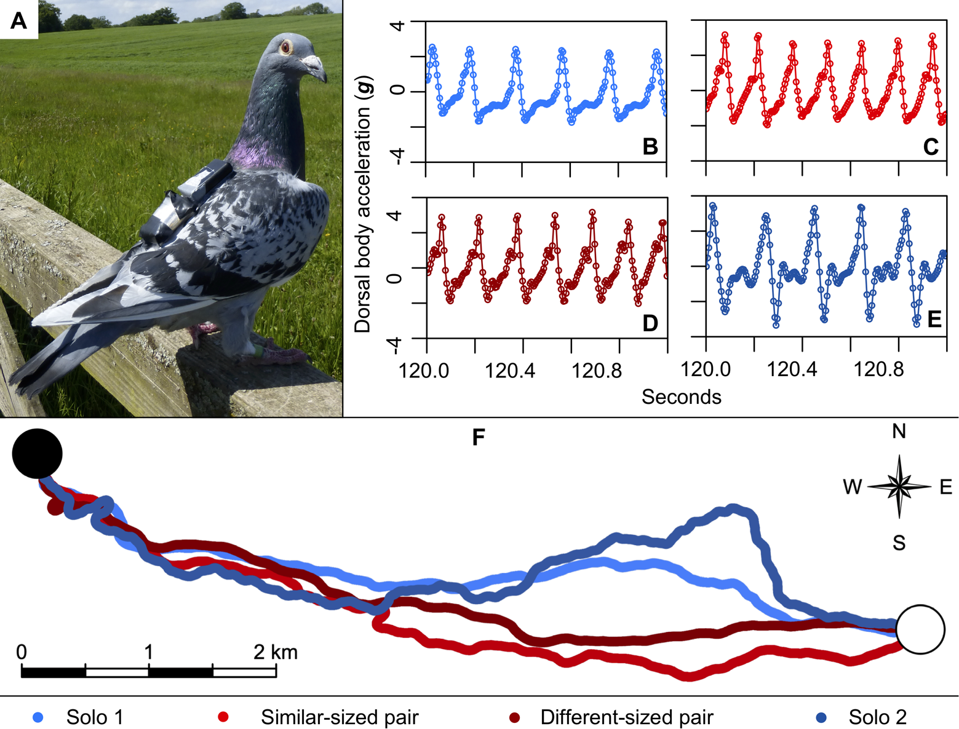
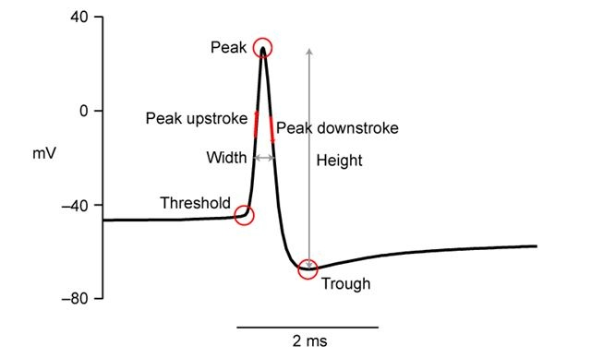
論文-論文數據分析

Slide 7
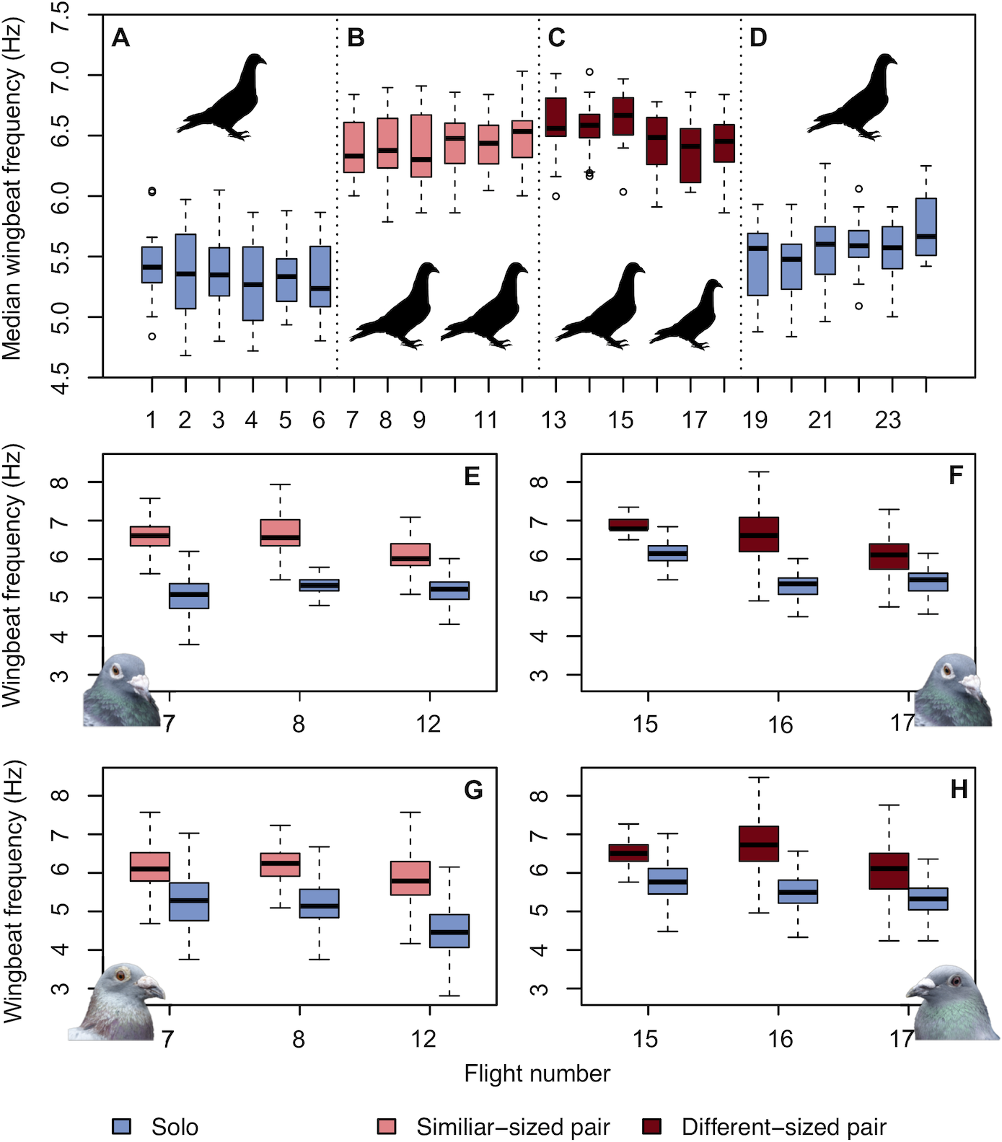
論文-論文數據分析

Slide 8
論文-實驗工具-1
he birds were tracked using 5 Hz GPS loggers (15 g; QStarz BT-Q1300ST, Qstarz International, Taipei, Taiwan) and 200 Hz tri-axial accelerometers (± 16g; 11 g; Axivity AX3, Axivity, Newcastle upon Tyne, UK), which were attached via Velcro strips glued to trimmed feathers on the birds’ backs. In total, the loggers and fastenings weighed 27 g. To enable subjects to adapt to carrying the additional mass, clay weights were attached to them throughout the pretraining and experimental periods, which meant the weights were attached for a minimum of 43 days prior to the start of the experiment. The weights were exchanged for the loggers immediately prior to each release.
實驗道具中的加速規的型號是： 200 Hz tri-axial accelerometers
加速規粘在鴿子的背部；
因為道具的負重在27g左右，所與在實驗之前的43天，實驗對象就已經負重了27g來生活了，實驗的時候，替換成兩個記錄儀

Slide 9
論文-實驗工具-2
We used a custom-built ‘p-Sensor’ to simultaneously record head movement and position. The p-Sensor included an IMU with a combination of a tri-axial gyroscope, tri-axial accelerometer and tri-axial magnetometer recording at 60 Hz, and a GPS logger recording at 10 Hz. The IMU was mounted using double-sided tape onto a custom-made and custom-fitted wire mask designed to fit each bird’s head. The GPS logger, SD card, battery, and microcomputer were placed in an elasticated backpack on the birds back. The instrumentation, mask, and backpack weighed 28.1 g and constituted 4.9% of the body mass of the smallest bird, of which the IMU unit on the bird’s head only weighed 1 g. For more details, see Kano and colleagues [34].
IMU道具是為了測量：頭部的運動和位置；
三軸的陀螺儀，加速規，磁力計，gps；IMU裝置做成面具一樣，放在鴿子的頭部；
電池，sd卡，微型電腦等都是放在背部；
總重量是28.1g，是總重量的4.9%；

Slide 10
論文-數據分析
Data processing.
Data were processed using the procedures outlined in Taylor and colleagues [21]. For each GPS point, the orthodromic (great-circular) distance travelled and birds’ final bearing from the previous point were calculated using the haversine formula and forward azimuth, respectively. The dorsal accelerometer measurements were filtered by taking a running mean over 3 data points (0.015 s). Static acceleration (or gravity) was removed by subtracting a running mean over 15 wingbeat cycles (>2 s). The wingbeat frequency (number of wingbeats per second; Hz) and peak-to-peak dorsal body acceleration (g) using the dorsal acceleration signal (Z-axis) were calculated for each individual wingbeat. The amplitude of the dorsal body displacement (mm) was then calculated by the double integration of dorsal accelerometer measurements [14,21]. In addition, we calculated the duration of the downstroke from the peak downstroke force (maximum g-force) to the lower reversal point (minimum g-force). The upstroke phase duration, which included the start of the downstroke, was measured from minimum g-force to the maximum. We used the maximum and minimum g-force peaks to divide the wingbeat for consistency, because the start of the kinematic downstroke was not distinguishable in the data from paired flights. See S1 Text for further analysis.
目前只知道振翅的頻率可以用加速規來測，具體的測量和計算方法後續需要再研究
使用了加速歸的論文：
https://journals.biologists.com/jeb/article/220/16/2908/33519/Homing-pigeons-Columba-livia-modulate-wingbeat

Slide 11
加速規
https://www.youtube.com/watch?v=To7JagpPDwY
1 An accelerometer is a type of sensor that measures the acceleration and vibration of a body.
測量加速度和震動的裝置；
2 實驗中用來檢測：振翅，身體的震盪，頭的位移；

Slide 12
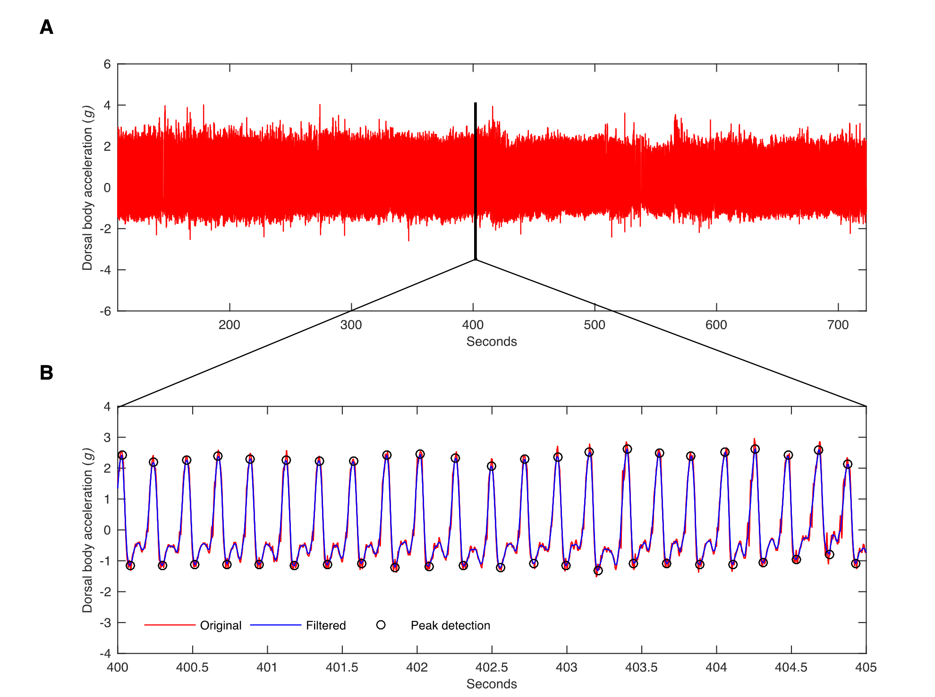
加速規-原始數據示例

Slide 13
陀螺儀
1 維基百科：
陀螺儀的裝置，一直是航空和航海上航行姿態（attitude）及速率等最方便實用的參考儀錶。
2 可以用來判斷：飛行姿態；

Slide 14
跑步參數分析
1 觸地時間（200ms～300ms），左右平衡觸地時間
移動效率 = 垂直振幅/步幅
（這些都可以通過加速規進行數據收集；類比於路徑效率；）
2 跑步功率：
體力就像智慧型手機的電量，您可以將螢幕亮度調至最高，但相對的續航力就會減少，就像您也可以將螢幕亮度調低以提升電池的續航力。同理，藉由得知在各種情況下跑步時身體的功率輸出，就能監控並加以調節自己的體能。在馬拉松與其他長跑訓練中，這項技巧有助於調整訓練以及提升競賽當天的表現。
（類比於：振翅的頻率；）

Slide 15
振翅頻率（wingbeat frequency）
Flapping flight is the most energetically demanding form of sustained forwards locomotion that vertebrates perform.
煽動翅膀的飛行，在脊椎動物中，是最消耗能量的持續向前運動中；（振翅頻率的提升意味着能耗提升）
Both individuals in a pair increased their wingbeat frequency by 18% by decreasing the duration of their upstroke.
通過減少了上沖時間，振翅頻率提升了18%；
We show that, for pigeons flying in pairs, two heads are better than one but keeping a steady head necessitates energetically costly kinematics.
（ Taylor LA, Taylor GK, Lambert B, Walker JA, Biro D, Portugal SJ (2019) Birds invest wingbeats to keep a steady head and reap the ultimate benefits of flying together.）
提升振翅頻率的目的是：提升視覺的穩定性；
Therefore, we hypothesised that for birds of different sizes either one or both birds may have to adjust their wingbeat frequency and/or amplitude to stay together as a pair, which would represent an additional ‘hidden’ compromise cost of flying with another bird.
為了一起飛行，體格相似的鴿子或者不相似的鴿子，都需要改變它們的振翅頻率 和 幅度；
The kinematics（運動學） of paired flight are independent of size and leadership within the pair；
Birds flying in pairs revert to solo flight kinematics if they separate；
振翅頻率可以用來描述：運動模式；這裡通過振翅頻率的變化，論文中認為：使用了不同的運動模式；

Slide 16
總結
已有的知識框架：
1 路徑效率的另一個計算方式；
2 pair flight會提升路徑效率的更多的佐證；
新的知識：
飛行的運動分析：
1姿態（陀螺儀，但不太實用）
2振翅頻率（加速規，可以藉此判斷能耗）
3頭部的位移（加速規，陀螺儀，磁力計；用來判斷視覺的穩定性）
方案：
買一個加速規，研究振翅頻率，進而分析能耗；

Slide 17
隨着路徑熟練度的變化，鴿子會調整振翅特點

Slide 18
路徑效率
Route efficiency was also significantly affected by both median wind support (estimate=−0.05, χ12=14.8, P<0.001) and median crosswind (estimate=0.10, χ12=7.9, P=0.005), with greater wind support and lower crosswinds associated with higher route efficiency.
路徑效率（算法一致）也會被風持和交叉風所影響：與風持正相關，與交叉風反相關；

Slide 19
風持與交叉風
wind support represents the length of the wind vector in the direction of the bird's flight and crosswind represents the absolute speed of the wind vector perpendicular to the bird's direction of travel (Fig. S1).
風持：風矢量在飛行方向上的長度；
交叉風：風矢量在飛行方向的垂直方向的絕對速度；

Slide 20
風持與交叉風的其他影響
Median wind support also had a significant effect on both median wingbeat frequency and median DB amplitude, with higher wind support associated with lower wingbeat frequencies (estimate=−0.02, χ12=26.5, P<0.001) and increased DB amplitude (estimate=0.20, χ12=25.3, P<0.001). By contrast, median wind support had no effect on peak-to-peak DB acceleration, and median crosswind had no effect on any of the wingbeat characteristics.
風持對於振翅頻率和背部的振幅有明顯的影響：風持越大，振翅頻率越低，背部的振幅越高；
相比之下，風持對於背部的加速度峰值沒有影響；交叉風對於振翅的特點沒有影響；

Slide 21
空速的影響
By analysing all 20 releases in an LME model with median peak-to-peak acceleration and median wingbeat frequency as fixed effects, we found that higher airspeeds were associated with higher peak-to-peak DB accelerations (estimate=1.57, χ12=10.3, P=0.001) and lower wingbeat frequencies (estimate=−0.78, χ12=3.9, P=0.048). Furthermore, in a model with DB amplitude (displacement) as a fixed effect, which is dependent on peak-to-peak DB acceleration (force exerted on the DB) and wingbeat frequency (duration of the wingbeat), DB amplitude was positively associated with airspeed (estimate=−0.24, χ12=23.3, P<0.001).
空速：與背部的加速度峰值正相關，與振翅頻率反相關；
背部的振幅：與空速正相關；

Slide 22
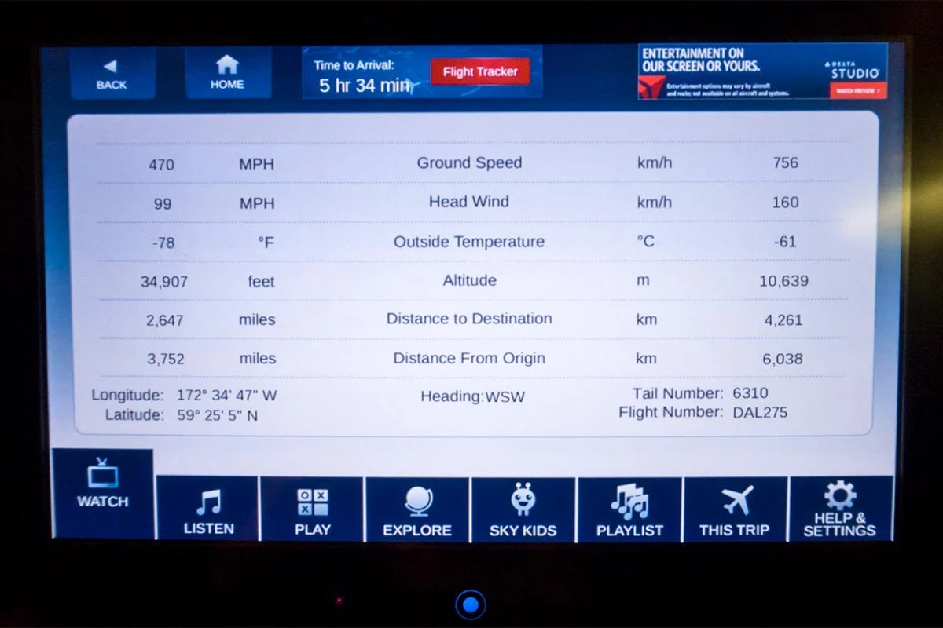
Airspeed vs ground speed
1 空速決定了有足夠的氣流讓它可以飛起來；地速決定了到達目的地的快慢；
2 地速 = 空速+風速；
3 順風(tailwind)的時候，地速>空速；逆風(headwind)的時候， 地速<空速；

Slide 23
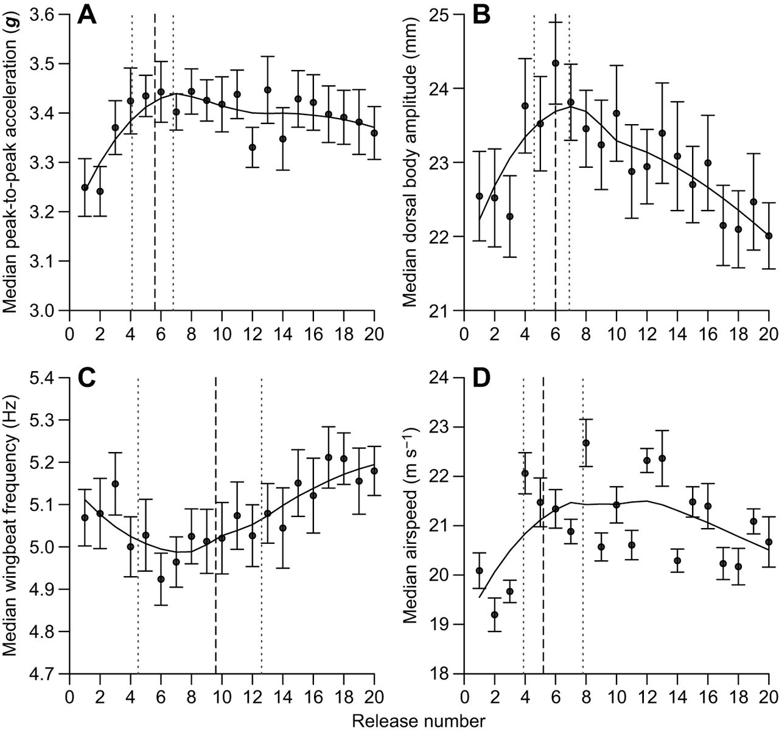
材料
1 A是平均峰值加速度，B是身體振幅，C是平均振翅頻率，D是平均飛行速度；

Slide 24
Acceleration gyroscope magnetometer sensor
1 accel：通過一個靈活的硅結構，測量三個垂直方向的振幅；
2 gyro：通過一個震動的結構偵測轉向率；
3 magnet：通過檢測地球的磁力場來檢測方向；

