Slide 1
DIAL: Distributed Elephant Flow Counting on SDN
Zheng Peng, Hao Li, Chengchen Hu
Xi’an Jiaotong University
Notes:
Good morning, everyone. My name’s Peng Zheng. Today I’m going to talk about a distributed counting approach. And the topic is DIAL: Distributed Elephant Flow Counting on SDN.

Slide 2
Statistics Counters
Record and update the expected statistics
Packet counts, byte counts
Support wire-speed counting
Kept in the high-speed memory
On-chip registers, SRAM: expensive!
Notes:
We know that per-flow counting is very essential to support various measurement scenarios. A per-flow measurement task associates each flow with a corresponding counter in the switch to record and update the expected statistics, for example, packet counts and byte counts of the flow. And then the high-level applications periodically query the counters to collect the statistics. So, to realize the wire-speed counting and respond to the frequent querying, the counters are kept in the high-speed memory in the switch, for example, on-chip registers or SRAM, which is very expensive though.

Slide 3
Memory Waste for Mice Flows
Traditional counters
Few
Elephant flows
Wasted!
Many
Mice flows
N−bit memory
Notes:
Nevertheless, existing counting approaches waste the majority of even this limited memory, making it more insufficient. To be specific, they allocate N-bit memory for each counter to count 2^N packets/bytes, where N is a fixed number. As a result, N should be large enough to measure the “elephant flows” with many packets/bytes. However, since the majority of flows in the traffic are “mice flows” with a few packets/bytes, many bits of memory are wasted in most counters. In other words, many fewer flows can be measured in a single switch.

Slide 4
A Simple Example
5 switches
Notes:
Consider a simple network shown in this figure. We have 5 switches S₁ to S₅, and they are linearly connected.

Slide 5
Fixed-Width: Average Case
1
1
1
1
1
16
mice
flows
1
1
1
1
1
4
elephant
flows
1
1
1
1
1
100
100
100
100
1
S
S
S
S
S
1
2
3
4
5
Each switch counts 4 flows
Notes:
In this network, we assume that there are 4 elephant flows and 16 mice flows. And each switch counts 4 flows evenly.
This is an example of the counter arrays for the traditional large fixed-width counter solution. If the 4 elephant flows are evenly counted in 4 switches, then it’s called the average case. As shown in this figure, red “one O O”s mean 4-byte elephant flows, while the other flows are 1-byte mice flows.

Slide 6
Fixed-Width: Dominant Case
100
1
1
1
1
Mouse
100
1
1
1
1
100
1
1
1
1
Elephant
100
1
1
1
1
S
S
S
S
S
1
2
3
4
5
Notes:
If the 4 elephant flows are gathered in a single switch, it is called the “dominant case”. For example in this figure, there’re only one switch counting all 4 elephant flows.

Slide 7
Fixed-Width: Memory
3 bits
100
001
001
001
001
100
001
001
001
001
100
001
001
001
001
100
100
100
100
100
S
S
S
S
S
1
2
3
4
5
3 (bits) * 4 (counters) * 5 (switches) = 60 (bits)
Notes:
From the above we can see that no matter in which case, the fixed-width approach always assumes the worst case, that is, it will allocate 3 bits memory for every counter, because it doesn’t know which flow will grow to be elephant. So it will take 3 bits per counter times 4 counters per switch times 5 switches, which is equal to 60 bits memory in total. So if a counter is counting a mouse flow, the higher two bits memory will be wasted.

Slide 8
Variable-Width: Average Case
BRICK
6 (bits) * 5 (switches) = 30 (bits)
Notes:
Recently, a variable-width counter architecture named BRICK has been proposed. BRICK splits the whole memory into small-sized buckets, and bundles each counter into one bucket initially. If the number of packets/bytes exceeds the counter’s capacity, BRICK will allocate an extra bucket for this counter as higher-order bits. So, each counter is expected to consume “just enough” memory for the measurement.
For example in this figure, BRICK can largely save the memory in the average case, because it can flexibly extend the 1-bit bucket. In this figure, it consumes 3 bits memory for each elephant flow, and only 1 bit memory for each mouse flow. So it needs only six bits per switch, and 30 bits in total, to handle all possible average cases.

Slide 9
Problem of BRICK
Counting on elephant flows may fail
When the switch runs out of the buckets
Count anywhere along the routing path
Tasks of elephant flows may aggregate
Notes:
Although BRICK has efficiently utilized all memory in a single switch, the counting on elephant flows may still fail when the switch runs out of the buckets. This is quite possible, because the high-level measurement applications could count the flows anywhere along the routing path, and such randomness may aggregate the tasks of counting elephant flows into a few switches, resulting in memory exceeding.

Slide 10
Variable-Width: Dominant Case
12 (bits) * 5 (switches) = 60 (bits)
Notes:
This is an example for BRICK in the dominant case. Since BRICK cannot predict which switch will be the hot spot, it has to allocate 12 bits for each switch if it wants to avoid exceeding the switch memory in any possible cases. And it will cost 60 bits memory, which is the same memory cost as the fixed-width approach. Otherwise it may fail the counting if too many elephant flows are counted in a single switch. Look at the spare bits in this figure, when the gathered elephant flows impact the memory in a single switch, much memory remains unused in others.

Slide 11
Basic Idea of DIAL
Exploit the spared memory in other switches
As a supplement to the local memory
The elephant flows can be jointly counted
By multiple switches
Instead of a single one
Notes:
Based on this simple observation, our basic idea is to exploit the spared memory in other switches as a supplement to the local memory, so that the elephant flows can be jointly counted by multiple switches instead of a single one.

Slide 12
Basic Idea of DIAL
f
1
f
1
f
1
f
1
f
1
4
8
12
16
20
f
1
f
1
f
1
f
1
f
1
Mouse
Elephant
3
7
11
15
19
f
1
f
1
f
1
f
1
f
1
2
6
10
14
18
f
1
f
1
f
1
f
1
f
1
1
5
9
13
17
S
S
S
S
S
1
2
3
4
5
Notes:
Still consider the aforementioned example, we use f₁–f₂₀ to denote the 20 flows in the network, where f₁–f₄ are the 4-byte elephant flows. DIAL allocates a set of 1-bit counters for each switch.

Slide 13
Basic Idea of DIAL
f
1
f
1
f
1
1
1
1
f
1
f
1
f
1
f
1
f
1
4
8
12
16
20
f
1
f
1
f
1
f
1
f
1
Mouse
Elephant
3
7
11
15
19
f
1
f
1
f
1
f
1
f
1
2
6
10
14
18
f
1
f
1
f
1
f
1
f
1
1
5
9
13
17
S
S
S
S
S
1
2
3
4
5
Notes:
And when a specific counter is exceeded, DIAL will use a spared counter in another switch to continue counting the flow.

Slide 14
DIAL: Dominant Case
f
1
f
1
f
1
4
4
4
f
1
f
1
f
1
3
3
3
f
1
f
1
f
1
2
2
2
f
1
f
1
f
1
1
1
1
f
1
f
1
f
1
f
1
f
1
4
8
12
16
20
f
1
f
1
f
1
f
1
f
1
Mouse
Elephant
3
7
11
15
19
f
1
f
1
f
1
f
1
f
1
40 bits
2
6
10
14
18
f
1
f
1
f
1
f
1
f
1
1
5
9
13
17
S
S
S
S
S
1
2
3
4
5
Notes:
This figure depicts one of the dominant cases, where all elephant flows are originally counted in the first switch. It can be seen that each elephant flow uses 4 bits in different switches. And 8 bits for each switch are sufficient. For this worst case, the total memory cost is 40 bits, which is lower than that of the fixed-width approach and BRICK.

Slide 15
Counting Rule Must Be Duplicated
f
1
f
1
f
1
20 flows
100 flow entries
100 bits
4
4
4
f
1
f
1
f
1
3
3
3
f
1
f
1
f
1
2
2
2
f
1
f
1
f
1
1
1
1
f
1
f
1
f
1
f
1
f
1
4
8
12
16
20
f
1
f
1
f
1
f
1
f
1
3
7
11
15
19
f
1
f
1
f
1
f
1
f
1
2
6
10
14
18
f
1
f
1
f
1
f
1
f
1
1
5
9
13
17
S
S
S
S
S
1
2
3
4
5
Notes:
Though the above analysis shows the potential benefit of DIAL, we note that DIAL could bring much overhead if being simply applied. The reason is that to implement the supplementary counters along a routing path, the original counting rule must be duplicated. To be specific, DIAL has to duplicate all the counting rules to all the switches, in case any of them becomes an elephant flow. This duplication makes DIAL impracticable for two reasons. First, the number of counting rules increases with the number of switches, which largely consumes the flow entries in the flow table. Second, the counter memory is occupied right after the counting rules are installed. That is, the counting memory cost will also increase with the number of switches.
For example in this figure, the 20 flows will consume 100 flow entries because the counting rule for each flow has to be duplicated in all 5 switches. And even assuming we have the pre-knowledge that there are only 4 elephant flows and that 8 bits for each switch are sufficient, each flow needs 5 bits in the 5 switches, and DIAL still has to allocate 100 bits overall , since we don’t know which 4 flows could grow to be elephant.

Slide 16
Counting Rule Duplication Problem
Duplicating all the rules wastes flow entries
Adaptively duplicate the counting rules
Many flows require extra rules simultaneously
Where to duplicate the rule for each flow?
Counting Rule Duplication Problem (CRDP)
Notes:
Recall the 80/20 rule indicating only a small portion of flows are elephant flows, duplicating all the counting rules will waste lots of flow entries. A straightforward method is to adaptively duplicate the counting rules for those flows that cannot be counted in their original switches. However, considering there could be multiple flows requiring extra counting rules simultaneously, the arbitrary duplication may produce the hot spot where the switch runs out of its flow table entries and/or counting memory. That is, we must carefully decide where to duplicate the rule for each flow, namely counting rule duplication problem (CRDP).

Slide 17
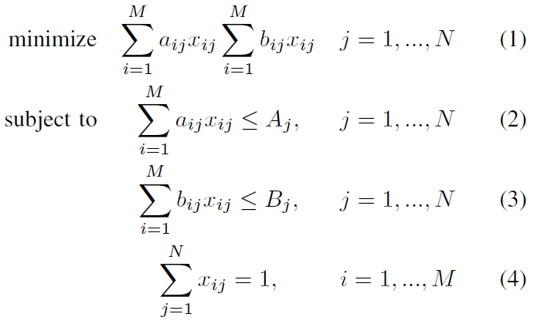
CRDP Formulation
N switches
M flows
a_{ij} memory
b_{ij} table entries
Flow M_{i} to switch N_{j}
CRDP is NP-hard!
Notes:
We formalize CRDP as follows. Assume there are N switches in total, and M flows requiring extra counting rules. If we duplicate a counting rule for flow Mi to switch Nj , it will consume aij counting memory along with bij flow table entries. In sum, CRDP can be formalized by this model.
Here equation (1) is to minimize the cost of counting memory and flow entries. Equation (2) and Equation (3) constrain the counting memory and number of flow entries. Equation (4) defines a 0-1 variable to represent that each rule can only be duplicated to one switch. Actually, aij is a constant value for all assignment (Mi to Nj ), since DIAL allocates same-size counters for each flow. As a result, we could rewrite the objective to minimize the second factor, i.e., the number of flow entries. In this way, CRDP captures the well-known Multi-Resource Generalized Assignment Problem (MRGAP), which has been proved to be NP-hard.

Slide 18
Heuristics
Counting memory and #flow entries
Should not go beyond their capacities
Should be balanced for all switches
Lightest-Loaded-First duplication (LLF)
Greedily duplicate the counting rule
The flows with shorter path first
Notes:
Due to the NP-hardness of CRDP, we propose some simple heuristics to approximately approach the optimal duplication solution under the acceptable time consumption. Specifically, we consider the following requirements of duplication placement: first, the consumption of the two resources (counting memory and #flow entries) should not go beyond their capacities, and second, the consumption of the two resources should be balanced for all switches. The heuristics is to greedily find the lightest-loaded switch to duplicate the counting rule for each flow that exceeds its original counter, namely Lightest-Loaded-First duplication (LLF). We note that, for a certain flow, the number of candidate switches for duplication is actually the number of hops of this flow. That is, flows with longer path have more options to place the duplicated rules. As a result, for a bunch of flows to be duplicated, LLF will first decide the duplication place for the flows with shorter path.

Slide 19
Example Duplication
f
1
f
1
1
2
f
0
f
0
f
0
f
0
f
0
4
8
12
16
20
f
0
f
0
f
0
f
0
f
0
S₁->S₂->S₃
3
7
11
15
19
f
1
f
0
f
0
f
0
f
0
2
6
10
14
18
S₁->S₂
f
1
f
0
f
0
f
0
f
0
1
5
9
13
17
S
S
S
S
S
1
2
3
4
5
Notes:
For example in this figure, each switch counts four flows in the beginning. Suppose that the routing path of f1 is S1 to S2 and the routing path of f2 is S1 to S2 to S3. If both f1 and f2 in S1 need to duplicate their counting rules, then we will first arrange to place(f1) that has a shorter routing path. For f1, only S2 is available, so it duplicates the rule to and creates a 1-bit counter in S2. Next, the function to place(f2) is called, and here S3 is lighter loaded than S2, so the duplicated rule will be placed in S3.

Slide 20
Evaluation Settings
Counting approaches
Fixed-width and variable-width
The placement of the counting rules
Randomly select the original counting switch
Choose the most empty switch to count (LLF)
Apply DIAL with adaptive rule duplication.
Notes:
Next, we evaluate the performance of DIAL. Since DIAL is complementary to the optimization in a single switch, we involve the fixed-width and variable-width approaches in our evaluation. The placement of the counting rules is critical for the above two approaches. We specifically simulate three cases: (1) randomly select the original counting switch for each flow, (2) choose the most empty switch to count the flow (i.e., LLF), and (3) apply DIAL with adaptive rule duplication.

Slide 21
Traces
Three public real-world Internet traffic traces collected in 2016 from CAIDA
Each trace has about 1M flows
Theoretical optimum (T. O.) memory cost
Sum of theoretical minimal width of each flow
Notes:
We use three public real-world Internet traffic traces collected in 2016 from CAIDA in our evaluation. Each trace has about 1M flows and the largest flow needs a 28/29-bit width counter. And each trace has a theoretical optimum (T. O.) memory cost which is calculated by the sum of every theoretical minimal counter width of each flow.

Slide 22
Network Topologies
Two real-world network topologies from the Internet Topology Zoo
CERNET (36 switches)
ChinaNet (38 switches)
A simulated topology based on fat-tree (k = 4)
Notes:
We employ two real-world network topologies from the Internet Topology Zoo, that is CERNET with 36 switches and ChinaNet with 38 switches. And we further involve a simulated topology based on fat-tree where k is equal to 4;

Slide 23
Simulation
Simulate the hosts
Evenly partition all IPv4 addresses
Distribute them to the edge switches
The routing path for each packet class
Source and destination IP pair from the traces
Generated by the shortest-path algorithm
Notes:
Given the topologies, we simulate the hosts by evenly partitioning all IPv4 addresses and distributing them to the edge switches. The routing path for each packet class (source and destination IP pair) from the traces is then generated by the shortest-path algorithm.

Slide 24
Metrics
The total memory cost
Fixed-width: use the actual consumed memory
Variable-width: a set of 1-bit buckets
DIAL: assume a threshold of 13-bit width
The memory efficiency
T. O. / the actual memory cost in total
Notes:
We consider the following two metrics: first, the total memory cost, We assume the ideal cases for fixed- and variable-width approaches when calculating the total memory cost: for fixed-width approach, we do not set the counter width beforehand, but use the actual consumed memory to calculate the total cost, which avoids the memory exceeding or unnecessary memory waste; for variable-width approach, we assume it has a set of 1-bit buckets without extra overhead, which could maximize the memory efficiency in a single switch. For DIAL, we assume a threshold of 13-bit width, which means the global counting mechanism will be triggered if the local counter exceeds 13-bit memory. This threshold can be adaptively adjusted for different situations if you like.
The second metric is the memory efficiency. Here the memory efficiency is defined as the ratio of the theoretical optimum to the actual memory cost in total, since all the involved approaches are inevitable to waste some of the memory.

Slide 25
Memory Cost
Reduced by: 80% - 90%
50% - 80%
50% - 70%
7% - 50%
Notes:
This figure depicts the total memory cost of all six approaches. It can be seen that DIAL can largely decrease the memory cost, no matter combined with fixed- or variable-width approach. Specifically, if we apply DIAL to the fixed-width approach, the memory cost will be reduced by eighty percent to ninety percent and fifty percent to eighty percent, compared to random and LLF placement, respectively. The variable-width approach has drawn a similar trend by applying DIAL: the memory cost will be reduced by fifty percent to seventy percent and seven percent to fifty percent, respectively.

Slide 26
Memory Efficiency
400% - 1000%
100% - 600%
100% - 300%
50% - 200% increases
Notes:
Additionally, the memory efficiency of these six approaches is shown in this figure. It can be seen that DIAL can significantly increase the memory efficiency for both fixed- and variable-width counter approaches. To be specific, when DIAL is applied to the fixed-width approach, the results of memory efficiency reveal that it will bring about four hundred percent to one thousand percent increases if compared to random placement, and one hundred percent to six hundred percent rises if compared to LLF placement. The effect of using DIAL is also satisfying with the variable-width counter approach: the memory efficiency will be raised by one hundred percent to three hundred percent and fifty percent to two hundred percent, compared to the two placements respectively.

Slide 27
DIAL Summary
A distributed counting approach
Duplicates rules to leverage global memory
Effective, efficient and scalable
Notes:
I'll just summarize the main points of the slides in a few words. We explored the memory waste problem of per-flow counting. Specifically, we propose a distributed counting approach on SDN, i.e., DIAL. In contrast to only focusing on reducing the local switch memory, DIAL leverages the spared memory along the routing path to make a global optimization. In this work, we formulate the problem of finding the optimal placement for the extra counting rules, and propose simple heuristics to fast generate a near-optimal solution. The evaluation based on real and synthetic traces and topologies has demonstrated that DIAL is effective, efficient and scalable with various local optimization approaches.

Slide 28
THANK YOU QUESTIONS AND COMMENTS
Notes:
Thank you for your listening! Any questions or comments?

Slide 29
Previous Work
Embed more information into the counters
N-bit memory counts more than 2^{N} packets/bytes.
A smaller counter for each flow
To measure more flows
Still assume fixed-width counters
Many bits still unused for mice flow counters
Notes:
To efficiently count the elephant flows, many attempts have been made. These approaches embed more information into the counters, so that N-bit memory can measure more than 2^N packets/bytes. That is, the switch can allocate a smaller counter for each flow, so as to measure more flows. However, they still assume fixed-width counters, leaving many bits unused for mice flow counters.

Slide 30
Variable-Width Counter
BRICK [1] splits the whole memory
Counter initialized with small-sized memory
Adaptively allocate higher-order bits
If the number exceeds the counter’s capacity
Consume “just enough” memory
[1] N. Hua, B. Lin, J. Xu, and H. Zhao, “Brick: a novel exact active statistics counter architecture,” in ACM/IEEE Symposium on Architecture for Networking and Communications Systems, ANCS 2008, San Jose, California, Usa, November, 2008, pp. 89–98.
Notes:
Recently, a variable-width counter architecture named BRICK has been proposed. BRICK splits the whole memory into small-sized buckets, and bundles each counter into one bucket initially. If the number of packets/bytes exceeds the counter’s capacity, BRICK will allocate an extra bucket for this counter as higher-order bits. In sum, each counter is expected to consume “just enough” memory for the measurement.

Slide 31
Adaptive Counting Approaches
Based on SDN architecture
Proactively report the statistics to the controller
To multiplex the switch counters before exceeding
The report messages would incur a heavy load on the south-bound interface of SDN controller
Since the counters may exceed very frequently
Notes:
Some other works propose the adaptive counting approaches based on SDN architecture. Besides reactively responding to the queries from the applications, SDN switches can proactively report the statistics to the controller, so as to multiplex the switch counters before exceeding. However, the report messages would incur a heavy load on the south-bound interface of SDN controller, since the counters may exceed very frequently as we discussed above.

Slide 32
Challenge for DIAL
Counting rules must be duplicated
In case any of them becomes an elephant flow
#Counting rules increases with #switches
Consumes the flow entries in the flow table
Counting memory increases with #switches
Memory occupied right after the rules installed
Notes:
Though the above analysis shows the potential benefit of DIAL, we note that DIAL could bring much overhead if being simply applied. The reason is that to implement the supplementary counters along a routing path, the original counting rule must be duplicated. To be specific, DIAL has to duplicate all the counting rules to all the switches, in case any of them becomes an elephant flow. This duplication makes DIAL impracticable for two reasons. First, the number of counting rules increases with the number of switches, which largely consumes the flow entries in the flow table. Second, the counter memory is occupied right after the counting rules are installed. That is, the counting memory cost will also increase with the number of switches.

Slide 33
First Time Duplication
We note that M could be relatively small in practice due to the limited number of elephant flows. However, the first time “duplication”, i.e., the initial counting rule placement, involves all flows in the network, incurring a large overhead of computing optimal solution. As a result, we still need to seek near-optimal solution for CRDP.

Slide 34
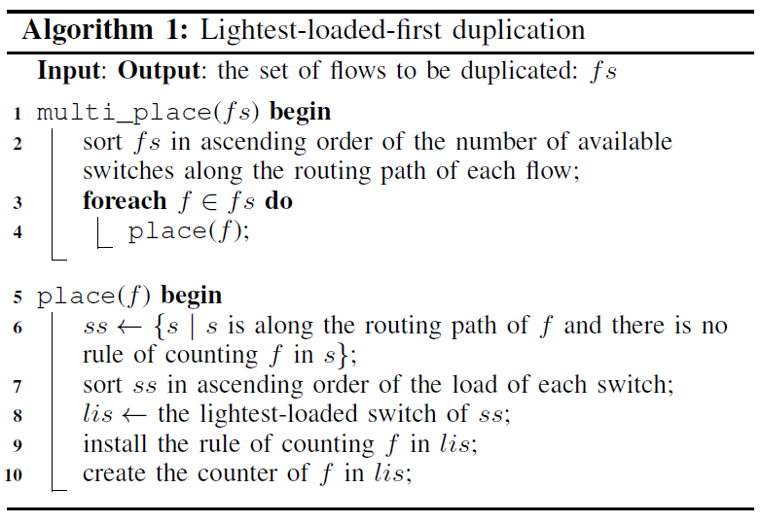
LLF Algorithm
Notes:
This Algorithm depicts the whole process of finding a near optimal duplication solution. To be specific, the function multi_place() works out the priority of all the duplicating flows by their routing paths’ length, and the function place() finds the lightest-loaded switch from the candidates for each duplicating flows sequentially.

Slide 35
Enforce DIAL into SDN
Tag packets
Update results
Handle exceptions
Notes:
In this section, we highlight some key designs of enforcing
DIAL into real SDN environment.

Slide 36
Tag Packets
Avoid redundant counting along the path
The first switch tags the packet as “counted”
Use an unused field of packet, e.g., VXLAN
Initialized with 0, denoting “uncounted”
Only match the uncounted packets
If a packet is matched, modify the field to be 1
Notes:
To avoid redundant counting in the switches along the routing path of a specific flow, the first switch that counts the flow should tag the packet as “counted”. In OpenFlow, we can tag packets using an unused field of packet, e.g., VXLAN. Such field will be initialized with 0, denoting “uncounted”. All the counting rules should only match the uncounted packets. In real time matching, if a packet is matched with a counting rule, the rule should modify the field to be 1, i.e., the packet has been counted.

Slide 37
Update Results
controller collect from all switches periodically
To be specific, at the end of each measurement period, switches will report their counter values to the controller by calling upload
This can be implemented by Statistics messages in OpenFlow for querying the counters.
Notes:
In the measurement system, the controller will collect the counters of all switches periodically. To be specific, at the end of each measurement period, switches will report their counter values to the controller by calling upload
in Algorithm 2. This can be implemented by Statistics messages
in OpenFlow for querying the counters.

Slide 38
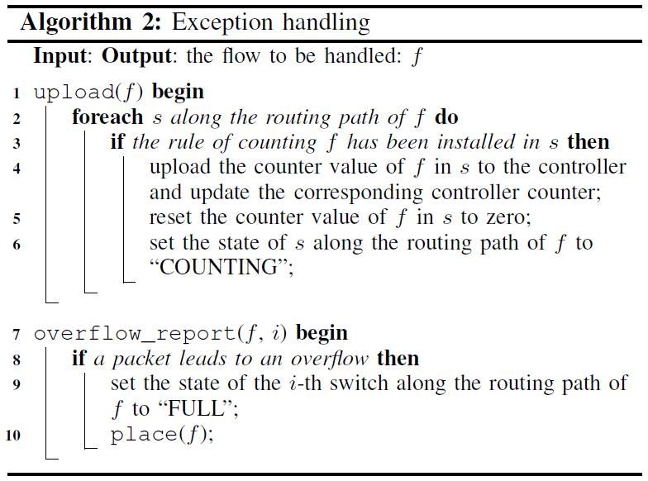
Exception Handling
Notes:
In real-time counting, if a counter exceeds,
overflow_report in Algorithm 2 will be triggered
to set the switch to be “FULL”. If it doesn’t exceed, this packet
of the flow will remain “uncounted” and pass the switches
which contain no rule or have been “FULL” for the flow. If
all switches of a flow are full or have installed the counting
rule, then upload will be triggered to upload the statistics
of the flow in all switches to the controller counters and then
clear the counter values in the switches to continue counting.
During the counting process of DIAL, when a counter exceeds,
the duplication happens as overflow_report is triggered.
In this procedure, an integer is used to help index the switch
which incurs the overflowing. Then the flow will set the switch
“FULL” and call place to find another switch to count it on.
In OpenFlow, overflow_report and upload launched
by switch-end can be implemented with Flow-monitor, Experimenter,
and Packet in messages in special cases.

Slide 39
Contribution
DIAL, a distributed counting approach
Duplicates rules to leverage global memory
Maximizing the counting efficiency
Notes:
In sum, we make the following contributions in this paper. First, We present DIAL, a distributed counting approach, which duplicates the counting rules to leverage the global memory resources, maximizing the counting efficiency.
Then, We pose and formulate the problem of finding the optimal placement for duplicated counting rules. After proving its NP hardness, we give some heuristics to fast generate a near-optimal placement.
We describe the feasibility of implementation, and carry out some evaluation on DIAL. The results demonstrate that DIAL can significantly decrease the memory cost (up to 93% and 78%) for both fixed-width and variable-width counter architecture, with acceptable extra overheads.

Slide 40
Pre-duplication
Wait for the controller to issue the new rule
Large latency through each duplication
Pre-duplication: re-running multi_place()
1st counter exceeds, the 3rd will be allocated
2nd counter is not full
Notes:
Ideally, the duplication happens only when the original counter exceeds. However, this process has to wait for the controller to issue the new counting rule, which will incur large latency through each duplication. We employ a pre-duplication process into DIAL to mitigate the latency problem. Specifically, after initially placing the counting rules, we directly duplicate them by re-running the function multi_place() of Algorithm LLF. That is, all the counting rules are at least duplicated once. When a flow exceeds its first counter, a third one will be allocated immediately. As a result, the controller has plenty of time to issue the new counting rule, as long as the second counter is not full. In this way, elephant flows are properly counted without employing extra latency.

Slide 41
Pre-duplication
Notes:
This figure depicts a possible result after the pre-duplication, in which the assumptions are the same as the aforementioned. After duplicating all the counting rules once, each switch counts eight flows now. It can be seen that f1 has two counters in S1 and S2 at the start, and the one in S1 is counting the first byte of f1. When f1 exceeds its counter in S1, a counting rule for f1 will be installed in another switch S3 immediately. Meanwhile, the elephant flow f1 can be properly and continuously counted in S2.

Slide 42
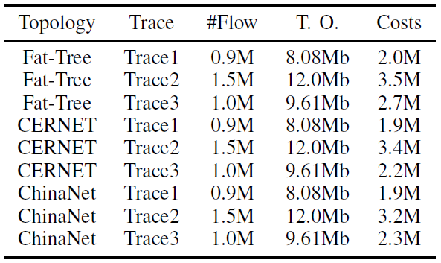
Costs
Notes:
We further measured the overhead of extra Packet-in messages when handling exceeding exceptions, as is denoted in the “Costs” field in this table. We find that the “Costs” count is at the same order of magnitude with the flow count. We know that in periodic network measurement in SDN, one flow has to lead the switch to communicate with the controller at least once when submitting the result at the end of the measurement period. In DIAL, the extra message cost is introduced, which leads to an increase in the number of the same messages for example, Packet-in costs in OpenFlow, but that is still at the same order of magnitude, so we consider that it is endurable with high bandwidth SDN link. For example, some real system has the 1Gbps SDN link.

Slide 43
Conclusion
Explored the memory waste problem
Propose a distributed counting approach, DIAL
Leverages the spared memory along the routing path to make a global optimization
Formulate the problem of finding the optimal placement for the extra counting rules
Notes:
In this paper, we explored the memory waste problem of per-flow counting. Specifically, we propose a distributed counting approach on SDN, i.e., DIAL. In contrast to only focusing on reducing the local switch memory, DIAL leverages the spared memory along the routing path to make a global optimization. In this work, we formulate the problem of finding the optimal placement for the extra counting rules

Slide 44
Conclusion (2)
Propose simple heuristics to fast generate a near-optimal solution
Evaluate based on real and synthetic traces and topologies
Demonstrate that DIAL is effective, efficient and scalable with various local approaches
Notes:
And propose simple heuristics to fast generate a near-optimal solution. The evaluation based on real and synthetic traces and topologies has demonstrated that DIAL is effective, efficient and scalable with various local optimization approaches.

