Slide 1
Nanopore Long-read Metagenome Analysis Pipeline (v1.0)
Raw FASTQ
QC
Host removal
Non-host reads
READS-BASED
CONTIG-BASED
p02 Taxonomy
Kraken2+Bracken
p03 Assembly
p04 Read mapping
p05 Binning
p06 Annotation
p08 Probiotic
Competitive mapping
p11 GTDB-Tk
p09 CAZyme
p10 AMR
p07 Urate
p12 geNomad
p13 Statistics
p14 Visualization
p15 Report

Slide 2
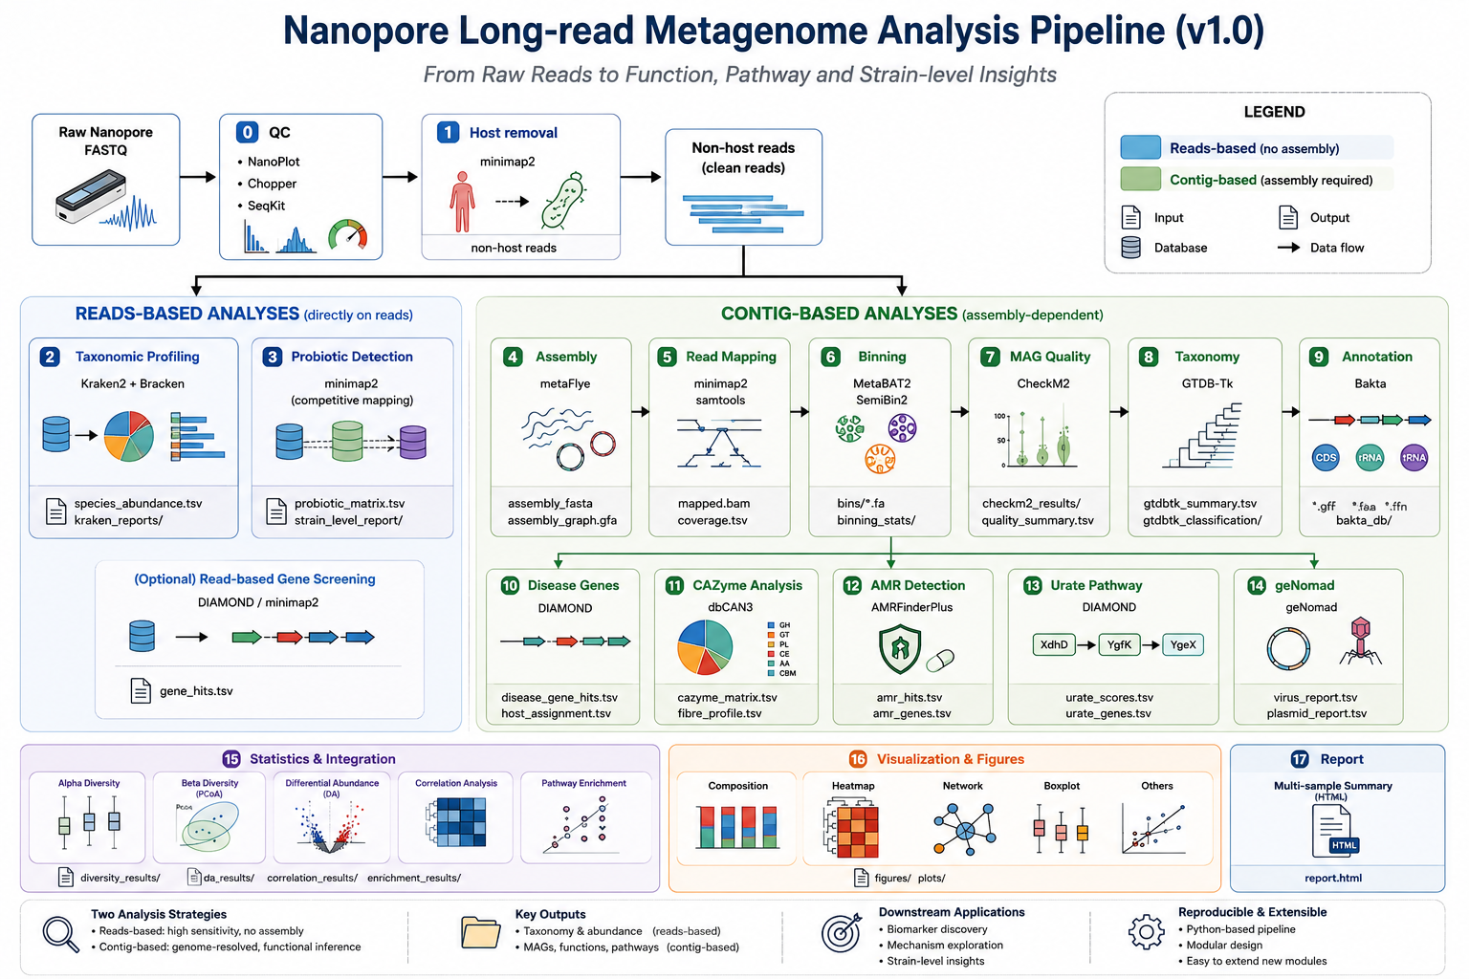
Pipeline illustration

