Slide 1

WEATHER-ADAPTIVE TIMETABLE GENERATOR FOR RENEWABLE ENERGY UTILIZATION

Slide 2
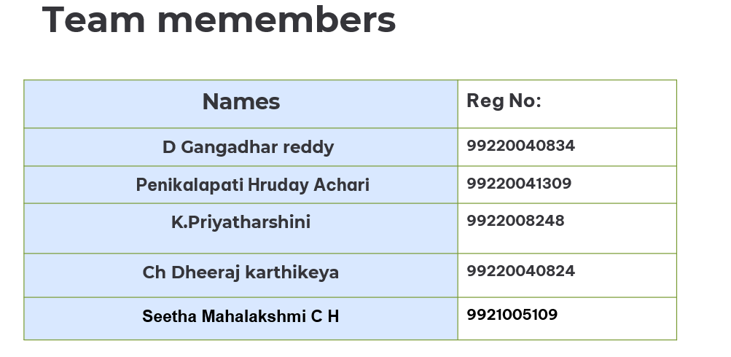

Slide 3
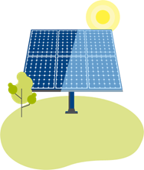

Problem Statement
Unoptimized energy use in current timetable systems.
Missed opportunities to leverage solar energy.
Lack of dynamic, weather-adaptive scheduling tools.
Proposed Solution
Weather-responsive web-based timetable generator.
Reschedules lab sessions from cloudy/rainy to sunny days.
Saves energy and supports sustainability.

Slide 4
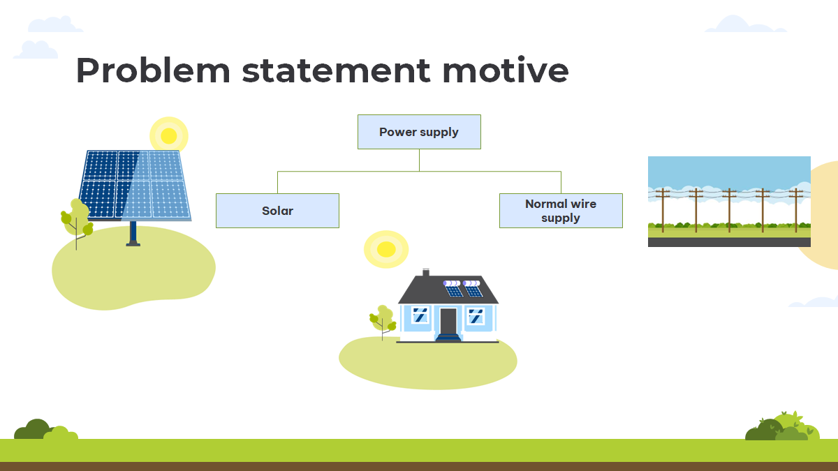

Slide 5
01
Introduction

Slide 6
Introduction
weather-adaptive lab timetable generator that leverages real-time weather forecasts to maximize solar energy utilization and reduce reliance on non-renewable electricity in educational institutions. By integrating Flask, Python, OpenWeatherMap API, and CSV-based file handling, the system intelligently schedules high-power lab activities on sunny days and avoids scheduling on rainy or cloudy ones.

Slide 7
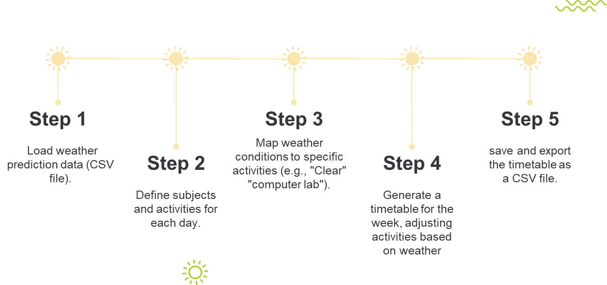
Methodology

Slide 8
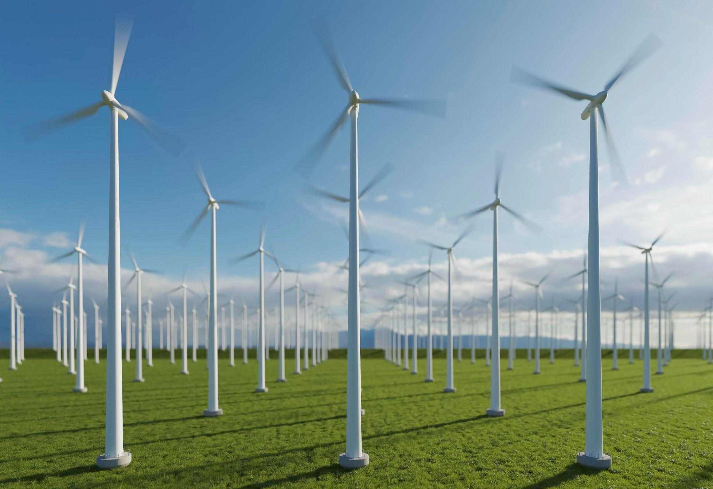

System Architecture: How It Works
Data Input
Collects temperature, irradiance, and precipitation from OpenWeatherMap.
AI Prediction
Uses scikit-learn to forecast solar energy availability precisely.
Scheduling Algorithm
Allocates high-power lab tasks during peak solar periods.
User Interface
Flask web app for viewing and adjusting lab timetables easily.

Slide 9
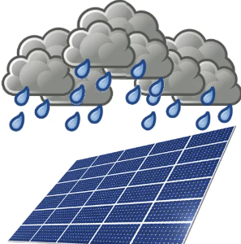
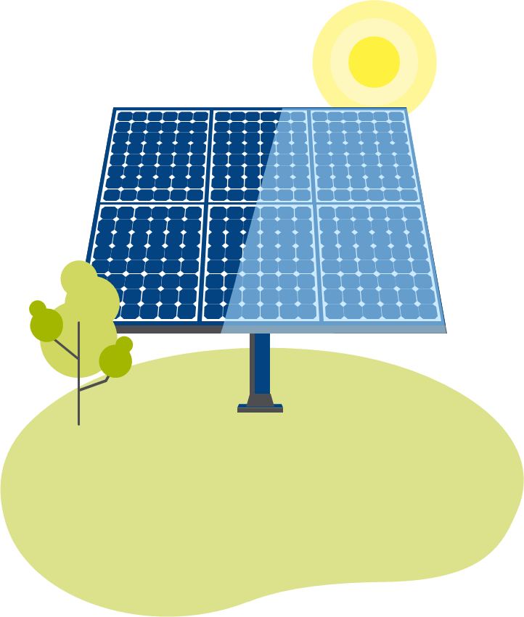
Technology Stack
Languages: Python, HTML, CSS
Libraries: Flask, Pandas, RequestsAPI: OpenWeatherMap dataset of whether
Fpdf history of downloads

Slide 10


How It Works ?
Reschedule based on weather.
Retrieve weather forecast
Generate & download updated pdf
Upload timetable CSV

Slide 11
Key Technologies

Slide 12
Reduce energy consumption by optimizing lab schedules based on solar availability.
Build a web-based tool for seamless timetable upload, generation, and download
Integrate real-time weather data to enable dynamic and intelligent scheduling
users (faculty/students) reported improved scheduling experience

Slide 13
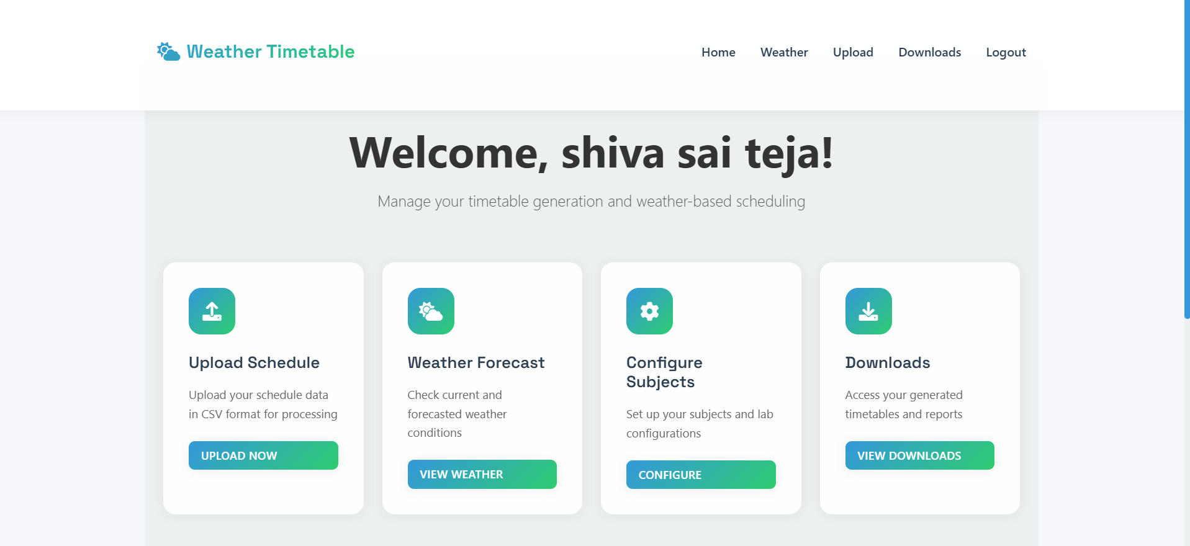
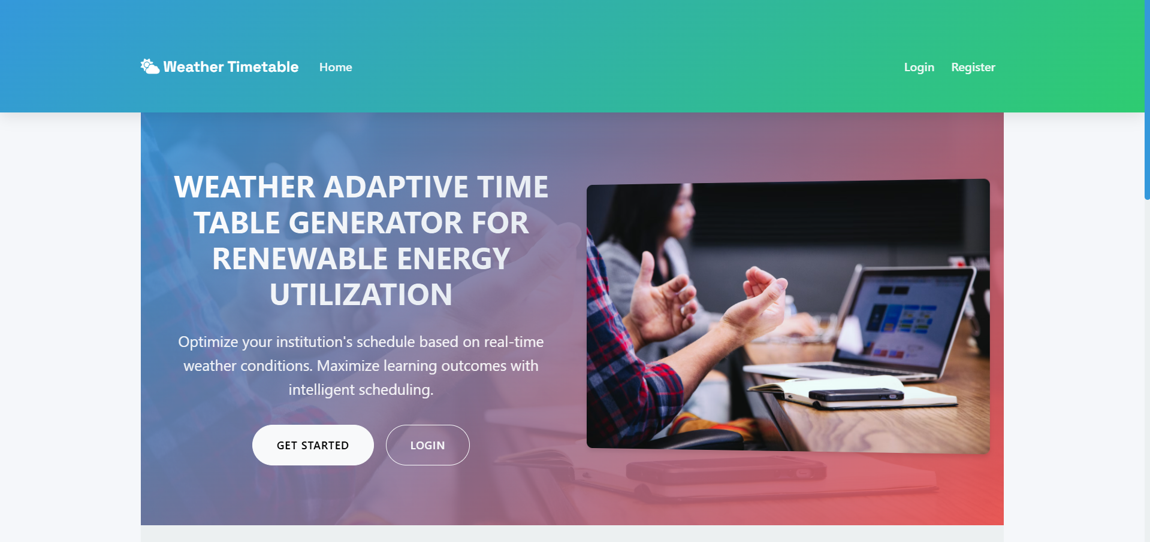
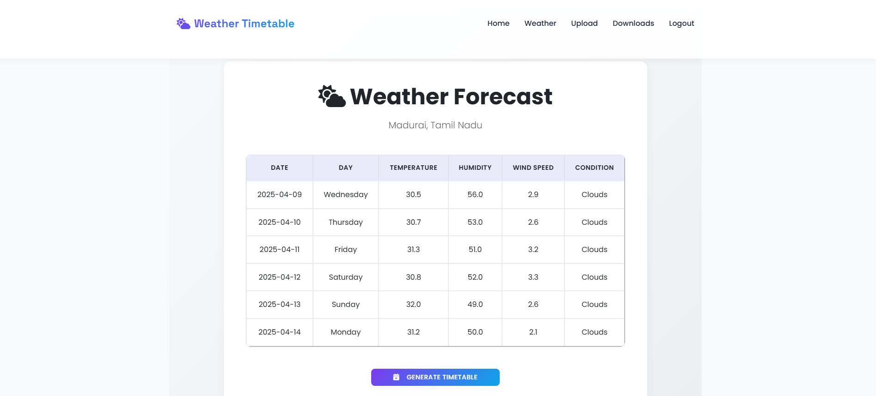
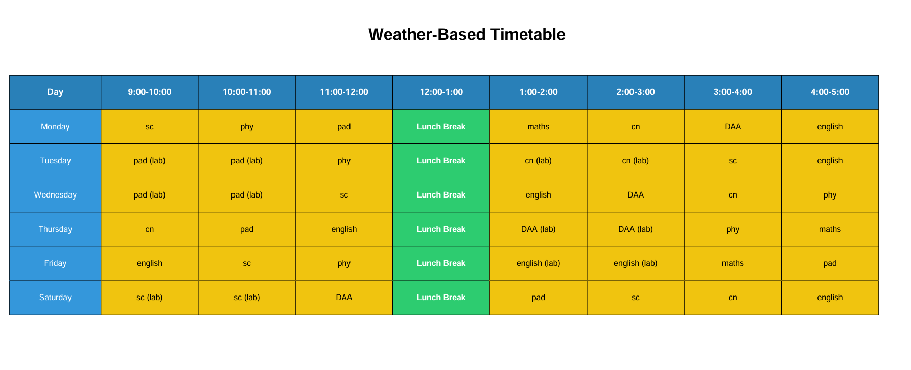
Output/result

Slide 14

Conclusion
The AI-Time Table Generator for Renewable Energy Utilization demonstrates a powerful, practical approach to promoting sustainability in educational institutions. By dynamically adjusting laboratory schedules based on real-time weather forecasts, this system ensures that energy-intensive sessions are conducted during periods of optimal solar availability.

