Slide 1
NextGen Online Retail and Order Management Platform
Project purpose: Deliver a maintainable, relational platform that unifies storefront, order processing, payments, and delivery tracking.
Team: Varshitha - 2510030400
Harini - 2510030374
Problem (one-line): Disconnected retail systems cause duplicate data, tracking gaps, and inconsistent inventory.
Main system flow: Customer → Product → Cart → Order → Payment → Delivery

Slide 2
Novelty of the Proposed DBMS Methodology
Centralized Database: All customer, product, order, payment and delivery data are managed in one PostgreSQL database.
Integrated Modules: Customer → Product → Cart → Order → Payment → Delivery are connected.
Reduced Data Duplication: Normalized tables help avoid repeated data.
Real-Time Data Consistency: Inventory and order information can be updated through connected modules.
Modular Design: New features such as analytics or AI recommendations can be added easily.
Better Tracking: The system provides a connected view of orders, stock, payments and delivery.
Report Generation: Centralized data can be used to generate order, sales, stock and customer reports.

Slide 3

System Architecture & Adaptability
Architecture: React UI → Node/Express API → PostgreSQL (managed via pgAdmin 4)
Layered design: UI, API, Data layers for separation of concerns
Independent modules: Customer, Product, Cart, Order, Inventory, Payment, Delivery, Reports
Adaptability: add or replace modules with minimal impact
Relational DB: supports connected modules and evolving business rules

Slide 4
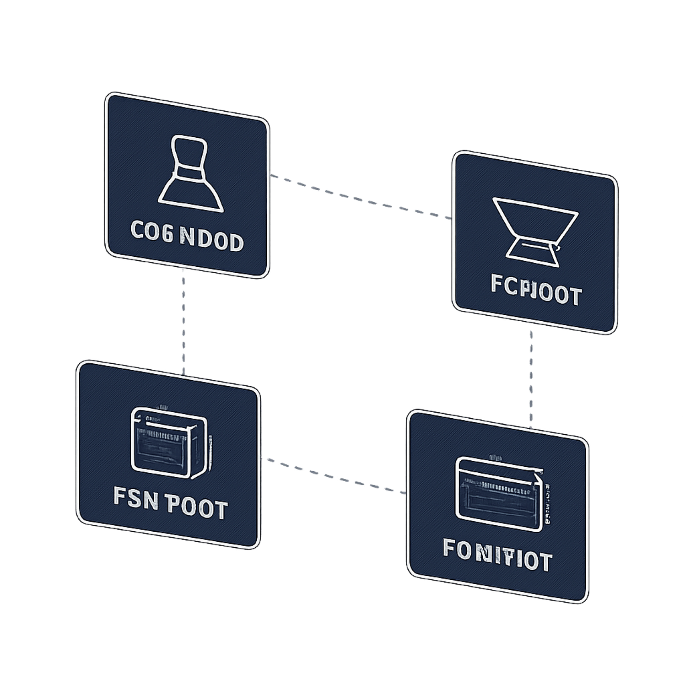
Database Design & Methodology
Core Entities: Customer, Product, Order
Supporting Tables: Cart, Order Item, Inventory, Payment, Delivery, Review
Foreign Keys: Connect tables and maintain relationships
Normalization: Reduces duplicate data
Outcome: Connected and organized database

Slide 5
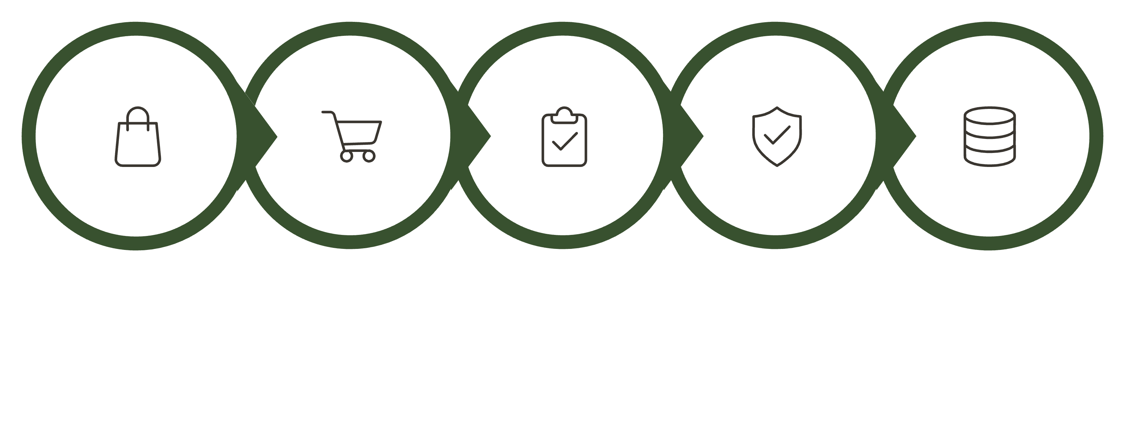
System Workflow & Implementation
Select
Add
Place
Validate
Create
Backend implementation steps:
Validate cart & calculate totals
Create Order and Order_Item records
Record payment status (pending/confirmed/failed)
Update Inventory (decrement, trigger low-stock alerts)
Update Delivery status and schedule

Slide 6
Methodology Evaluation & Testing
Test Area | Purpose | Expected Result
Data insertion | Verify records save correctly | Rows persisted with PKs
Relationships | Enforce referential integrity | FKs prevent orphan records
Order flow | Ensure lifecycle correctness | Order → Payment → Inventory → Delivery updated
Testing checklist
Data insertion
Data retrieval
Table relationships
Constraints
Complete order flow
Include DB / app screenshot placeholders showing test queries and sample order record.

Slide 7
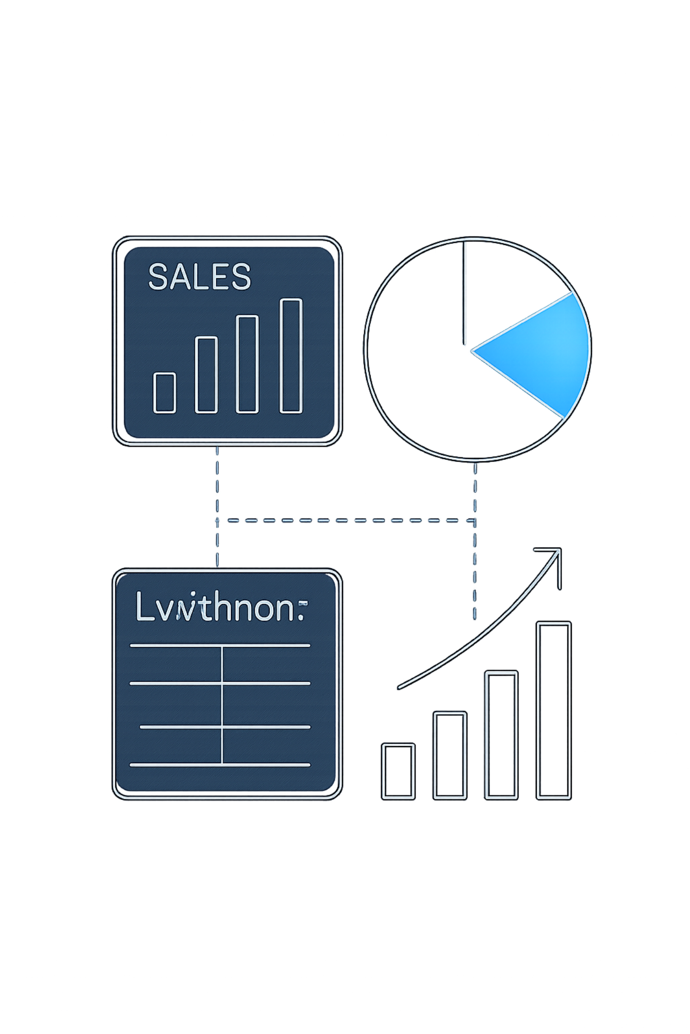
Dissemination, Accessibility & Practical Outcomes
Centralized access: admins and analysts can query unified data
Reports provided: Order Report, Product/Stock Report, Sales Summary, Customer Information
Accessibility: consistent API endpoints and pgAdmin for DB access
Practical outcomes: easier tracking, reliable reports, reduced reconciliation effort
Before → After: Duplicate data → Centralized DB; Difficult tracking → Connected modules

Slide 8
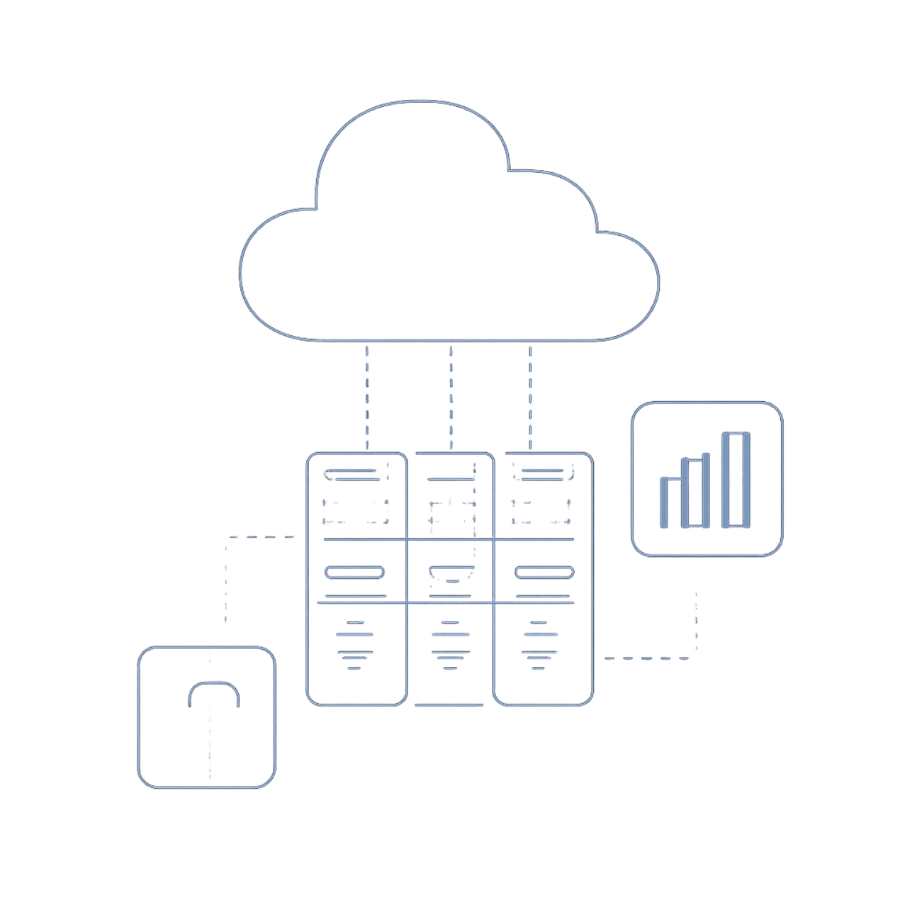
Future Scope — Key Takeaway — Conclusion
Future scope: Payment gateway integration; advanced analytics & dashboards
AI enhancements: product recommendations
Deployment: cloud deployment and horizontal scaling
Key takeaway: A centralized relational database makes online retail data easier to manage, connect, and analyze.
Thank you

