Slide 1

Smart RFID Attendance System
Team: Pranavi — 2510030178 · Varshitha — 2510030278 · Sri Harini — 2510030374 · Varshitha Reddy — 2510030400
Guide: Mr. P. CHANDRA SEKHAR
Department of [CSE] · KL University

Slide 2





Motivation — Why Traditional Systems Fail
Time-consuming
Human errors
Manual roll calls and paper logs waste lecture time and slow administrative work.
Paper-based attendance is prone to missed entries, incorrect counts, and misplaced records.
Poor tracking
No real-time data
Traditional systems make it hard to monitor attendance patterns and identify trends over time.
Attendance details are not instantly available, delaying updates and limiting quick action.

Slide 3
Project Objectives
Automate attendance
Eliminate manual roll calls
Real-time tracking
Use RFID tags and an Arduino reader to record attendance quickly and reliably.
Remove paper records and time-consuming attendance sheets.
Provide instant attendance updates and reports for faculty and administrators.
Secure records
Easy integration
Maintain tamper-proof attendance logs with secure storage and auditability.
Enable seamless integration with existing student management systems.

Slide 4


Introduction — How It Works
Students carry RFID cards or tags. When they enter the classroom, they tap their card on the RFID reader connected to Arduino. The Arduino reads the unique ID, verifies the student identity, and automatically records attendance with a timestamp. Data is stored in a database and displayed on a dashboard in real time.
Designed for contactless, fast attendance tracking in classroom and lab environments.

Slide 5

System Block Diagram
RFID Tag
RFID Reader
Arduino
Database
Visual flow from tag scan to reporting — modular pipeline enables independent upgrading of reading, control, storage, and dashboard components.

Slide 6
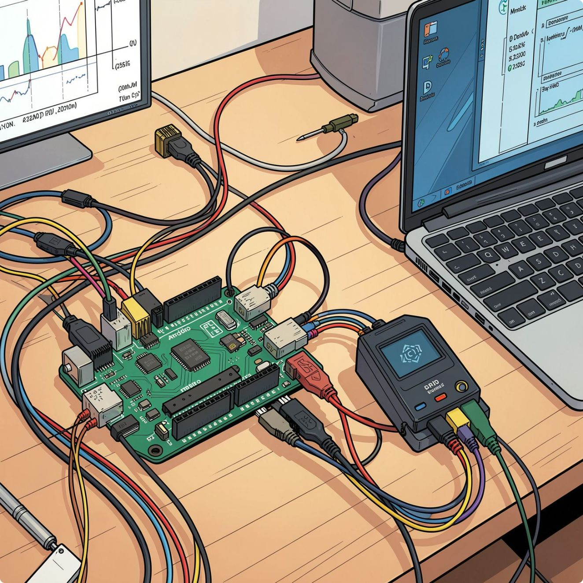
Methodology — Technical Workflow
01
1. Tap RFID Card
The student taps an RFID card on the reader to begin attendance capture.
02
2. Serial Signal Transmission
The reader sends the card data to the Arduino through a serial communication protocol.
03
3. Decode Unique ID
Arduino firmware reads the serial input, decodes the UID, and validates the card format.
04
4. Verify in Database
Arduino queries the attendance database to match the UID with the enrolled student record.
05
5. Record Attendance
The system stores timestamp, attendance status, and device metadata for the session.
06
6. Sync to Database
Attendance data syncs to the cloud or local database for reliable storage and backup.
07
7. Real-Time Dashboard
Faculty dashboards update live to show present/absent status and attendance summaries.
Arduino programs the RFID workflow by continuously listening on the serial port, parsing incoming UID packets, and handling database requests through an integrated communication layer. The database integration keeps student identity records synchronized with attendance logs so the dashboard can display accurate real-time results.

Slide 7

Flowchart — Decision Path
Arduino Reads ID
Extract unique card identifier
Reader Detects Signal
Capture card presence
Student Taps RFID Card
Present card at reader
Start
Begin attendance flow
The flowchart shows the RFID attendance decision path, with a clear enrollment check that branches to either attendance marking or admin alerting.

Slide 8



Applications & Advantages
Fast
Accurate
Schools and Colleges
Instant tap-based marking at scale.
Unique RFID IDs prevent errors.
Lecture attendance using instant tap-based marking.
Secure
Contactless
Encrypted data storage protects records.
No physical interaction required.
Universities
Lab and practical sessions with accurate attendance logging.
Cost-effective
Scalable
Low-cost RFID tags and Arduino keep deployment affordable.
Can handle multiple readers across locations.
Training Institutes
Course tracking for workshops and short-term programs.
Tamper-proof
Unique IDs cannot be duplicated.

Slide 9
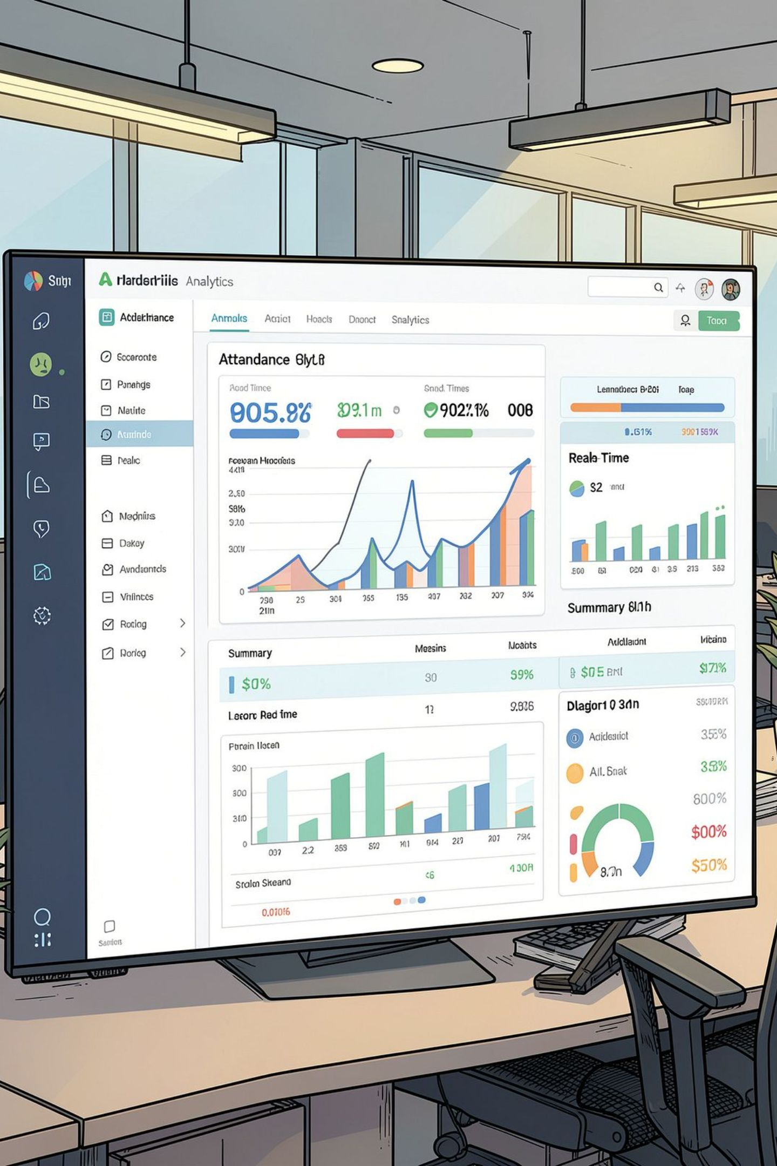
Conclusion & Future Scope
RFID-based attendance significantly improves efficiency and accuracy.
Modular Arduino design allows easy upgrades and integration with other systems.
Provides auditable, timestamped records for compliance and analytics.
Future Enhancements
Mobile app for attendance verification.
Cloud integration for multi-campus tracking.
Integration with biometric systems for enhanced security.
SMS/email notifications for parents.
Analytics dashboard for attendance patterns and insights.
Integration with fee/grade management systems.

Slide 10

References
Key sources consulted:
Arduino documentation and programming guides
RFID reader/tag specifications and datasheets
Serial communication protocols and hardware interface references
Database design principles for attendance and record management
IEEE papers on RFID-based attendance and identification systems
Python/C++ libraries for Arduino development and device integration
IoT and embedded systems research papers relevant to smart attendance
Student information system integration guides and deployment notes
For a full bibliography, datasheet references, and integration links, please refer to the project appendix shared with the review panel.
Prepared for B.Tech Major Design Review · KL University

