Slide 1
Automated Segmentation of resection zone in Brain MRI images

Slide 2
Approach
Total of 5690 brain MRI images from 37 epilepsy patients; many images contain surgically resected tissue (manually labeled)
Images were pre-processed to a proper file format and cropped to a common size
Keras running on Tensorflow backend in Google Colab
DenseNet CNN architecture to classify images containing and not containing resected tissue
Transfer learning: used starting weights from the ImageNet dataset, adapted architecture to a binary classification system
Trained with 10 epochs on ¾ of the dataset: achieved a loss of 0.0312 and accuracy of 0.9895 on training data
Tested on the remaining ¼ of the dataset: achieved an accuracy of 0.9768 on testing data

Slide 3
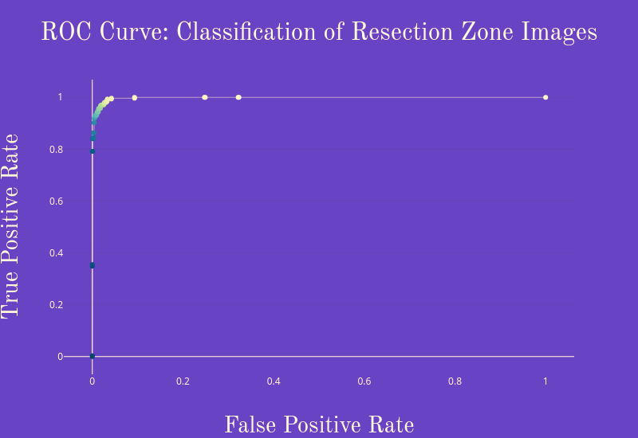
AUC: 0.9979

