Slide 1
DeepResection: segmentation of resections and ablations using neural networks

Slide 2
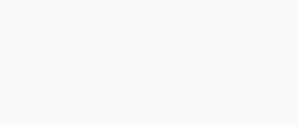
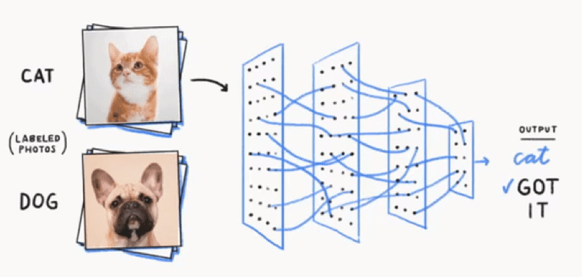
Neural networks for image classification
Notes:
https://medium.com/@tm2761/what-is-deep-learning-15b487adaaa3

Slide 3
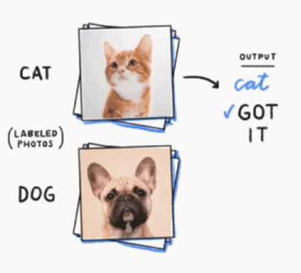
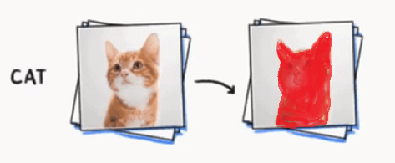
Neural networks for object detection
Problem 1: classify image
Problem 2: detect object in image
Notes:
https://medium.com/@tm2761/what-is-deep-learning-15b487adaaa3

Slide 4

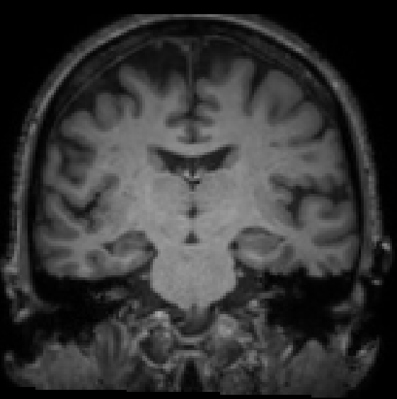
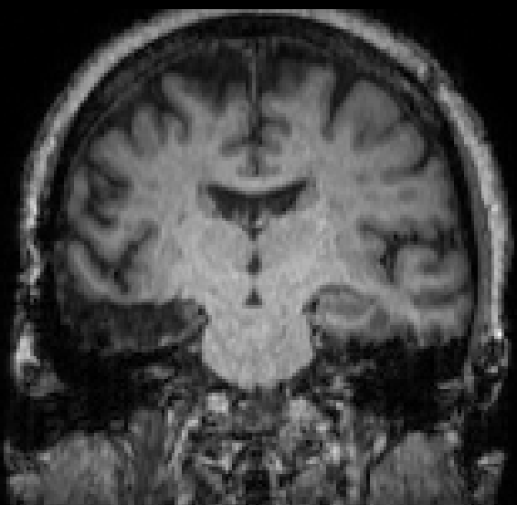
Segmentation in epilepsy
Pre Resection
Post Resection

Slide 5
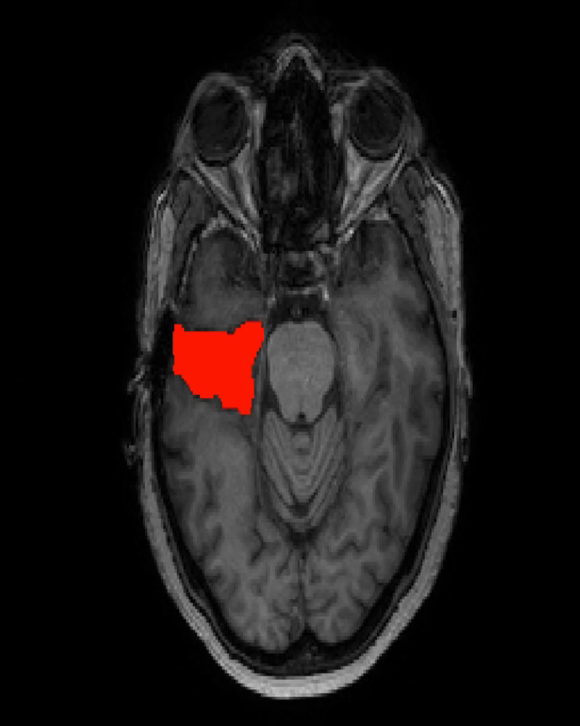
Labeled data
37 subjects total
23 Training
7 Testing
7 Validation
Notes:
79 resection images

Slide 6
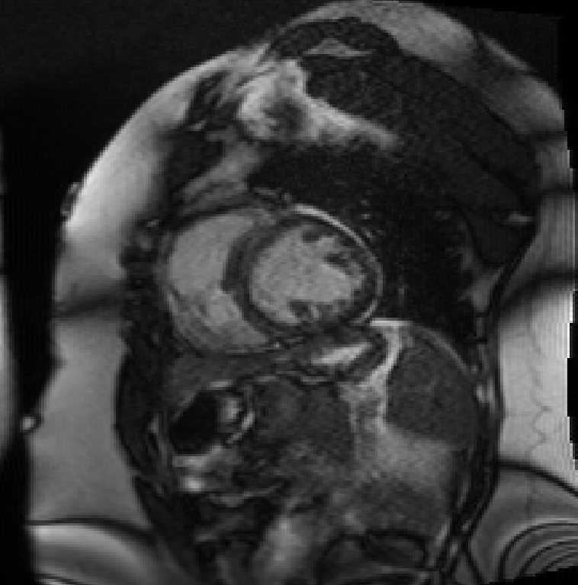
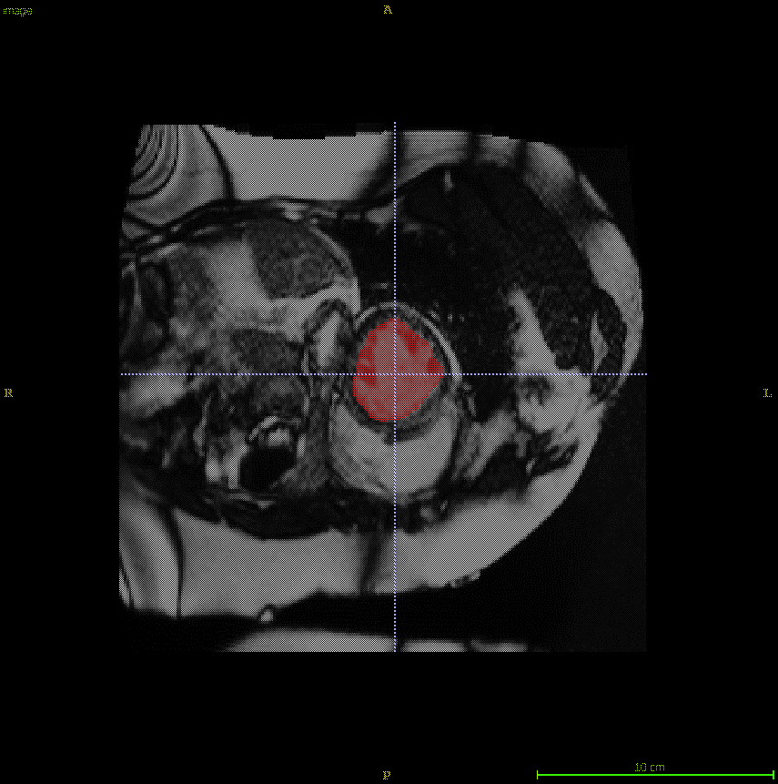
UNets: Deep learning for cardiac imaging
image frame
224x224x32
224x224x32
Labeled Frame
112x112x64
112x112x64
56x56x128
56x56x128
3x3
28x28x64
14x14x128
28x28x64
Convolution + ReLu Layer
Deconvolution + Concatenation Layer
Pooling Layer
¹Ronneberger, et al. MICCAI. 2015:9351:234-4!
Notes:
End-to-end
Large number of operators
Input Image
Data is estimated through the
Pixel channels, Feature channels
Standard 3x3 convolution followed by activation

Slide 7
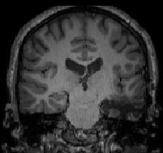
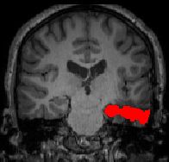
256x256x1
256x256
Input image
128x128
128x128
Segmented
64x64
64x64
2x2
32x32
16x16
32x32
64
72
64
32
32
16
16
8
8
Convolution + ReLu Layer
Deconvolution + Concatenation Layer
Pooling Layer
Adapted from Ronneberger, et al. MICCAI. 2015

Slide 8
U-Net Architecture
16x16x72
32x32x64
32x32x128
64x64x32
64x64x64
128x128x16
128x128x32
256x256x8
256x256x16
256x256x1
Convolution + ReLu Layer
Upsampled Convolution + ReLu Layer
Sigmoid Layer
Normalization Layer
Normalization Layer
Merged Layers

Slide 9
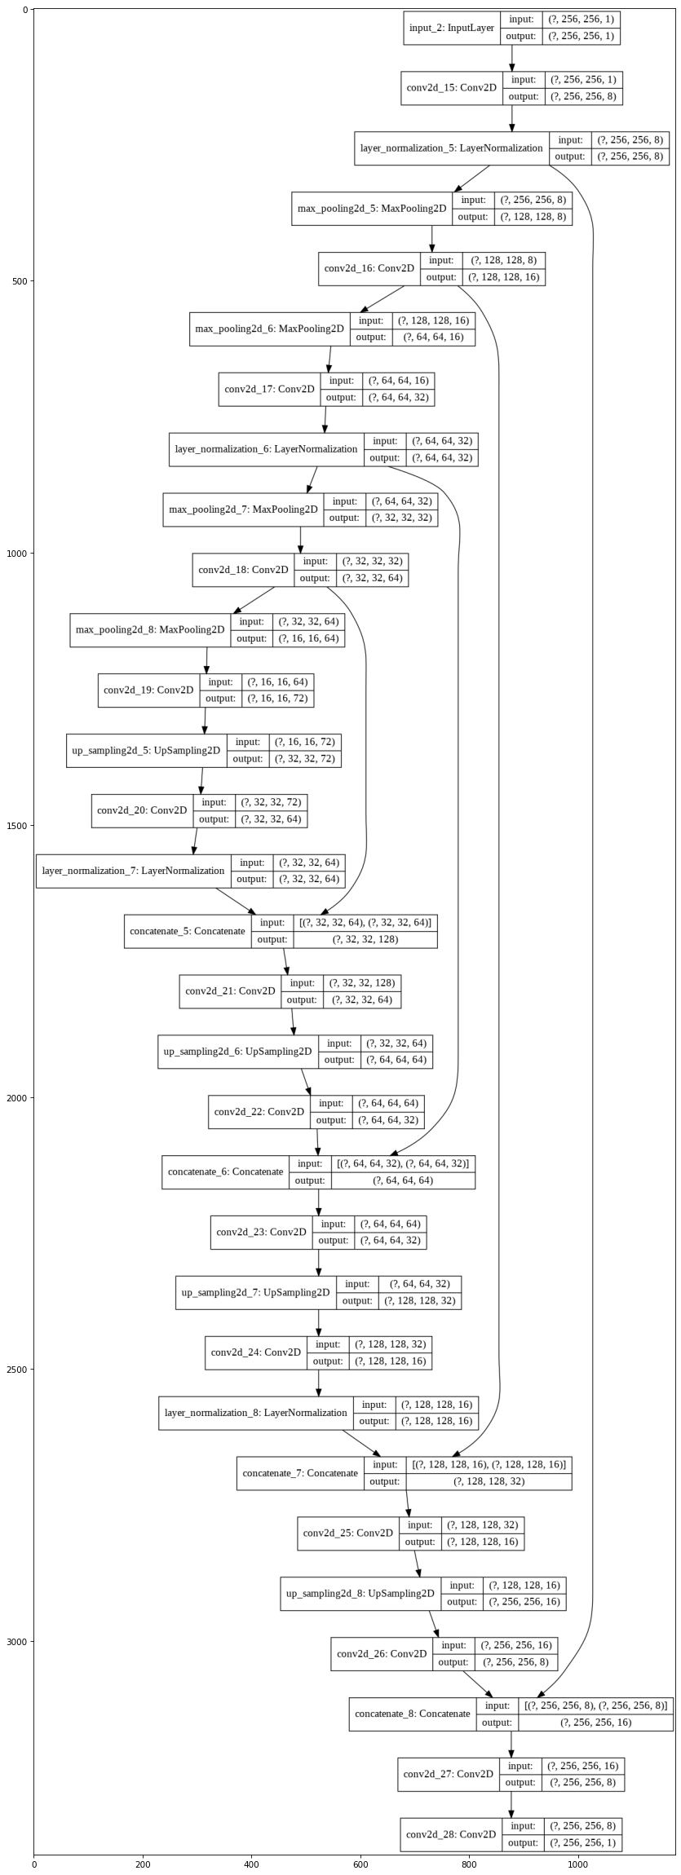
Model Architecture

Slide 10
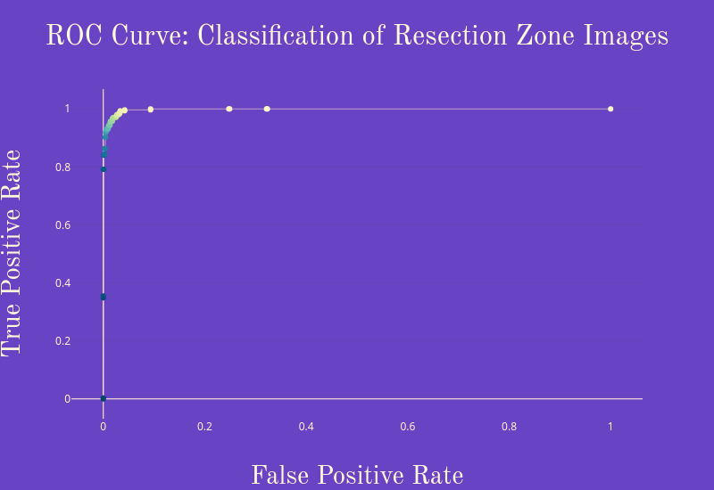
Approach
Total of 5690 brain MRI images from 37 epilepsy patients
pre-processed (DICOM -> PNG, padded)
Keras running on Tensorflow backend in Google Colab
Binary DenseNet CNN architecture (resection versus no resection)
Transfer learning: ImageNet starting weights
Trained with 10 epochs on ¾ of the dataset: loss of 0.0312, accuracy of 0.9895
Tested on the remaining ¼ of the dataset: accuracy of 0.9768

Slide 11
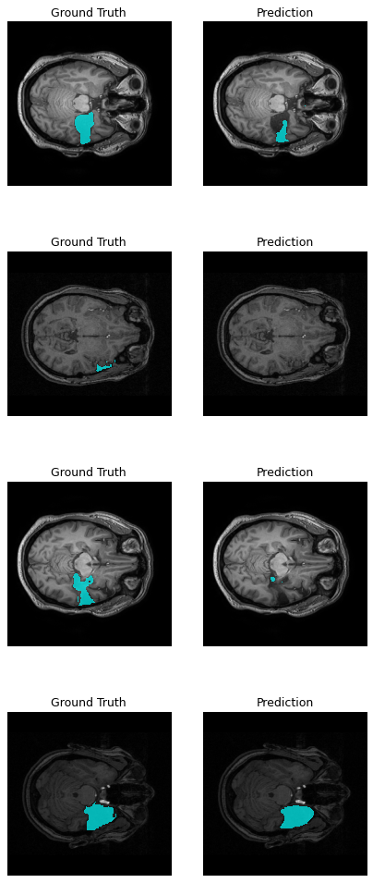
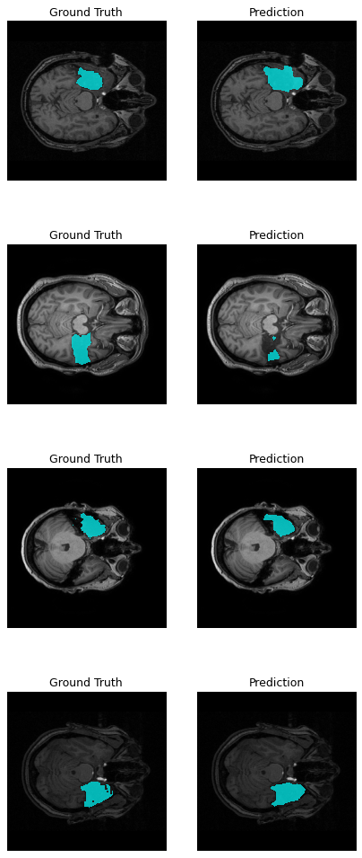
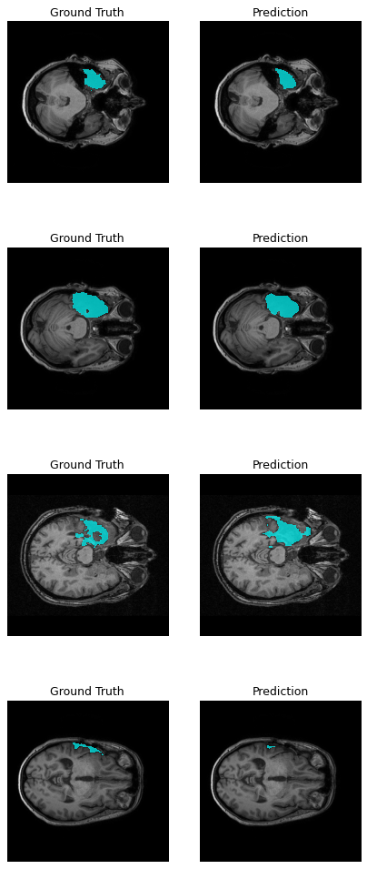
DSC = 0.64

Slide 12
DSC = 0.64

Slide 13
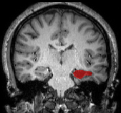
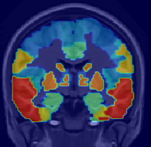

Proposed Analysis Pipeline
User Input
Algorithm
Output
Pre-op Image
1. Register pre to post
3. Segment post RZ
User Input
Algorithm
Output
Pre-op Image
1. Register pre to post
3. Segment post RZ
5. Calculate volumes
Resected Regions
92% right hipp.
0% left hipp.
0% left ACC
Resection Volume
2cm²
vs
…
2. Apply atlas to pre
4. Mask RZ from atlas
Post-op Image
Post-op Image
2. Apply atlas to pre
4. Mask RZ from atlas
Resected Regions
92% right hippocampus
0% left hippocampus
0% left ACC
…
5. Calculate volumes
Notes:
Overall analysis pipeline

