Slide 1
DeepResection Web Interface
AKASH PATTNAIK
3 FEBRUARY 2021

Slide 2
Goal: To have a user-friendly web interface for clinicians to interact with.
The resection segmentation pipeline (not including the pre-operative to post-operative registration) takes 4.5 minutes.
Built using Flask, SQLite

Slide 3
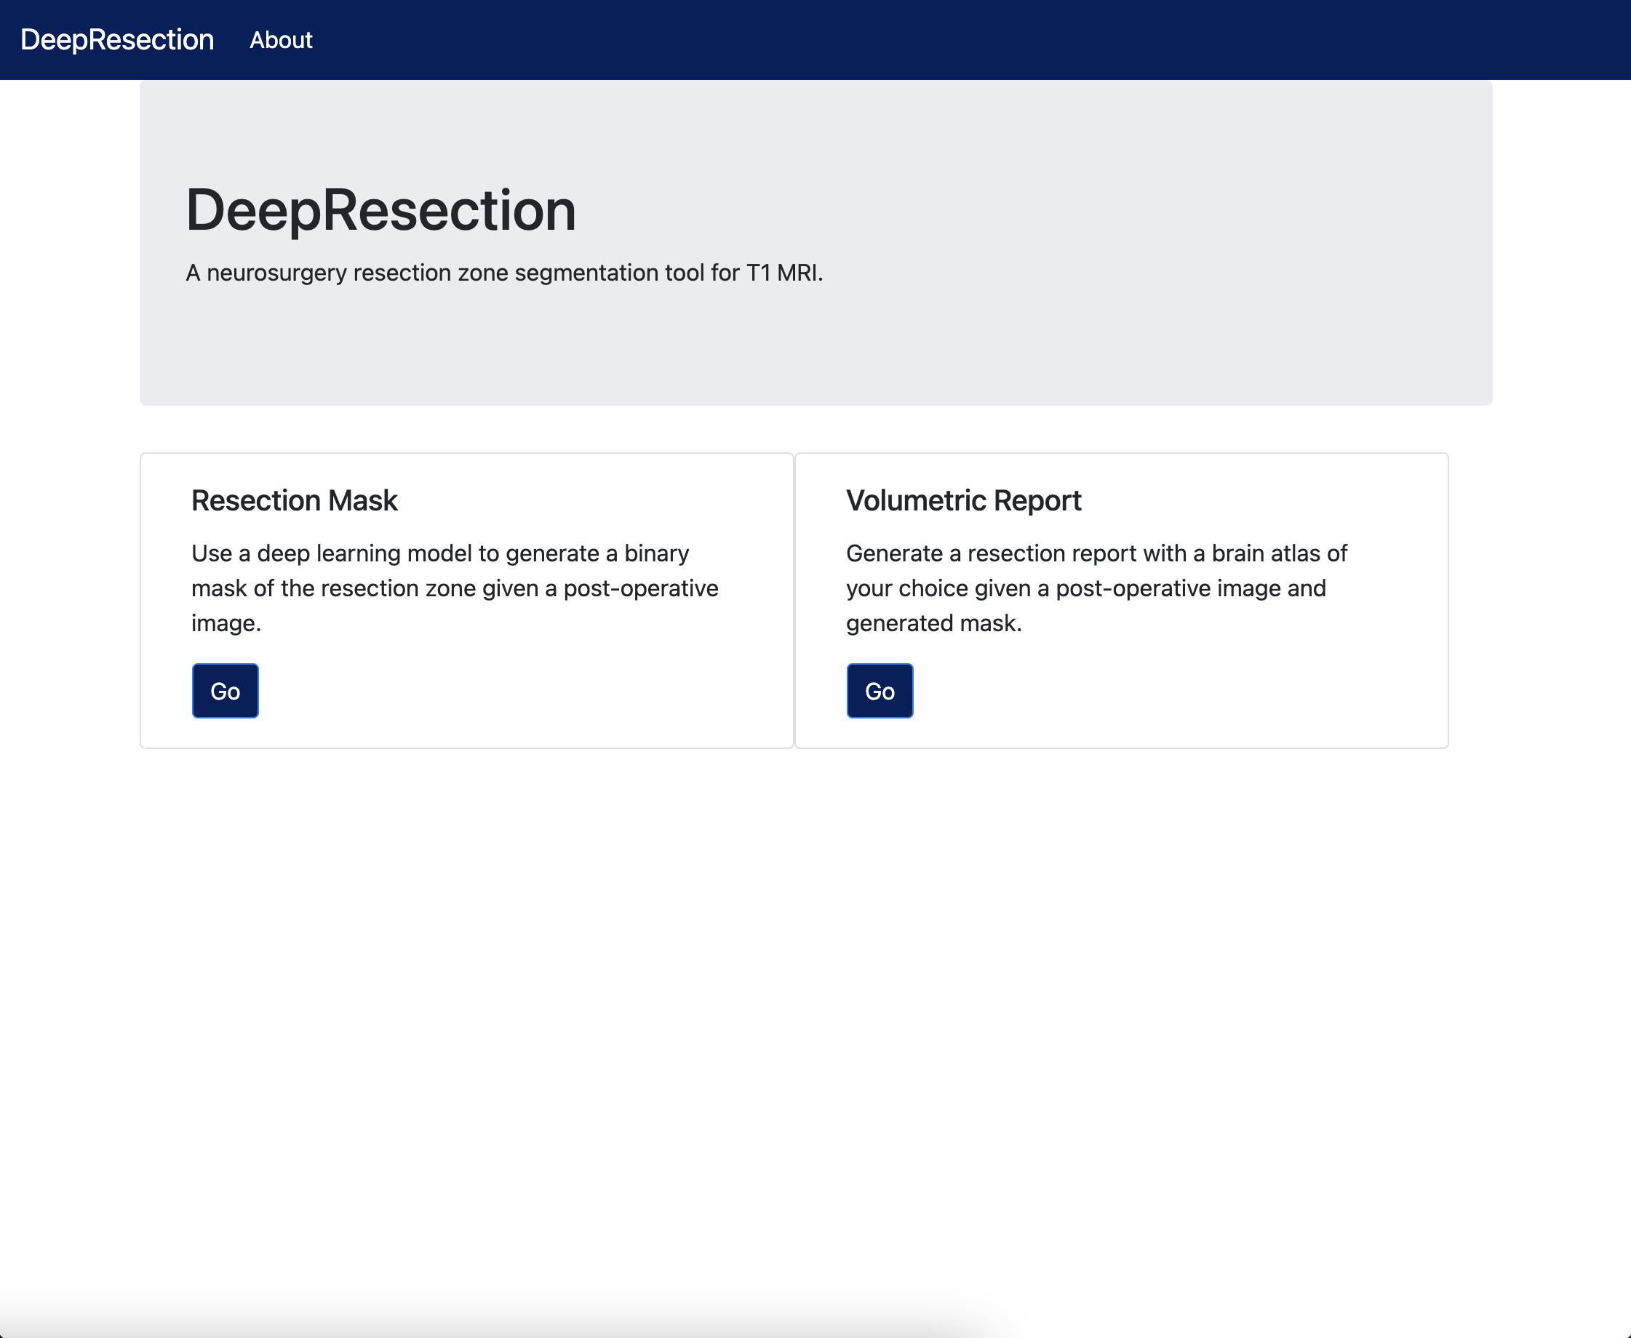

Slide 4
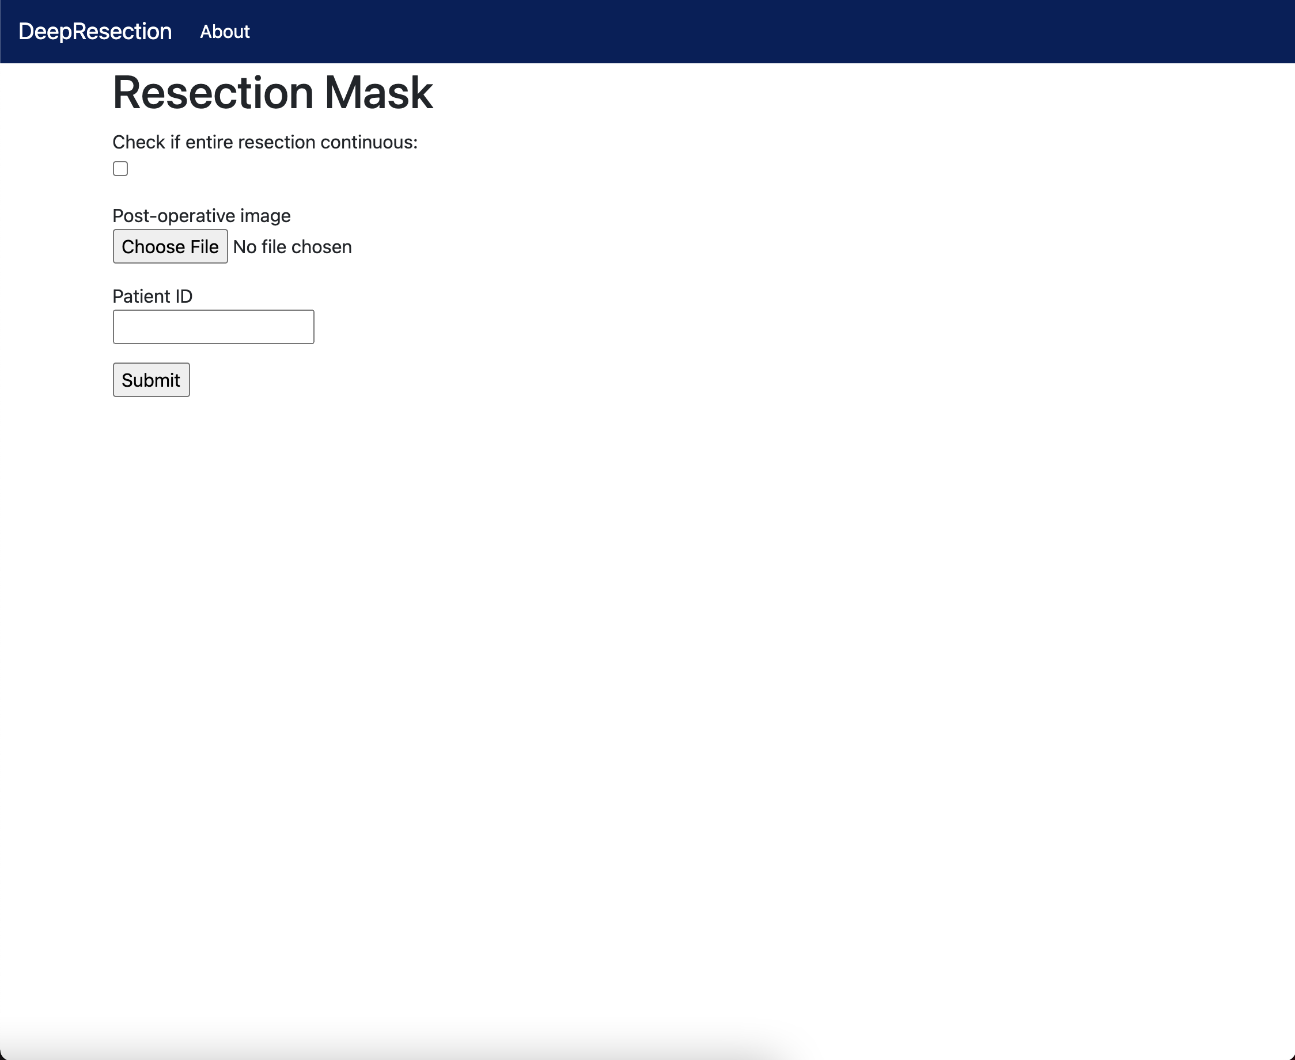

Slide 5
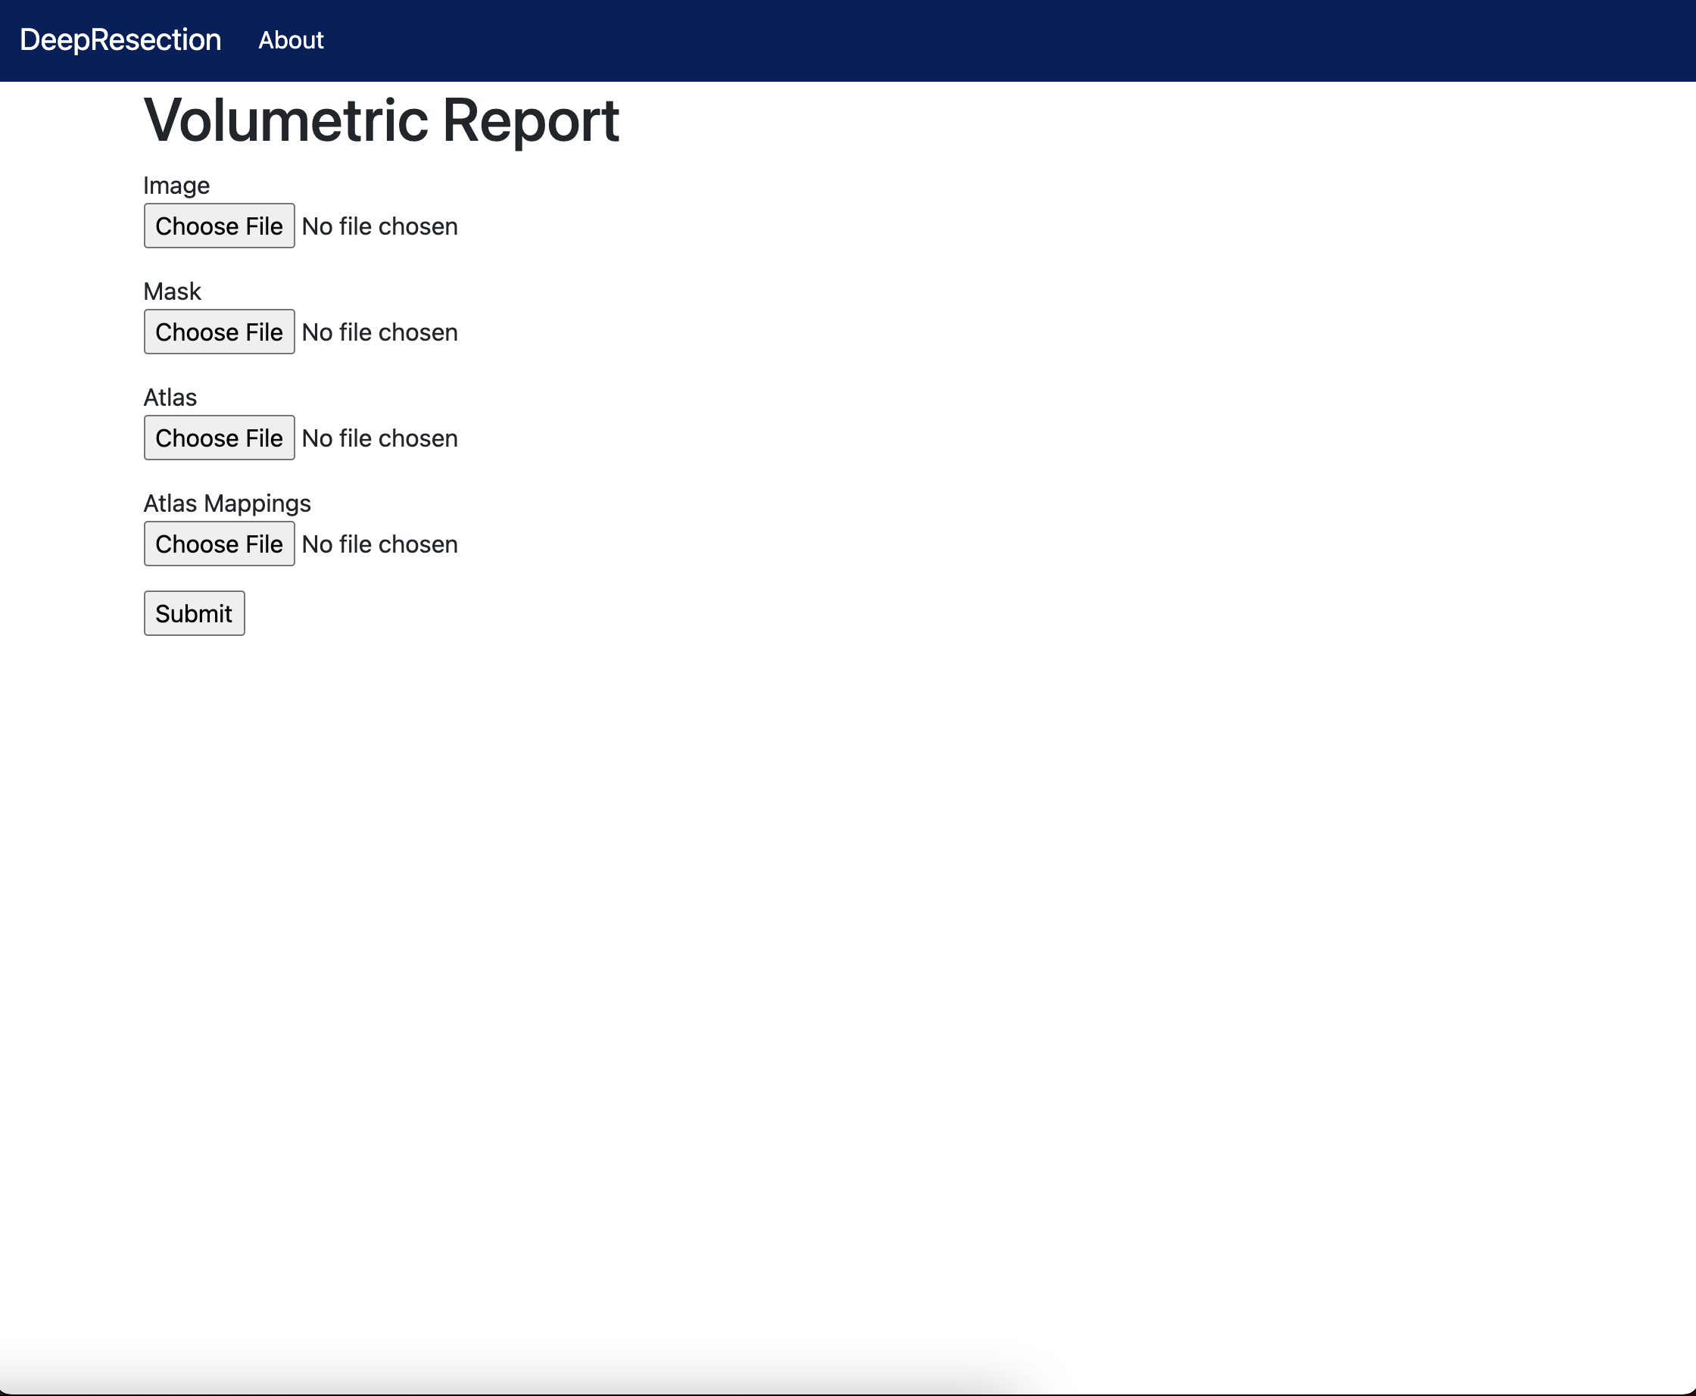

Slide 6
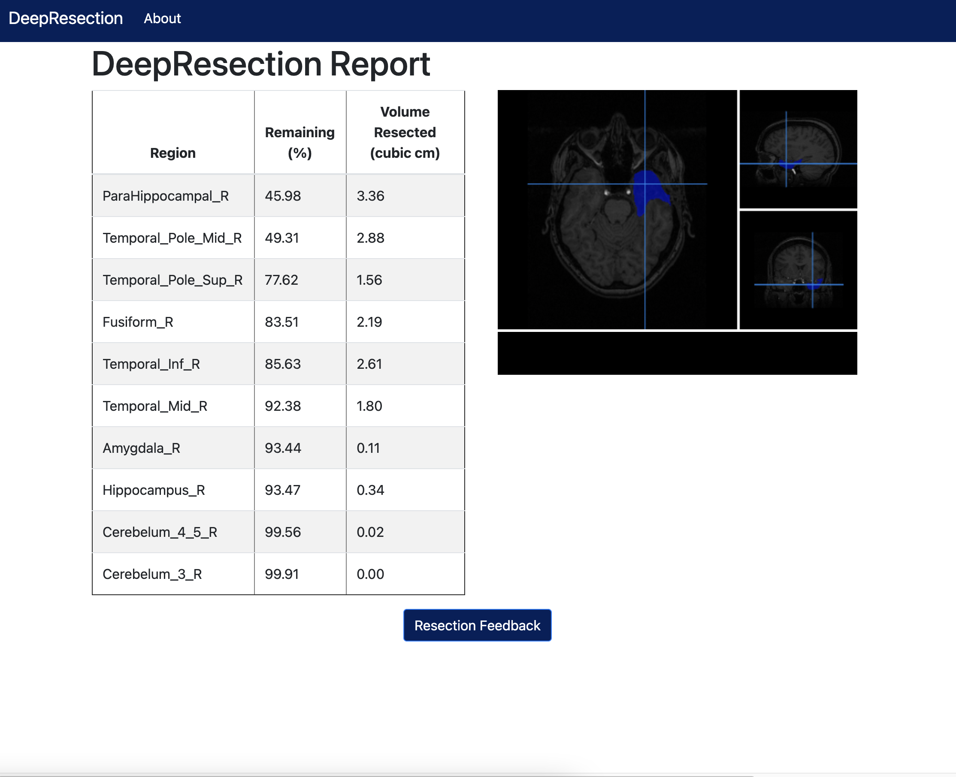

Slide 7
Live Demo of Report Page

Slide 8
Future work
Option to save report as a PDF file
Building in other atlases (currently, only AAL-116)
Integrate with cloud file storage system

