Slide 1
Cutting Deep: segmentation of resections and ablations using neural networks

Slide 2

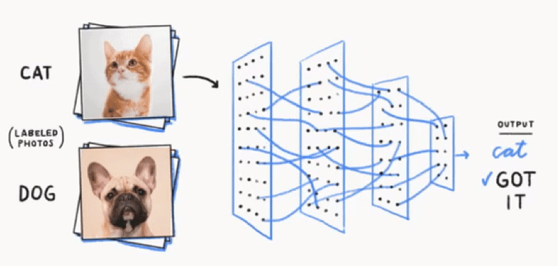
Neural networks for image classification
Notes:
https://medium.com/@tm2761/what-is-deep-learning-15b487adaaa3

Slide 3
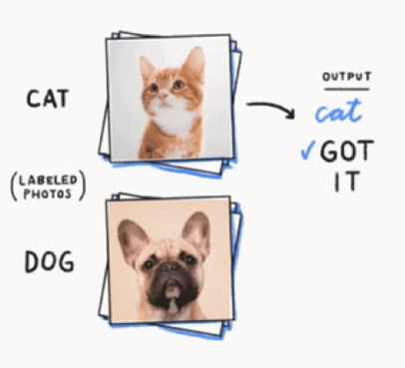
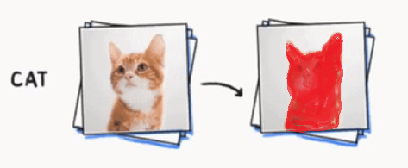
Neural networks for object detection
Problem 1: classify image
Problem 2: detect object in image
Notes:
https://medium.com/@tm2761/what-is-deep-learning-15b487adaaa3

Slide 4
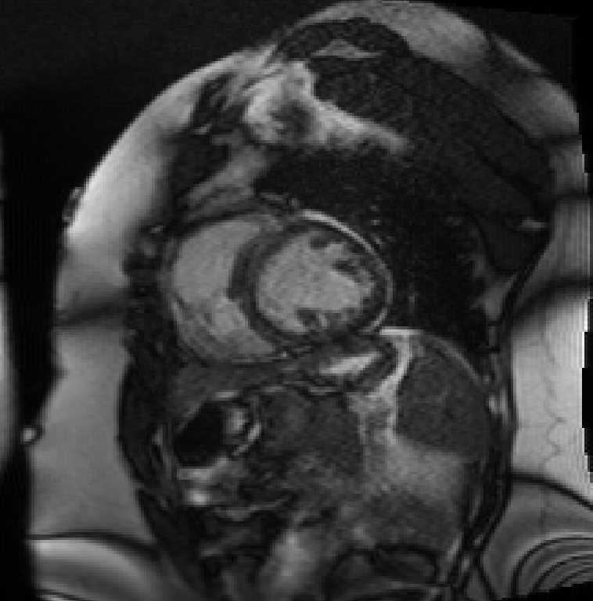
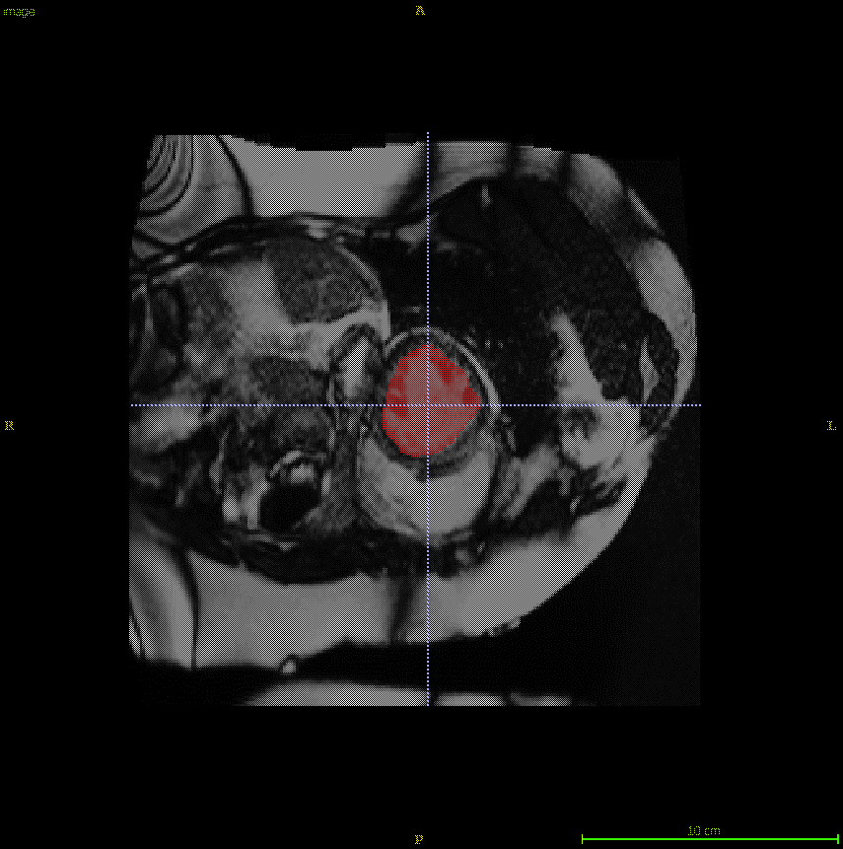
UNets: Deep learning for cardiac imaging
image frame
224x224x32
224x224x32
Labeled Frame
112x112x64
112x112x64
56x56x128
56x56x128
3x3
28x28x64
14x14x128
28x28x64
Convolution + ReLu Layer
Deconvolution + Concatenation Layer
Pooling Layer
¹Ronneberger, et al. MICCAI. 2015:9351:234-4!
Notes:
End-to-end
Large number of operators
Input Image
Data is estimated through the
Pixel channels, Feature channels
Standard 3x3 convolution followed by activation

Slide 5
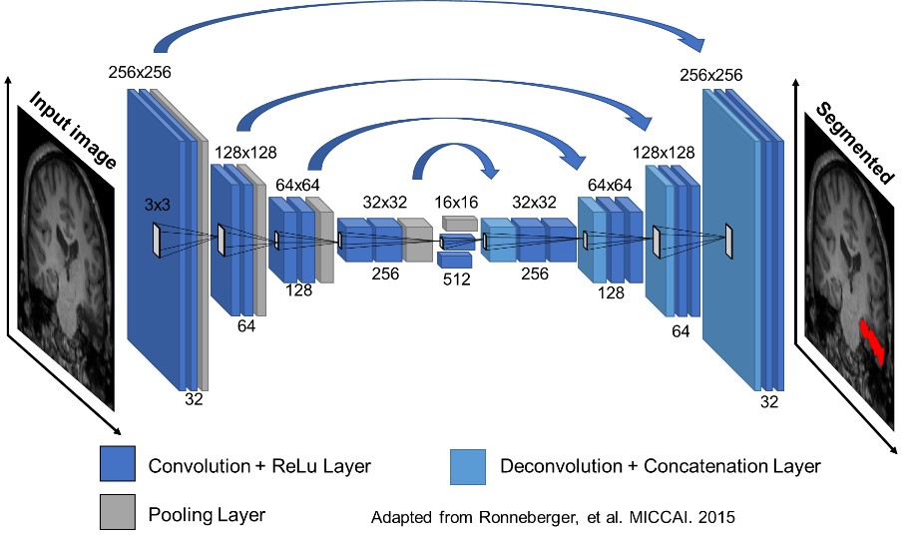

Slide 6

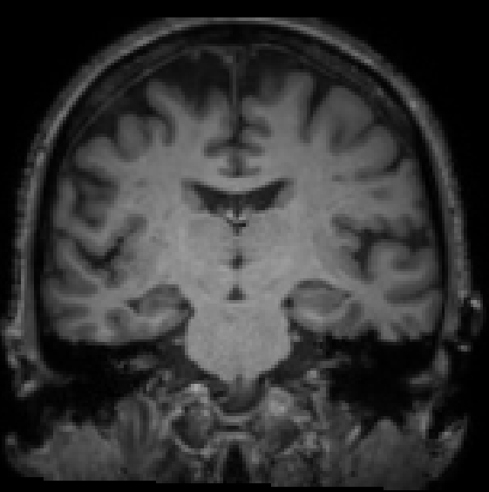
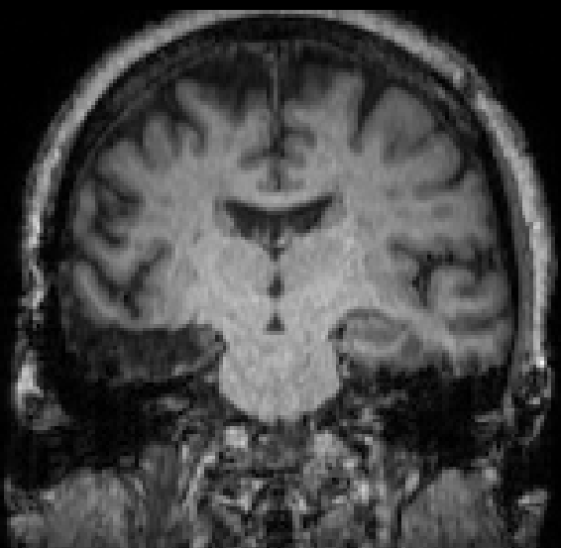
Segmentation in epilepsy
Pre Resection
Post Resection

Slide 7
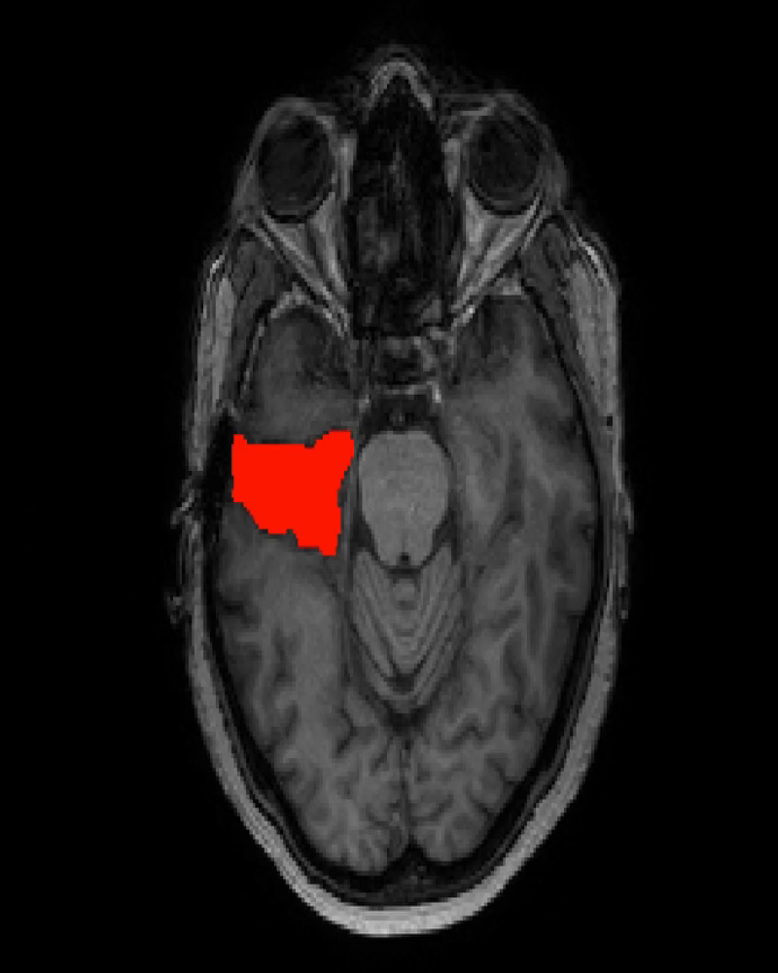
Labeled data
23 Resections/Ablations from VU
15 HUP – Ablation
38 HUP – Resection
Can generate additional data using itksnap
Working on automated pipeline
Clinical review of resections available “ground truth”
Notes:
79 resection images

Slide 8
= ?
Notes:
79 resection images

