Slide 1
fMRI Language Testing

Slide 2
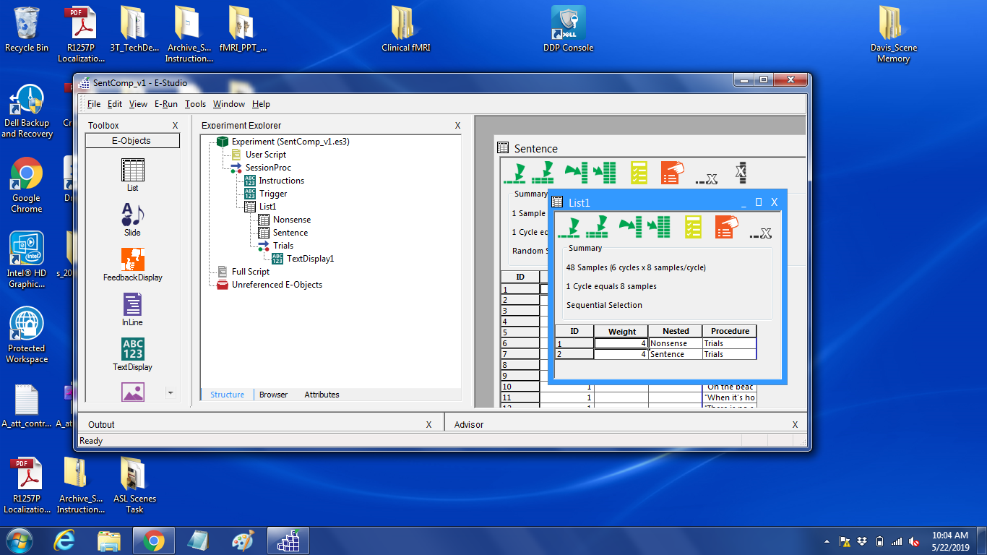

Slide 3
Task 1:
Fill in the blank ____

Slide 4
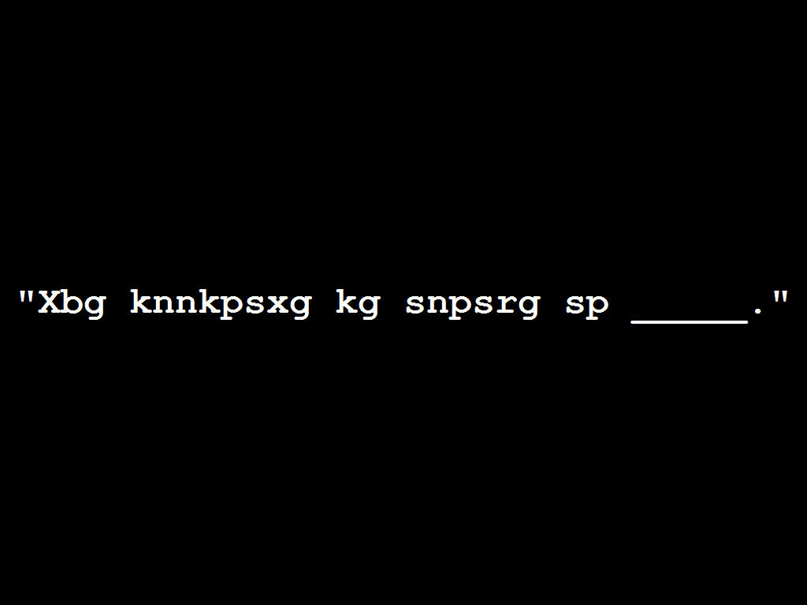

Slide 5
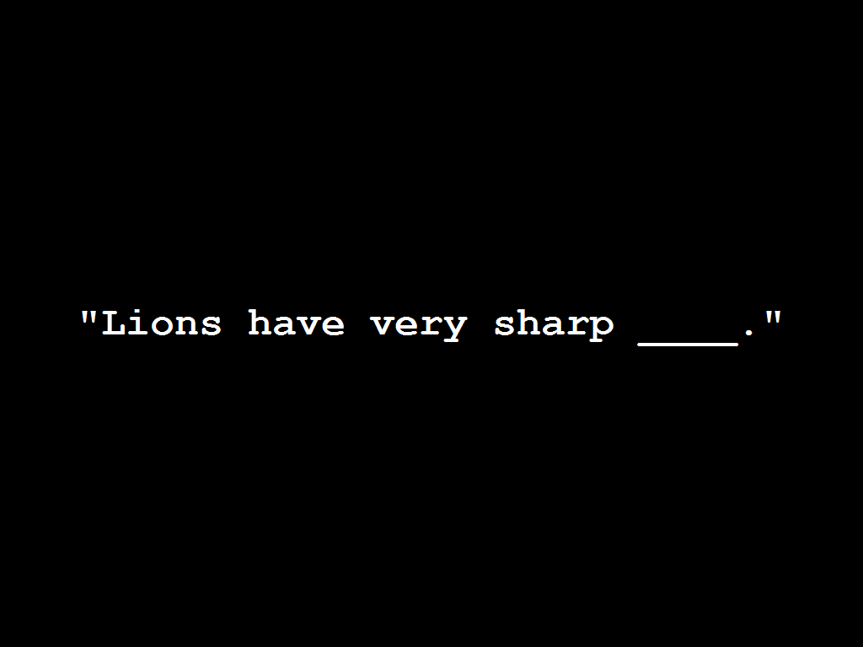

Slide 6
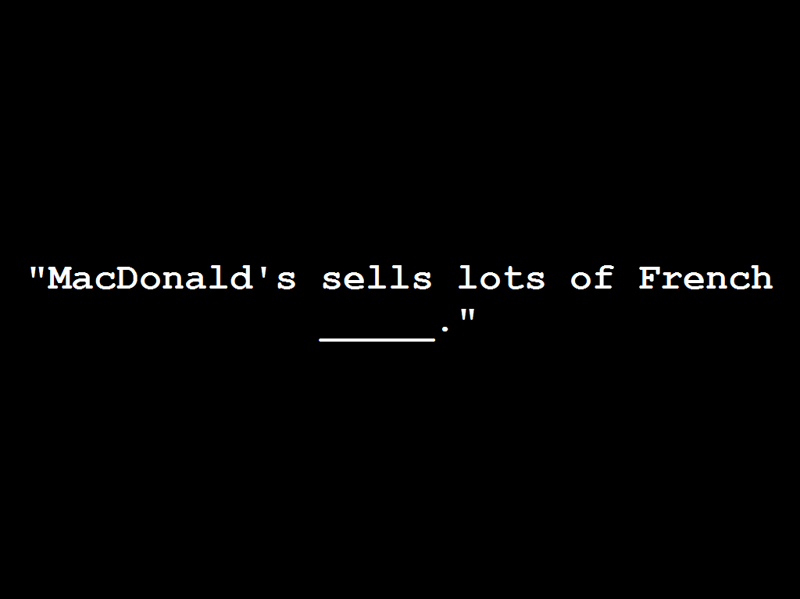

Slide 8
Task 2:
Thinking of words

Slide 9


Slide 10


Slide 11


Slide 12


Slide 14
Task 3:
Patterns / Rhyming

Slide 15


Slide 16


Slide 17


Slide 18
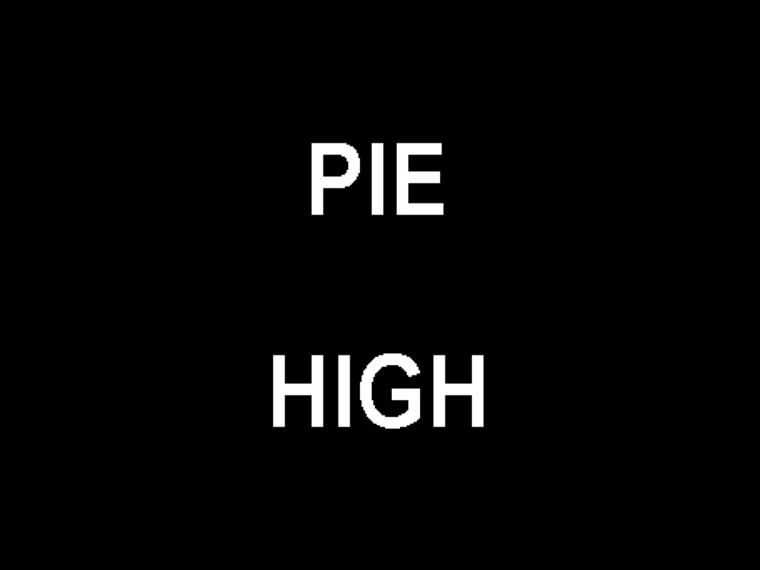

Slide 19
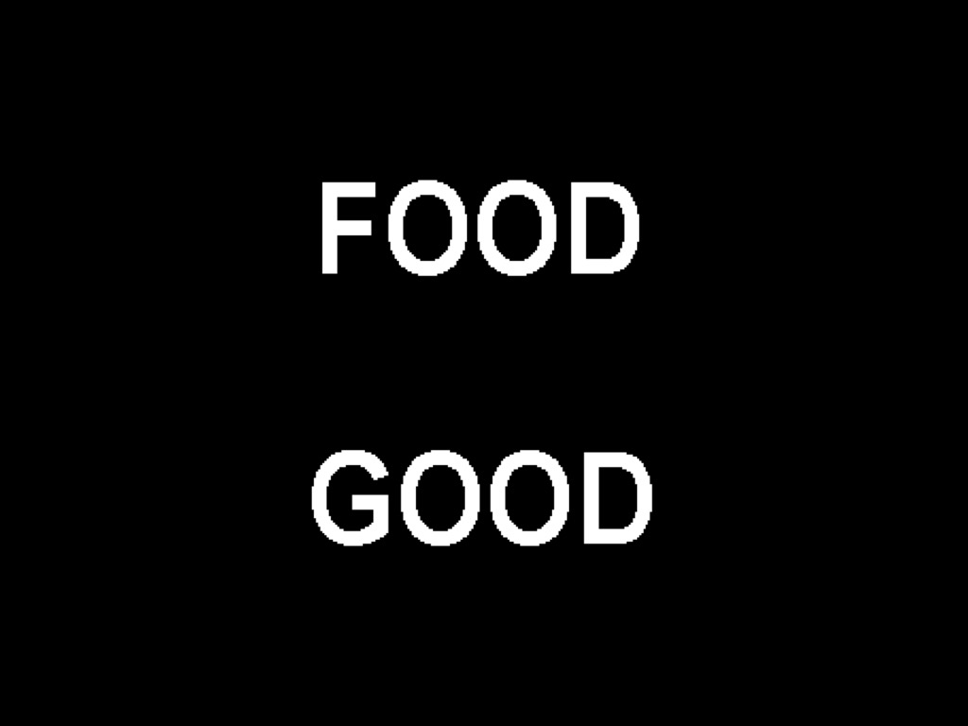

Slide 20
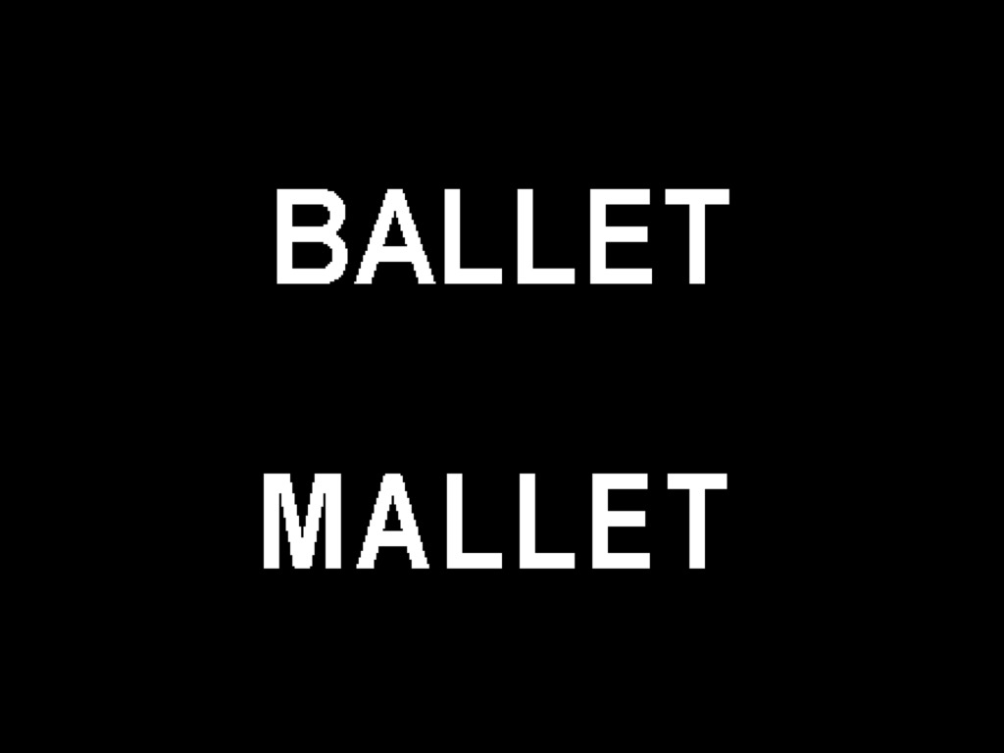

Slide 22
Task 4:
Think of what the image is
(use complete sentences)

Slide 23
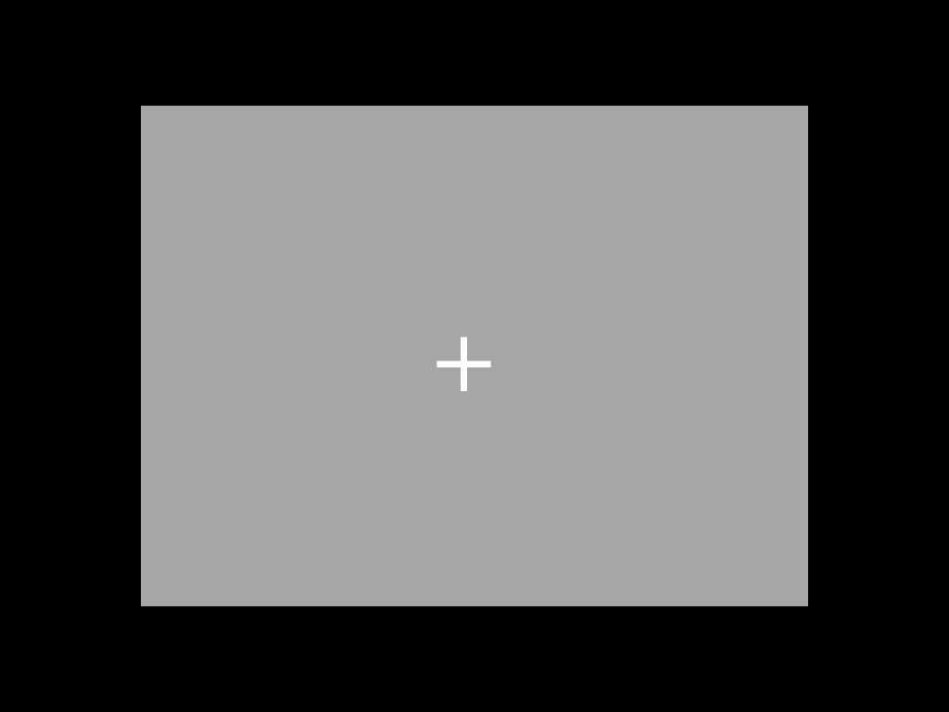

Slide 24
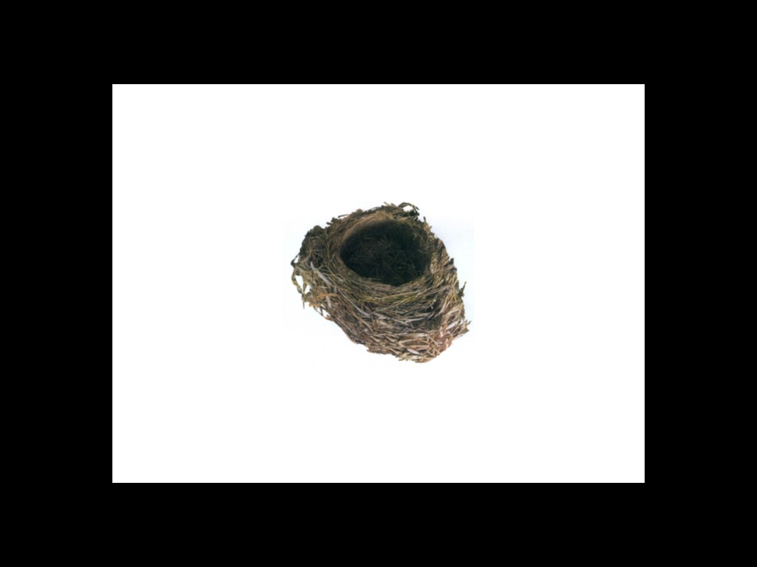

Slide 25
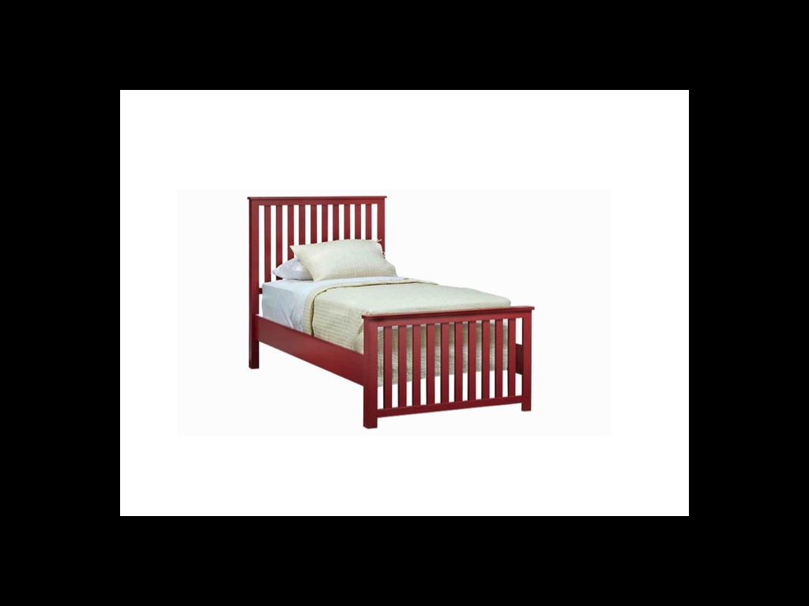

Slide 27
Task 5:
X vs T / Meaningful?

Slide 28
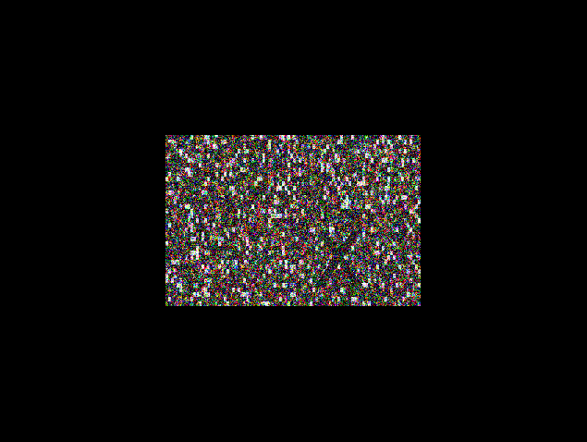

Slide 29
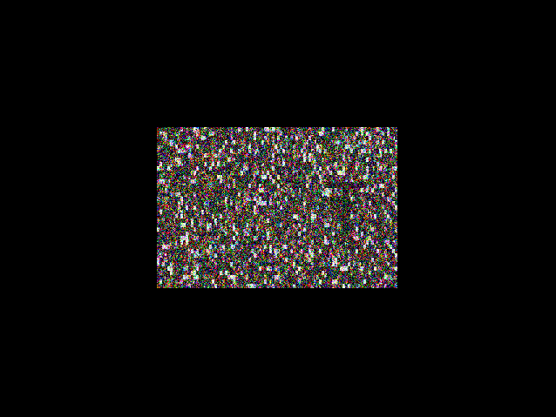

Slide 30
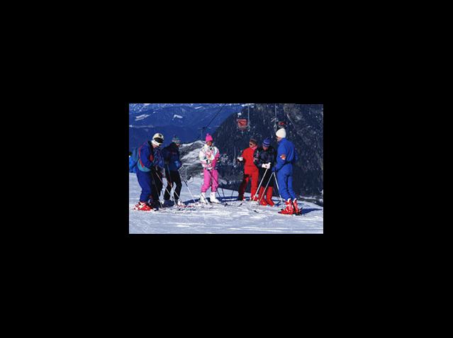

Slide 31
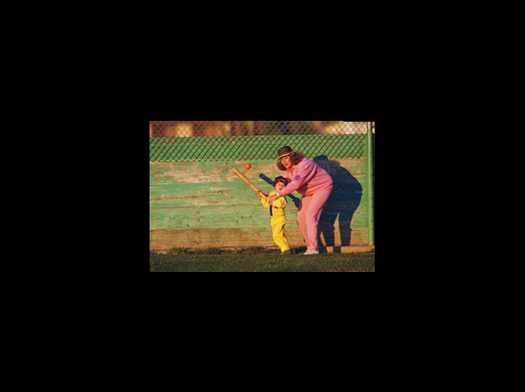

Slide 33
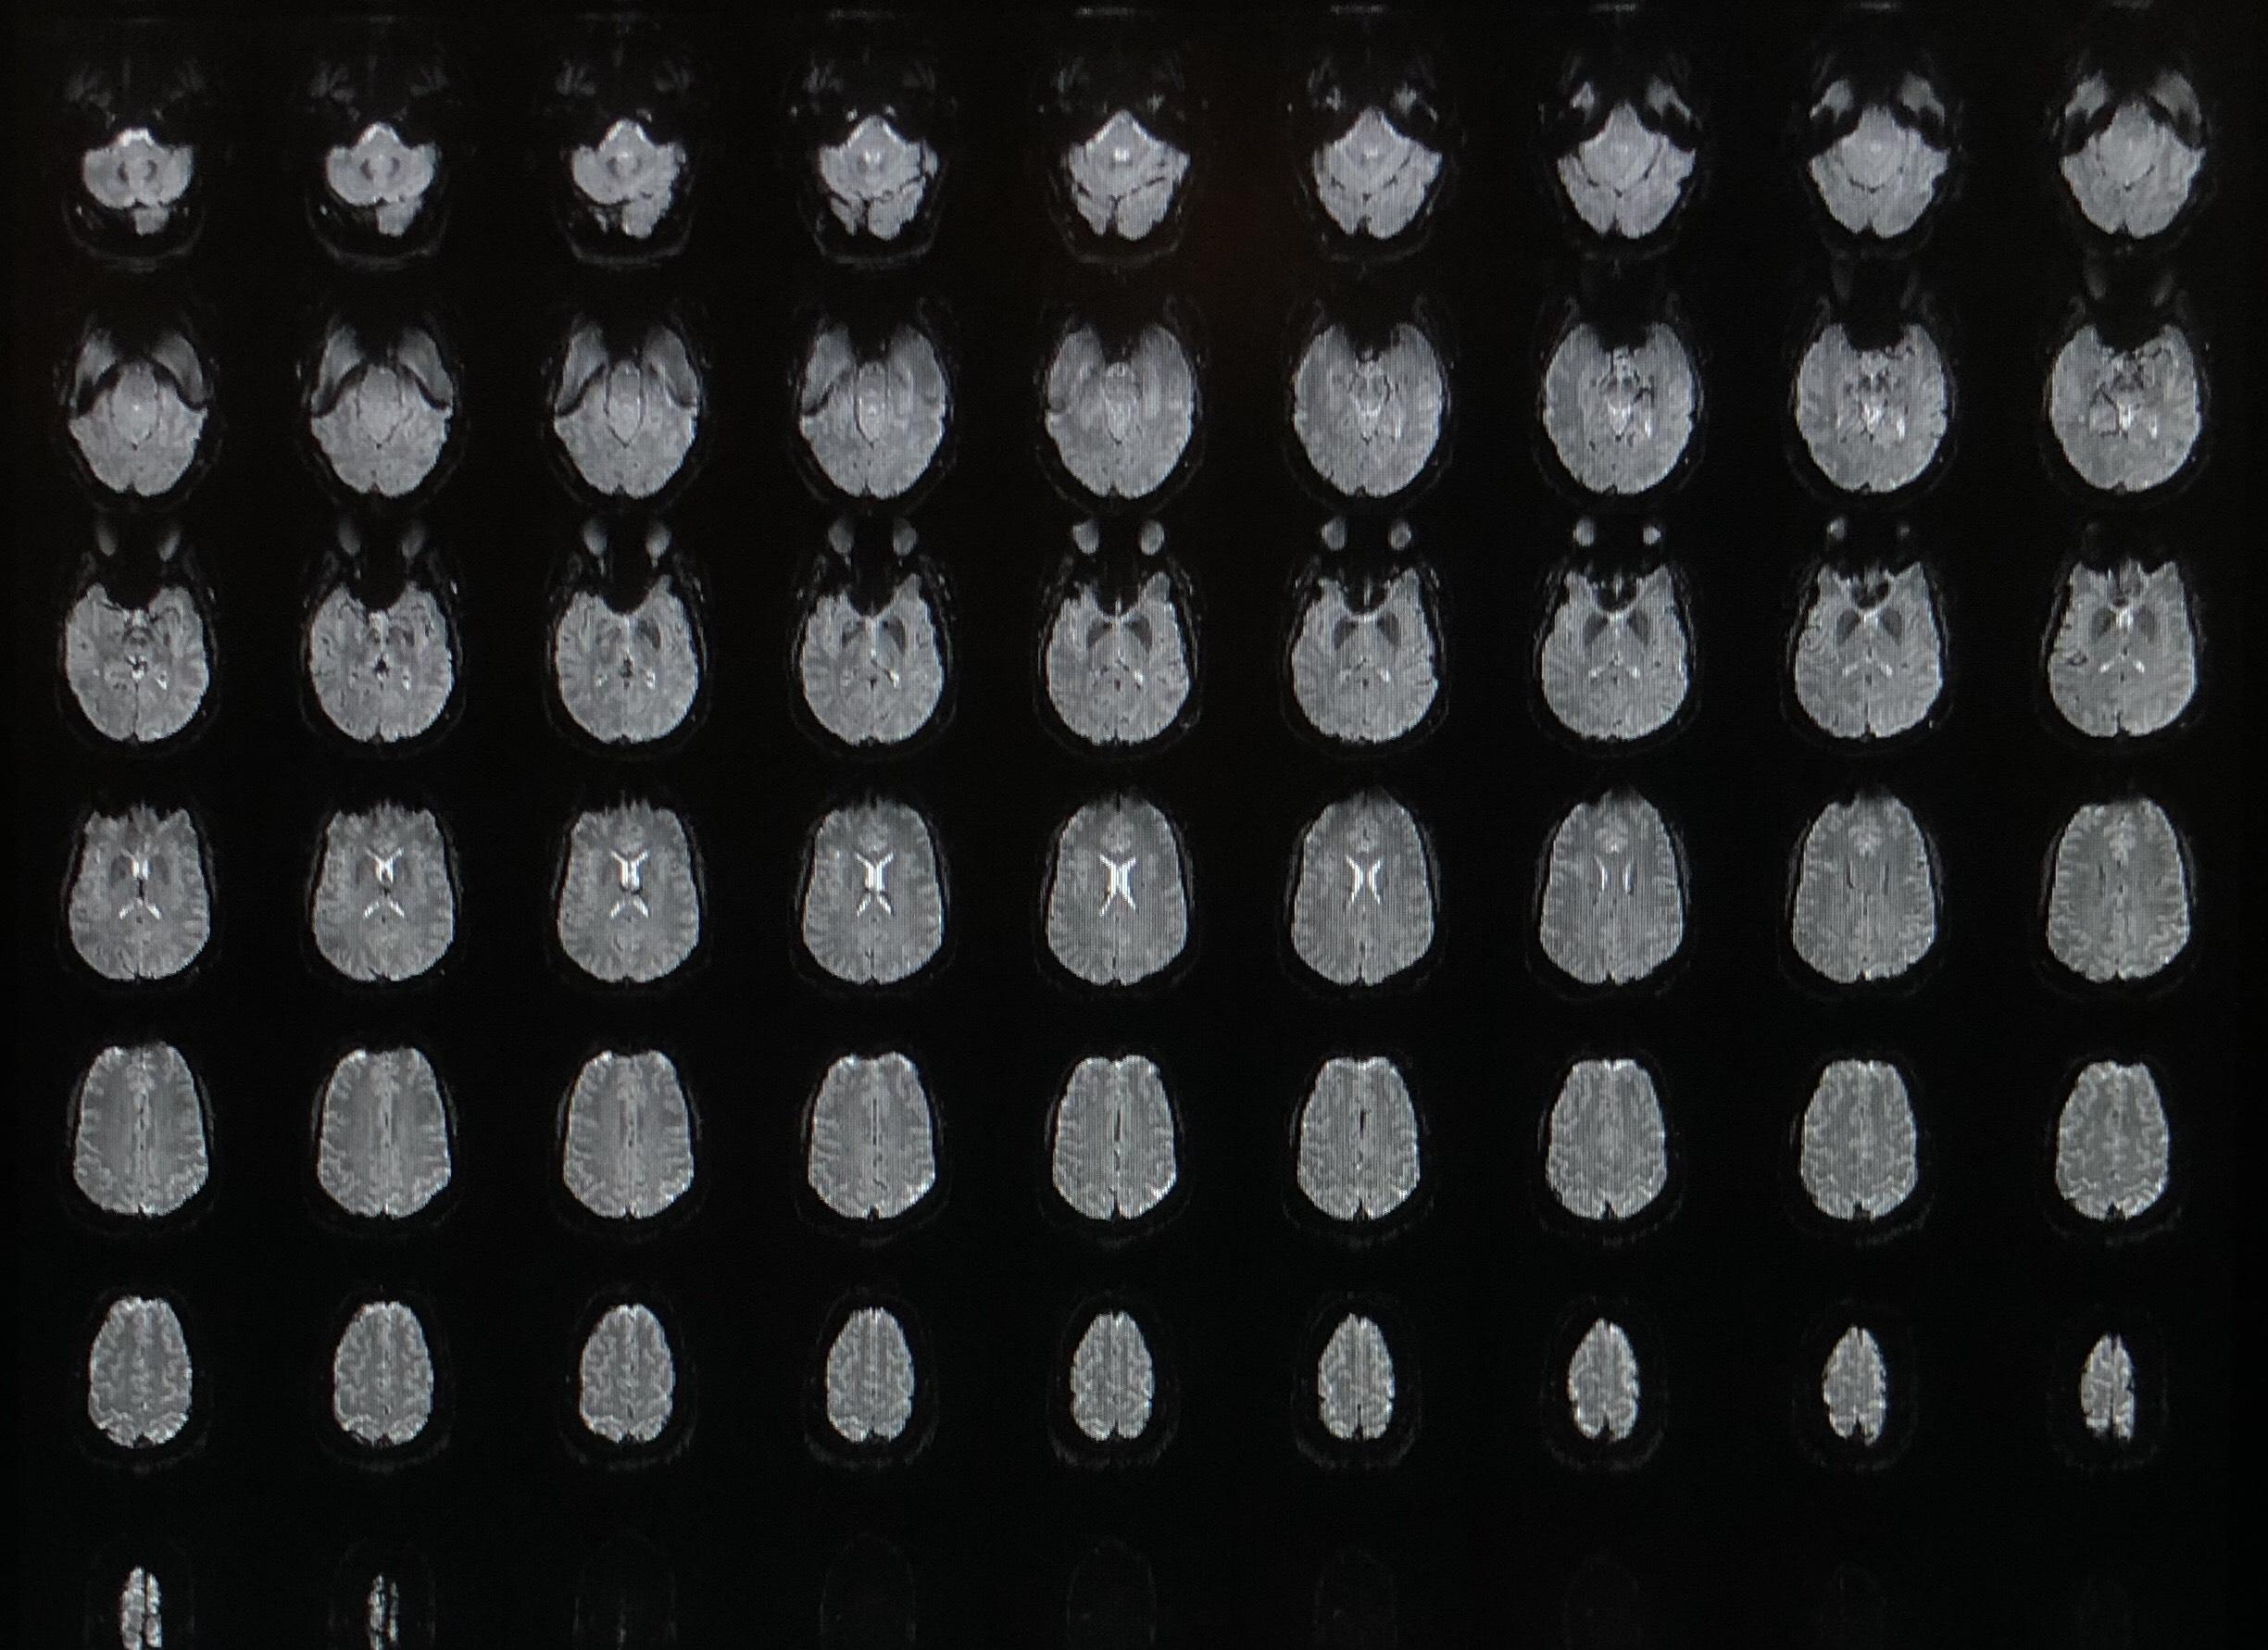

Slide 34
