Slide 1
Human Subjects Protections
Research involving human subjects and data
Requires IRB approval
  IRB protocols defines study activities involving Human Subjects and the study team allowed to do those activities
  Survey form to be added to protocols: https://redcap.link/CNTIRBpersonnelrequestform
Training – email PDF certificates to Carolyn: *part of the survey form
  HIPAA (personal health information protections)
    Knowledgelink: Protecting Patient Information (HIPAA) (COURSE HS.30006.ITEM.HIPAA_Y19)
  CITI (human research protections)
    Citiprogram.org (requires a PennKey and PennID number): Biomedical Basic Course
HIPAA Security Rule

Slide 2
What is PHI?
(Protected Health Information)

Slide 3
18 HIPAA Identifiers – direct identifiers
Name
Address (all geographic subdivisions smaller than state, including street address, city county, and zip code)
All elements of dates (except year) for dates directly related to an individual, including birth date, admission date, discharge date, date of death; and all ages over 89 and all elements of dates (including year) indicative of such age, except that such ages and elements may be aggregated into a single category of age 90 or older
Telephone numbers
Fax number
Email address
Social Security Number
Medical record number
Health plan beneficiary number
Account number
Certificate or license number
Vehicle identifiers and serial numbers, including license plate numbers
Device identifiers and serial numbers
Web URL
Internet Protocol (IP) Address
Biometric identifiers, including finger and voice prints
Full-face photographs and any comparable images
Any other characteristic that could uniquely identify the individual

Slide 4
Datasets are ____ if they contain _____ .
Fully Identifiable => Any 1 of the 18 HIPAA identifiers are included
Limited => Dates, city/town, state or zip code
Anonymized => All identifiers removed

Slide 5
CNT Data
EEG
  Clinical data used secondarily for research: Intracranial and scalp data
  Bedside patient testing EEG clips
Imaging
  Clinical data used secondarily for research: MRI, CT, PET
  Research MRI: 3T and 7T
Clinical metadata
  Manual extraction from EMR
  Data Analytics Center (DAC) data queries of EMR
Device (Vitale Lab)
  Animal Data
  Human Data

Slide 6
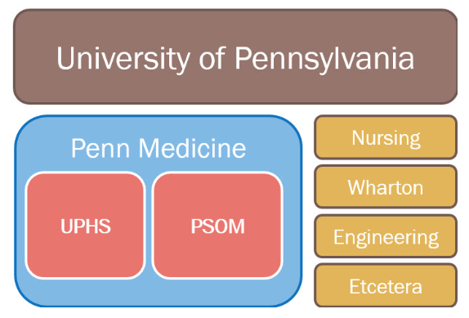
Penn Medicine is our Covered Entity
Where PHI is allowed
CNT
Penn+Box
Neurology
DAC
SEAS
CETS
Radiology
Borel
BSC
Neurosurgery
PNMR
PMACS – cnt1, cnt-fs
Pioneer
GoogleDrive
PennChart
ieeg.org
REDCap
PHI allowed here
De-identified data
allowed here
https://www.med.upenn.edu/dac/irb-compliance.html

Slide 7
CNT Computing Networks
Where and how to access data

Slide 8
CNT Computing Schematic
Outside of Penn
Penn
No PHI allowed
PHI allowed
Only anonymized data can be shared without DUA
DUA needed for limited datasets and datasets containing PHI
Natus Review
UPHS Computer
UPHS/
PennMed
Network
Penn Medicine IS Services – BIG-IP Edge VPN Client
BSC Cluster
cnt1
REDCap
PMACS/
DART
(PSOM)
Network
cnt-fs
PMACS/DART – CNT VDI Interface
Borel
Pioneer
PennNet Network
SEAS CETS –
UPenn ISC VPN
Global Protect
IEEG.org
NODDI
AWS
Surgrec - Reconstructions

Slide 9
Account Access Cheat Sheet
UPHS Username/Password
PennKey Username/Password
PMACS Username/Password
PennMedAccess
PennMedicine Email
PennChart
UPHS VPN (Big-IP Edge Client)
University ISC VPN – GlobalProtect (PennKey Password)
Borel (SEAS local password)
Habitat (Habitat password)
Knowledgelink (PennKey Password)
REDCap (PMACS Password)
Penn + Box (PennKey Password)
Workday (PennKey Password)
REDCap
BSC
cnt1
cnt-fs
Lab meeting listserv: labmeetingcnt@lists.seas.upenn.edu

Slide 10
Where can you save and use data?
PHI and non-PHI data

Slide 11
Data storage locations
Borel, Pioneer (CETS)
  Borel: Linux server with compute & storage; sandbox space for EEG & imaging (to be moved to BSC)
  Pioneer: GPU server connected to Borel; compute server with good processing speed
  Main storage for limited and anonymized EEG data, code, output of analyses
IEEG.org (CNT)
  Online public portal, where AWS backend stores processed, anonymized EEG
  Web based EEG viewer
BSC (PMACS)
  Computing cluster in LPC environment for imaging data, analyses
cnt1, cnt-fs (PMACS)
  Linux server and Windows file share
  temporary way station to collect PHI data for de-identification
REDCap (PMACS)
  Database for clinical research data; can create queries to generate reports
  Manually extracted from EHR metadata and study specific data

Slide 12
Data type => data storage
  EEG => IEEG.org, Borel, Pioneer
    Identifiable data is collected, preprocessed and de-identified on cnt1/cnt-fs before being moved
  Imaging => cnt1/cnt-fs, BSC, Borel (moving to BSC), Penn+Box (Reconstructions for sharing)
    Identifiable data is collected, preprocessed and de-identified on cnt1/cnt-fs before being moved
  Clinical metadata => REDCap, cnt1 (NLP data)
  Device => Borel, DropBox (no human data), locally on laptops/lab workstation
  Administrative => Penn+Box, LabArchives

Slide 13
Borel - no PHI allowed
Outside of Penn
Penn
No PHI allowed
PHI allowed
Only anonymized data can be shared without DUA
DUA needed for limited datasets and datasets containing PHI
Natus Review
UPHS Computer
UPHS/
PennMed
Network
Penn Medicine IS Services – BIG-IP Edge VPN Client
BSC Cluster
cnt1
REDCap
PMACS/
DART
(PSOM)
Network
cnt-fs
PMACS/DART – CNT VDI Interface
Borel
Pioneer
PennNet Network
SEAS CETS –
UPenn ISC VPN
Global Protect
IEEG.org
NODDI
AWS
Surgrec - Reconstructions

Slide 14
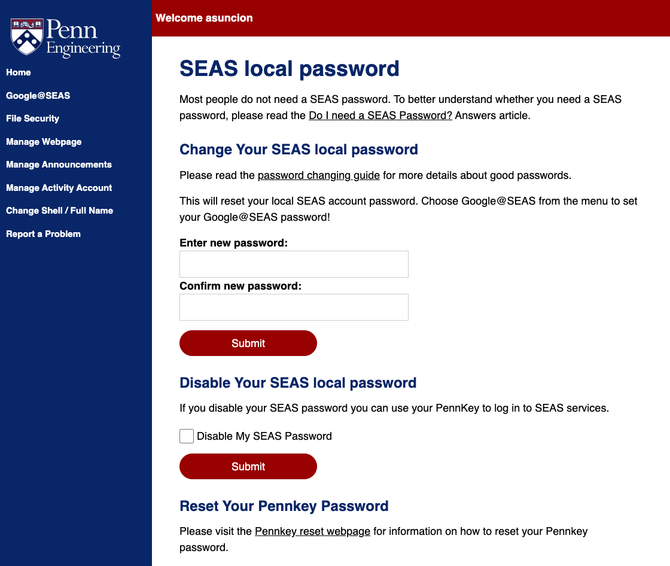
Borel – SEAS server – NO PHI borel.seas.upenn.edu
Access is granted by CETS with approval by CNT staff
  Email 1) Josh, 2) Jacqueline to request access
  Non-SEAS students will be given a SEAS sponsored research account
Once your account has been created, must set SEAS local password here (currently removed from site but still accessible via this link):
  https://accounts.seas.upenn.edu/passwd
Login is PennKey username and SEAS local password

Slide 15
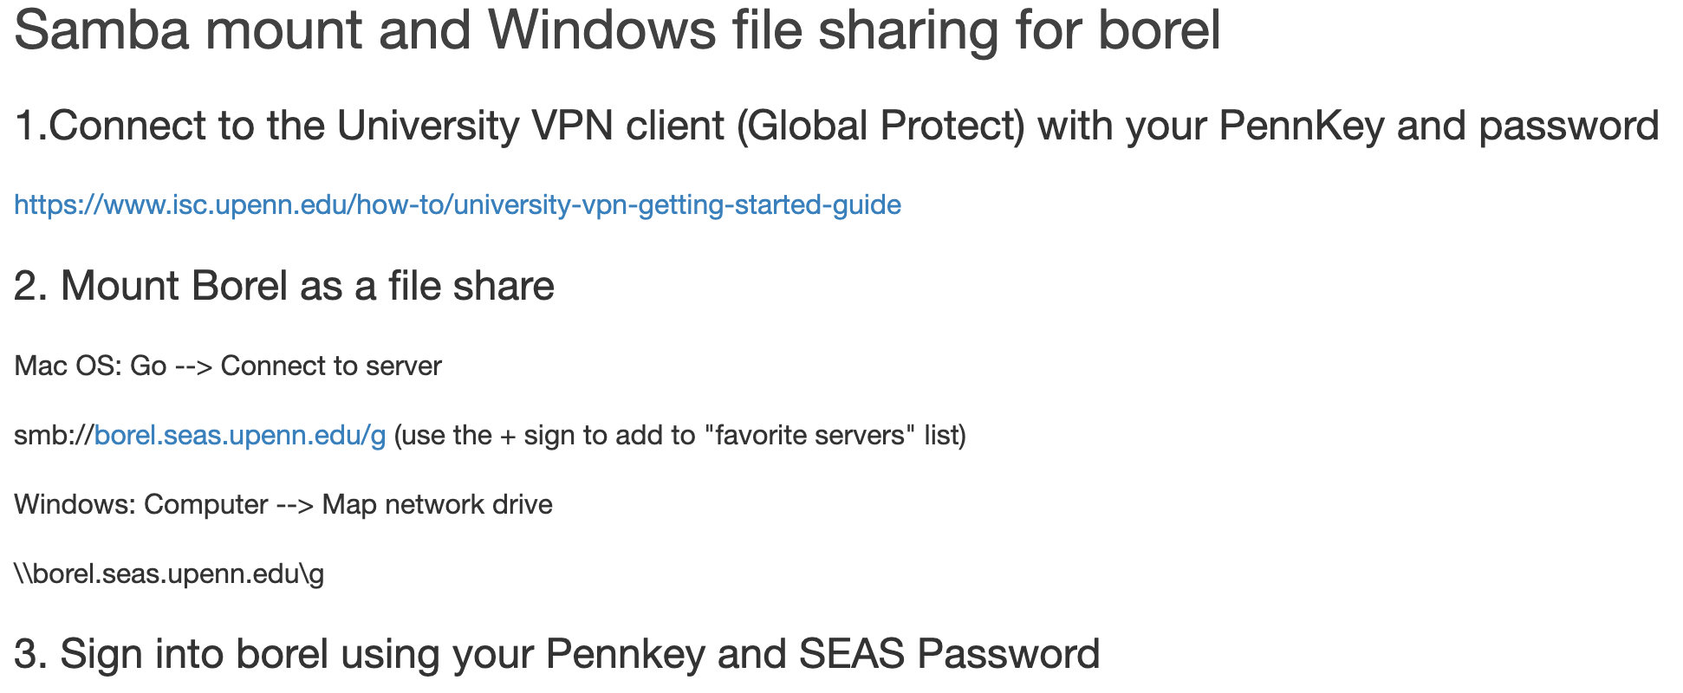
samba mount borel borel.seas.upenn.edu

Slide 16
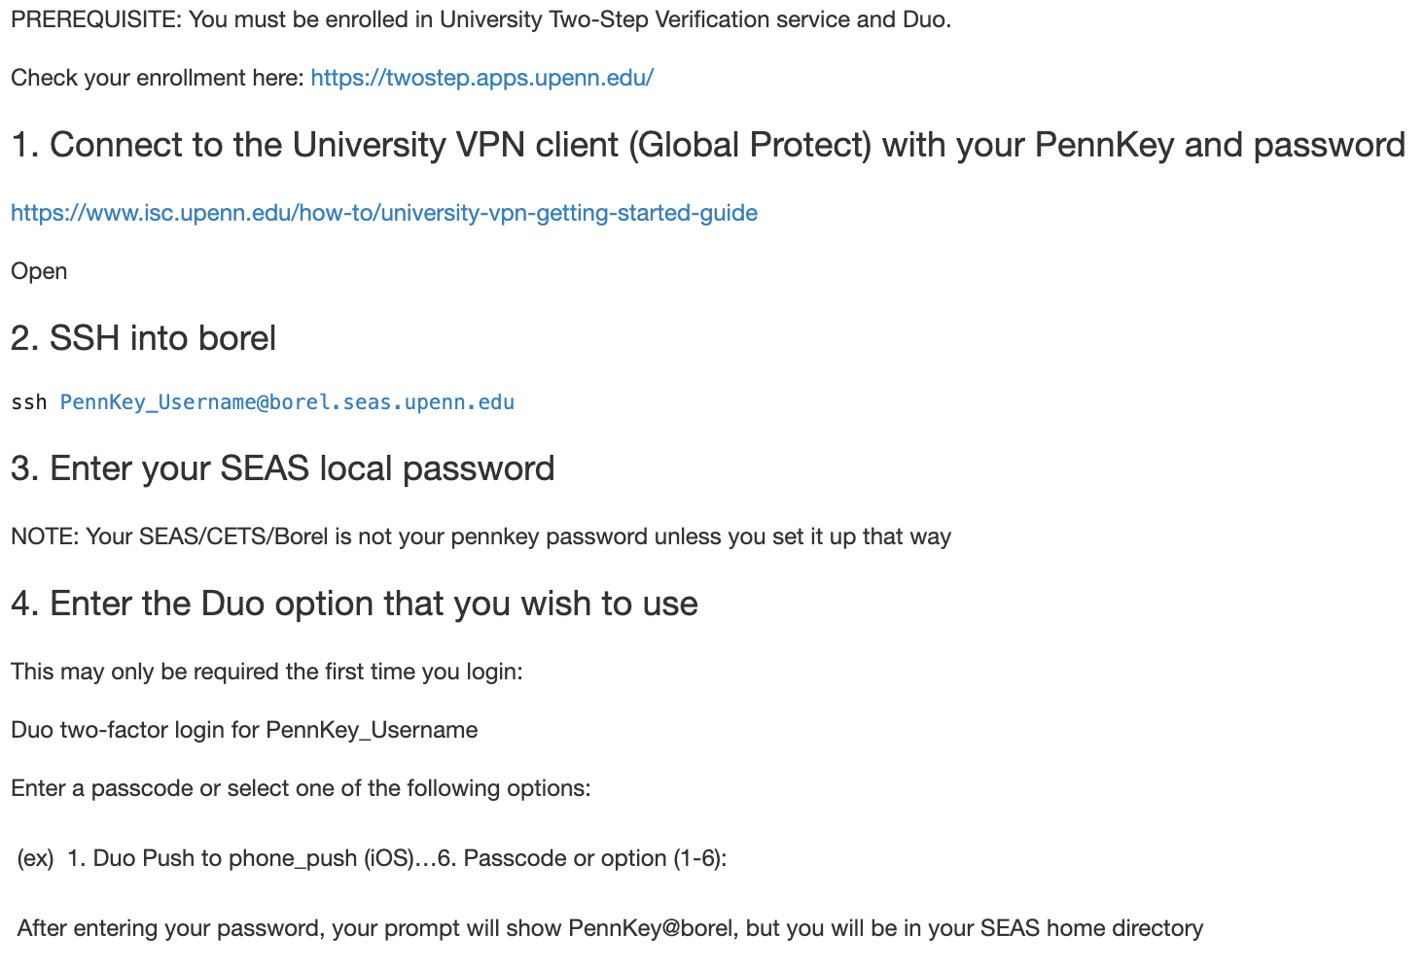
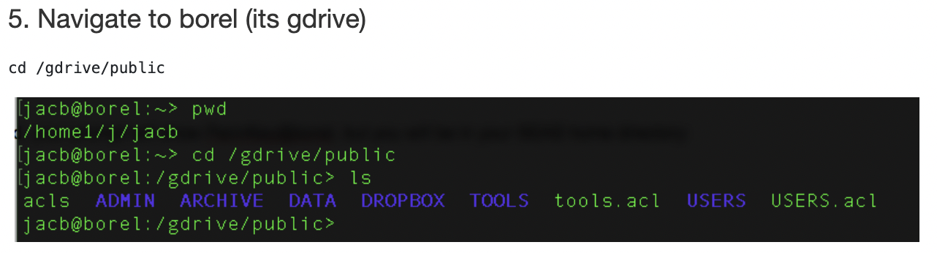
ssh into borel borel.seas.upenn.edu

Slide 17
Borel – SEAS server – NO PHI borel.seas.upenn.edu
NO PHI, but limited datasets in the form of dates are OK
CETS is the root user
  Jacqueline, Andy and Campbell have access to a manager account
Permissions follow ACLs
  Getfacl
  setfacl
Please use Linux Screens (and don’t forget to Terminate them) or nohup
Watch your memory and size: clean up your code
MongoDB
USER folders have open read & execute permissions (but not write permissions)
Good data etiquette:
  Use your USERS folder
  DO NOT move or copy data: Output can be in your USERS folder, but do not MOVE or COPY data from BIDS or DATA into USERS folder
  Use the MongoDB

Slide 18
Borel demo
Pioneer: use can be guided by student mentor

Slide 19
IEEG.org - no PHI allowed
Outside of Penn
Penn
No PHI allowed
PHI allowed
Only anonymized data can be shared without DUA
DUA needed for limited datasets and datasets containing PHI
Natus Review
UPHS Computer
UPHS/
PennMed
Network
Penn Medicine IS Services – BIG-IP Edge VPN Client
BSC Cluster
cnt1
REDCap
PMACS/
DART
(PSOM)
Network
cnt-fs
PMACS/DART – CNT VDI Interface
Borel
Pioneer
PennNet Network
SEAS CETS –
UPenn ISC VPN
Global Protect
IEEG.org
NODDI
AWS
Surgrec - Reconstructions

Slide 20
IEEG.org
Create Account on IEEG.org
Contact your CNT advisor, 1) Josh, 2) Jacqueline to be added to projects
  All intracranial data are anonymized
  Most scalp data are anonymized with a few exceptions that are limited datasets
Open Source Code and wiki:
  https://bitbucket.org/ieeg/
  CLI info is under the Wiki
Matlab and Python Toolboxes
  Allow you to download sections of data
  Clean code to minimize downloads from ieeg.org
Ieeg.org on GitHub:
  https://github.com/ieeg-portal/
  We will be consolidating CNT GitHub repositories
  Please use GitHub for your code!

Slide 21

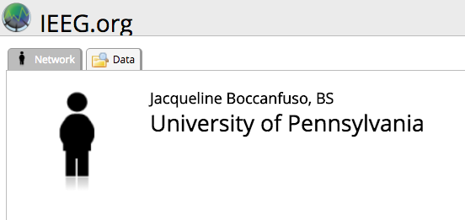
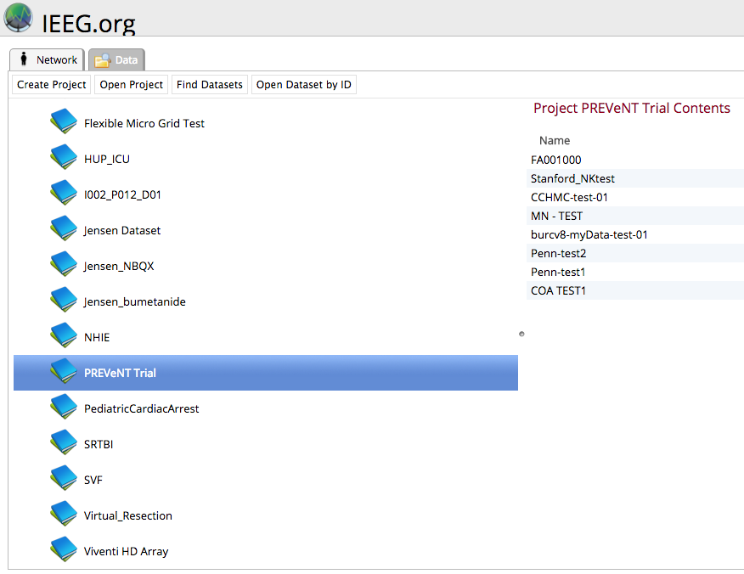
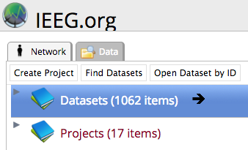
Viewing Data
1) Click on the data tab.
3) Click on your project
4) Click on the Open Project button
2) Click on the arrow of the Project section to display the dropdown items

Slide 22
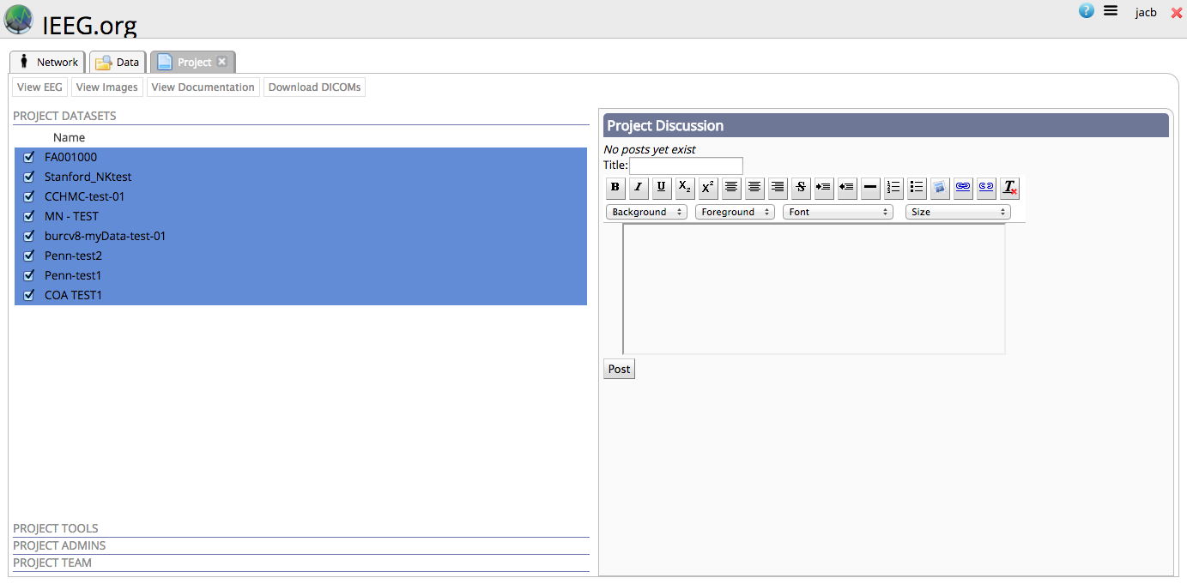
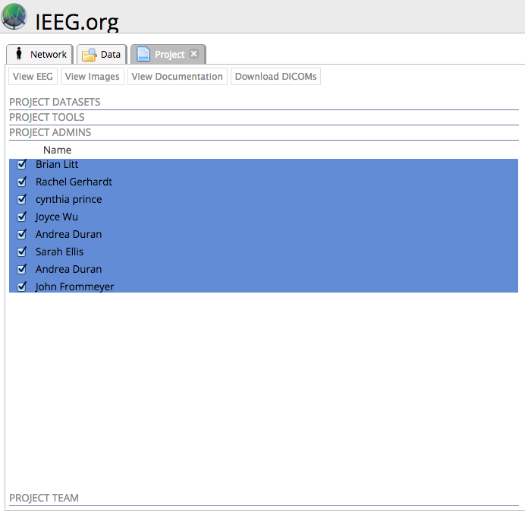
Viewing Data
Project Home Page
Data Sharing Among Team Members
Admins: Can upload data
Team: Can view data in a project

Slide 23
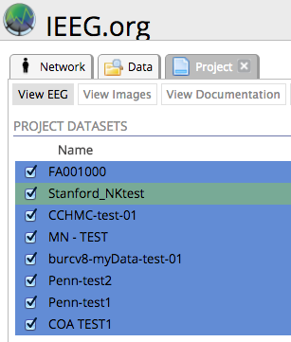
Viewing Data
5) Select the dataset that you want to view (it will highlight in green)
6) Click on the View EEG button.
DO NOT uncheck the datasets. Unchecking a dataset will remove it from the project for every project member.

Slide 24
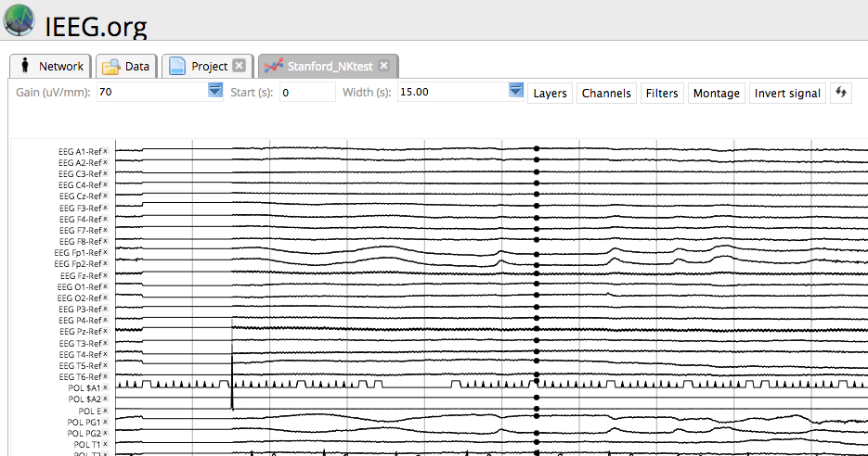

Viewing Data
7) A new tab will open with the EEG viewer of the selected data set. If the dataset is positive up, then click the “Invert signal” button. The button becomes the “Restore signal” button once the signal has become inverted.

Slide 25
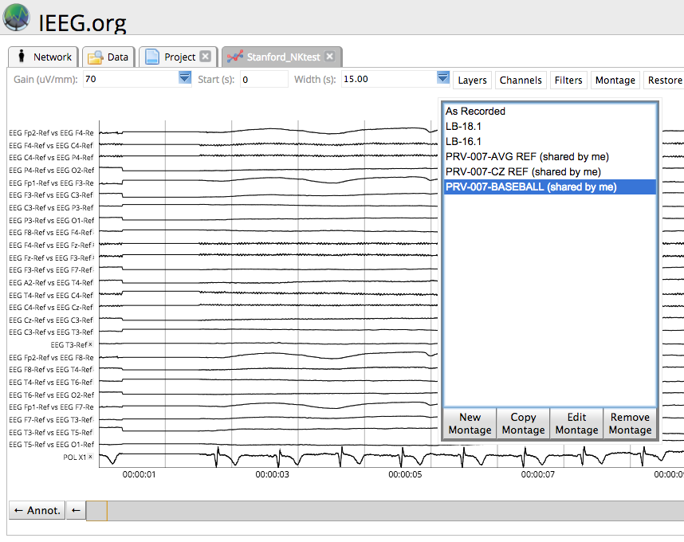
Montages

Slide 26
BSC - no PHI allowed
Outside of Penn
Penn
No PHI allowed
PHI allowed
Only anonymized data can be shared without DUA
DUA needed for limited datasets and datasets containing PHI
Natus Review
UPHS Computer
UPHS/
PennMed
Network
Penn Medicine IS Services – BIG-IP Edge VPN Client
BSC Cluster
cnt1
REDCap
PMACS/
DART
(PSOM)
Network
cnt-fs
PMACS/DART – CNT VDI Interface
Borel
Pioneer
PennNet Network
SEAS CETS –
UPenn ISC VPN
Global Protect
IEEG.org
NODDI
AWS
Surgrec - Reconstructions

Slide 27
BSC Cluster
Brain Science Center (BSC) Computing Cluster is supported by PMACS/DART LPC hardware, networking, and account management
  PMACS/DART usernames and passwords are used as the login for the BSC Cluster
To access, please contact 1) Josh, 2) Jacqueline to have your PMACS/DART account added to the correct user groups
  All users will be granted a user folder on the BSC Cluster
Storage costs on the BSC Cluster are charged to Dr. Davis
  Make sure to minimize duplicate data
No PHI, but limited datasets (i.e. dates) are allowed within datasets

Slide 28
BSC - direct SSH
SSH access is the expected connection method for the cluster. Currently, there is no networking or SSO requirement before connecting to the cluster.
  Direct from BSC Info: https://brainsciencecenter.github.io/bscLPC/docs/clusterEnvironment/access/
>> ssh pennkey@scisub.pmacs.upenn.edu
>> pmacs password
You will then be directed into your user home directory within the cluster
>> cd /project/davis_group
All shared data is stored in /project/davis_group
  Do NOT copy this data into your user directory. Please reference this data from your scripts but do not copy or move it. Duplicate data leads to duplicate costs.

Slide 29
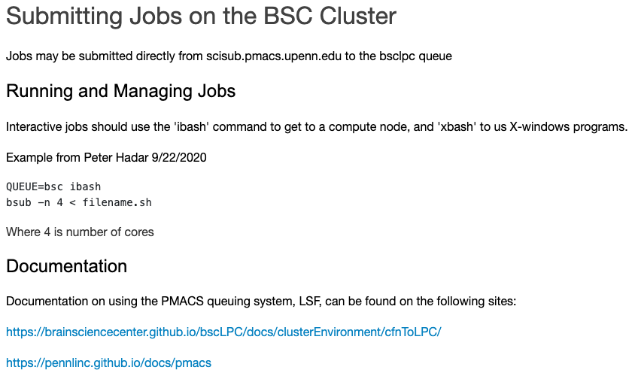

Slide 30
If you need to access
PHI data…
Set up PMACS account to access cnt1/cnt-fs/VDI and/or REDCap
Set up UPHS account to access PennMed email

Slide 31
cnt1 / cnt-fs - PHI allowed
Outside of Penn
Penn
No PHI allowed
PHI allowed
Only anonymized data can be shared without DUA
DUA needed for limited datasets and datasets containing PHI
Natus Review
UPHS Computer
UPHS/
PennMed
Network
Penn Medicine IS Services – BIG-IP Edge VPN Client
BSC Cluster
cnt1
REDCap
PMACS/
DART
(PSOM)
Network
cnt-fs
PMACS/DART – CNT VDI Interface
Borel
Pioneer
PennNet Network
SEAS CETS –
UPenn ISC VPN
Global Protect
IEEG.org
NODDI
AWS
Surgrec - Reconstructions

Slide 32
cnt1 Linux server / cnt-fs Windows file share
cnt1 and cnt-fs are maintained by PMACS
PMACS provides a Virtual Desktop Interface (VDI) to interact with cnt1 and cnt-fs
Will need PMACS account and VDI to access
  Email Jacqueline/Josh to ask to submit a PMACS account request (if you don’t already have one) and VDI access request to access cnt1/cnt-fs

Slide 33
cnt1 / cnt-fs demo
Access through the VDI

Slide 34
REDCap - PHI allowed
Outside of Penn
Penn
No PHI allowed
PHI allowed
Only anonymized data can be shared without DUA
DUA needed for limited datasets and datasets containing PHI
Natus Review
UPHS Computer
UPHS/
PennMed
Network
Penn Medicine IS Services – BIG-IP Edge VPN Client
BSC Cluster
cnt1
REDCap
PMACS/
DART
(PSOM)
Network
cnt-fs
PMACS/DART – CNT VDI Interface
Borel
Pioneer
PennNet Network
SEAS CETS –
UPenn ISC VPN
Global Protect
IEEG.org
NODDI
AWS
Surgrec - Reconstructions

Slide 35
REDCap https://redcap.med.upenn.edu/
login with PennKey and PMACS password
Access accounts and hardware maintained by PMACS
  Email/Josh to ask to submit a PMACS account request
Fill out https://redcap.med.upenn.edu/surveys/?s=YbCvd4 once you have a PMACS account, and a REDCap account will be created for you
  All users are required to have a PennKey, so be sure to include your PennKey in the survey
  If you are having trouble with your REDCap account, please submit a service ticket through PMACS/DART to the REDCap Team:
  https://helpdesk.pmacs.upenn.edu/
    1) Login with your PMACS/DART account
    2) Select New/New Ticket from Queue/REDCap
    3) Include Magda, Jacqueline and Josh in your CC list on the ticket
HIPAA Compliant – the REDCap Server is located behind the Penn Medicine firewall
Web-based interface makes it available
Reporting allows for export of de-identified data
REDCap support team

Slide 36
UPHS Access
Create a UPHS Account:
  Email Carolyn/Chadric for UPHS account request
  Process takes around a week
  You will be granted an account and a PennMedicine email address

Slide 37
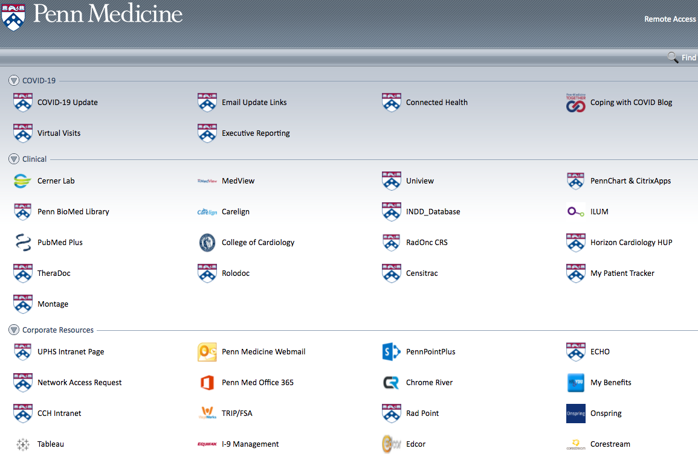
Penn Med Access Portal pennmedaccess.uphs.upenn.edu login with UPHS Account credentials
go to Penn Med Access Portal website
log in with UPHS account credentials
open Penn Med Office 365 to access Penn Medicine email

Slide 38
Penn Medicine Email pennmedaccess.uphs.upenn.edu login with UPHS Account credentials
Penn Med Office 365
Secure email communication:
  Between PennMedicine addresses
  Between PennMedicine and UPHS addresses
  Between UPHS addresses
Insecure email communication:
  Between SEAS addresses
  Between SAS addresses
  Between PennMedicine/UPHS and SEAS/SAS
  Any personal email addresses
Need to send a secure file?
  Secure file share instructions on lab archives
  You can always ask Magda, Jacqueline, or Josh

Slide 39
LabArchives
cloud-based lab notebook platform used by the CNT as a wiki to store documentation
  need PennKey and password to log in
https://mynotebook.labarchives.com/login
  Select Institution
  choose University of Pennsylvania from the drop down menu
  click Go to Institution’s Login
this slide and other documentation are stored in LabArchives
  go to CNT Notebook / Training / CNT Summer Orientation 2022

