Slide 1
Quarto: A tool for open scholarship
Part I Rick Gilmore

Slide 2
Preliminaries

Slide 3
Agenda
Motivation
Installing the tools
Case study: RevealJS slides
Under the hood

Slide 4
Motivation

Slide 5
Installing the tools

Slide 6
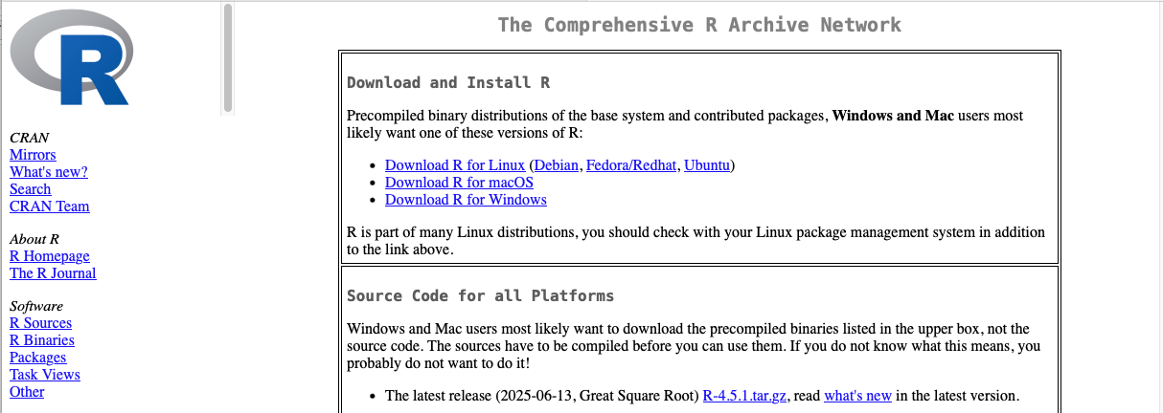
Install R
Download & Install R: https://cran.rstudio.com
https://cran.rstudio.com

Slide 7
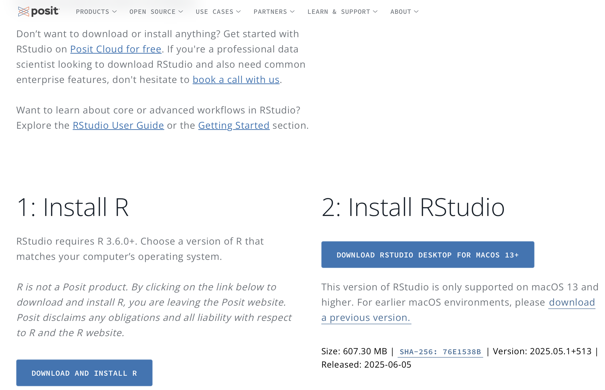
Install RStudio
Download & Install RStudio
https://posit.co/download/rstudio-desktop/

Slide 8
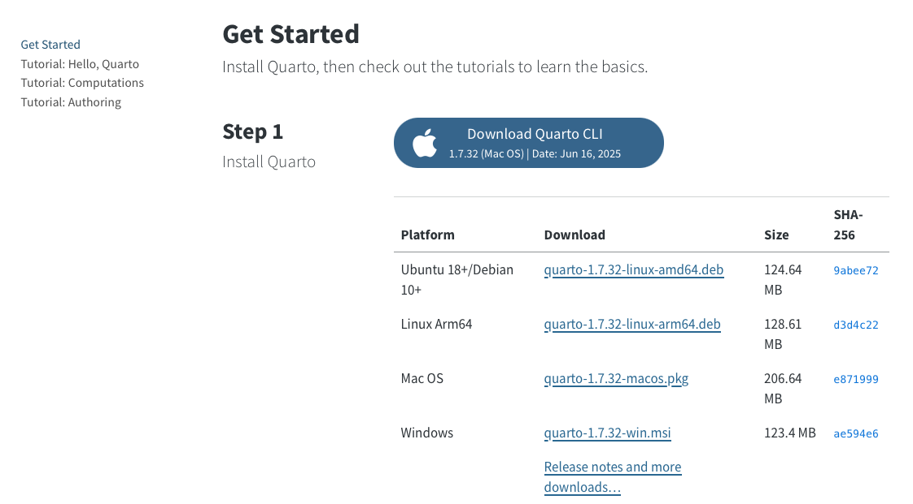
Install Quarto
Download & Install Quarto for your operating system: https://quarto.org/docs/get-started/
https://quarto.org/docs/get-started/

Slide 9
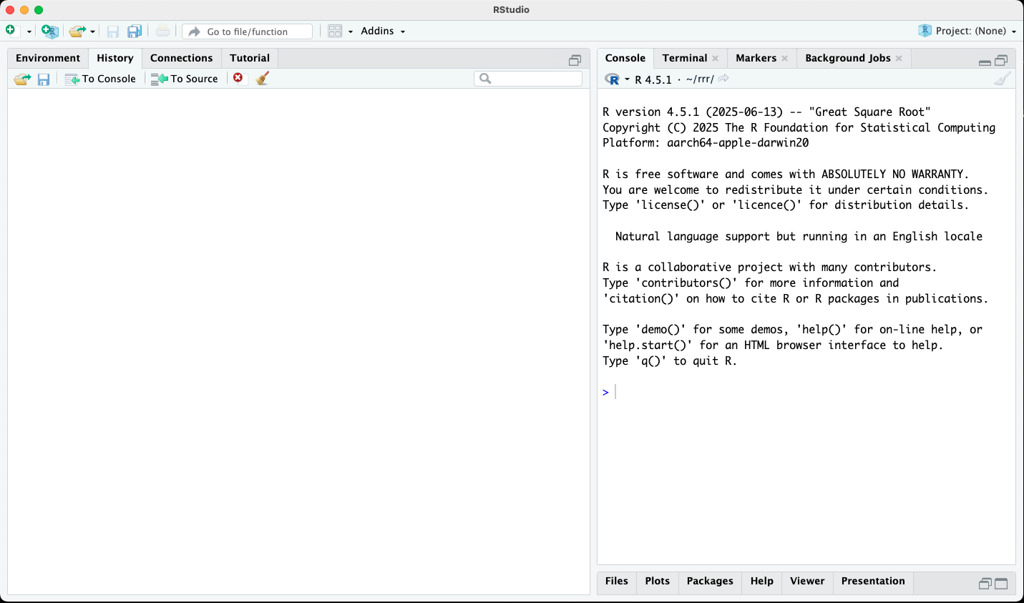
Launch RStudio

Slide 10
Case studies

Slide 11
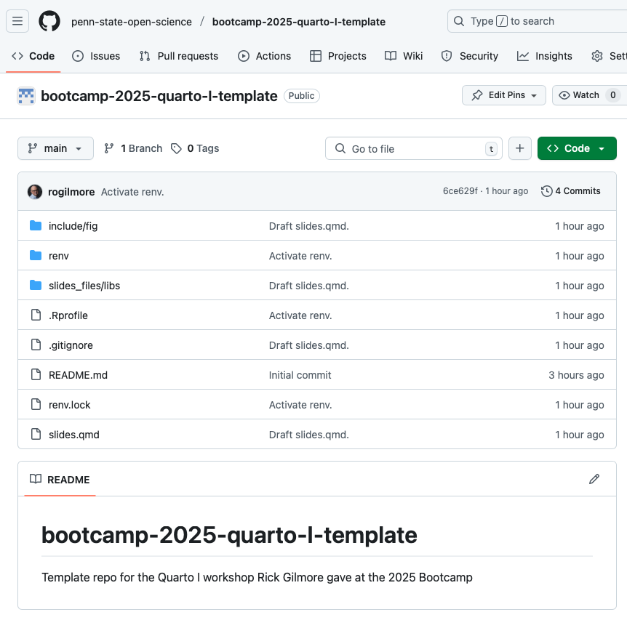
RevealJS Slides
Visit GitHub to download the template repository (‘repo’) for the workshop
https://github.com/penn-state-open-science/bootcamp-2025-quarto-I-template

Slide 12
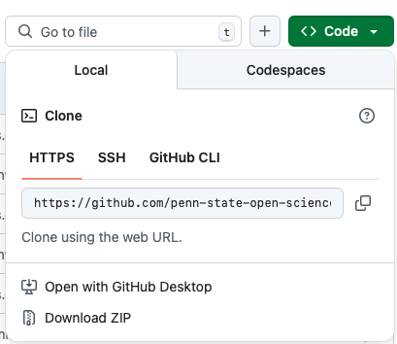
Press on the green ‘Code’ button

Slide 13
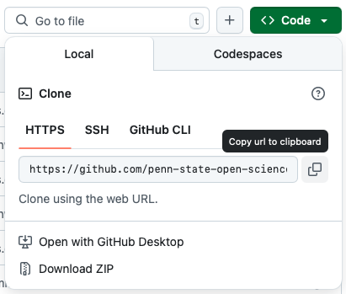
Press the ‘copy url to clipboard’ button.

Slide 14
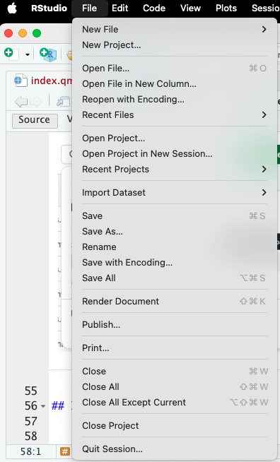
In RStudio
Open RStudio if it is not already open
Create a new Project using either the File menu at left

Slide 15
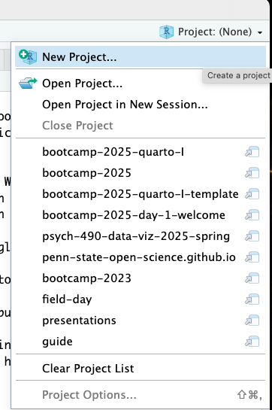
or the Project menu at right

Slide 16
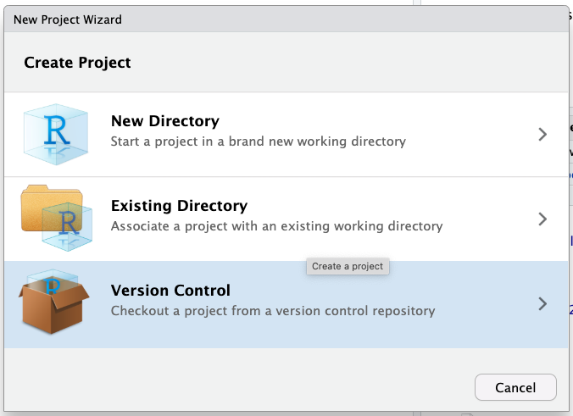
Content

Slide 17
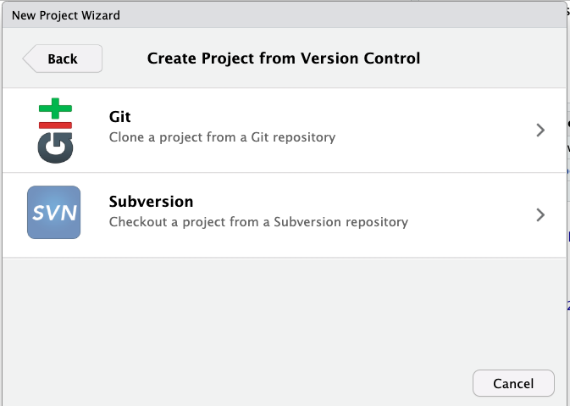
Content

Slide 18
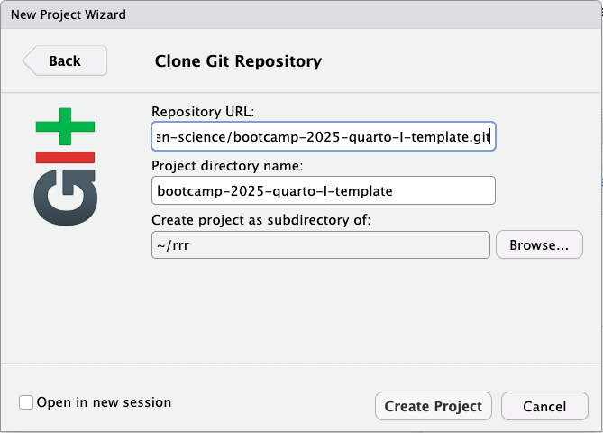
Content

Slide 19
Research report

Slide 20
Resources

