Slide 1
Getting credit for sharing your data (Part II):
Sharing your Data
Alaina Pearce
azp271@psu.edu
Open Science Bootcamp 2025

Slide 2
Why Share your Data?
Advance Rigorous & Reproducible Research
Enable validation of research results
Make high-value datasets accessible
Accelerate future research directions
Increase opportunities for citation and collaboration

Slide 3
Why Share your Data?
Advance Rigorous & Reproducible Research
Enable validation of research results
Make high-value datasets accessible
Accelerate future research directions
Increase opportunities for citation and collaboration
Promote Public Trust
Foster transparency and accountability
Demonstrate stewardship over taxpayer funds
Maximize research participants’ contributions
Support appropriate protections of research participants’ data

Slide 4
Why Share your Data?
Advance Rigorous & Reproducible Research
Enable validation of research results
Make high-value datasets accessible
Accelerate future research directions
Increase opportunities for citation and collaboration
You (may Be) required to by Funder
(In terms & conditions of your award)
Promote Public Trust
Foster transparency and accountability
Demonstrate stewardship over taxpayer funds
Maximize research participants’ contributions
Support appropriate protections of research participants’ data

Slide 5
NIH Data Management & Sharing Policy
Effective Date: January 25, 2024
Requirements:
Submission of a Data Management & Sharing Plan (DMSP) for ALL NIH-funded research that generates scientific data
Expects researchers to ‘maximize appropriate data sharing’ in established repositories
Sharing should occur no later than publication or end of award
Requires researchers to justify any sharing exceptions (i.e., ethical, legal, technical factors
Allows research to request funding for personnel costs or other fees related to data management and share actives, but the money must be spent during the grant’s award period

Slide 6
NIH Data Management & Sharing Policy
Effective Date: January 25, 2024
Requirements:
Submission of a Data Management & Sharing Plan (DMSP) for ALL NIH-funded research that generates scientific data
Expects researchers to ‘maximize appropriate data sharing’ in established repositories
Sharing should occur no later than publication or end of award
Requires researchers to justify any sharing exceptions (i.e., ethical, legal, technical factors
Allows research to request funding for personnel costs or other fees related to data management and share actives, but the money must be spent during the grant’s award period
Approved DMSPs become a term and condition of your award and non-compliance could impact future funding decisions

Slide 7
NIH Data Management & Sharing Policy
What is scientific data?
In Scope
“recorded factual material…of sufficient quality to validate and replicate research findings, regardless of whether the data are used to support scholarly publications”
Out of Scope
Lab notebooks, preliminary analyses, case report forms, physical objets, drafts of scientific papers, plans for future research, peer reviews

Slide 8
NIH Data Management & Sharing Policy
When to Share:
Publication 1: Data supporting published findings
Publication 2: Data supporting published findings
All data, even if not supporting published findings
Data collection
Data analysis
End of award period

Slide 9
NIH Data Management & Sharing Policy
When to Share:
Publication 1: Data supporting published findings
Publication 2: Data supporting published findings
All data, even if not supporting published findings
Data collection
Data analysis
End of award period
When Limit to Sharing - Justifiable ethical, legal, and technical factors:
Informed consent will not permit or limits scope of sharing or use
Privacy or safety of research participants would be compromised and available protections insufficient
Explicit federal, state, local, or Tribal law, regulation, or policy prohibits disclosure
Restrictions imposed by existing or anticipated agreements with other parties

Slide 10
NIH vs Draft NSF DMSP
 | NIH | NSF (Draft)
What must be shared? | Scientific data: “Recorded factual material…of sufficient quality to validate and replicate research findings, regardless of whether the data are used to support scholarly publications” | •Primary data •Samples •Physical collections •Scripts/code •Curriculum material •Other supporting materials created or gathered during award period
Timeline | •At publication •End of Award (even if not supporting published finding) | At publication
Page Limit | 2 pages | Must use NSF webform (no page limit)
Required Elements | •Data Types •Related tools, software/code •Standards •Data preservation, access, & timelines •Access, distribution, & reuse considerations •Oversight | •Data and Research Product Categories •Access Policies and Limitations •Data Standards and Metadata •Data Provenance •Public Archiving •Retention Time •Accountability
Repository Requirements | Encourages use of established repositories | Must provide a persistent identifier (e.g., DOI)

Slide 11
What data do I share?
All data must be managed - Not ALL data can be shared
“Raw” data need to support published findings or contribute to new studies
Accompanying code/materials to support data
Copyrighted data
Data contains personal identifiable information, health information, or other sensitive information about individuals, communities, or locations
You intend to make a patent application and must avoid prior disclosure

Slide 12
How to prepare your data
Good Enough Data Practices
FAIR Data
Repositories
Metadata
Institutional Resources
Open
Findable
Reusable
Accesible
Interoperable
Version
Control
Best Practices
Back-Up
Tidy Data
Metadata
Code

Slide 13
FAIR Data
Findable
Accessible
Data is documented with rich metadata, has a unique and persistent identifier (e.g., DOI), and is in a resource that can be searched or indexed.
Metadata and data is both human and machine readable and is stored in a trusted repository.
Interoperable
Reusable
Data is in open formats with a common structure and metadata uses accepted, disciplinary terminology (e.g., controlled vocabulary or ontologies)
Data has clear licenses and provenance and align with community/disciplinary standards

Slide 14
FAIR Data
 | Researcher | Repository
Findable | Files are unambiguously named All files are fully described with rich metadata (e.g., README) All data are fully described with rich metadata (e.g., data dictionary, data manual) | Provides a persistent identifier (e.g., DOI) (Meta)data are discoverable through an open search protocol
Accessible | Identify appropriate access controls, if necessary Clearly document how to find and access data, including authentication/access protocols | (Meta)data are retrievable via a persistent identifier with clear download instructions Provides reliable storage with long-term sustainability (Meta)data are machine actionable
Interoperable | Use standard and open file formats (Meta)data follow disciplinary notation and terminology (e.g., controlled vocabularies and/or ontologies) If available, follows (meta)data standards (e.g., BIDS, DDI, Pysch-DS) | Provides a standard interface and protocol for data deposit and retrieval Metadata is structured and can be parsed by algorithms
Reusable | Choose open license Detailed documentation about the data, its provenance, and relevant data collection and/or processing steps Well documented context so user can understand the data’s purpose and limitations | Versions are tracked Has license and/or clear terms of use Mechanism for documenting origin, history, and who to cite

Slide 15
How to prepare your data
Good Enough Data Practices
FAIR Data
Repositories
Metadata
Institutional Resources
Open
Findable
Reusable
Accesible
Interoperable
Version
Control
Best Practices
Back-Up
Tidy Data
Metadata
Code

Slide 16
Repositories
Curation
(from metadata enhancement to individualized help)
Technical Support:
FAIR principles and data preservation
Access:
Persistent identifiers and licenses/terms of use
Notes:
Desired features:
Provides a persistent identifier
Provides your work a landing page with metadata
Matches your needs (e.g., formats accepted, access, back-up and recovery, etc.)
Platform is sustainable and provides longevity of service
Clear terms and conditions
Curation support
Provides guidance on how to cite the data
Tracks how the data has been used by providing access and download statistics
Limited to no cost

Slide 17








Repositories
Domain Specific
Institutional
Generalist
Notes:
Desired features:
Provides a persistent identifier
Provides your work a landing page with metadata
Matches your needs (e.g., formats accepted, access, back-up and recovery, etc.)
Platform is sustainable and provides longevity of service
Clear terms and conditions
Curation support
Provides guidance on how to cite the data
Tracks how the data has been used by providing access and download statistics
Limited to no cost

Slide 18
Repositories
Public-Public
(Open Access)
Public-Private
(Metadata Open Access)
Private-Private
(Closed Access)
Metadata is fully discoverable
Data are accessible
Data can be downloaded immediately
Data access is mediated
Good for level 1 data
Good for identifiable/highly sensitive data
Notes:
Desired features:
Provides a persistent identifier
Provides your work a landing page with metadata
Matches your needs (e.g., formats accepted, access, back-up and recovery, etc.)
Platform is sustainable and provides longevity of service
Clear terms and conditions
Curation support
Provides guidance on how to cite the data
Tracks how the data has been used by providing access and download statistics
Limited to no cost

Slide 19
How to prepare your data
Good Enough Data Practices
FAIR Data
Repositories
Metadata
Institutional Resources
Open
Findable
Reusable
Accesible
Interoperable
Version
Control
Best Practices
Back-Up
Tidy Data
Metadata
Code

Slide 20
Metadata
Highly structured data laid out in fields, often with controlled vocabularies - the who, what, when, where, and why of data

Slide 21
Metadata
Highly structured data laid out in fields, often with controlled vocabularies - the who, what, when, where, and why of data
Data Dictionary
Variable names and definition
Data units and formats
Min and max values
Coded values and their meanings
Null/NA representations
Known issues with the data
Relationships with other variables
How it was measured

Slide 22
Metadata
Highly structured data laid out in fields, often with controlled vocabularies - the who, what, when, where, and why of data
Data Dictionary
Variable names and definition
Data units and formats
Min and max values
Coded values and their meanings
Null/NA representations
Known issues with the data
Relationships with other variables
How it was measured
README.txt (or .md)
Information about the files it accompanies
Often describes the directory structure
Licensing information
Project description
Funding information
How to use the data/files being shared
Author name and contact information
Any disclosures

Slide 23
README Template Worksheet

Slide 24
How to prepare your data
Good Enough Data Practices
FAIR Data
Repositories
Metadata
Institutional Resources
Open
Findable
Reusable
Accesible
Interoperable
Version
Control
Best Practices
Back-Up
Tidy Data
Metadata
Code

Slide 25
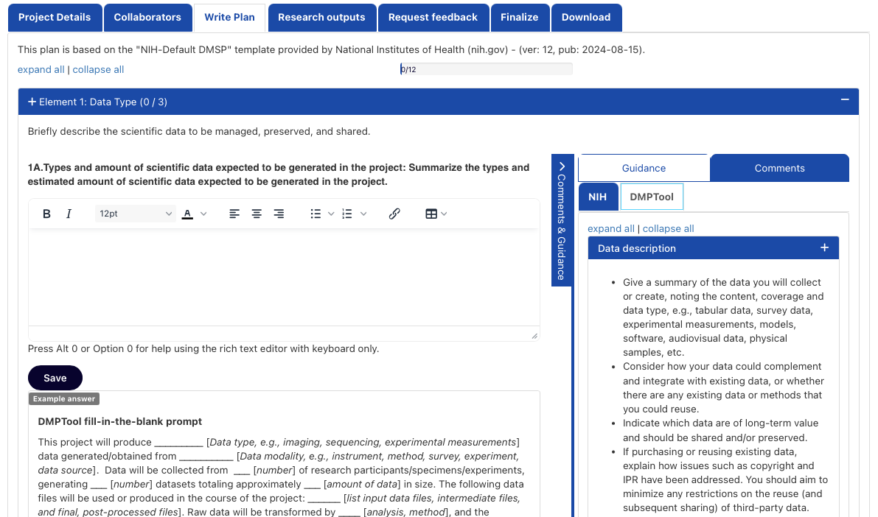
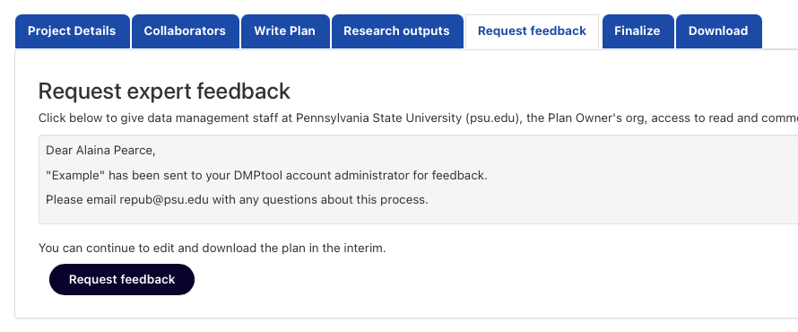
Institutional Tools & Resources
DMP Tool
www.dmptool.org

Slide 26
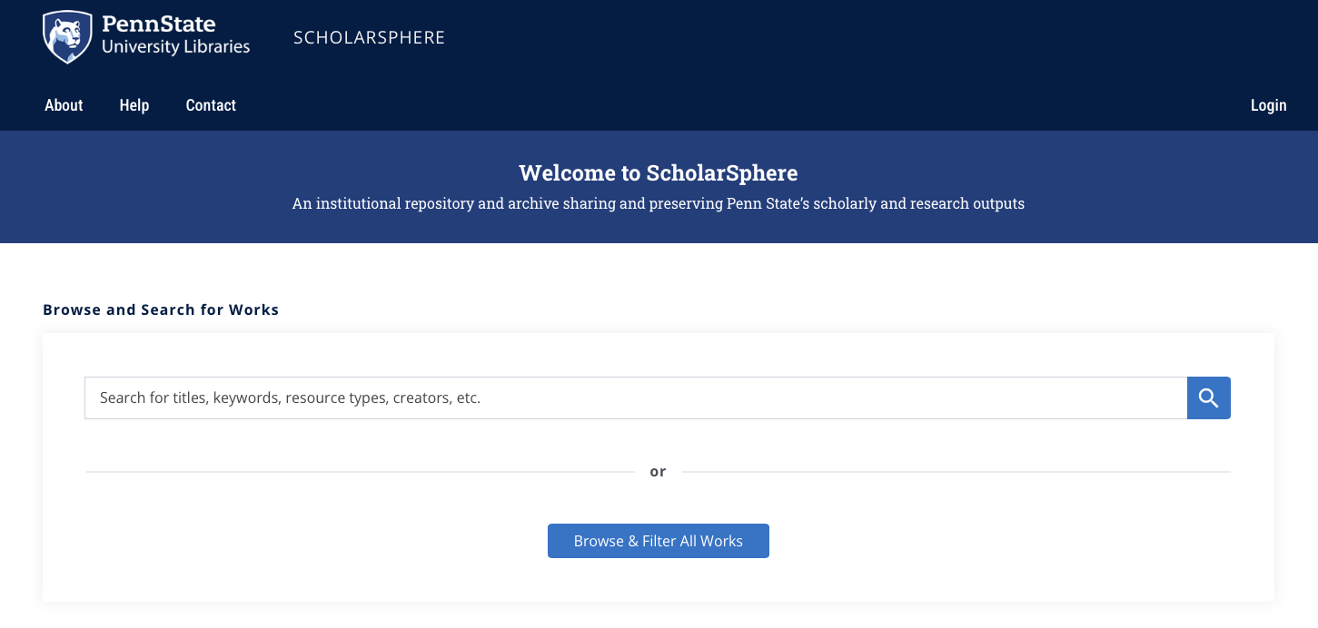
Institutional Tools & Resources
ScholarSphere
scholarsphere.psu.edu
Notes:
Self-deposit for PSU faculty, staff, and students at no cost
Supports data sharing requirements and “F.A.I.R” principles
Findable. Accessible. Interoperable. Reusable.
Satisfies requirements of PSU Open Access Policy (AC02)
Work drafts and versioning
Flexible access and visibility controls
Persistent access and preservation of work through DOI minting​
Monthly reports tracking download statistics
Curation services from PSU Librarians and the Data Curation Network​

Slide 27
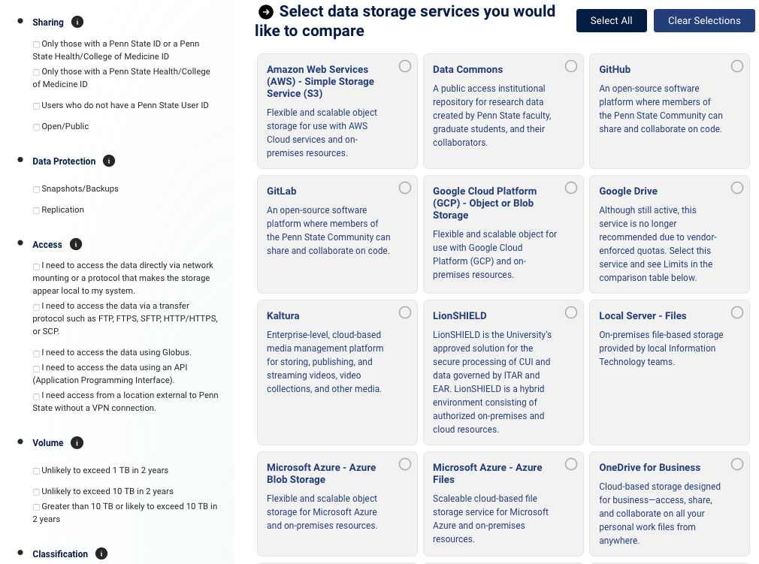
Institutional Tools & Resources
Penn State Data Storage Finder
datastoragefinder.psu.edu

Slide 28
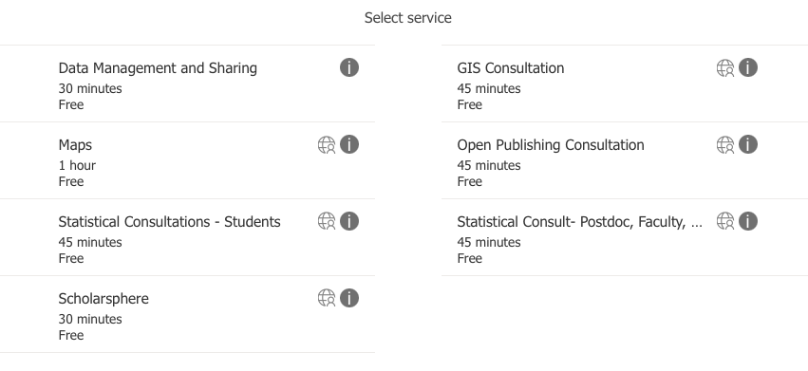
Institutional Tools & Resources
Data Learning Center
libraries.psu.edu/about/departments/units/data-learning-center

Slide 29
NIH Data Management & Sharing Policy
Data Management and Sharing Plan Elements
Data Types
Related Tools, Software, and/or Code
Metadata Standards
Data Preservation, Access, and Associated Timelines
Access, Distribution, or Reuse Considerations
Oversight of Data Management and Sharing
Notes:
Data Type: Identifying data to be preserved and shared
Related tools, software, code: Tools and software need to access and manipulate data
Standards: Standards too be applied to scientific data and metadata
Data preservation, access, timelines: Repository to be used, persistent unique identifier, and when/how long data will be available
Access, distribution, reuse considerations: Description of factors for data access, distribution, or reuse
Oversight of data management: Plan compliance will be monitored/managed and by whom

