Slide 1
ScholarSphere
Alaina Pearce
azp271@psu.edu
Open Science Bootcamp 2025

Slide 2
ScholarSphere
Penn State’s open access institutional repository for publication and research data
Self-deposit for Penn State faculty, staff, and students at no cost
Supports data sharing requirements and FAIR principles
Curation services from PSU Librarians and the Data Curation Network
Satisfies requirements of PSU Open Access Policy (AC02)
Work drafts and versioning
Flexible access and visibility controls
Persistent access and preservation of work through DOI minting
Data DOIs are indexed in GoogleScholar
Monthly reports tracking download statistics

Slide 3
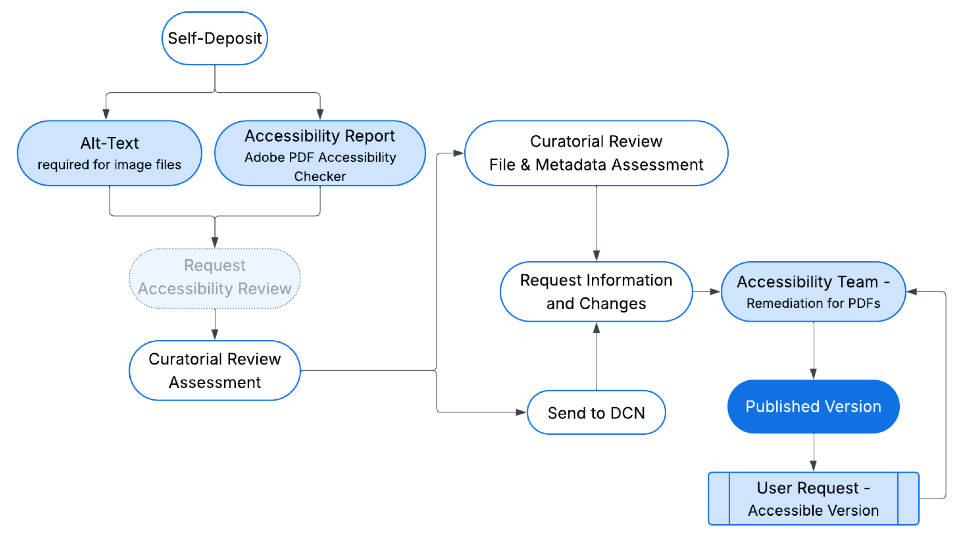
ScholarSphere
Penn State’s open access institutional repository for publication and research data

Slide 4
Curation Services
Check that files can be opened and appear to be working
Check that discover metadata is accurate and sufficiently described
Request additional metadata or documentation to support FAIR
README file required for data deposits
Partner with the Data Curation Network for specialized data curation
Accessibility Checks
Alt-text required for all image files
PDF accessibility remediation

Slide 5
Curation Services
Check that files can be opened and appear to be working
Check that discover metadata is accurate and sufficiently described
Request additional metadata or documentation to support FAIR
README file required for data deposits
Partner with the Data Curation Network for specialized data curation
Accessibility Checks
Alt-text required for all image files
PDF accessibility remediation
The researcher is not a passive participant - what you choose to do impacts what we can do for you

