Slide 1
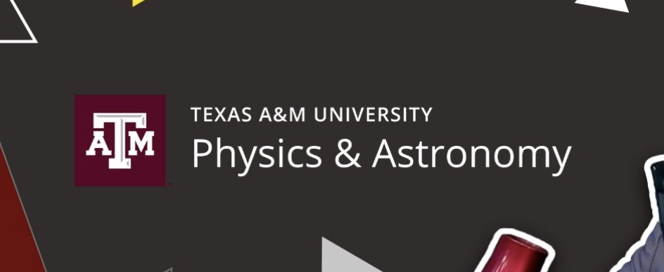
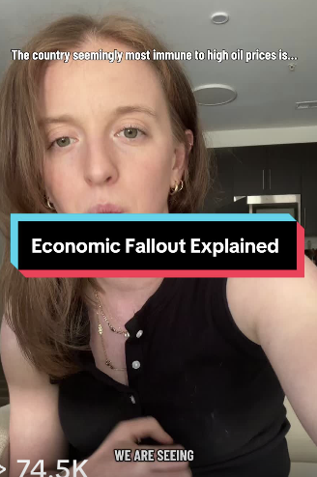
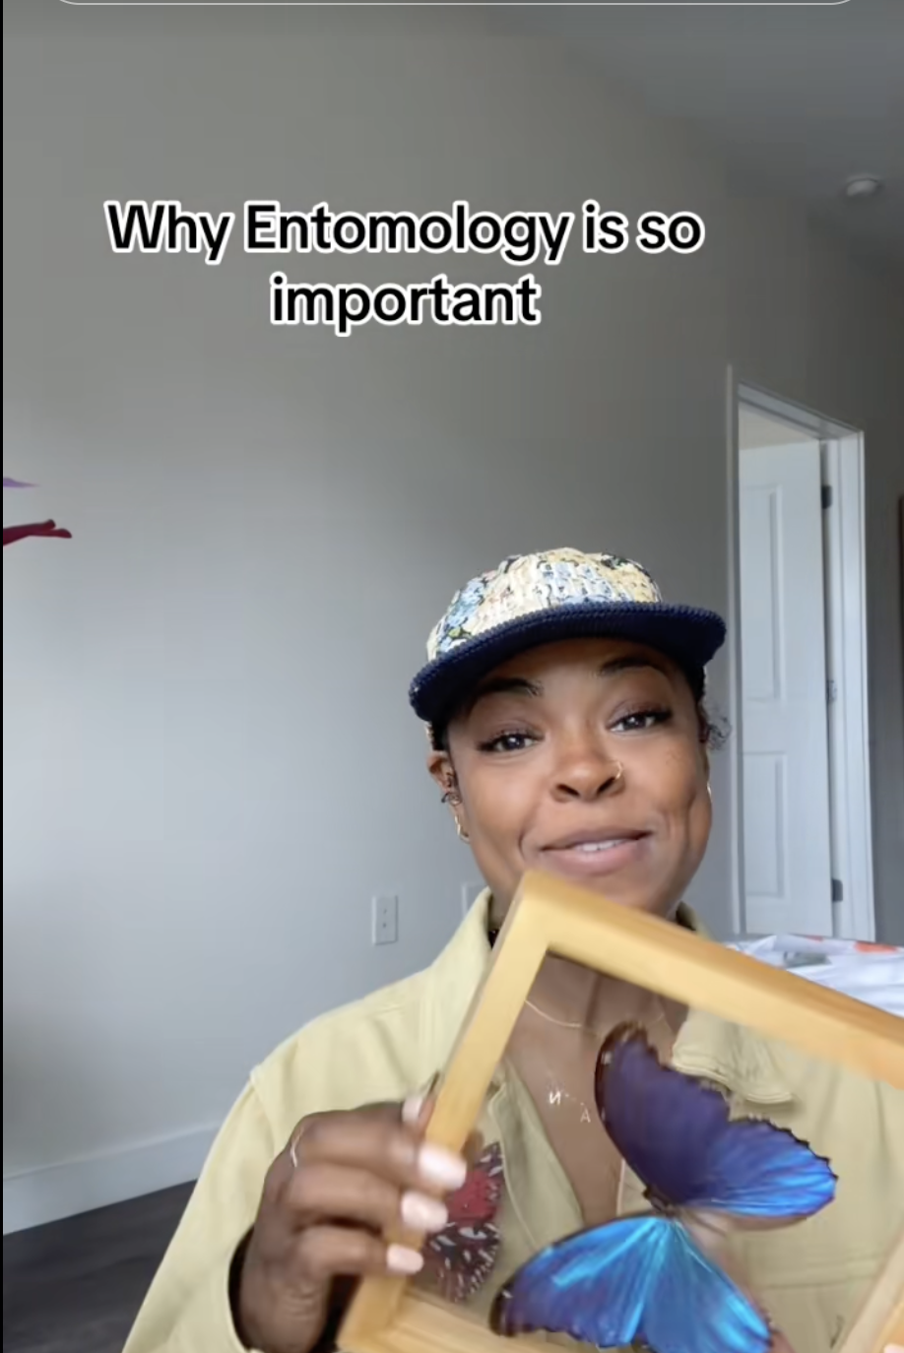
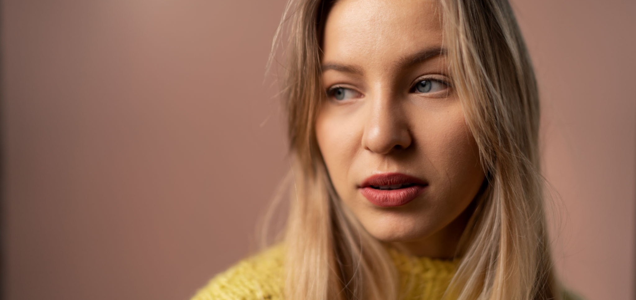


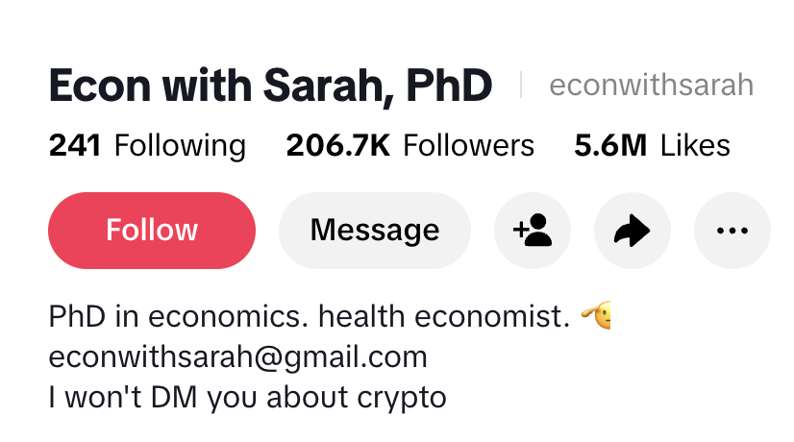

BEING SOCIAL
IN RESEARCH

Slide 2
AGENDA
1
WHY IT MATTERS
2
ABOUT THE PLATFORMS
3
CREATING CONTENT
4
ATOMIZATION
5
A SELECTION OF RELEVANT CREATORS
6
ACTIVITY AND QUESTIONS

Slide 3
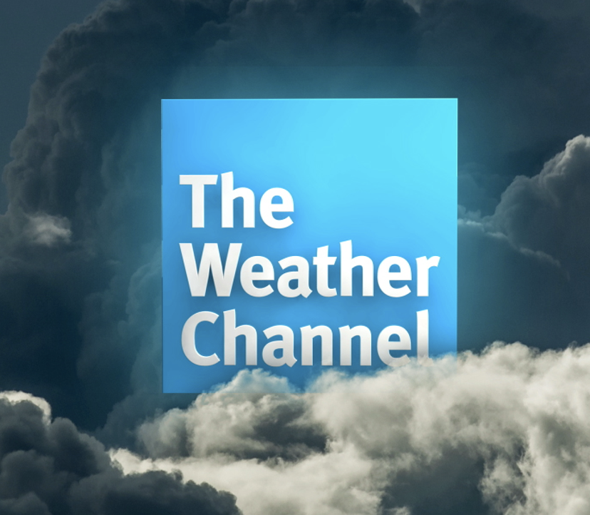

NEWS CONSUMPTION IS EVOLVING
SHIFTING PERSPECTIVES
A CHANGING LANDSCAPE
STORYTELLING MATTERS
WHAT’S IN IT
FOR YOU?
Today, The Weather Channel is the most trusted news source in America…
Social media has replaced TV as the top way Americans get news. Only 40% of people trust the news, yet 38% of people in the U.S. have accidentally shared fake news.
Only 20% of Americans trust educational institutions as a whole. 70% say the U.S. higher education system is generally going in the wrong direction.
Invitations for speaking, collaboration, book deals, etc. Attract potential students and news outlets. Educate the public, which can impact policy and change.

Slide 4
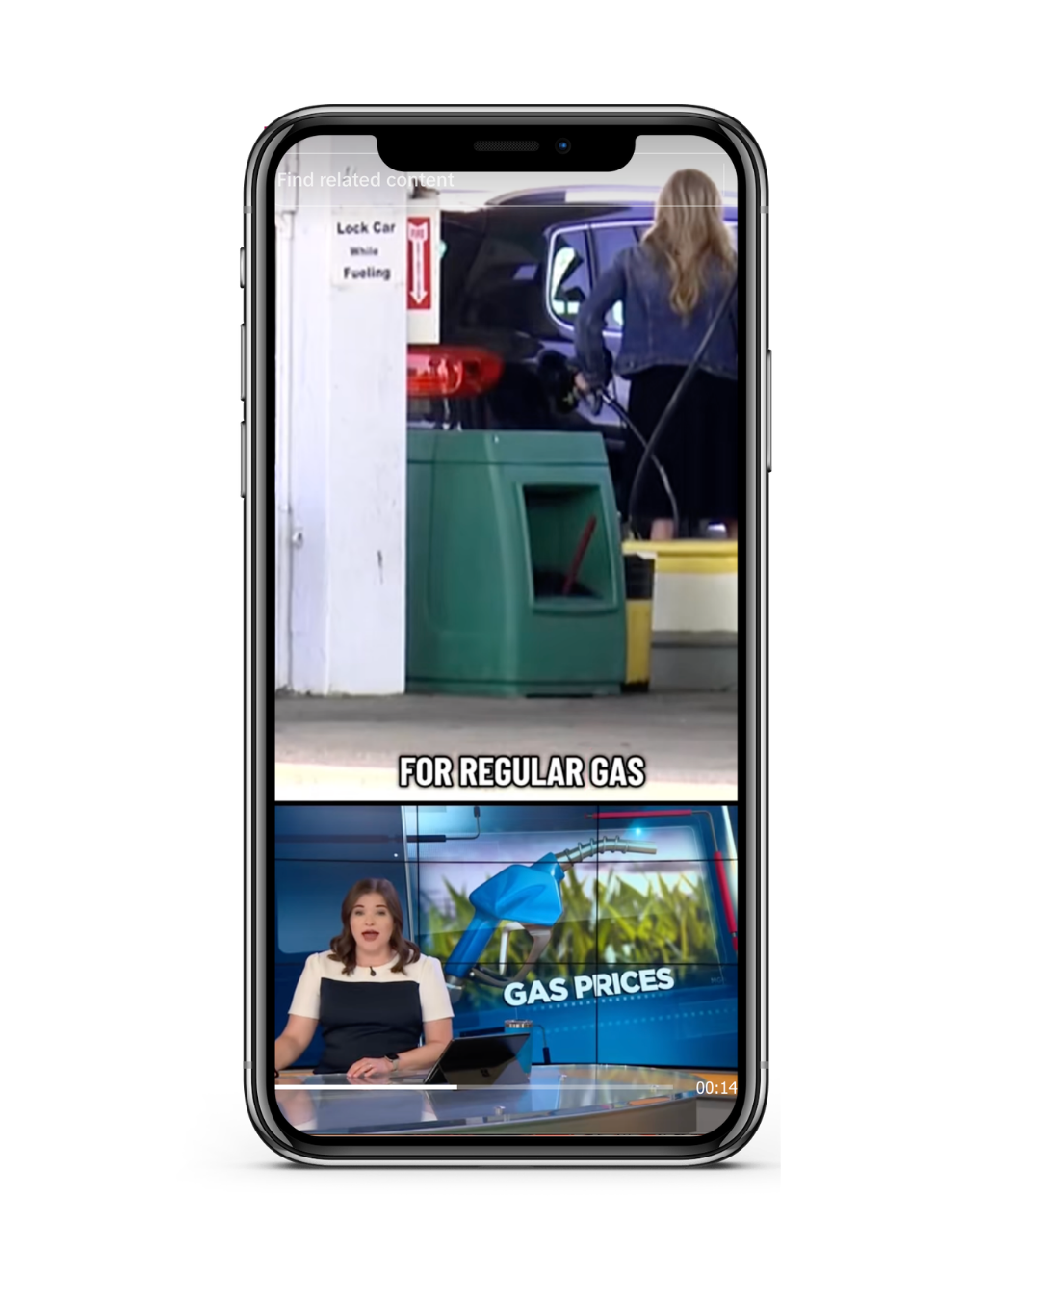
“DID YOU SEE THE STORY ABOUT XYZ?”
What was the last news story that caught your attention?
Where did you come across it?
What made it stand out?

Slide 5
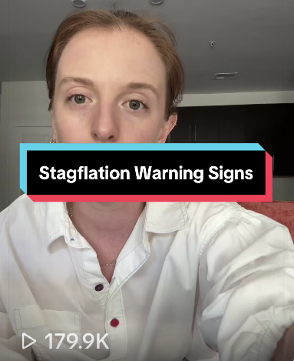
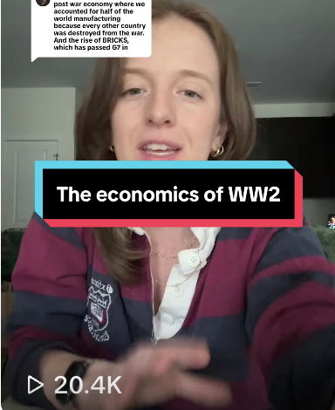
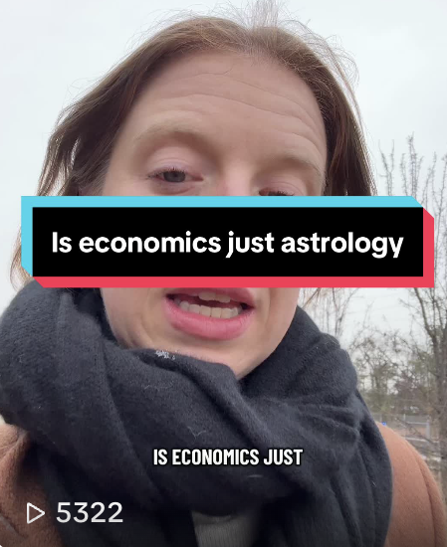
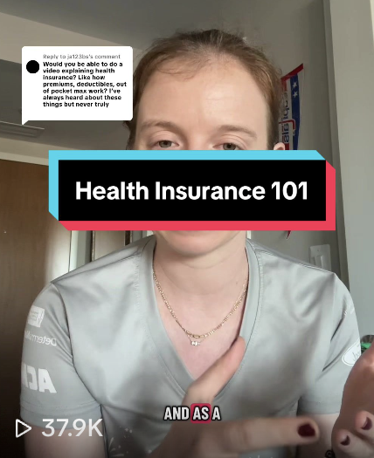
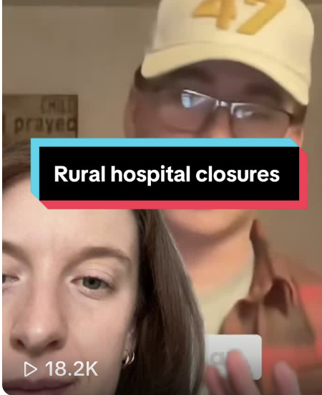
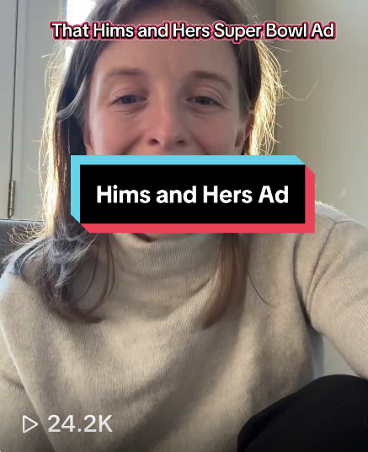
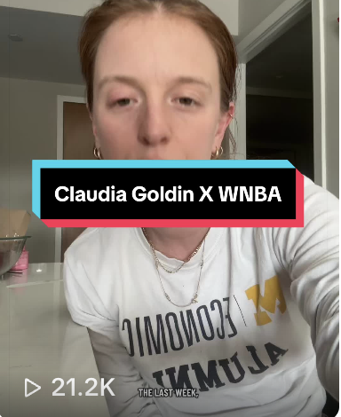
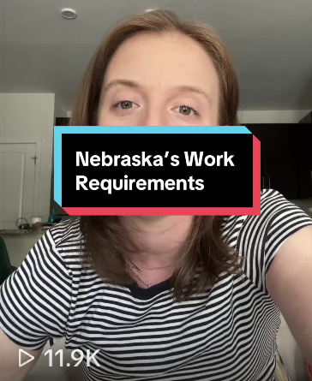
WHAT MAKES SOMETHING WORTH “SHARING”?
TIMELINESS
TIMELESSNESS
NOVELTY
RELEVANCE
IMPACT
ENTERTAINMENT
HUMAN INTEREST
PROXIMITY

Slide 6
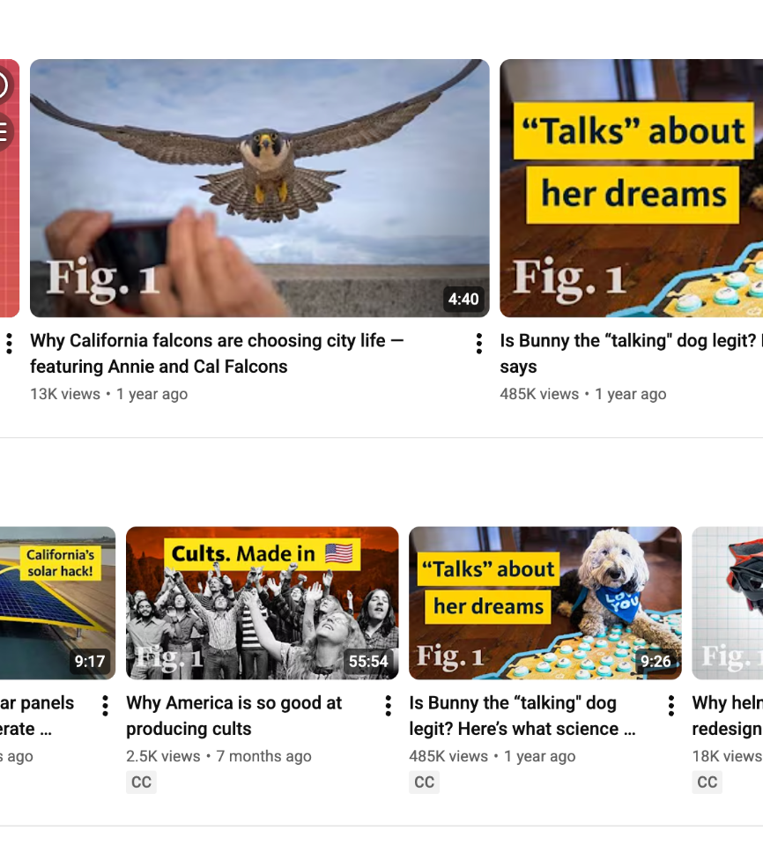
CONTENT—AND
CONTEXT—MATTER
Long or short form? Vertical or horizontal? Are they on LinkedIn or Instagram? Facebook or TikTok? YouTube or Twitter?

Slide 7
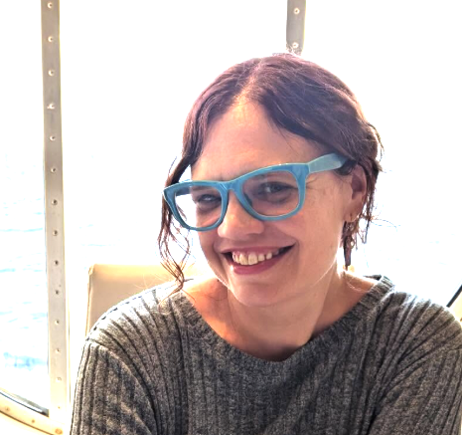

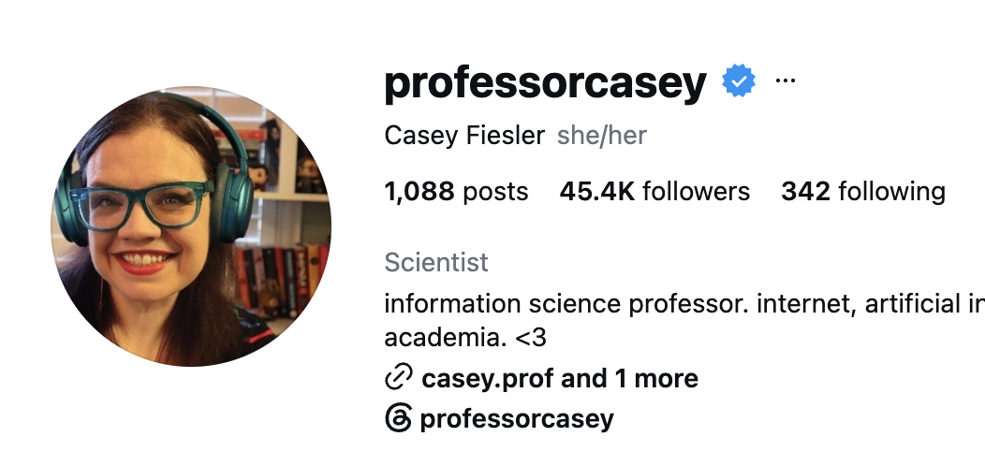
“The great thing about TikTok is …people stumble onto my content without necessarily looking for it,” said Fiesler. “There’s a dancing video and there’s a dog and then suddenly there’s me, so it’s a way to reach people, to teach them things when they might not be explicitly looking for it.”
– Casey Fiesler, University of Colorado at Boulder
Academics are increasingly using social media – especially TikTok & YouTube – to connect with new and larger audiences, demystify their work, and build community

Slide 8
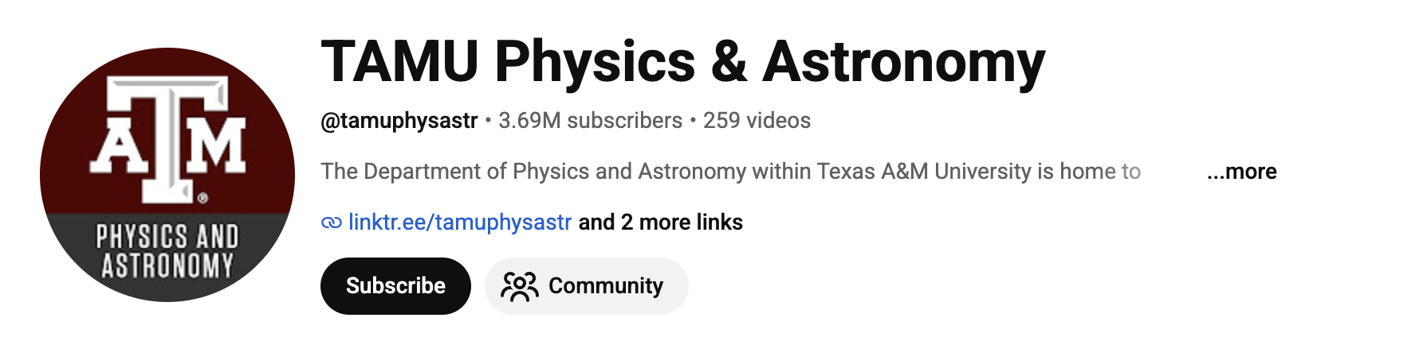
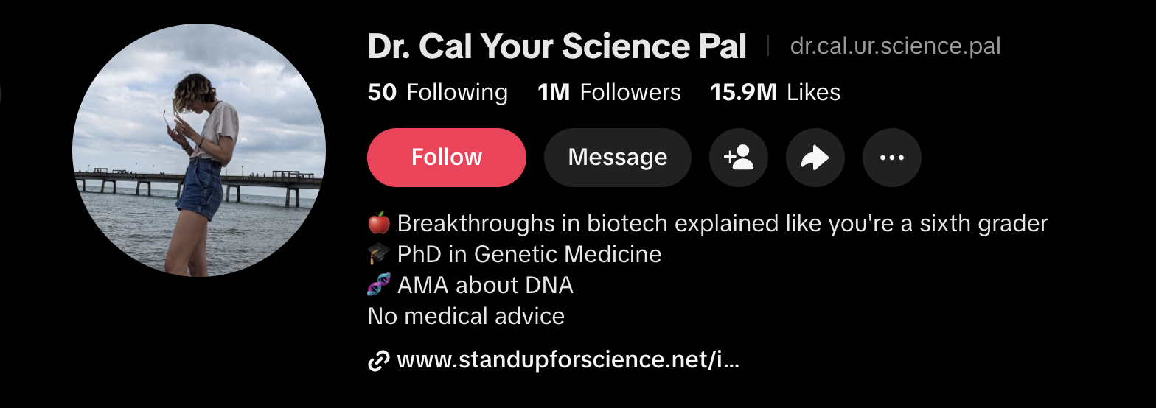
KEEP PLATFORM SPECIFICITY IN MIND
Each platform has different strengths, audiences, expectations, and algorithm quirks.

Slide 9
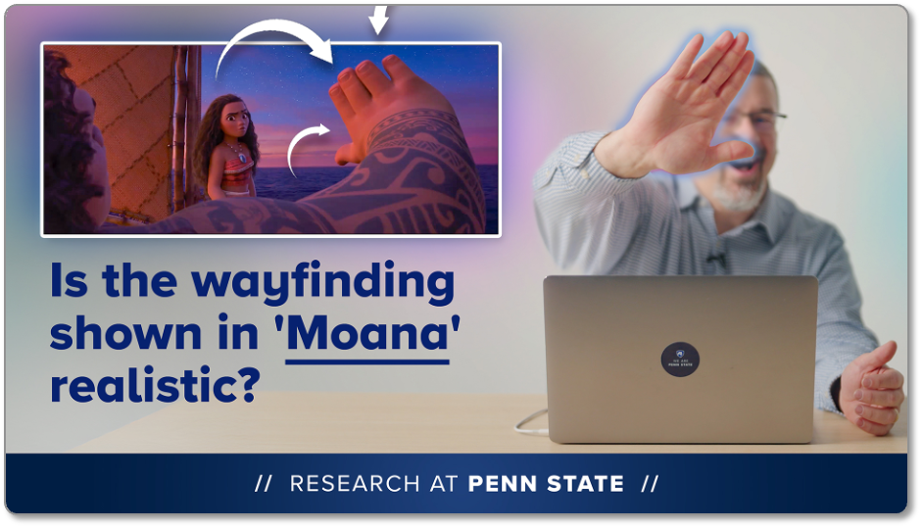
YOUTUBE
1
2
3
VIDEO ONLY
ALPHABET SOUP
KEYWORDS ARE KING
Long-form should be horizontal. Short form should be vertical
Owned by Google, so content shows up easily in search results.
SEO-driven; your keywords, video title, file name are all crucial.

Slide 10
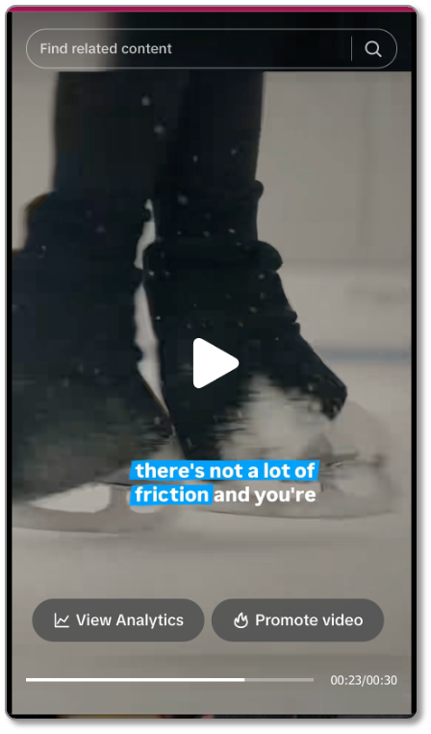
TIKTOK
1
2
3
VIDEO MAINLY
DEMOCRATIC PROCESS
SEARCH ENGINE WANNABE
Photo carousels exist but can be difficult to get views on. Not just for silly dances and kids anymore!
Algorithm treats each new video independently, so it can be easier to get views as a small account.
Becoming keyword driven as more people use it for search, making captions, descriptions, etc. critical.

Slide 11
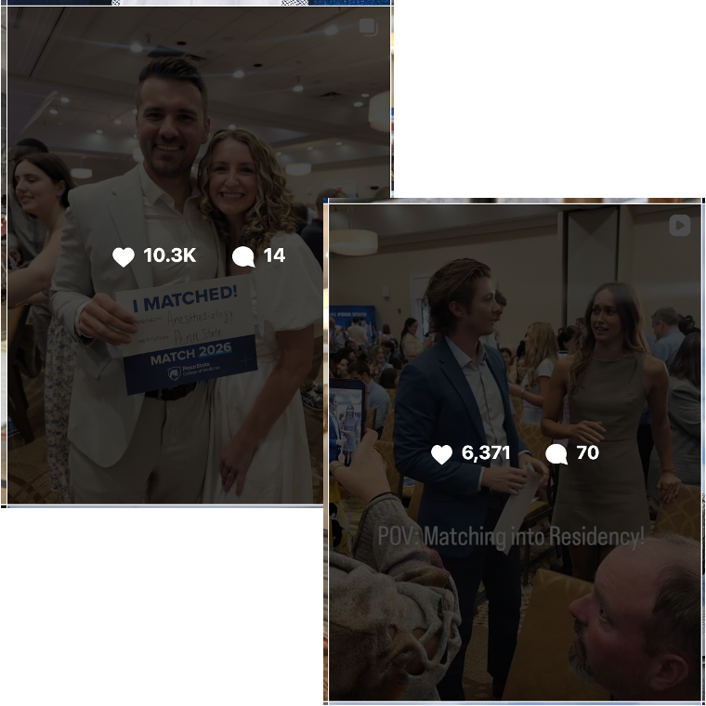
INSTAGRAM
1
2
3
PHOTO AND VIDEO
DIFFERENT FORMATS
SEARCH ENGINE DREAMS
Reels (short form video), photos (single or carousels), and Stories (short term).
Video attracts new audiences and photos speak to existing one.
Keywords are becoming critical as more people use it for search.

Slide 12
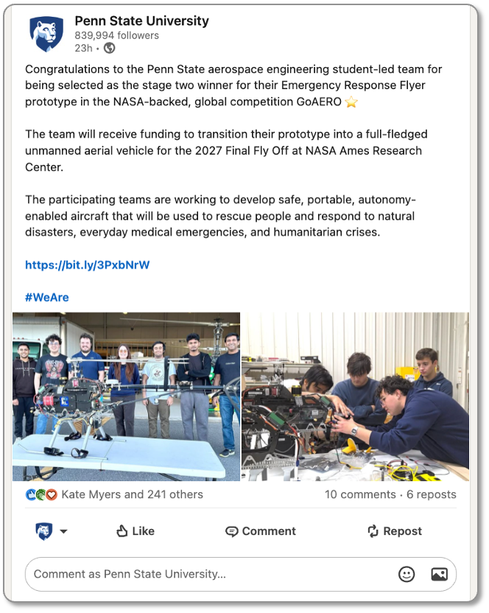
LINKEDIN
1
2
3
THE WRITTEN WORD
SO PROFESH
TOOT YOUR OWN HORN
Supports video, photos, and long- or short- form written posts with or without visuals.
More professionally oriented, but that’s beginning to change.
Easy to share links to connect with students, collaborators, and potential funders.

Slide 13
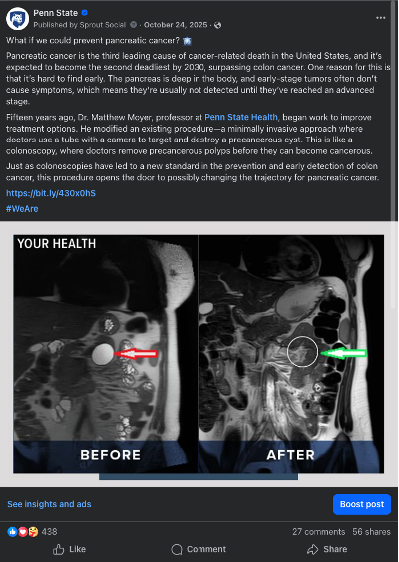
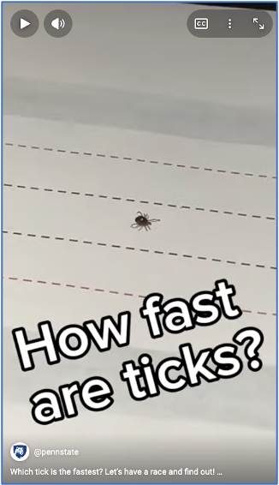
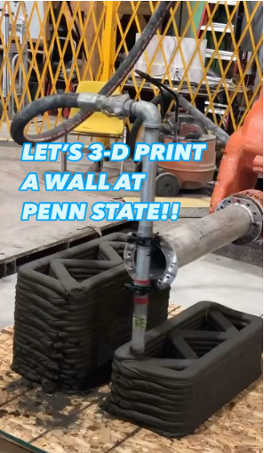
WHAT MAKES
COMPELLING CONTENT?
EYE-CATCHING DIGESTIBLE RELATABLE SHAREABLE RELEVANT

Slide 14
CREATING CONTENT
4
Am I being a good community member—following and engaging with relevant content and other creators in the space?
1
2
3
5
Always start with a clean lens! Videos don’t need to be “professional” looking—approachable tends to do better.
Make sure photos, videos, and written posts are clear and have an obvious focus; don’t put too much in one post.
With video, grab attention with the first 1-2 seconds. Start with a “hook” or a conclusion first to capture attention.
“What’s in it for me?” Show don't tell. ELI5. No graphics/time-delimited posts. BE YOURSELF; passion can take you far.

Slide 15
CONTENT
ATOMIZATION
Take one longer piece of content and utilize it in as many ways as possible across different platforms based on their individual content formats and audiences.
Record video podcast episode
Post link to post on LinkedIn
Post full horizontal video on YouTube
Post shorts on LinkedIn
Post shorts on TikTok and Instagram Reels
Post YT shorts from episode in playlist

Slide 16
RELEVANT CREATORS
Big Think
SciShow
Odd Animal Specimens
StarTalk (podcast)
Astro Alexandra
The Well
Kurzgesagt - In a Nutshell
Nightshift - Kurzgesagt After Dark
Veritasium
Sleepy Science Channel
The Diary of a CEO (podcast clips)
Fig. 1
VSauce
Crash Course
TAM Physics and Astronomy
Dr Cal Your Science Pal
Econ with Sara
Dr. Megan Wilkerson
professor casey

Slide 17
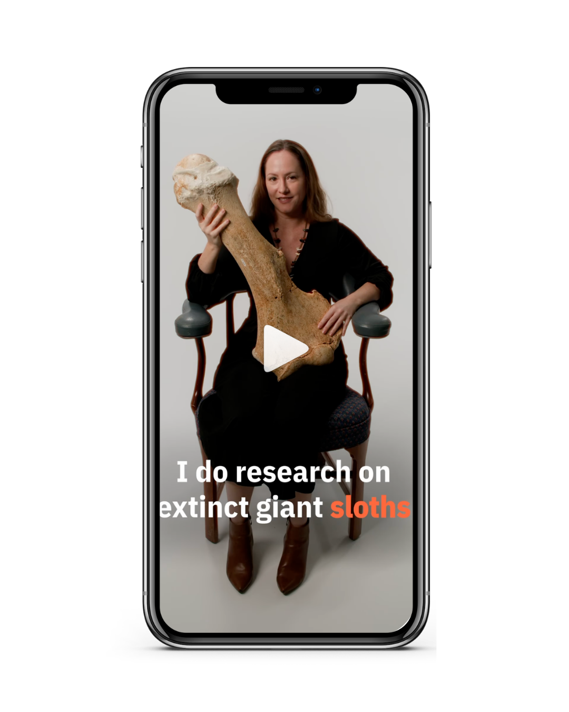
“WHAT DO YOU STUDY?”
Pick an active research project.
Turn to your partner; explain what you are doing as though to a 5-year-old.
Switch roles and repeat.

Slide 18
QUESTIONS?

Slide 19
THANK
YOU!
CONTACT OUR TEAM
cpf118@psu.edu

