Slide 1
Introduction to Copyright and Open Access Publishing
Danielle Steinhart
Interim Head, Office of Scholarly Communications and Copyright
copyright@psu.edu

Slide 2
Resources
Visit copyright.psu.edu to:
Make an appointment.
Submit a question.
Request this workshop for your college, department, or lab.
Find more resources on copyright and scholarly communications.

Slide 3
Plan for Today
Copyright Basics
Fair Use
Copyright Duration
Copyright Infringement vs. Plagiarism
Creative Commons and Public Domain
Open Access Publishing

Slide 4
What is Copyright?
In the U.S., copyright aims “To Promote the Progress of Science and useful Arts.”
It gives authors certain rights in their works, and it limits the authors’ rights by recognizing rights for users.
Intro to Copyright and Open Access Publishing by Danielle Steinhart of the Penn State Libraries is licensed under CC BY 4.0.

Slide 5
To Avoid Copyright Infringement, Ask Yourself:
Is the work protected by copyright?
Is your use the kind that copyright regulates?
Do any users’ rights, such as fair use, apply?
Who holds the copyright? Have they already made any licenses that would permit your use?

Slide 6

Is the work covered by copyright?
Is it the sort of thing copyright covers?
Original AND fixed
Not an invention, idea, fact, etc.
Not a U.S. federal government work
What's not covered by copyright?
Ideas, procedures, systems, methods of operation, concepts, principles, or discoveries
Federal government works

Slide 7
The sort of thing copyright covers
Copyright covers works of authorship that are:
Original
Possessing at least a modicum of creativity
The independent creation of their author(s)
Fixed in a tangible medium of expression
Copyright does not cover works created by officers or employees of the U.S. government in their official duties.

Slide 8
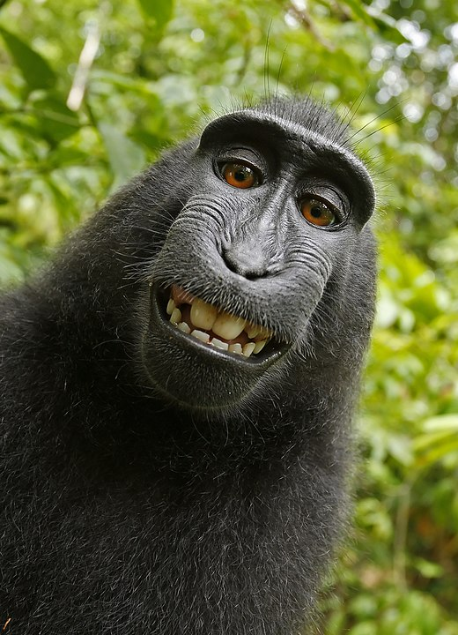
Works must be created by a human being to get copyright protection
Macaca Selfie from Wikimedia is in the Public domain

Slide 9

Copyright Duration
A work created in the U.S. today will be covered by copyright in the U.S. until 70 years after the death of the author.
Under earlier copyright regimes, there were many other ways a work could enter the public domain.
Key dates (as of 2020)
Works created after March 1, 1989 are under copyright (unless by U.S. government).
Works published prior to 1925 are public domain.

Slide 10
Copyright Registration
In addition to establishing a public record of a copyright claim, registration offers several other statutory advantages:
Before an infringement suit may be filed in court, registration (or refusal) is necessary for U.S. works.
Registration establishes prima facie evidence of the validity of the copyright and facts stated in the certificate when registration is made before or within five years of publication.
When registration is made prior to infringement or within three months after publication of a work, a copyright owner is eligible for statutory damages, attorneys’ fees, and costs.
Registration permits a copyright owner to establish a record with the U.S. Customs and Border Protection (CBP)4 for protection against the importation of infringing copies.

Slide 11
Does copyright regulate your use?
Reproduction
Derivative Works
Distribution to the Public
Public Performance and Display

Slide 12
How can I use this work?
Do any user's rights apply?
Fair use (107)
Reproduction by libraries and archives (108)
First sale (109)
Exemption of certain performances and displays (110)

Slide 13
Fair Use Factors
the purpose and character of the use, including whether such use is of a commercial nature or is for nonprofit educational purposes;
the nature of the copyrighted work;
the amount and substantiality of the portion used in relation to the copyrighted work as a whole; and
the effect of the use upon the potential market for or value of the copyrighted work.

Slide 14
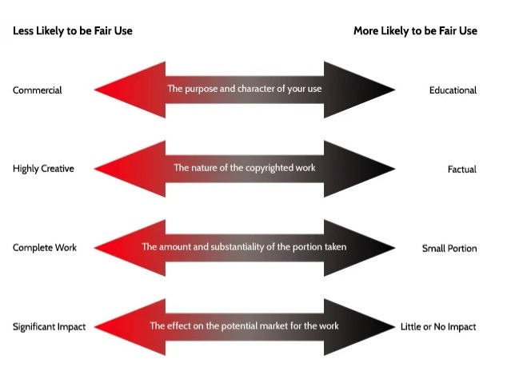
Intro to Copyright and Open Access Publishing by Danielle Steinhart of the Penn State Libraries is licensed under CC BY 4.0.
The Four Factors by Georgetown University Library is licensed under a Creative Commons Attribution NonCommercial 4.0 International License.

Slide 15
Public Domain
Federal Government Works
Copyright has expired
Released into the Public Domain
Intro to Copyright and Open Access Publishing by Danielle Steinhart of the Penn State Libraries is licensed under CC BY 4.0.

Slide 16
Public Licenses
The rightsholder is the licensor, and everybody else is the licensee.
Examples:
MIT License
BSD Licenses
GNU General Public License
GNU Free Documentation License
Creative Commons Licenses

Slide 17
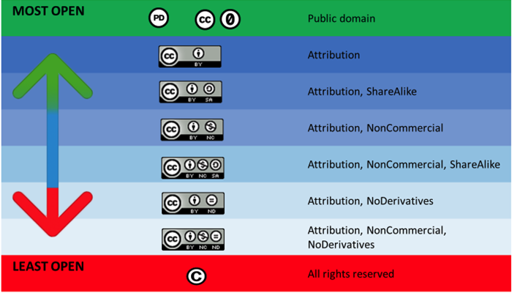

Slide 18
Which Creative Commons license should I use?
Find more information on licenses:
Our Creative Commons licenses webpage
Creative Commons About CC Licenses page

Slide 19
Types of Open Access for Articles
Green OA
Gold OA with an APC
Article Processing Charges (APC) page
Diamond OA (Gold OA with no APC)
Intro to Copyright and Open Access Publishing by Danielle Steinhart of the Penn State Libraries is licensed under CC BY 4.0.

Slide 20
Penn State Open Access Policy
AC02 Open Access to Scholarly Articles

Slide 21
Reminder Emails
Before sending, RMD checks:
If the article is open access on the publisher’s website or in an open access repository
If a copy of the article has been uploaded in Activity Insight for the Libraries to deposit in ScholarSphere
If the researcher is currently affiliated with Penn State
If the researcher or any PSU coauthor has waived the OA policy for this article
If an article is mentioned in a reminder email, we need help from the researcher or a proxy to make it open.

Slide 22
Article Versions
Pre-print
Accepted Manuscript (aka post print)
Final Published Version (aka Version of Record)

Slide 23

Need Help?
Email openaccess@psu.edu to
Ask questions
Have us deposit the file for you
Request a waiver

Slide 24

APC Discounts for Penn State Authors
Full list of discounts is in our Open Access guide.
Highlights:
ACS
Cambridge University Press
Springer
SAGE
Springer
Taylor & Francis
Wiley
Intro to Copyright and Open Access Publishing by Danielle Steinhart of the Penn State Libraries is licensed under CC BY 4.0.

Slide 25
U.S. Federal Agency Public Access and Publisher Policies
Resources
SPARC Core Elements of Federal Public Access Policies
SPARC Guide for Authors Complying with U.S. Federal Agency Public Access and Publisher Policies

Slide 26
More Questions?
copyright@psu.edu

Slide 27
Attributions
The following resources were used in preparing this presentation:
Teaching Copyright by EFF is licensed under CC BY 3.0 US.
www.copyright.gov is in the Public Domain.
www.creativecommons.org is licensed under CC BY 4.0.
The public domain and 5 things not covered by copyright by Timothy Vollmer is licensed under CC BY 4.0.
Test Your Knowledge from www.copyright.gov is in the Public Domain.
Introduction to Copyright by Ana Enriquez of the Penn State Libraries and is licensed under CC BY 4.0.
Circular 1 Copyright Basics from www.copyright.gov is in the Public Domain.
Using Creative Commons Licensed Material by Amanda Larson and Ana Enriquez. It is licensed under a CC BY 4.0.
Workshop in a Box: Copyright for Grad Students by Authors Alliance and is available under a CC BY 4.0 license.

