Slide 1
Testing Efficient Methods for Emergency Updates on the Campus Map
Chris Sternberger

Slide 2

How can we make quick updates to our campus map to alert people of emergencies?

Slide 3
GeoJSON
GitHub
GitHub Gist
Raw Git
JSFiddle

Slide 4
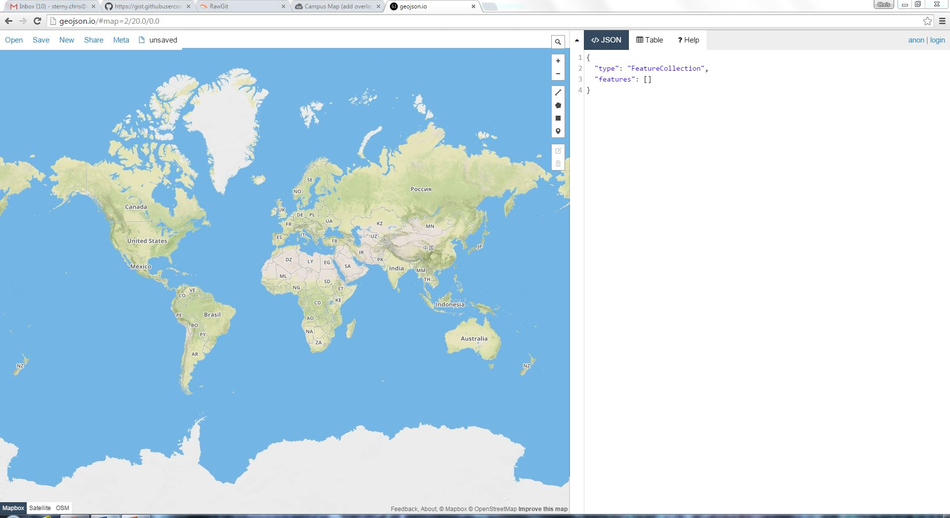
GeoJSON
A quick, simple tool for creating, viewing, and sharing maps
Uses mapbox, OSM, and satellite basemaps
Works with JavaScript (hence Geo JavaScript Object Notation)

Slide 5
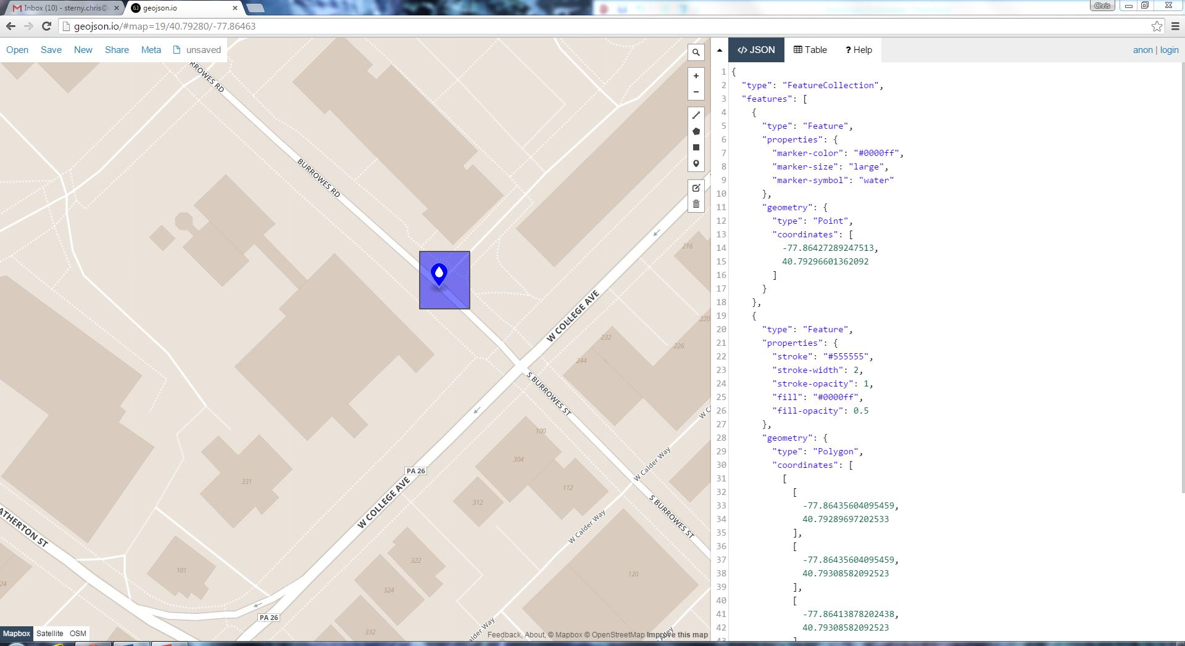
GeoJSON
A quick, simple tool for creating, viewing, and sharing maps
Uses mapbox, OSM, and satellite basemaps
Works with JavaScript (hence Geo JavaScript Object Notation)

Slide 6
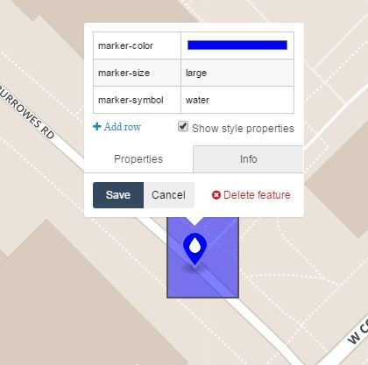
Simple, easy to use attribute table and customization (not without a couple pitfalls, however)

Slide 7
GeoJSON
A quick, simple tool for creating, viewing, and sharing maps
Uses mapbox, OSM, and satellite basemaps
Works with JavaScript (hence Geo JavaScript Object Notation)

Slide 8
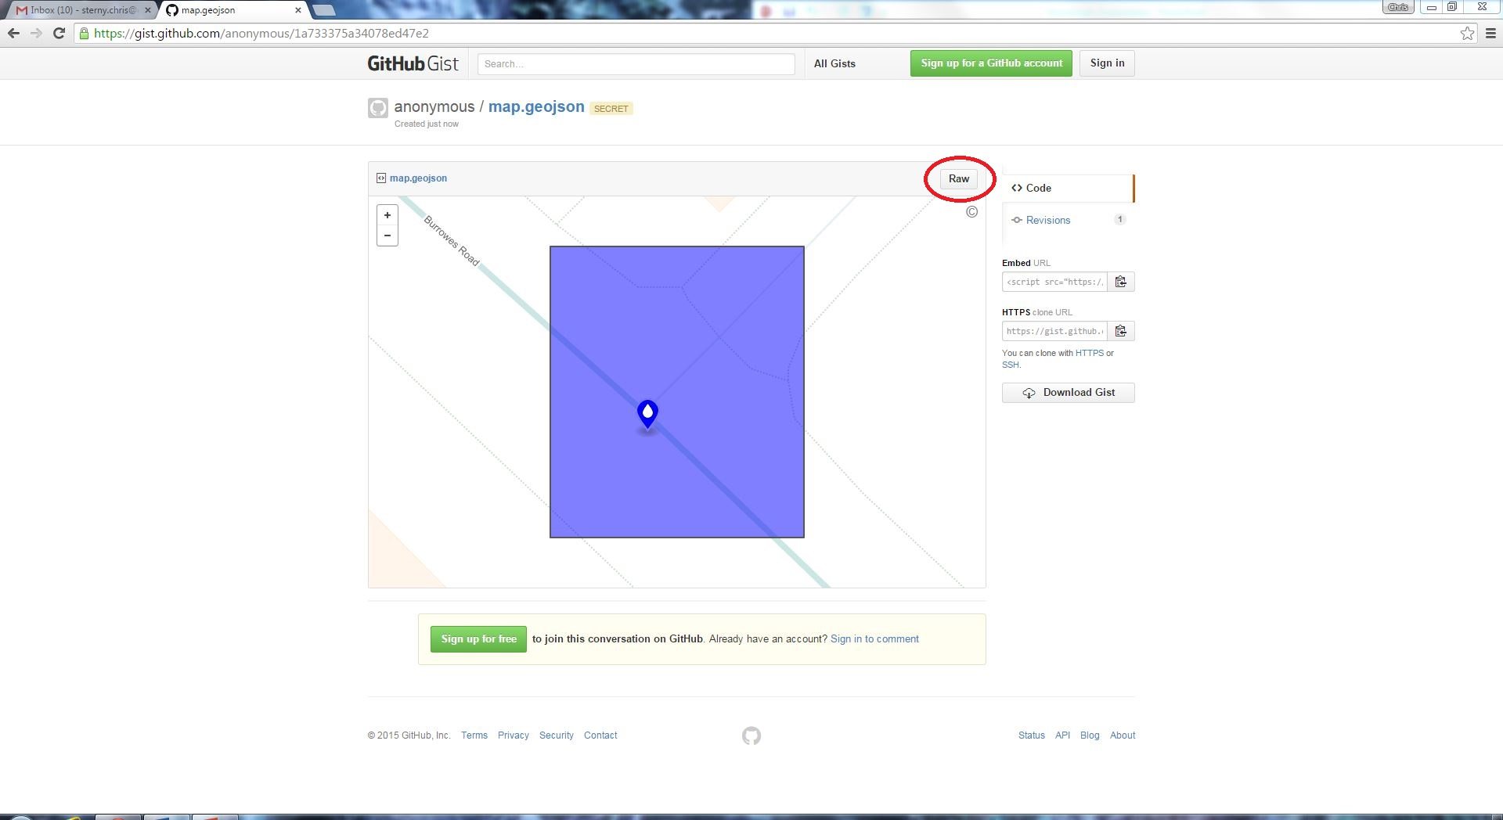
GitHub
A social network for programmers and developers
Allows sharing and publishing of code to easily collaborate on projects
“Repositories” contain all of the code of the projects
“The software that builds software” -The New Yorker, August 7th, 2013

Slide 9
GitHub Gist: a simple way to share “snippets and pastes” with others.

Slide 10
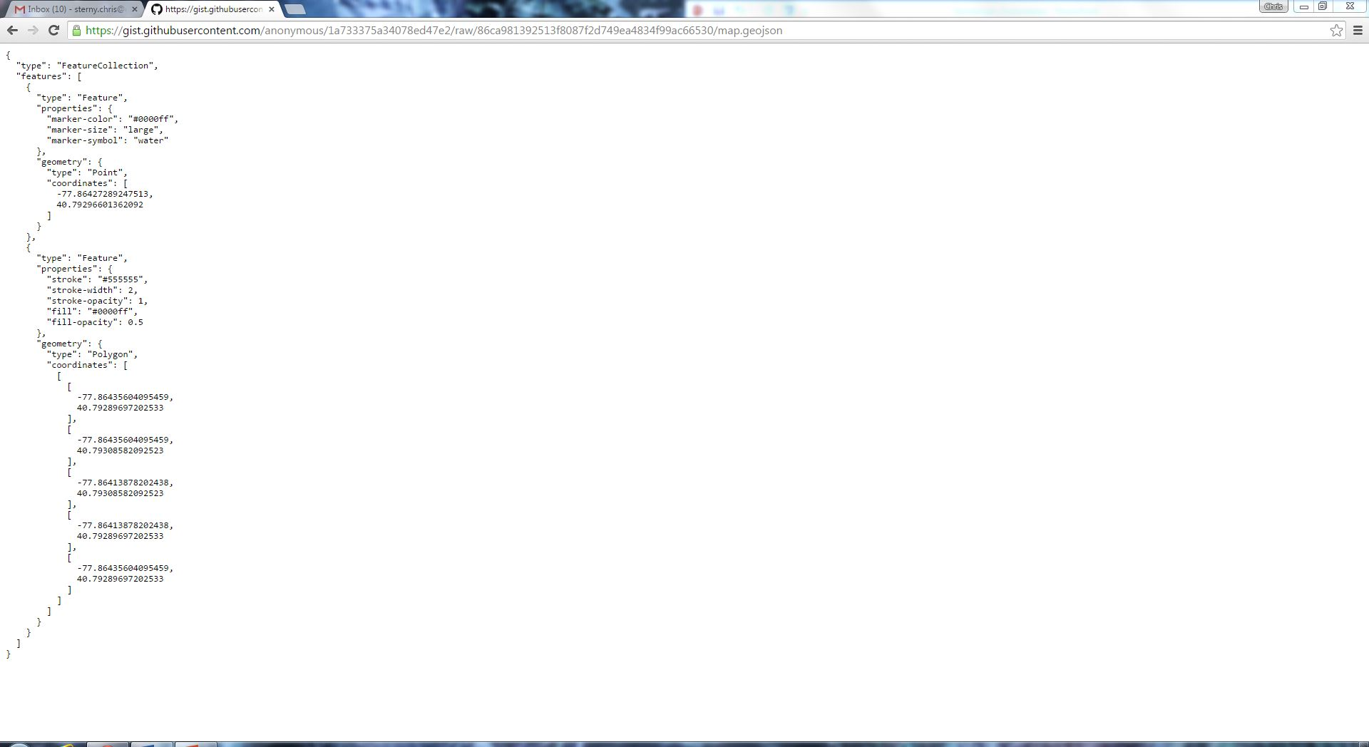

Slide 11
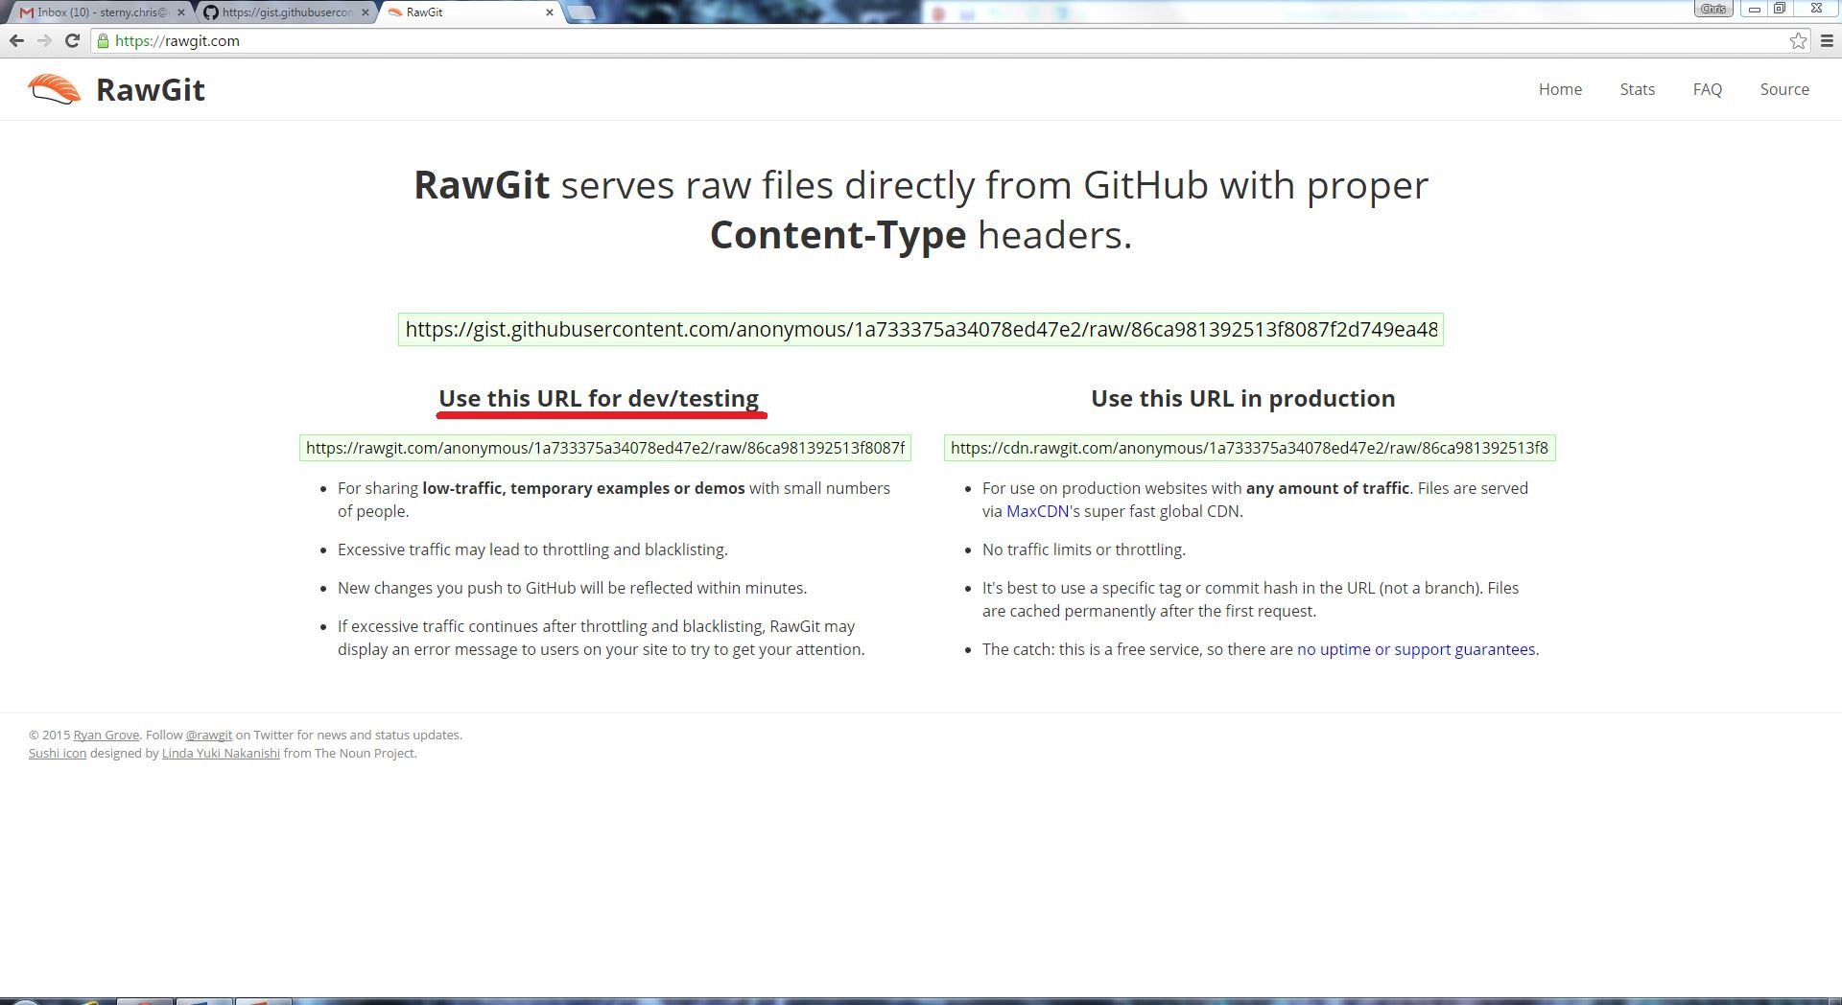
RawGit
Ensures that minimal load is placed on GitHub, and you get quick and easy static file hosting directly from a GitHub repository

Slide 12
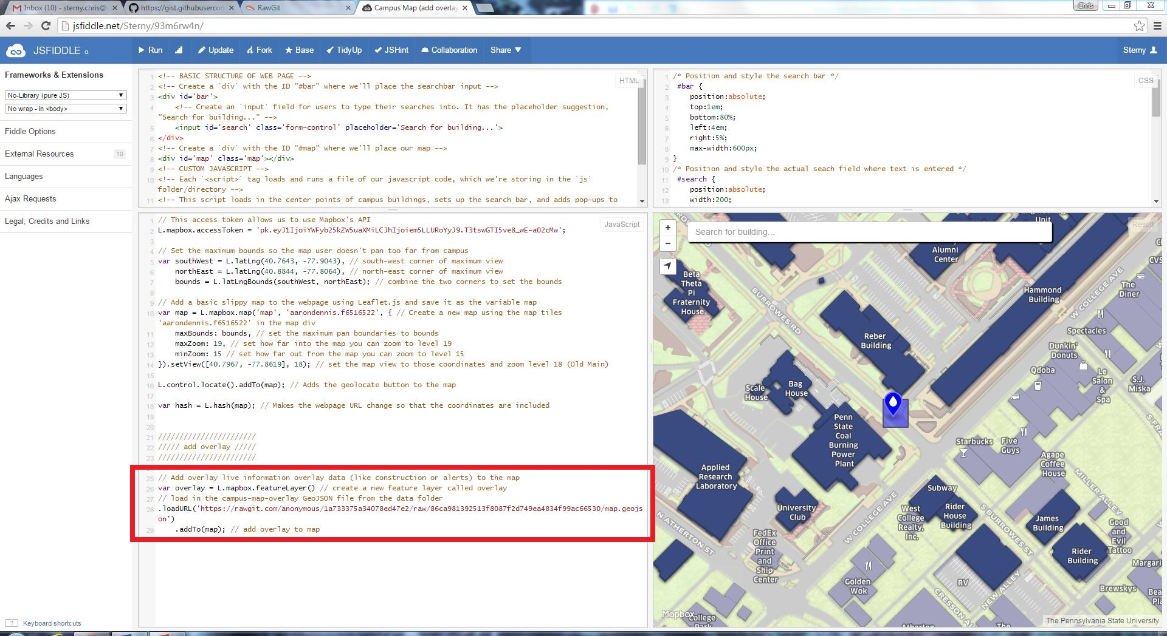
JSFiddle
A web based tool that lets you edit website code and see a simulation of the live result
4 quadrants

Slide 13

JSFiddle
A web based tool that lets you edit website code and see a simulation of the live result
4 quadrants

Slide 14


Potential User Issues
Is there a standard for using certain symbols for specific emergencies?
i.e. If there is a car accident, one user might use a road block symbol “ “ while another may use a car symbol “ “
A set of standard criteria must be created
The audience must be considered as well
They symbols used must have an inherent nature as to be easily interpreted by the audience

Slide 15
Workflow
Make edits in geojson.io. Save to “anonymous” github and click link (will be taken to GitHubGist
From GithubGist, select “Raw”
Copy the URL for the raw code, and paste into rawgit.com
Take the new URL on the lower left under the title “Use this URL for dev/testing”, and navigate to jsfiddle.net
Paste the given code using the command .loadURL(‘URL goes here’)
This is on line 28 in the example
Once the new URL is in place, click the run button on the tabs at the top left of the page.
The result in the lower right window is a simulation of what will be integrated into the campus map.

