Slide 1
Emergency Management
Everleigh Stokes

Slide 2
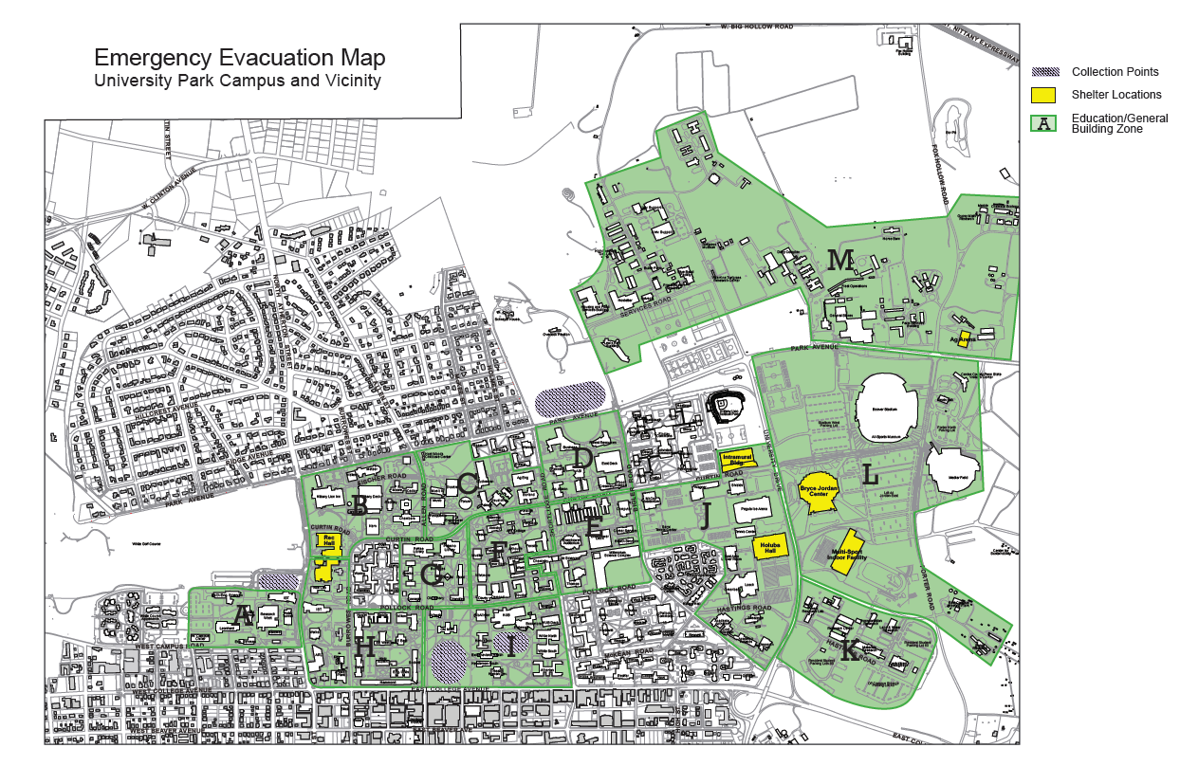
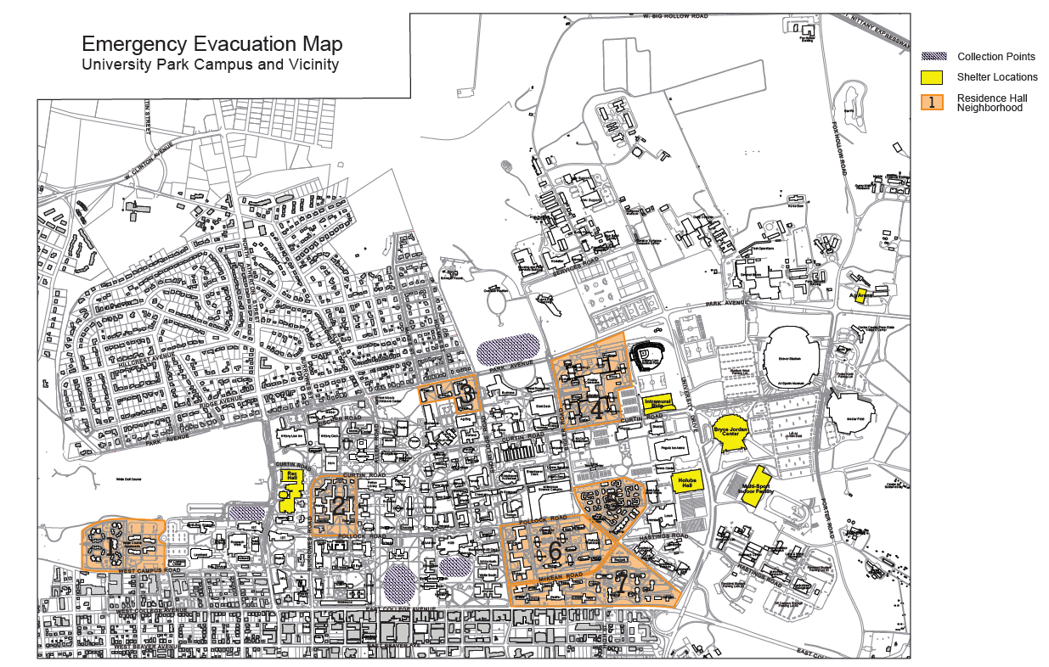
Protective Action Annex
CADD drawings
Low Access
Niche Audience

Slide 3
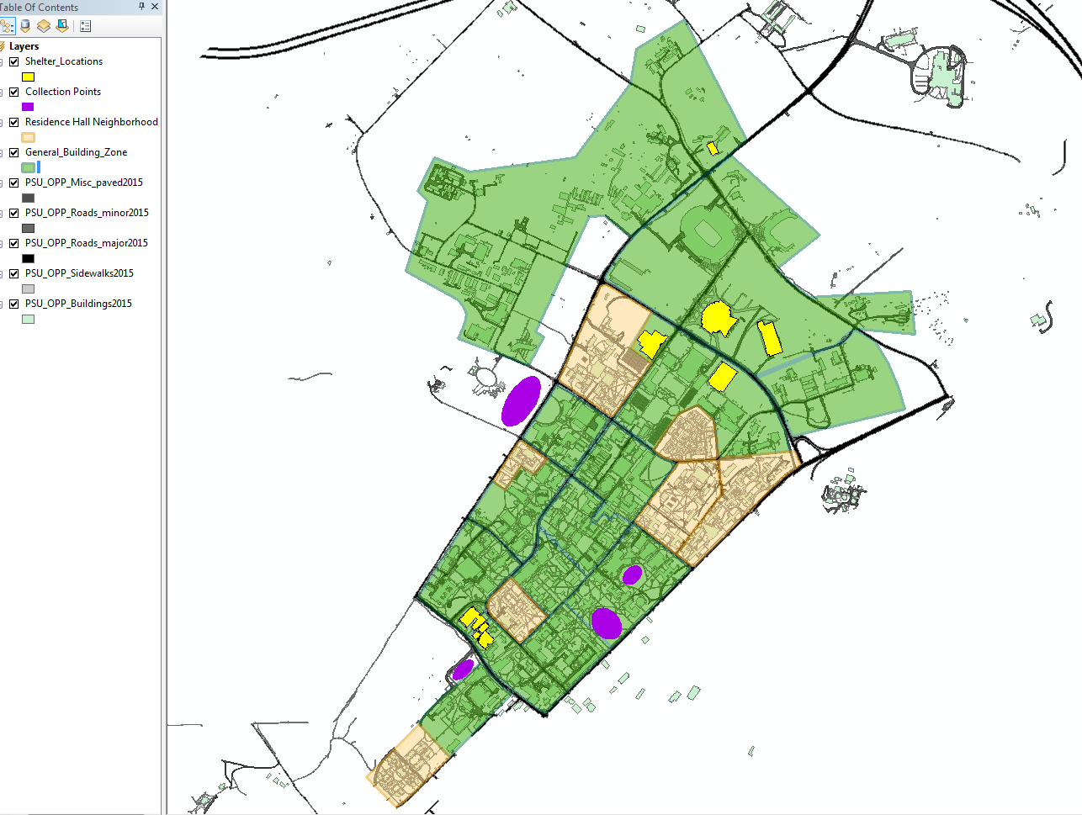
Campus Map Layers
Shapefiles
Including layers within MapBox

Slide 4
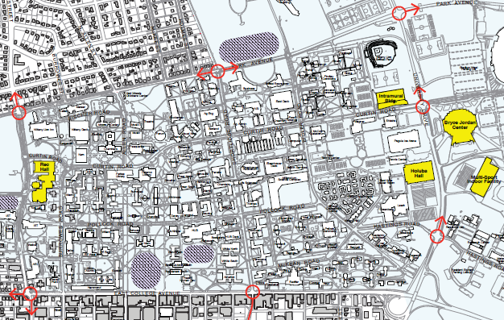
Future Steps
Security access for layers
Traffic controls
Search tool
“How do I get from Walker to the Arboretum using emergency management routing?”

