Slide 1
Database of building information (TO BE USED FOR POP-UPS)
Jake Simon- Geography 467

Slide 2
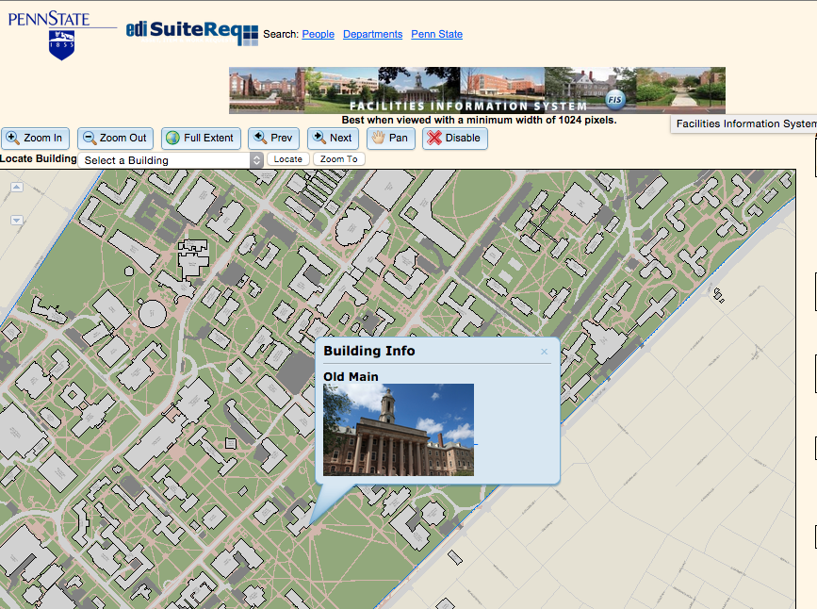
What already exists?
PSU OPP DATA FOR XXX BUILDINGS- GUESS!

Slide 3
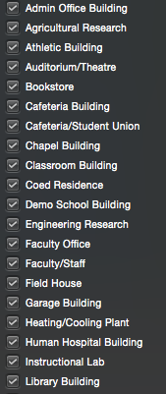
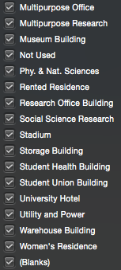
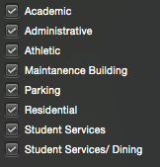
functions
HAD TO FILTER/CONDENSE ALL EXISTING FUNCTIONS

Slide 4
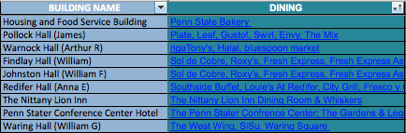
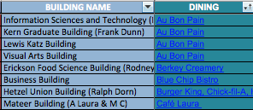
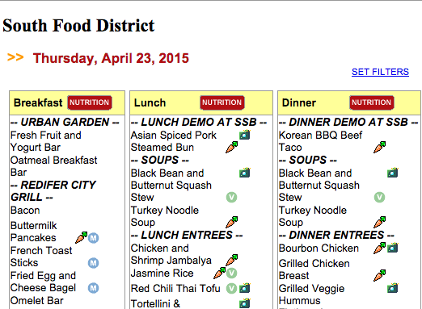
PLACES TO EAT
http://www.foodservices.psu.edu/FoodServices/CampusDiningOptions/au-bon-pain.cfm
EVEN TODAY’S MENU LINKS!

Slide 5
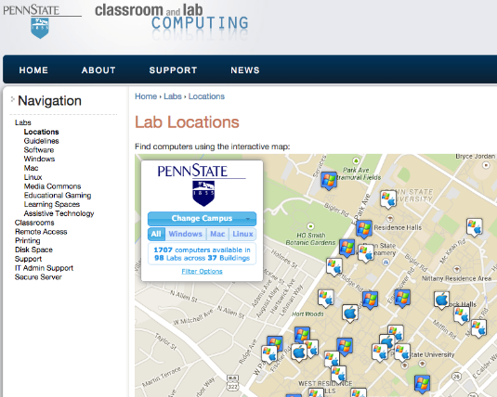
Computers around campus
A MAP ALREADY DISPLAYING THE INFORMATION WE WANT TO INCLUDE

Slide 6
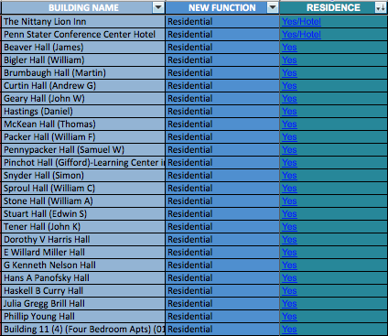
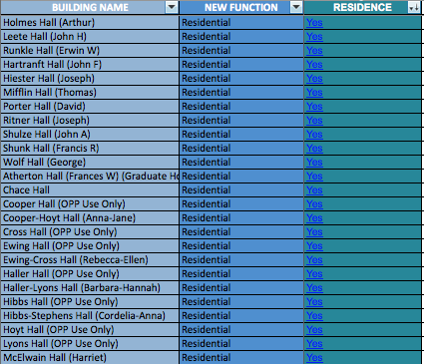
WHERE CAN I LIVE?
http://www.hfs.psu.edu/housing/housing/residence-areas/east-halls.cfm
http://www.hfs.psu.edu/housing/housing/residence-areas/west-halls.cfm
EVEN FOR MARRIED STUDENTS= WHITE COURSE

Slide 7
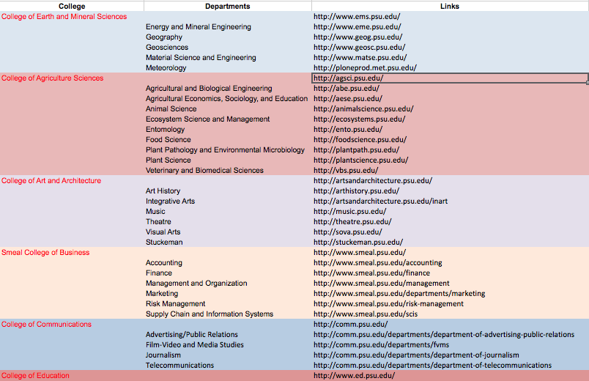
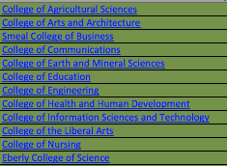
colleges
TOO DIFFICULT TO SEPARATE BY DEPARTMENT

Slide 8

THINGS FOR THE FUTURE
NAMES:
Walker (Eric A.) ----> Walker Building
MICHELLE!
ABBREVIATIONS:
Hetzel Union Building ----> HUB
MICHELLE!
MULTIPLE SERVICES:
Walker Building = Dept. of Geography
& Dept. of Meteorology
POSSIBLE CHANGES TO MAKE THE DATASET EVEN BETTER!

Slide 9
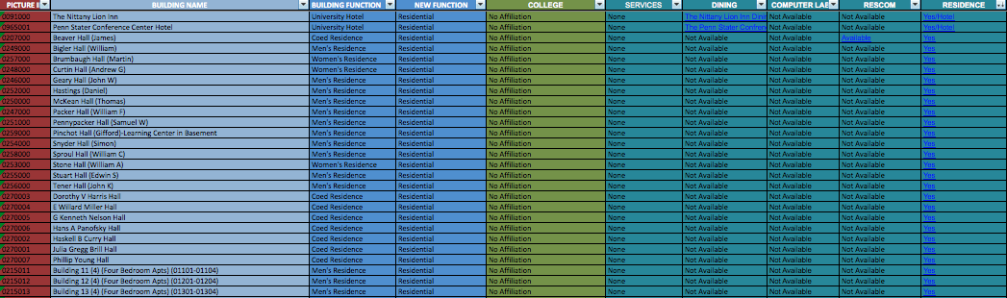
…DATASET WAS MADE TO HELP FORM THE BUILDING POP-UP INFORMATION
SEE MICHELLE, WILL & BRITTANY FOR HOW THEY TOOK THIS INFO AND MADE IT INTO A POP-UP!

