Slide 1
Golf Course Data Enrichment
By Braden Crowell

Slide 2
Preliminary Research
What type(s) of information should be gathered
Limited documentation available
How to go about obtaining it accurately
What are the acceptable ways to represent it within Open Street Map

Slide 3
Models
Two courses in major championships used:
Augusta National in Georgia
Royal and ancient golf club of St. Andrews
Several key features found in both
Hole number
Dogleg line
Teebox
Fairways & Greens properly represented
Par
Blue & White courses lacked all of these

Slide 4
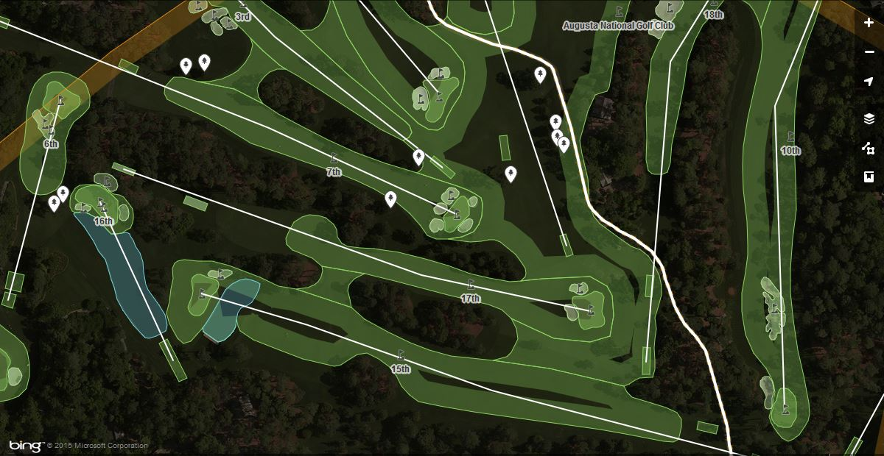
Augusta National

Slide 5
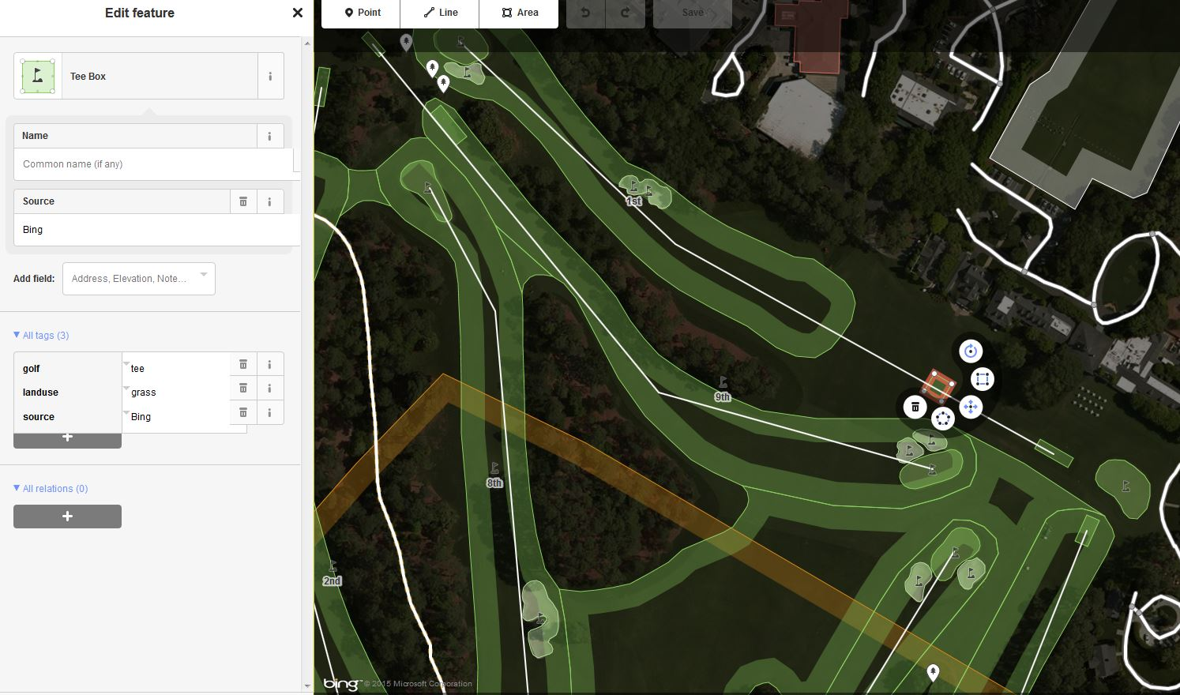
Tee box example

Slide 6
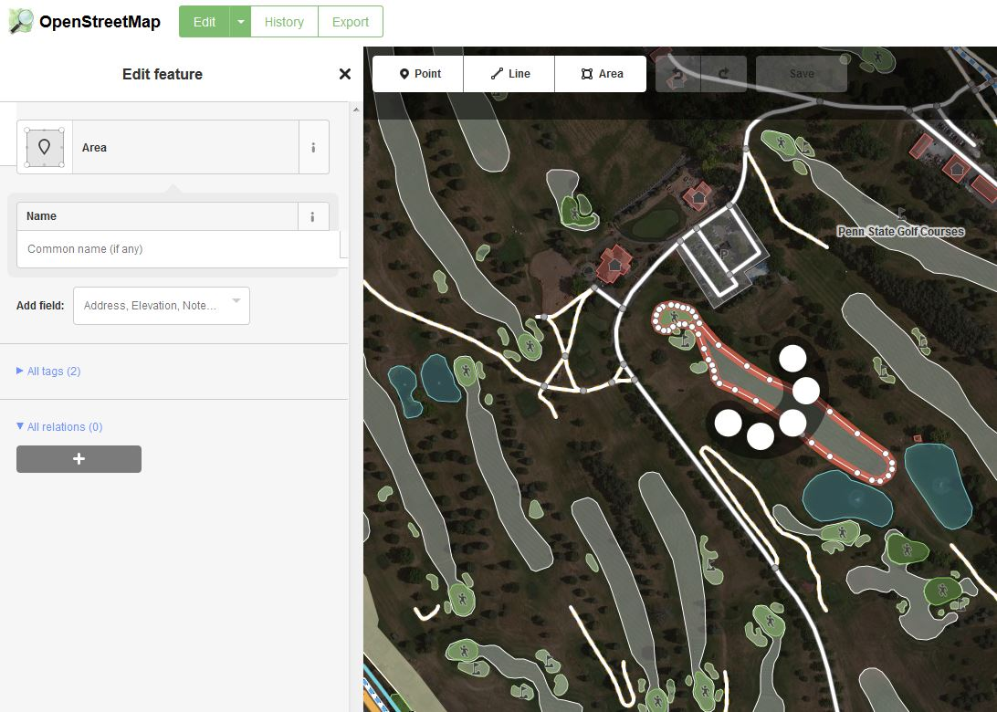
Blue & White Courses

Slide 7
Gathering Necessary Data
First step in obtaining data was physically visit pro shop
Paper map of course exists but lacks detail
Used as a reference
Out of date
Using aerial imagery from OSM & a golf cart, necessary features were documented

Slide 8
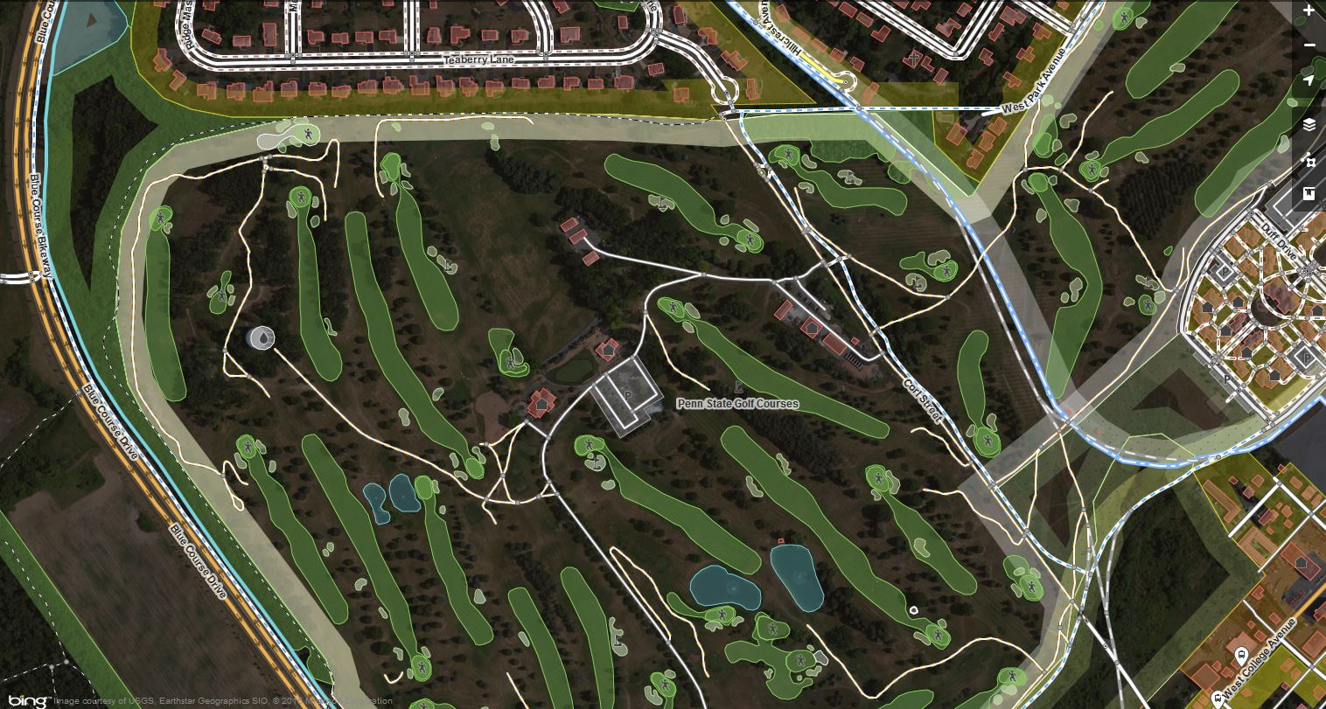

Slide 9
Updating the map
Digitizing all of the features collected
Adding hole number as common name
Par added as tag
Features added specific to B&W course:
Blue tee yardage distance added as tag
Points specifying which part of course is B/W
Yardage distances found on course website scorecard

Slide 10
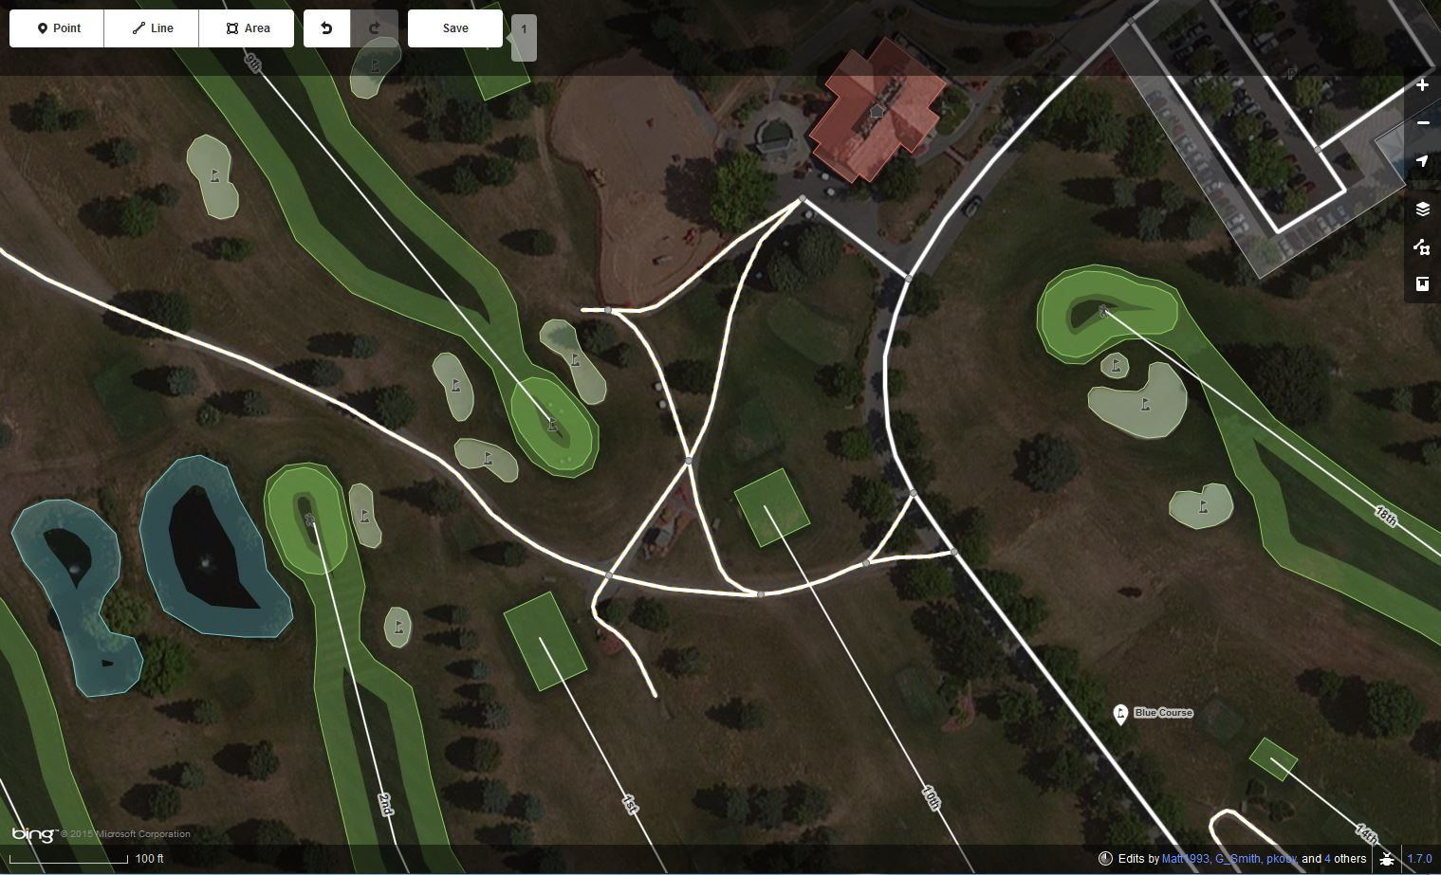

Slide 11
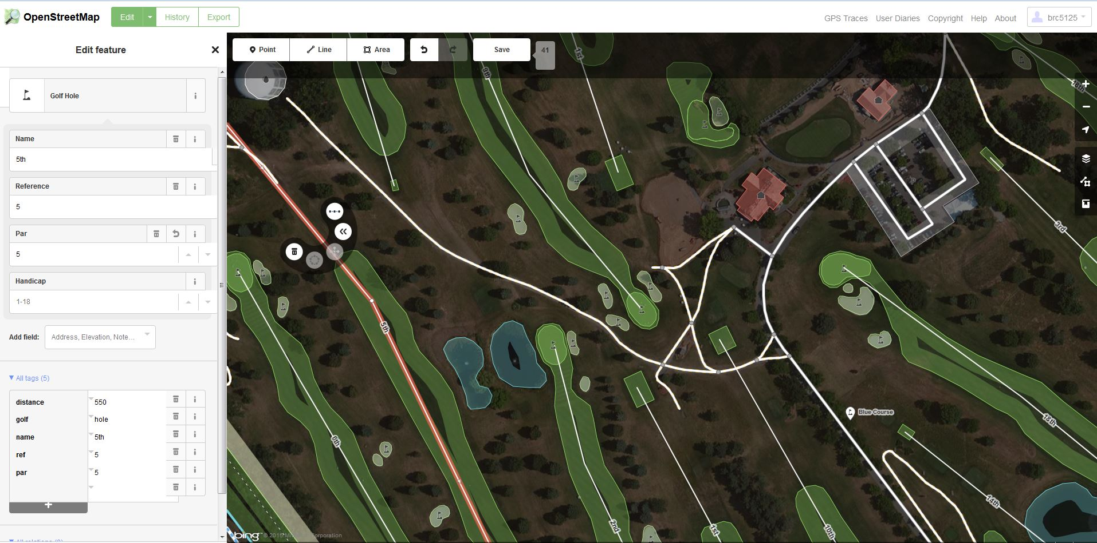

Slide 12
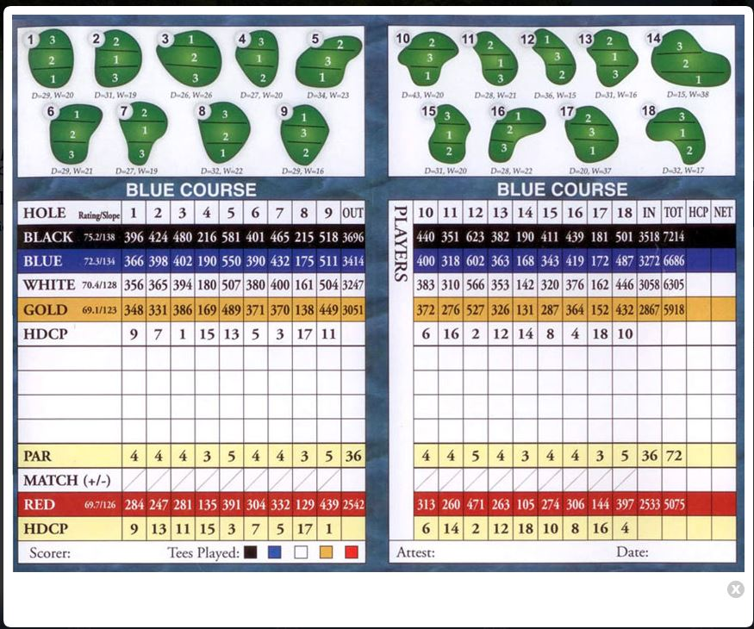

Slide 13
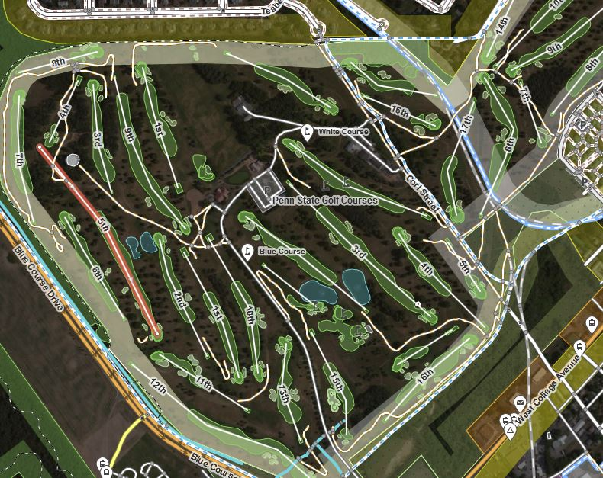
Finished product

Slide 14
Future Updates
Digitizing additional tee boxes
Yardage updates for white, red, & gold tees
Cart paths added
Research into standard practice
Trees represented by points
Using models similar to Augusta

Slide 15
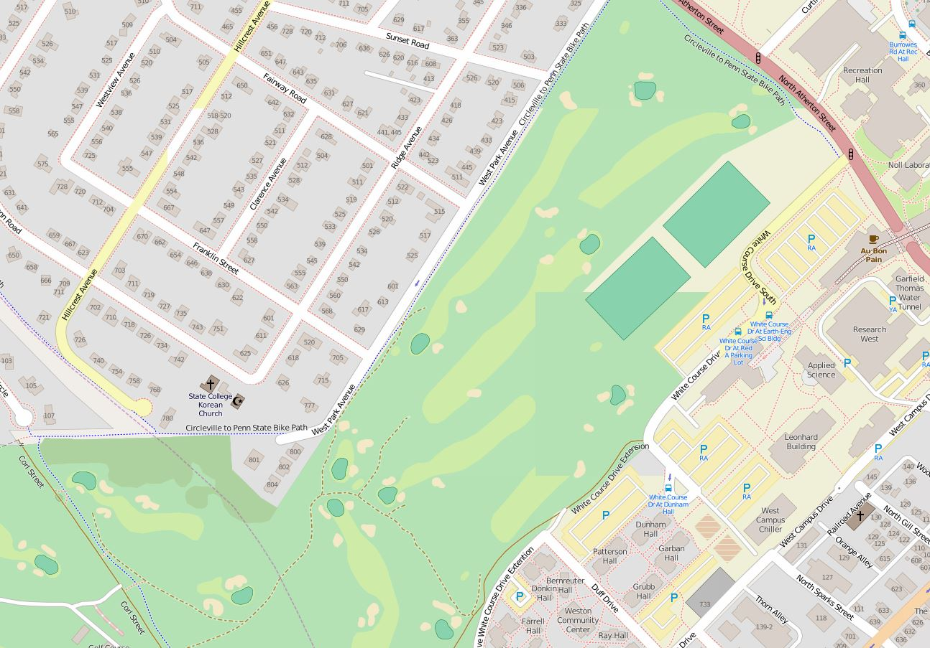
Additional Images: Before

Slide 16
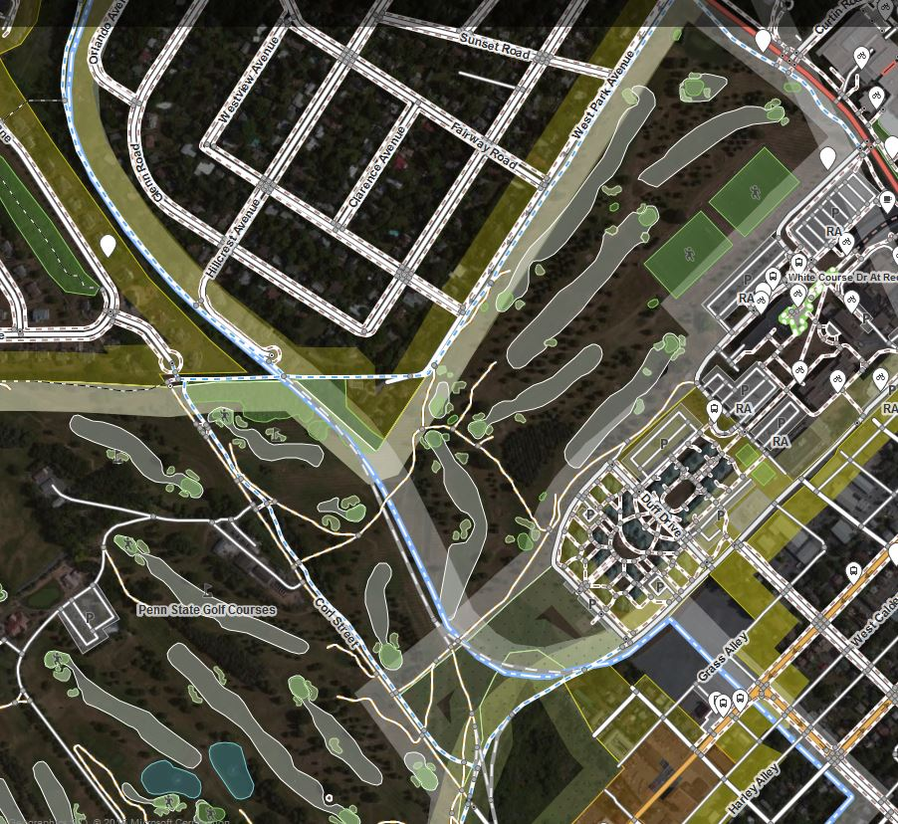
Initial OSM data

Slide 17
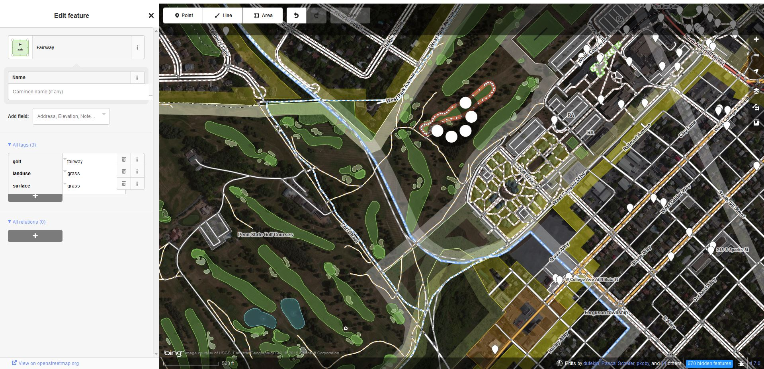
Updating Fairways

