Slide 1
Temporary and Planned Road Closures & Changes
Brad Guay GEOG 467 April 28, 2015

Slide 2
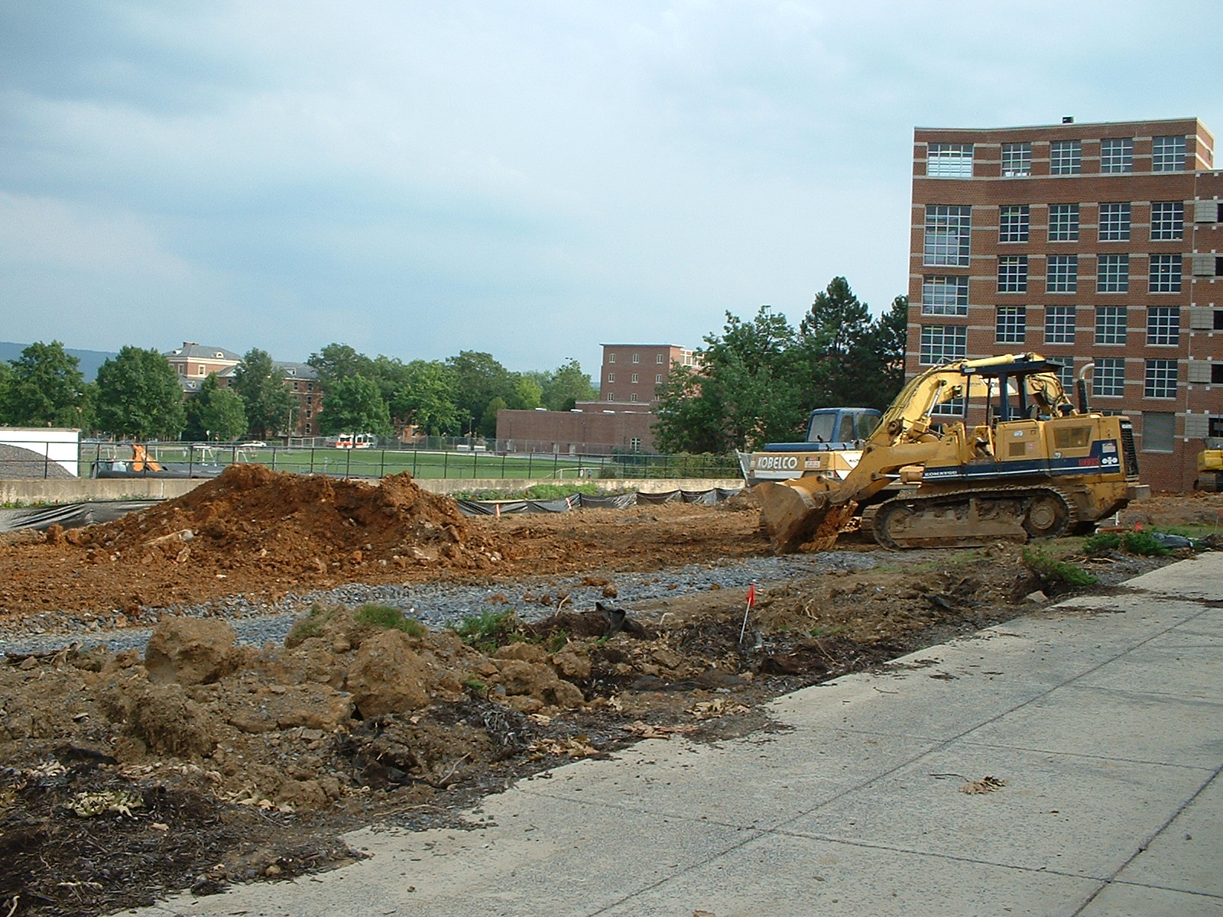
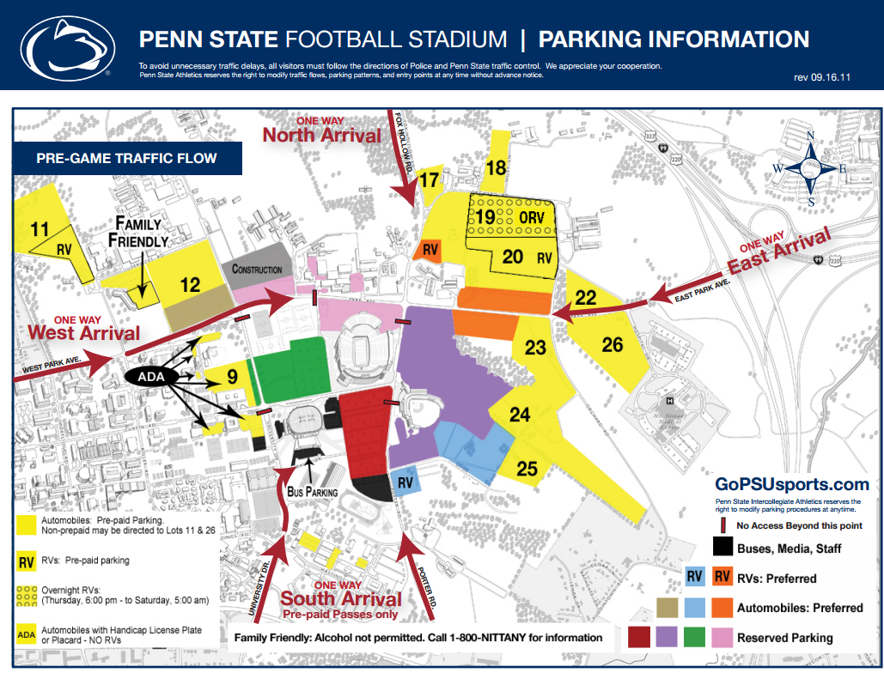
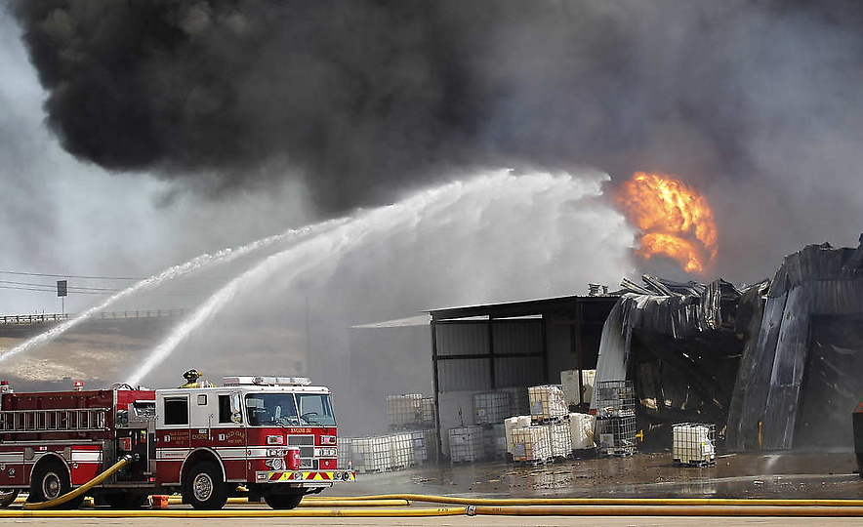
Introduction
Campus roads are closed and rerouted on both a planned and unplanned basis
Football games
Construction
Emergencies

Slide 3
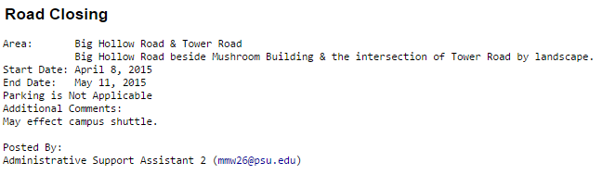
Sources of Information
Football parking maps
PSU Emergency Alerts
OPP Alerts
http://apps.opp.psu.edu/alerts.cfm
Must be translated from text form to GIS

Slide 4
Editing OpenStreetMap
OpenStreetMap can be edited with conditional access tags
Access on roads can be changed for certain dates
This works best with planned closures

Slide 5
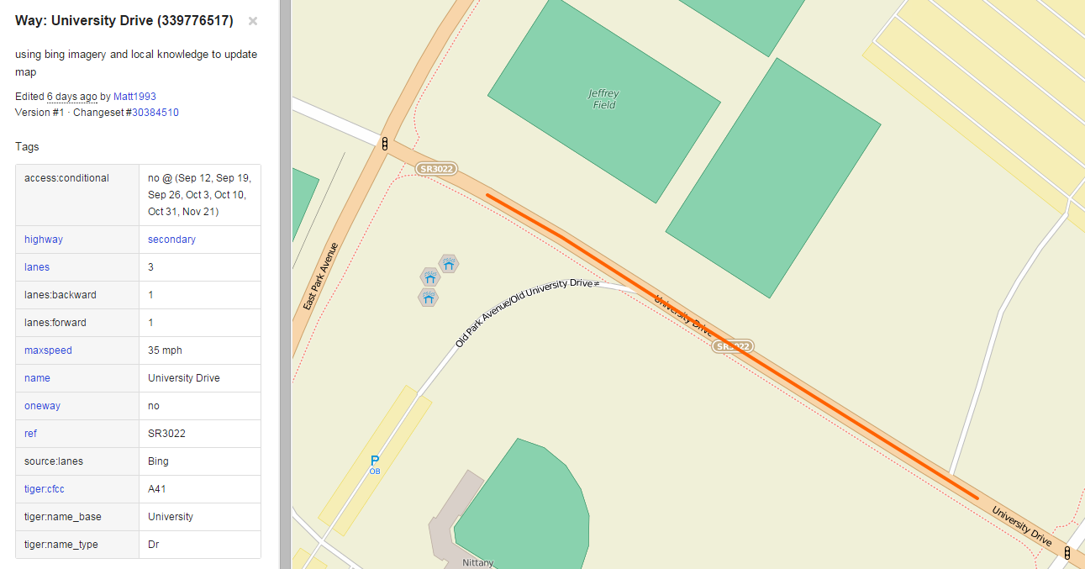

Slide 6
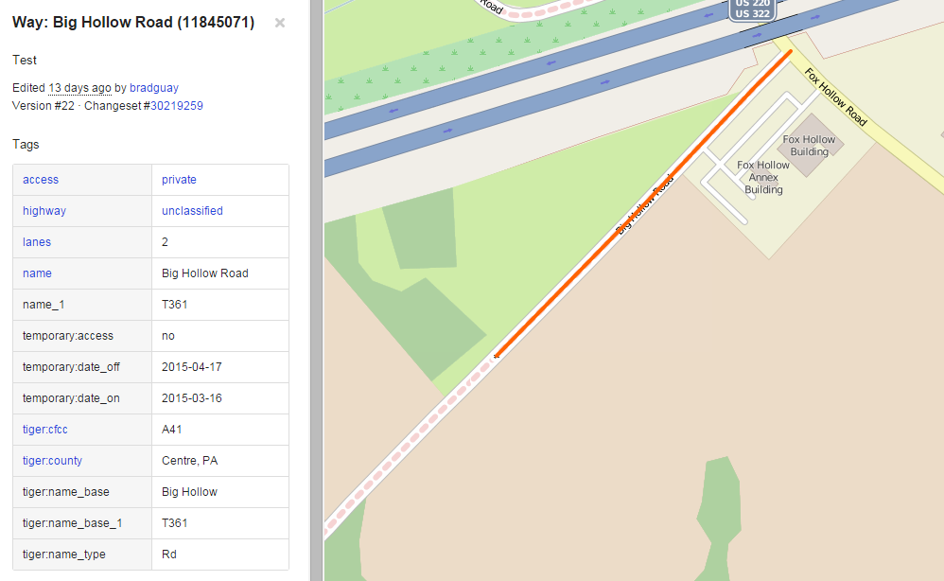

Slide 7
Limitations
Mapbox takes up to a week to ingest the information into its routing server
Directions are likely to be unreliable in many cases
This is of no use in an emergency
This will require someone to maintain it – information has to stay updated
If tags aren’t removed, the road will close again at the same time the next year

Slide 8
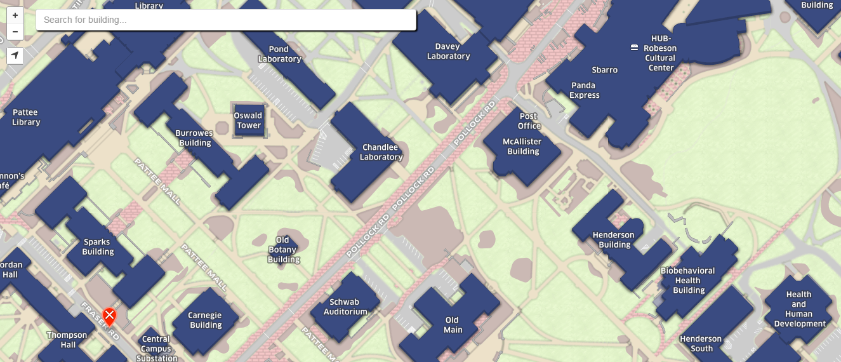
A Possible Solution?
If routing isn’t important, perhaps the road closures could be made as a simple red line on top of the campus map with information when the user clicks
This will still require someone to maintain and update the information
Can this be automated?

