Slide 1
Pre - Qualification

Slide 2
Pre - Qualification
Pre – Qualification :
Document evaluation
Site verification (Audit)
Contractor tidak perlu melalui tahap pre – qualification:
Low risk assessment
Medium risk assessment
Contractor yg sudah lulus pra – kualifikasi sebelumnya

Slide 3
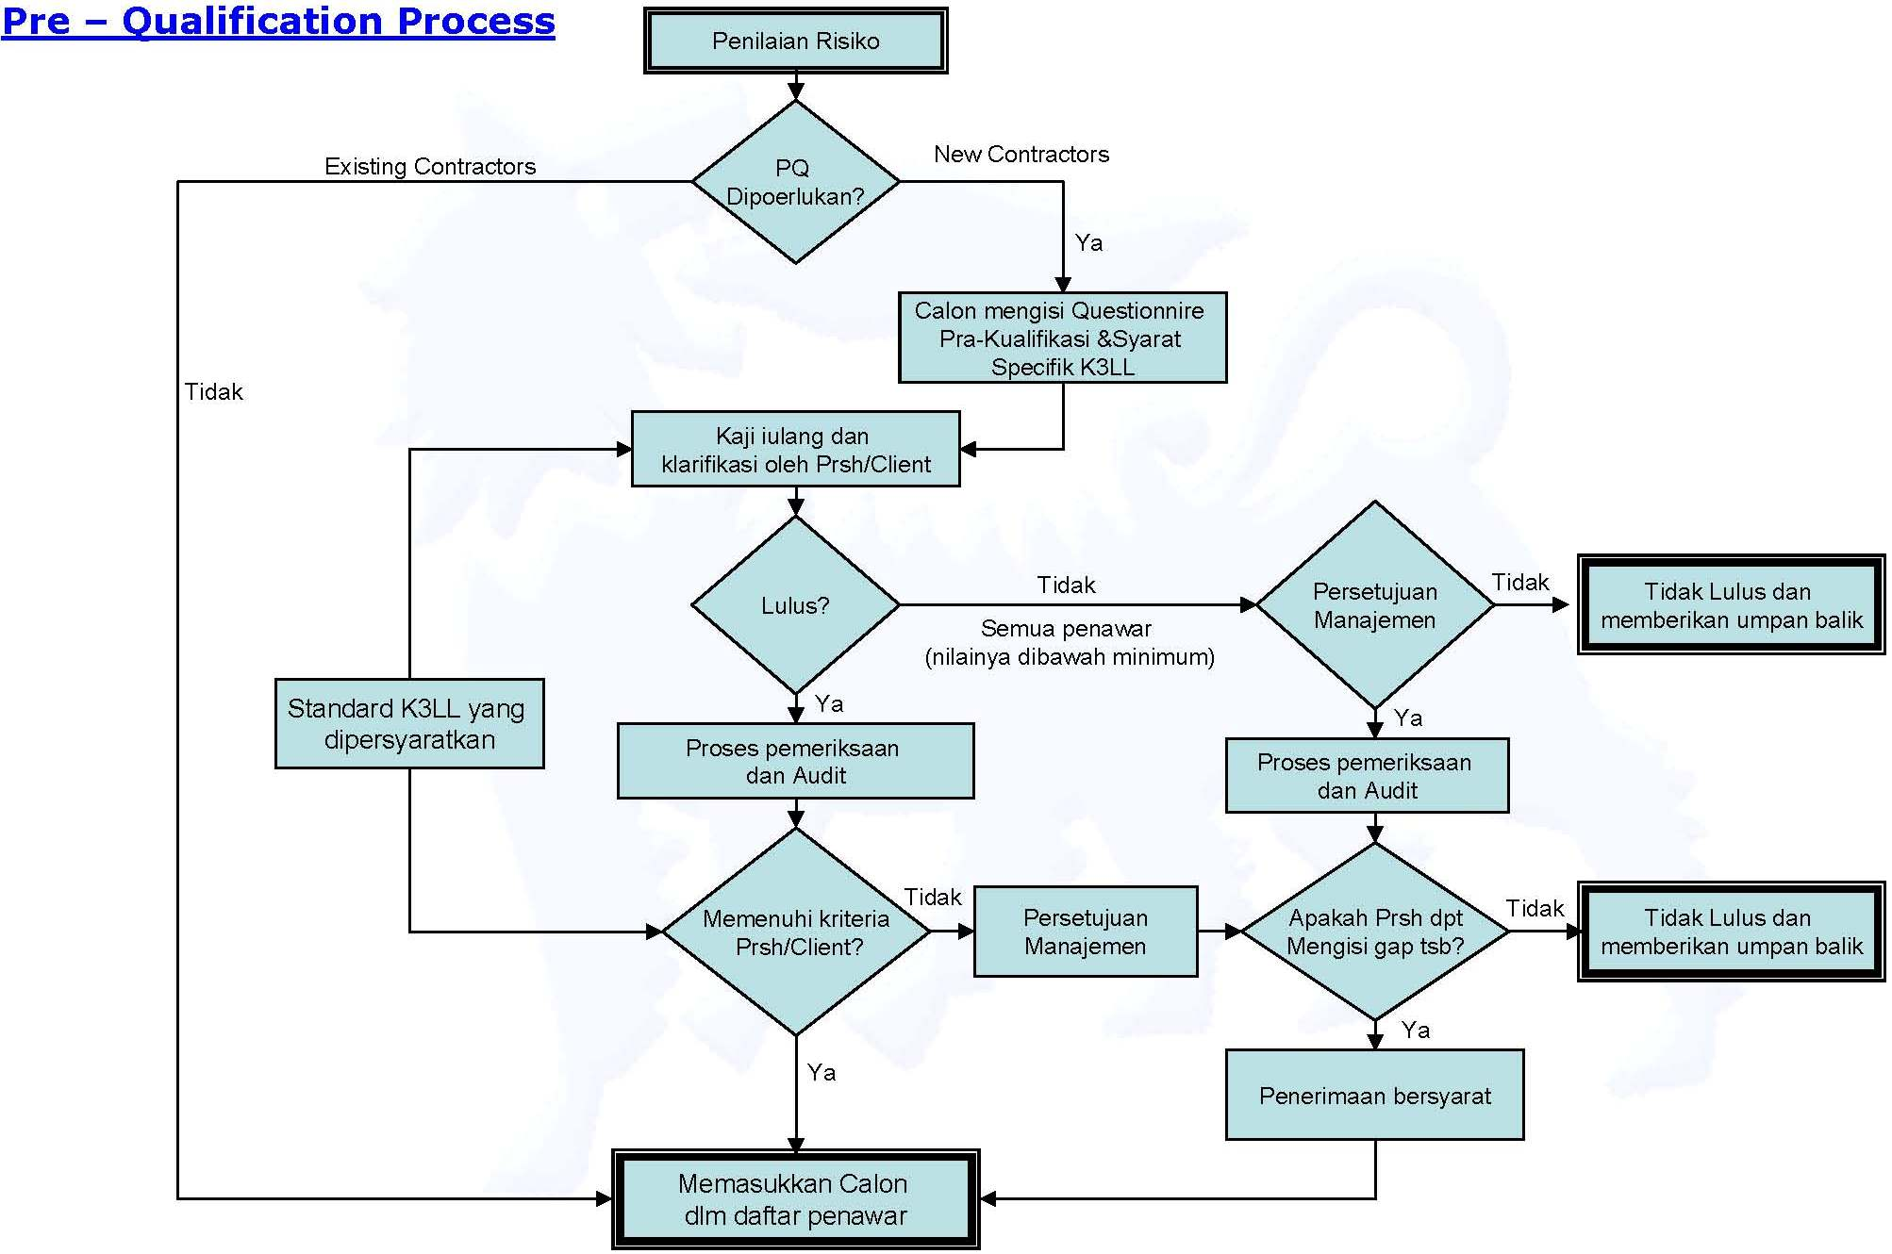

Slide 4
Selection in CSMS
Administration
Contracted Work
Qualification Phase: Select A Qualified Contractor
Pre-Qualification
CSMS
Risk Assessment
Selection
Contract Award
Data Bank
Field Implementation Phase: Ensure Field Safe Work
Pre Job Activity
Work In Progress
Final Evaluation

Slide 5
Selection
SELECTED CONTRACTOR SHOULD BE BEST:
Health safety and Environment
Technical
Commercial

Slide 6
Selection Continue…..
HSE Document in bid package :
HSE general requirements
Client HSE goals and objectives
HSE plan scope and potential hazard
HSE control procedure and compliance
Responsibilities, authorities and controlling between Client and Contractors (e.g. Emergency Response Plan)
Training needs and competence of Contractors

Slide 7
Contract Award in CSMS
Contract Award
Contracted Work
Administration Phase: Select A Qualified Contractor
Pre-Qualification
CSMS
Risk Assessment
Selection
Contract Award
Data Bank
Field Implementation Phase: Ensure Field Safe Work
Pre Job Activity
Work In Progress
Final Evaluation

Slide 8
Pre Job Activity in CSMS
Pre Job Activity
Contracted Work
Administration Phase: Select A Qualified Contractor
CSMS
Pre-Qualification
Selection
Risk Assessment
Contract Award
Data Bank
Field Implementation Phase: Ensure Field Safe Work
Pre Job Activity
Work In Progress
Final Evaluation

Slide 9
Pre-Job Activity
To open First Communication between
Client and Contractor among fieldwork level
Pre-Job Activity is not equal to Pre-Job Safety Meeting

Slide 10
Pre – Job Activity
Pre – job Activity (Aktifitas Awal Pekerjaan) :
Tujuan
Memastikan aspek risk assessment & K3LL yang relevan dengan pekerjaan dikomunikasikan dan dipahami oleh semua pihak sebelum pelaksanaan kontrak/pekerjaan
Terdiri – dari :
Pra – mobilisasi
Rapat awal/Kick off meeting (potential hazards, HSE plan, personal competence, HSE objective & target, Hse general requirements, ERP, Incident Report Procedures etc)
Inspeksi & audit lokasi Contractor (see form VIII)
Orientasi lokasi kerja (follow up of kick off meeting)
Peatihan K3LL (job planning, potential hazards review, HSE matters, inspection of PPE, equipments and ERP alertness)
Mobilisasi (implementation of HSE Planning)
Rapat awal lokal (all key persons must be attending in this meeting)
Mobilisasi staf & perlengkapan Contractor
Finalisasi rencana K3LL
Audit mobilisasi

Slide 11
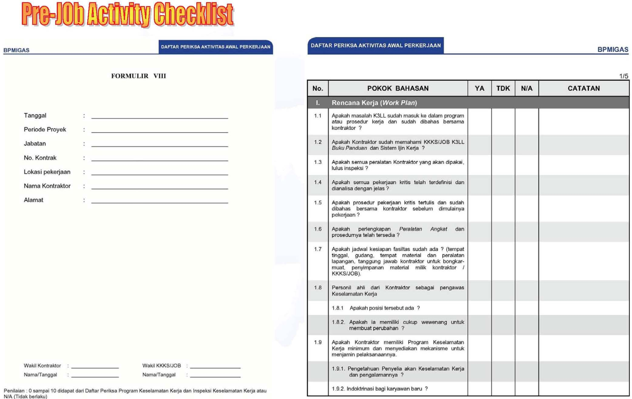

Slide 12
Work In Progress in CSMS
Work In Progress
Contracted Work
Administration Phase: Select A Qualified Contractor
Pre-Qualification
CSMS
Risk Assessment
Selection
Contract Award
Data Bank
Field Implementation Phase: Ensure Field Safe Work
Pre Job Activity
Work In Progress
Final Evaluation

Slide 13
Pekerjaan Berlangsung – Work in Progress
Tujuan
Menjamin pekerjaan yang dilaksanakan sesuai dengan rencana K3LL yang sudah disepakati
Work in Progress:
Periode dimana pekerjaan fisik dilaksanakan di lapangan.
Merupakan evaluasi sementara (interim Evaluation) → regularly inspection
Menguji apakah semua K3LL didalam kontrak sudah dilaksanakan oleh Contractor
Client & Contractor bertanggung jawab thd pelaksanaan evaluasi sementara yg dilakukan secara berkala
Client dapat melakukan inspeksi medadak

Slide 14
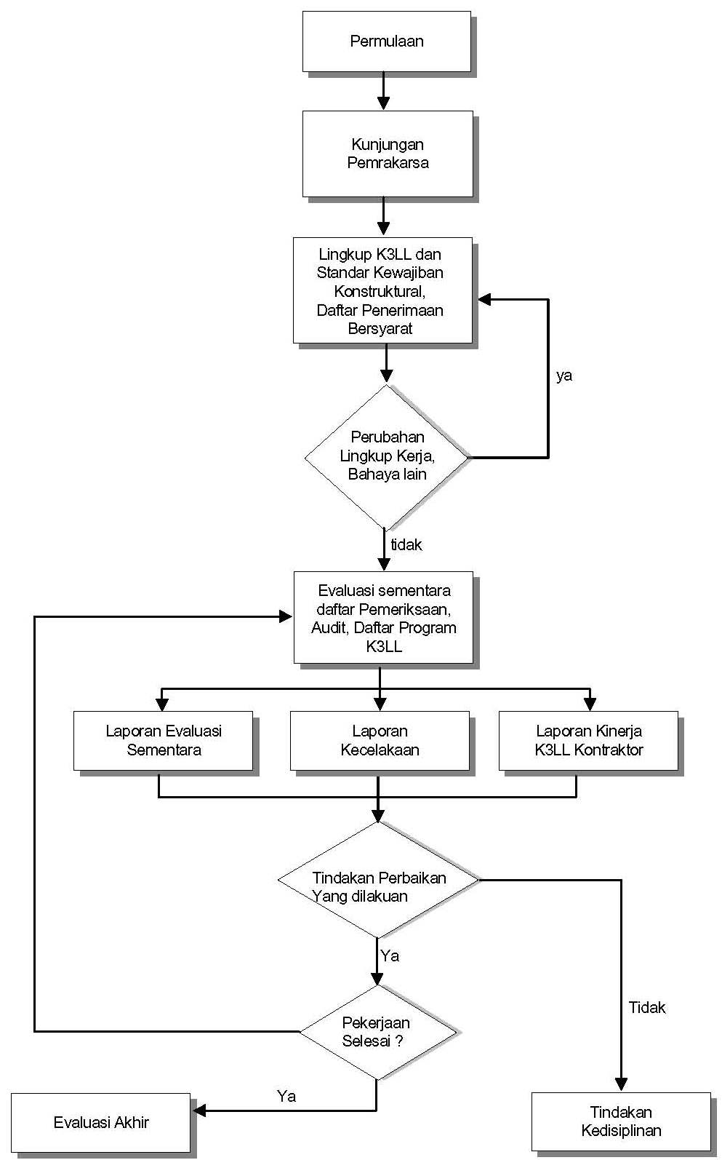
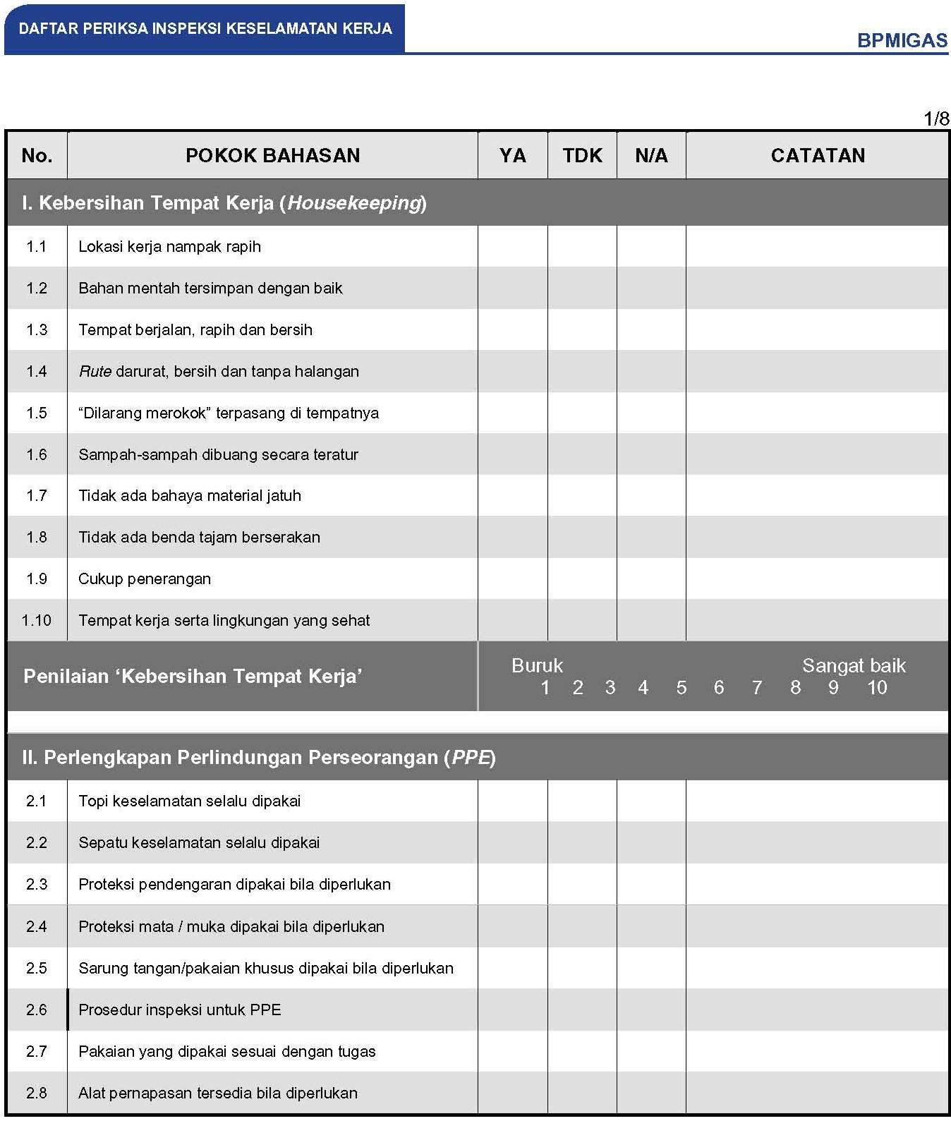
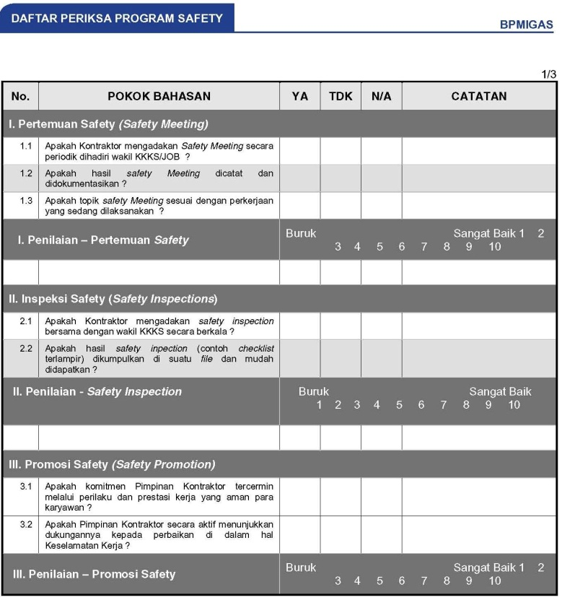
Work in Progress Process
Work in Progress Checklist
Form IX
Form X

Slide 15
Work In Progress
INTERIM EVALUATION CHECKLIST
SAFETY INSPECTION CHECKLIST
SAFETY PROGRAM CHECKLIST

Slide 16
Work In Progress
INTERIM EVALUATION = CORRECTIVE ACTION
+
HSE
PERFORMANCE
SHEP
STANDARD
PERFORMANCE
SHEP
STANDARD
PERFORMANCE
SHEP
STANDARD
PERFORMANCE
HSE
STANDARD
PERFORMANCE
CORRECTIVE ACTION
CORRECTIVE ACTION
CORRECTIVE ACTION
CORRECTIVE ACTION
INTERIM CHECKLIST:
SAFETY INSPECTION
SAFETY PROGRAM
INTERIM CHECKLIST:
SAFETY INSPECTION
SAFETY PROGRAM
INTERIM CHECKLIST:
SAFETY INSPECTION
SAFETY PROGRAM
INTERIM CHECKLIST:
SAFETY INSPECTION SAFETY PROGRAM

Slide 17
Final Evaluation in CSMS
Final Evaluation
Contracted Work
Administration Phase: Select A Qualified Contractor
Pre-Qualification
CSMS
Risk Assessment
Selection
Contract Award
Data Bank
Field Implementation Phase: Ensure Field Safe Work
Pre Job Activity
Work In Progress
Final Evaluation

Slide 18
Final Evaluation
HSE Contractor performance evaluation
Feed back to Contractor and Client for future job
Based on :
HSE Contractual Obligation
Pre – job activity report
Interim evaluation report
Follow up Contractor toward conditional acceptance
Follow up Contractor toward corrective action in interim evaluation

Slide 19
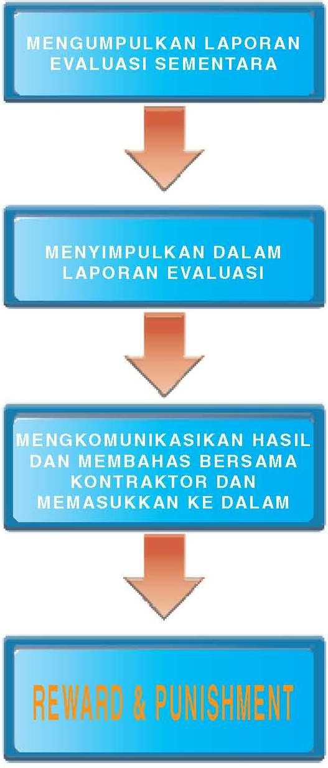
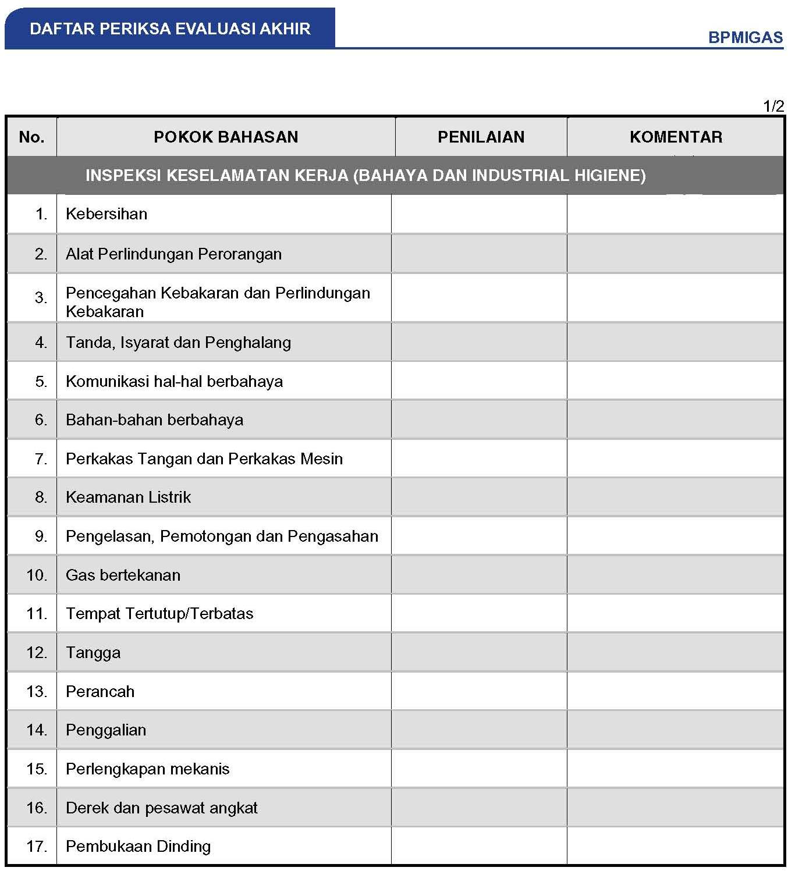
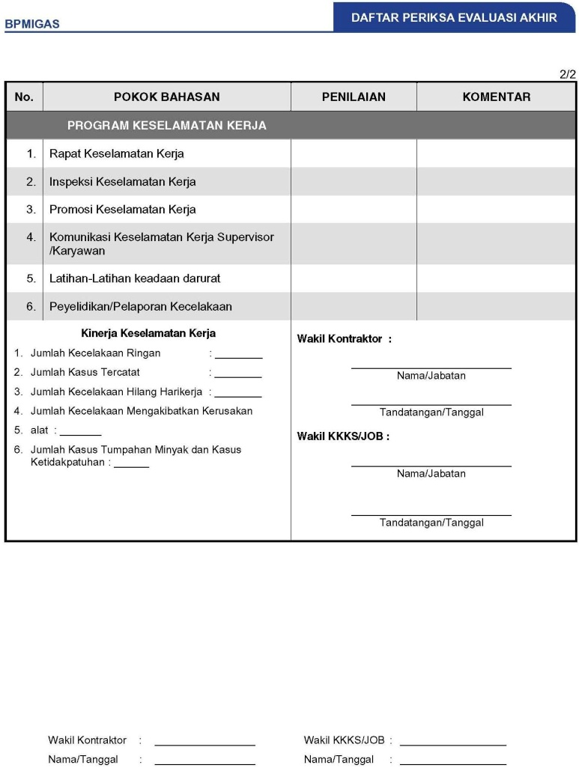
Final Evaluation Process
Final Evaluation Checklist
Form XII

Slide 20
CSMS Reporting Systems
Part of Process Tender Procedures
E
No Specific
CSMS Report
for
Selection
RISK ASSESSMENT
PRE-QUALIFICATION
E
Risk Assessment Resume
Office Report
Pre-Qualification Report
Office Report
Selection Report
Office Report
Field / Job Site Inspection and Control
E
E
E
PRE-JOB ACTIVITY
FINAL EVALUATION
INTERIM EVALUATION
E
E
E
Pre-Job Activity Report
Office & Job Site
Work In Progress Report
Job Site
Final Evaluation Report
Job Site & Office

Slide 21
CSMS Program Evaluation
Short Term Evaluation
(Yearly)
Medium Term Evaluation
Bi-annually
Long Term Evaluation
every Three Years
Program Appraissal
Performance Bench Marking
Program Reformulation
Strengths, Weaknesses
and Areas need
improvement
Compare RCIR with other
PSCs, other Industy Sectors (if possible)
Observed latest API RP,
other Companies Systems,
ISO, MIGAS, etc.
Improved Program / Guidelines
where deemed required:
Strategy
Corrective Actions
Schedule
Resources
RCIR = Recordable Case Incident Rate
API = American Petroleum Institute
RP = Reformulation Program

