Slide 1
Pentaho Metadata Architecture
Schema Metadata
(SchemaMeta class)
CWM Schema Factory
MDR
The Netbeans Metadata Repository
CWM
Common Warehouse Metamodel
Multi
Dimensional
Relational
OLAP
Data types
Relationships
Business
Information
Core
Keys
Indexes
Instance
Behavioral

Slide 2
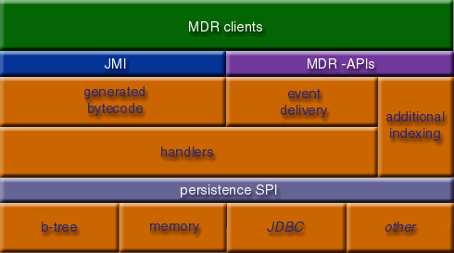
The MDR Architecture
JMI : Java Metadata Interface (JSR-40)
  The Java Metadata Interface specification addresses the need for a pure Java metadata framework API that supports the creation, storage, retrieval, and interchange of metadata.
A Netbeans project : http://mdr.netbeans.org

Slide 3
The Schema Overview
SchemaMeta
The Schema Metadata
Business Views
Business Tables
Business Categories
Business
Columns
Business
Columns
Physical Tables
Physical
Columns
Physical
Columns
Physical
Columns
Physical
Columns
Databases
Default
Concepts
Locales
(languages)

Slide 4
Schema Model Elements
Model Elements are
  Physical Tables
  Physical Columns
  Business Tables
  Business Columns
  Business Views
  Business Categories

Slide 5
Concepts
All model elements...
  Have a unique ID
  Have a properties system called a Concept
  Concepts can receive properties from Concepts
    A parent concept (global settings)
    An inherited concept (Business Table – Physical Table)
  There are 12 property types

Slide 6
Concepts
Parent Concept
Inherited Concept
Concept
Concept
Properties
Name – Value pairs

Slide 7
Concepts
Advantages
  Business Columns/Tables automatically “see” properties from the Physical layer
  We can now define standard property values for all model elements : default concepts
  Management of model elements can become a lot more efficient because of the default concepts. (under development)

Slide 8
Concept Properties
Aggregation
  Sum, Average, Minimum, ...
Boolean
  True or false
Color
  RGB : (255,0,0) is Red
Data Type
  String, Date, Image, Sound
  Including length and precision

Slide 9
Concept Properties
Date
  A date + time
Field Type
  Key, Dimension, Fact, Attribute
Font
  Font name, size + bold or italic
Localized String
  Allows a string to be translated into any language

Slide 10
Concept Properties
Number
  A numerical value (BigDecimal)
String :
  A normal piece of text
Table Type
  Dimension, Fact or Other
URL
  A valid web-address or other URL

Slide 11
Default Properties
"name"
  Property type : Localized String
  Name of the model element
"description"
  Property type : Localized String
  Description of the model element
"aggregation"
  Property type : Aggregation
  Physical or Business Column : aggregation type
"formula"
  Property type String
  Physical/Business Column : column name or formula

Slide 12
Default Properties
"hidden"
  Property type Boolean
  Physical/Business Column : field hidden for user?
"exact"
  Property type Boolean
  Physical/Business Column : do not modify formula during SQL generation, it is specified exact.
"mask"
  Property type String
  Physical/Business Column : formatting mask for dates and numbers

Slide 13
Default Properties
"font"
  Property type Font
  Physical/Business Column : default font to report with
"fieldtype"
  Property type Field Type
  Physical/Business Column : key, dimension or fact?
"tabletype"
  Property type Table Type
  Physical/Business Table : Dimension, fact or other?

Slide 14
Default Properties
"datatype"
  Property type Data Type
  Physical/Business Column : the data type
"relative_size"
  Property type Number
  Physical/Business Table : relative size to make choices easier during SQL generation (aggregate awareness)
"target_table"
  Property type String
  Physical/Business Table : the table-name in the database

Slide 15
Default Properties
"foreground_color"
  Property type Color
  Physical/Business Column : default foreground color (black) to use in reports
"background_color"
  Property type Number
  Physical/Business Table : default background color (white) to use in reports
"comments"
  Localized String
  Model elements : additional comments

