Slide 1

Python Essentials – Evaluated Course Project
CampusMate
Student Productivity System
Presented by: Hemanth Pentakota
Registration No.: 26MIM10061
Faculty/Supervisor: Dr. Adarsh Patel
VIT Bhopal University
20-09-2026
Hemanth Pentakota, VIT Bhopal (26MIM10061)
1

Slide 2
Outline / Agenda
Introduction
Problem Statement
Objectives
Existing System / Literature Review
Research Gap
Development Methodology
Functional & Non-Functional Requirements
System Design (Architecture, Workflow, Diagrams)
Work Plan
Implementation
Results and Discussion
Testing
Design Decisions, Challenges and Learnings
Conclusion and Future Enhancements
References
20-09-2026
Hemanth Pentakota, VIT Bhopal (26MIM10061)
2

Slide 3
Introduction
Students handle multiple academic activities – assignments, attendance, study schedules and performance tracking.
This information is often scattered across notebooks, spreadsheets and separate apps.
Manual tracking is inconvenient and makes it difficult to get a consolidated view of academic progress.
CampusMate is a Python-based command-line application that brings these common academic management tasks into a single system.
It is built using Python and SQLite, and is designed to be simple, modular and easy to extend.
20-09-2026
Hemanth Pentakota, VIT Bhopal (26MIM10061)
3

Slide 4
Problem Statement
“Students often manage assignments, attendance, study schedules and academic performance separately, making it difficult to maintain an organized view of their academic activities. CampusMate provides a single Python-based system to manage these activities and generate a consolidated academic dashboard.”
20-09-2026
Hemanth Pentakota, VIT Bhopal (26MIM10061)
4

Slide 5
Objectives
To develop a simple Python-based student productivity system.
To manage student academic information in one application.
To provide assignment tracking and status management.
To monitor attendance and identify low-attendance situations.
To organize study sessions.
To calculate academic performance and grades.
To provide a consolidated dashboard.
To demonstrate modular Python programming, database handling and testing.
20-09-2026
Hemanth Pentakota, VIT Bhopal (26MIM10061)
5

Slide 6
Existing System / Literature Review
Category | Purpose | Advantages | Limitations
Manual academic tracking | Track assignments, attendance on paper | Simple, no tools needed | Error-prone, hard to consolidate
Spreadsheet-based tracking | Maintain records in Excel/Sheets | Flexible, widely available | Manual data entry, no automatic alerts
General task- management apps | Track tasks and to-do items | Good reminders and scheduling | Do not combine attendance or marks
Student productivity applications | Combine some academic features | Purpose-built for students | Often complex or not customizable
Gap: Existing approaches largely manage individual activities separately, while CampusMate combines student profile, assignments, attendance, study planning and performance into one lightweight Python application.
20-09-2026
Hemanth Pentakota, VIT Bhopal (26MIM10061)
6

Slide 7
Research Gap / Existing System Gap
Academic information may be distributed across multiple tools.
General task applications may not combine attendance and marks.
Manual tracking does not automatically calculate academic indicators.
Students may need a lightweight solution rather than a complex enterprise platform.
CampusMate combines multiple academic tracking functions in one modular application.
  Note: CampusMate is not claimed to be the first or only application of its kind.
20-09-2026
Hemanth Pentakota, VIT Bhopal (26MIM10061)
7

Slide 8
Development Methodology
1. Problem
Identification
2. Requirement
Analysis
3. System
Design
4. Module
Development
5. Database
Integration
6. Input
Validation
7. Testing
8. Documentation
9. GitHub
Deployment
20-09-2026
Hemanth Pentakota, VIT Bhopal (26MIM10061)
8

Slide 9
Functional & Non-Functional Requirements
Functional Requirements
Non-Functional Requirements
FR1 – Student Profile Management
FR2 – Assignment Management
FR3 – Attendance Tracking
FR4 – Study Planning
FR5 – Academic Performance Management
FR6 – Dashboard and Reporting
FR7 – Data Validation
FR8 – Persistent Data Storage
Usability – simple menu-driven interface
Reliability – validates input, handles invalid entries
Maintainability – divided into separate modules
Data Persistence – SQLite storage
Error Handling – invalid input does not crash the app
Resource Efficiency – lightweight, local storage
20-09-2026
Hemanth Pentakota, VIT Bhopal (26MIM10061)
9

Slide 10
System Architecture
Student / User
Main Menu (main.py)
Student Profile
Assignment Manager
Attendance Manager
Study Planner
Academic Performance
Dashboard & Reports
Validation Layer
Database Layer
SQLite Database
20-09-2026
Hemanth Pentakota, VIT Bhopal (26MIM10061)
10

Slide 11
System Workflow
START
Launch CampusMate
Initialize SQLite Database
Display Main Menu
Select Module
Enter Data
Validate Input
Process Data
Save / Retrieve Data
Display Result
Return to Main Menu
EXIT
20-09-2026
Hemanth Pentakota, VIT Bhopal (26MIM10061)
11

Slide 12
Use Case Diagram
CampusMate
Manage Student Profile
Manage Assignments
Track Attendance
Manage Study Plan
Manage Academic Performance
View Dashboard
Search Assignments
Generate Academic Summary
Student
20-09-2026
Hemanth Pentakota, VIT Bhopal (26MIM10061)
12

Slide 13
Component / Module Diagram
main.py
student.py
assignments.py
attendance.py
study_planner.py
performance.py
reports.py
validation.py
(used by validation-dependent modules)
database.py
SQLite Database
20-09-2026
Hemanth Pentakota, VIT Bhopal (26MIM10061)
13

Slide 14
Sequence Diagram – Adding an Assignment
Student
Main Menu
Assignment
Module
Validation
Module
Database
Module
SQLite
Database
1. Enter assignment details
2. Forward request
3. Validate input
4. Confirm valid data
5. Send data to store
6. INSERT record
7. Success response
8. Acknowledge save
9. Display confirmation
20-09-2026
Hemanth Pentakota, VIT Bhopal (26MIM10061)
14

Slide 15
Database / ER Design
STUDENT
ASSIGNMENTS
ATTENDANCE
STUDY_SESSIONS
PERFORMANCE
id
name
student_id
branch
semester
email
id
title
subject
deadline
priority
status
id
subject
conducted
attended
id
subject
topic
study_date
duration
priority
status
id
subject
internal
assignment
exam
SQLite Database (Storage Layer)
Note: Relationships shown reflect only what is implemented in the current project.
20-09-2026
Hemanth Pentakota, VIT Bhopal (26MIM10061)
15

Slide 16
Work Plan
Week | Planned Activities
Week 1 | Problem identification, requirement analysis, project planning
Week 2 | Python project structure, Student Profile, Assignment Manager
Week 3 | Attendance Manager, Study Planner, Academic Performance
Week 4 | SQLite integration, Dashboard, Validation, Testing
Week 5 | Documentation, diagrams, GitHub, final report, final testing
20-09-2026
Hemanth Pentakota, VIT Bhopal (26MIM10061)
16

Slide 17
Implementation – Project Structure & Technologies
Python Project Structure
Core Technologies
CampusMate/
├─ main.py
├─ README.md, requirements.txt
├─ src/
│ ├─ database.py
│ ├─ validation.py
│ ├─ student.py
│ ├─ assignments.py
│ ├─ attendance.py
│ ├─ study_planner.py
│ ├─ performance.py
│ └─ reports.py
└─ tests/
├─ test_attendance.py
├─ test_performance.py
└─ test_validation.py
Programming Language: Python
Database: SQLite
Testing: Python unittest
Dev. Environment: Visual Studio Code
Version Control: Git and GitHub
External Dependencies: None – standard library + SQLite
20-09-2026
Hemanth Pentakota, VIT Bhopal (26MIM10061)
17

Slide 18
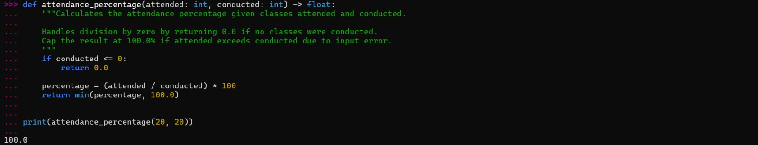
Implementation – Features ... Contd.
Implementation Features
Sample Code Snippet – Attendance Calculation
Menu-driven CLI
Modular Python files
SQLite persistence
Input validation
CRUD operations
Calculations (attendance %, grades)
Search functionality
Reporting / dashboard
Automated unit tests
def attendance_percentage(attended, conducted):
if conducted == 0:
return 0.0
return (attended / conducted) * 100
Sample Output
20-09-2026
Hemanth Pentakota, VIT Bhopal (26MIM10061)
18

Slide 19
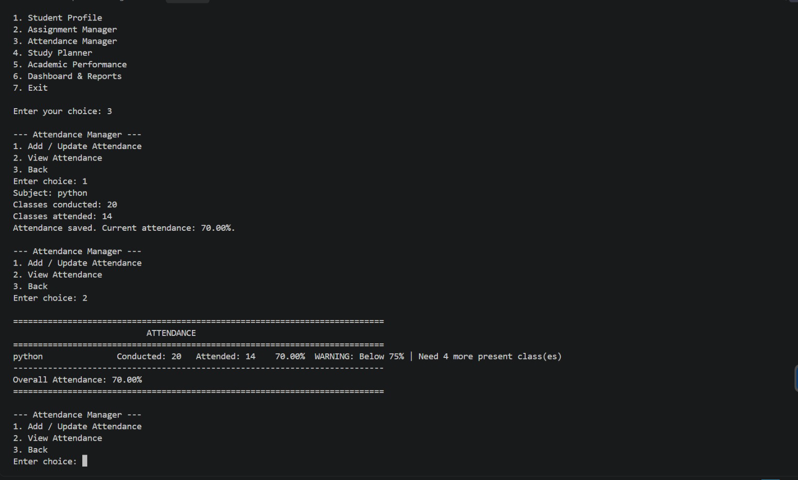
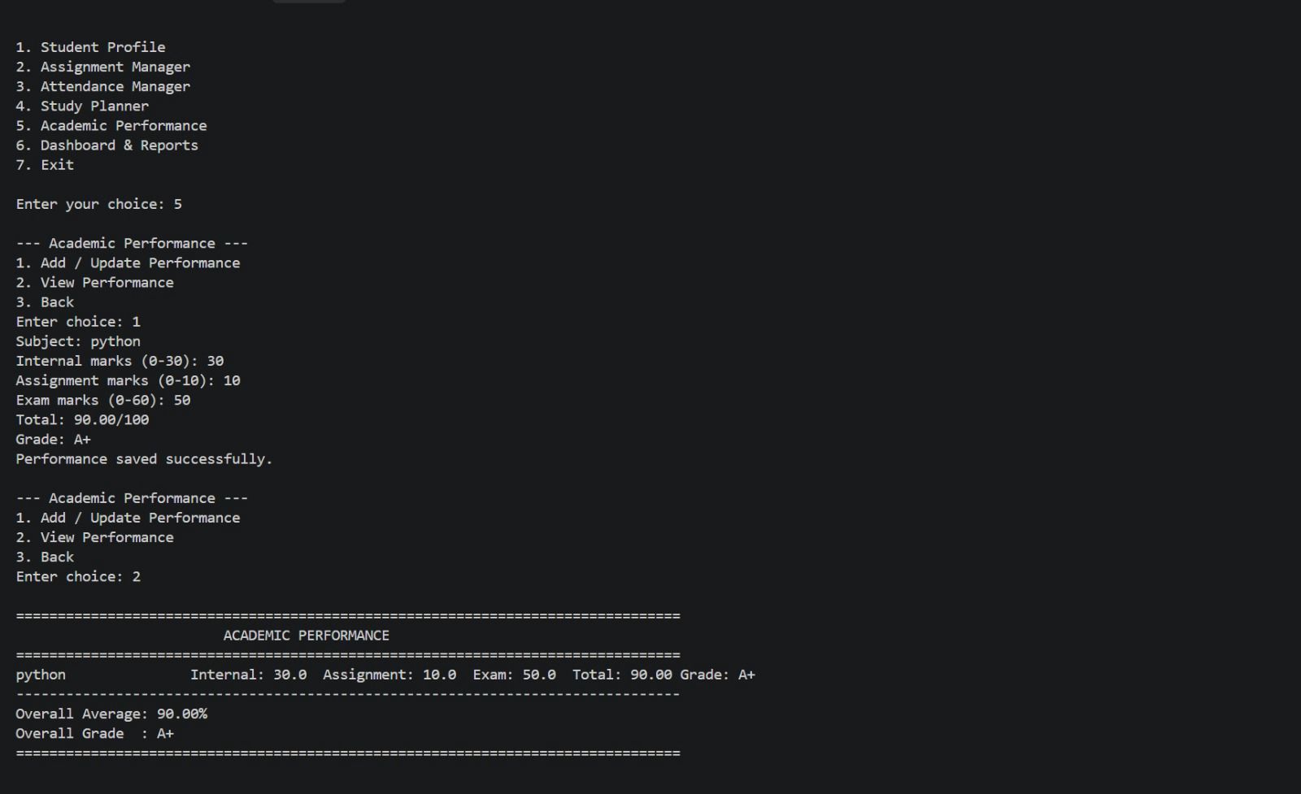
Results and Discussion
Sample Input / Output – Attendance & Performance
Attendance
Classes Conducted | 20
Classes Attended | 14
Attendance % | 70%
System Alert | Below 75% – Warning
Performance
Internal (max 30) | 30
Assignment (max 10) | 10
Exam (max 60) | 50
Total / Grade | 90/100 – Grade A+
20-09-2026
Hemanth Pentakota, VIT Bhopal (26MIM10061)
19

Slide 20
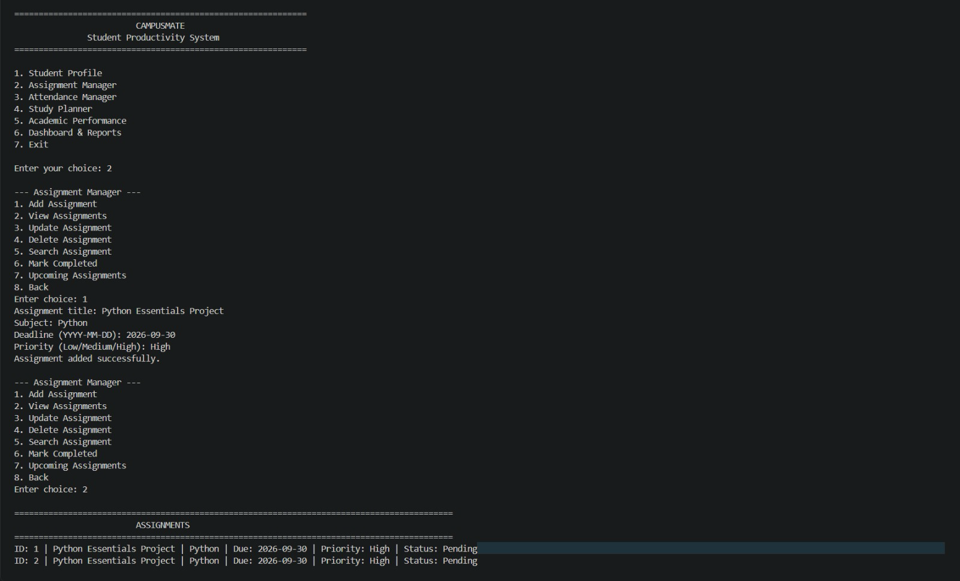
Results and Discussion ... Contd.
Assignment (Sample)
Title | Python Essentials Project
Deadline | 2026-09-30
Priority | High
Status | Pending
Dashboard: Combines student information, total/completed/pending assignments, overall attendance, academic average, overall grade, total study hours and academic alerts into a single consolidated view.
20-09-2026
Hemanth Pentakota, VIT Bhopal (26MIM10061)
20

Slide 21
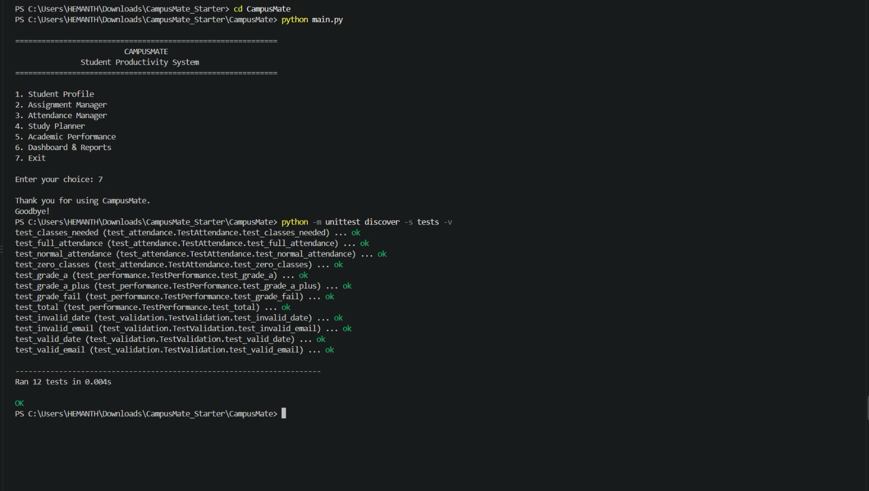
Testing
Testing Framework: Python unittest
Test Areas
12
Attendance percentage calculation
Attendance target calculation
Performance total calculation
Grade calculation
Email validation
Date validation
Input validation
Automated Tests
Expected Result: All tests pass successfully
20-09-2026
Hemanth Pentakota, VIT Bhopal (26MIM10061)
21

Slide 22
Design Decisions and Rationale
Why Python?
Why SQLite?
Beginner-friendly syntax
Standard library support
Easy modular development
Lightweight, local database
No separate database server
Suitable for a small student application
Why Modular Architecture?
Why Command-Line Interface?
Easier maintenance
Easier testing
Separation of responsibilities
Focuses on Python Essentials concepts
Simple to implement
Low resource requirements
20-09-2026
Hemanth Pentakota, VIT Bhopal (26MIM10061)
22

Slide 23
Challenges and Key Learnings
Challenges Faced
Key Learnings
Organizing the project into modules
Connecting Python modules with SQLite
Validating different types of user input
Handling incorrect user input
Designing the database structure
Testing different calculations
Integrating multiple modules into one application
Python functions and modules
Conditional statements and loops
Exception handling
Input validation
CRUD operations
SQLite database handling
Software project organization
Unit testing
Git and GitHub
Technical documentation
20-09-2026
Hemanth Pentakota, VIT Bhopal (26MIM10061)
23

Slide 24
Conclusion and Future Enhancements
Conclusion
Future Enhancements
CampusMate combines common student academic management activities in one application.
The system demonstrates modular Python programming.
SQLite provides persistent local data storage.
Validation improves reliability.
Dashboard functionality provides a consolidated academic view.
Automated tests verify important calculations and validation logic.
(Not currently implemented)
Graphical User Interface
Web-based version
Mobile application
Cloud database
Notification / reminder system
Calendar integration
Export reports to CSV/PDF
Multi-student accounts
Authentication
More detailed analytics
20-09-2026
Hemanth Pentakota, VIT Bhopal (26MIM10061)
24

Slide 25
References
Python Documentation – https://docs.python.org/3/
SQLite Documentation – https://www.sqlite.org/docs.html
Python unittest Documentation – https://docs.python.org/3/library/unittest.html
GitHub Documentation – https://docs.github.com/
20-09-2026
Hemanth Pentakota, VIT Bhopal (26MIM10061)
25

Slide 26
Thank You!
Questions?
Hemanth Pentakota
Registration No.: 26MIM10061
20-09-2026
Hemanth Pentakota, VIT Bhopal (26MIM10061)
26

