Slide 1
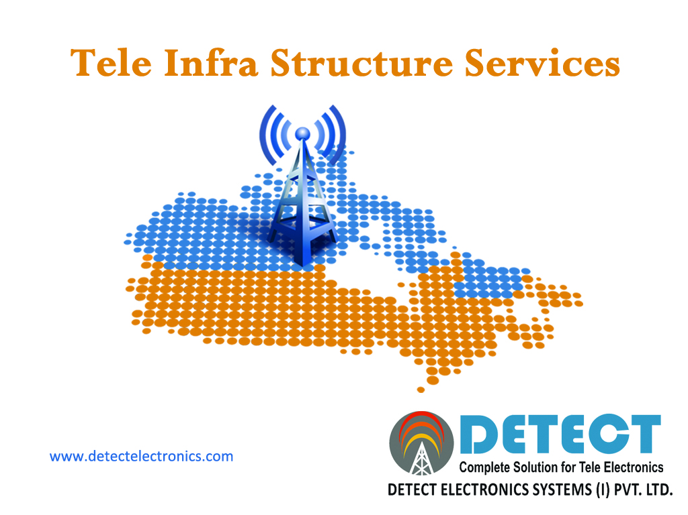
BIGMARK MEDIA
DIGITAL
MARKETING
PROPOSAL
For : PRABHAT DAIRY LIMITED.

Slide 2



About Us
Detect Electronics Systems (I) Private Limited, a sister company of Detect Electronics System with 14 years of experience our existence in the market is marked in providing customer satisfactory service. DETECT constitutes of well trained and skilled manpower in OFC, Civil Engineering, Telecommunications, Electrical and Contract Management fields. It has attained laurels in timely completion of projects and quality management. This has been possible because of its dynamic and diligent team which towards developing best solutions in telecom system, implementation, integration, maintenance, electrical and civil construction and quality management. It has proved itself as a pioneer in quality controlled turn key works in diversified sectors.
Detect Electronics Systems (I) Pvt. Ltd
Contact : Satish Ajabe
Mobile: +91 99222 60007
Email: satish.ajabe@detectelectronics.com

Slide 3

About Director
Satish Ajabe is the Director of Detect Electronics Systems (I) Private Limited Located at Aurangabad.
Satish started his career at a young age of 21 after Bachelor of engineering from Pune University and founded DETECT, with a modest capital, in the year 1998. Today, at 33 he heads a successful enterprise, amongst the top companies, with of over 18 crores turn over.
Satish has played a pivotal role in Detect’s phenomenal growth in a short span of fourteen years. He has been closely involved from the very beginning in the growth of Detect in the telecommunication services sector.
Detect Electronics Systems (I) Pvt. Ltd
Contact : Satish Ajabe
Mobile: +91 99222 60007
Email: satish.ajabe@detectelectronics.com

Slide 4
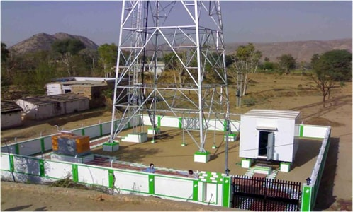
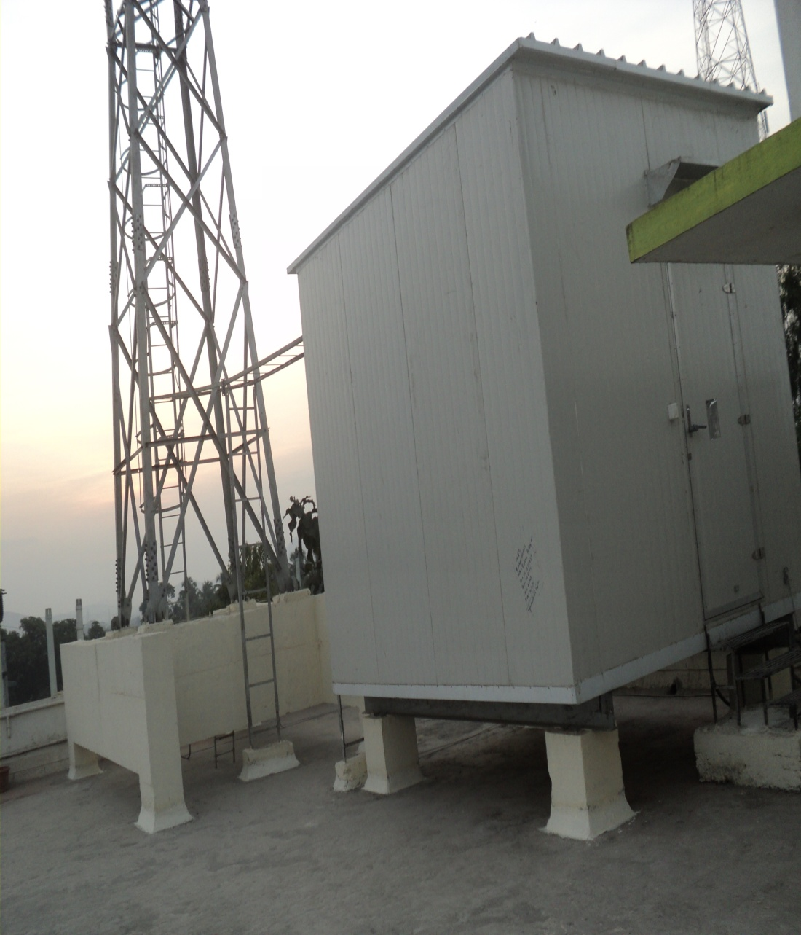
Services
Tower Foundation Work.
Tower Erection Work.
Tower Electrification Work.
RF Installation Work.
OFC Work.
Detect Electronics Systems (I) Pvt. Ltd
Contact : Satish Ajabe
Mobile: +91 99222 60007
Email: satish.ajabe@detectelectronics.com

Slide 5
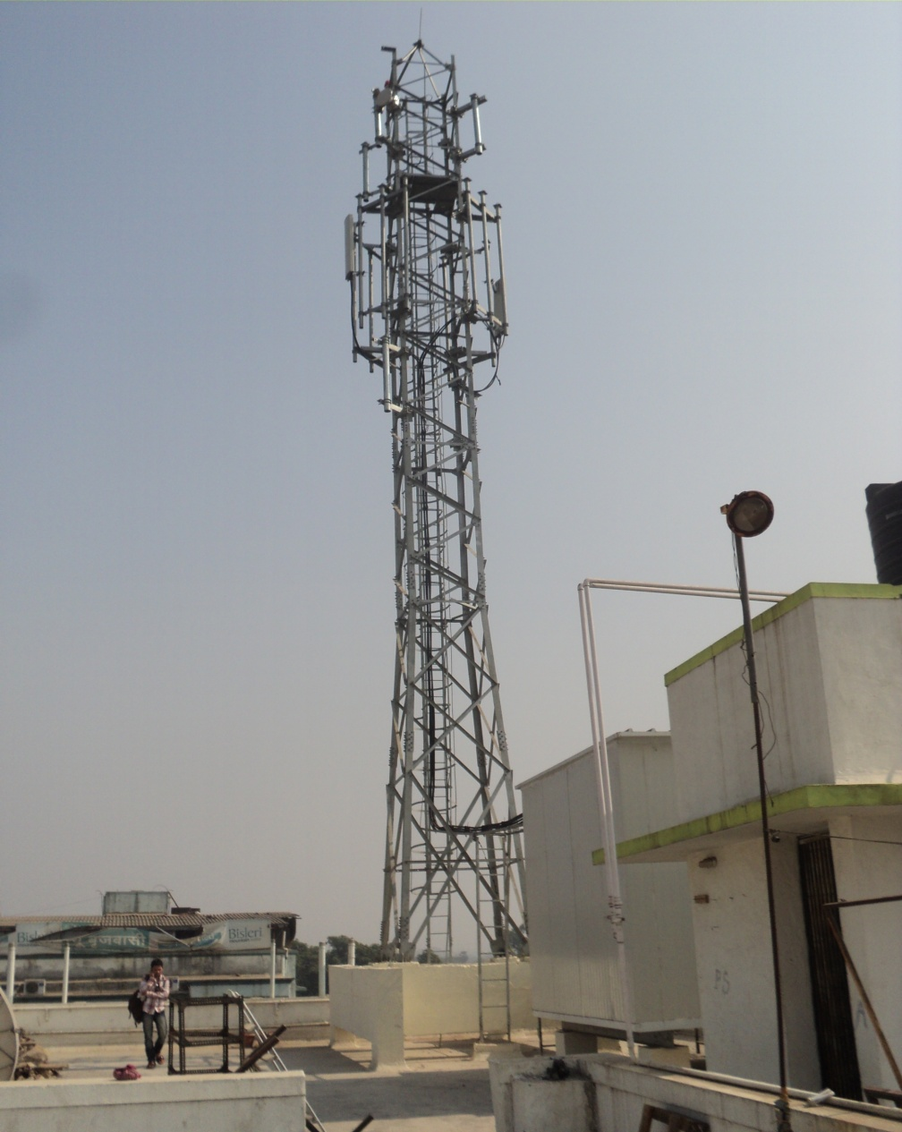
Services
CIVIL
DETECT involved in Civil construction of GBT, RTT & BTS foundation for mobile towers.
Tower Foundation.
RTT (9, 12,15,18,21,24,30 meters)
GBT – 4 Leg & Irthins (40,60,80 meters)
Monopole – 20 meters, 40 meters
Tower Erection.
RTT (9, 12,15,18,21,24,30 meters)
GBT (40 meters, 60 meters, 80 meters)s
BTS Foundation.
Tower Painting.
Tower Strengthening.
Detect Electronics Systems (I) Pvt. Ltd
Contact : Satish Ajabe
Mobile: +91 99222 60007
Email: satish.ajabe@detectelectronics.com

Slide 6
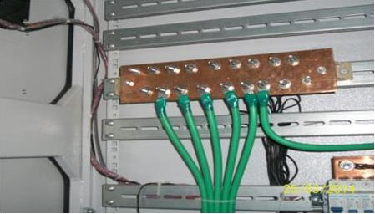
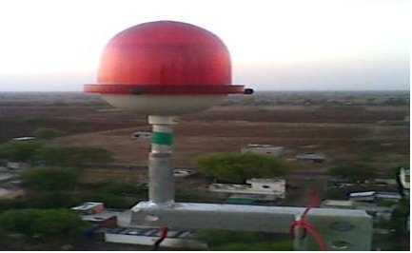
Services
ELECTRICAL SOLUTIONS
We look at complete Electrical Solutions required for Tower
Approvals from MSEDCL for Load & Transformer.
Installation & Commissioning of LT & HT.
Connectivity between LT/HT, DG & BTS.
PMU installation.
Bore/Plate Earthlings.
Installation & Commissioning of DB.
(MCB & MCCB), ICTPN, SERVO Stabilizer.
Commissioning of DG Panel.
Detect Electronics Systems (I) Pvt. Ltd
Contact : Satish Ajabe
Mobile: +91 99222 60007
Email: satish.ajabe@detectelectronics.com

Slide 7
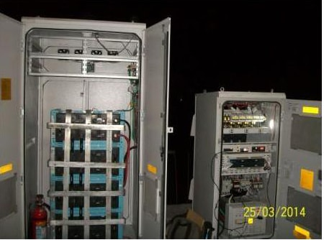
Services
TELECOM SOLUTIONS
DETECT provides the service at Radio Systems Installation & Commissioning of BTS,BSC and MSC SYSTEM, Installation & Commissioning of 8 MB, 34MB & STM OFC System, C- DOT Equipment Installation & Commissioning , i.e. C- DOT 256, SBM Exchanges, MBM Exchanges, Installation & Commissioning of OCB Exchanges (2 K RSU and 10 K ), Installation of EWSD Exchange (5K TAX) and Providing NTC on WLL System 1000 Nos.
Site Engineering Survey.
Confirmation of Infrastructure completion & functionality.
Layout / plan for equipment installation.
Transmission & RF Data For the Site.
Material checkup at Site and Far end.
BTS & Transmission Rack installation & grouting.
Installation of indoor and outdoor Cable Trays .
Installation of Battery Bank & S.M.P.S.
Detect Electronics Systems (I) Pvt. Ltd
Contact : Satish Ajabe
Mobile: +91 99222 60007
Email: satish.ajabe@detectelectronics.com

Slide 8
Services
TELECOM SOLUTIONS
Connect orisation (IF,RF,PCM Alarm etc)
Cable laying (RF, IF, Jumpers, PCM, Alarm, AC/DC Supply OFC etc.)
Routing & proper fixing of all cables e.g. IF, RF, Jumpers, Microwave, Alarm, PCM,AC/DC
Supply, earthling, OFC etc (Over cable trays, casing capping, saddling etc)
Antennae installation GSM & MW (Azimuth, Height, tilt)
Weather proofing, earthlings kits installation etc
Equipments Earthlings, EGB & IGB , Hatch plate installation, extending earths using suitable lugs sleeves.
Labeling all cables at both ends, Marking over M/W antenna, VSWR, Power / level measurements,
BER measurements,
Commissioning and alignment of MW Link.
Commissioning of BTS & Integration, call test, Alarm test.
Site Cleaning & handover of extra material.
Drive test, optimization of network etc
ASM & AGE implementation & Acceptance Test
Detect Electronics Systems (I) Pvt. Ltd
Contact : Satish Ajabe
Mobile: +91 99222 60007
Email: satish.ajabe@detectelectronics.com

Slide 9

Services
OFC
In view of technology development in telecom infrastructure, Optical Fiber Cable occupied its own space to provide advanced 3G features for the fast growing world. OFC is a part of DETECT, which starts with Route survey, Route marking, Trenching, Ducting ( with required protection like GI, Half/Full round RCC, PCC, DWC), Back filling, Aerial OFC, DIT, Blowing, Splicing, Chambers for Splicing and Looping, Earthlings, Termination & Route lit up.
DETECT provides complete solution required for OFC
Trenching.
Ducting.
Blowing.
Splicing.
Termination.
Detect Electronics Systems (I) Pvt. Ltd
Contact : Satish Ajabe
Mobile: +91 99222 60007
Email: satish.ajabe@detectelectronics.com

Slide 10

Project Management
Quality management is a method of ensuring the efficiency in designing, developing and implementing a product or service with respect to the system and its performance. Quality management can be considered to have three main components: quality control, quality assurance and quality improvement. Quality management is focused not only on product quality, but also the means to achieve it. Quality management therefore uses quality assurance and control of processes as well as products to achieve more consistent quality. DETECT considers Quality as a key factor at OFC areas like route survey including touch points and landmarks, Trenching, Ducting, Backfilling, Blowing, Splicing, Termination, Documentation of Lessoning, Measurement and billing as per the client specifications.
Detect Electronics Systems (I) Pvt. Ltd
Contact : Satish Ajabe
Mobile: +91 99222 60007
Email: satish.ajabe@detectelectronics.com

Slide 11
Milestones
Work Completed
Tower Foundation Work : 2000 sites (GBT, RTT, Monopoles across the Maharashtra).
OFC Work : 1000 KMS (Work Trenching, Ducting, Blowing, Splicing, Termination).
PMC for OFC work : 1500 KMS(Idea Cellular Limited).
RF Installation : 3000 sites (Installation for 2G,3G,4G).
Detect Electronics Systems (I) Pvt. Ltd
Contact : Satish Ajabe
Mobile: +91 99222 60007
Email: satish.ajabe@detectelectronics.com

Slide 12







Clients
Detect Electronics Systems (I) Pvt. Ltd
Contact : Satish Ajabe
Mobile: +91 99222 60007
Email: satish.ajabe@detectelectronics.com

Slide 13
Get in touch
Corporate Office
DETECT ELECTRONICS SYSTEMS (I) PVT LTD
Plot No.55, Shree Nagar ,Near Ulkanagari, Aurangabad - 431005
Telefax:- 0240 – 2357400,Mobile no.- 9922260007
Email :- info@detectelectronics.com, Visit us :- www.detectelectronics.com
Branch Office
DETECT ELECTRONICS SYSTEMS (I) PVT LTD
No.59B, 3rd Cross Cholurpalya, Magadi Road, Vijay Nagar, Bangalore-560023
Detect Electronics Systems (I) Pvt. Ltd
Contact : Satish Ajabe
Mobile: +91 99222 60007
Email: satish.ajabe@detectelectronics.com

