Slide 1


Required components for lab setup

Slide 2
Required components for lab setup
Storage
RAM (Excluding Base OS)
Processor
Operating systems: (Free evaluation version)
Virtualization Platform

Slide 3
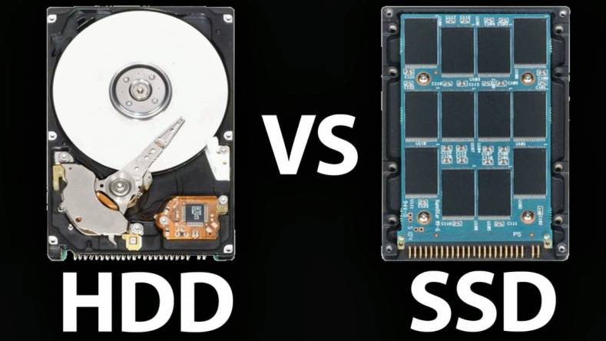
Storage
400 – 500 GB Space
Preferred storage type SSD.
On my System primary Drive is: “Crucial P1 1TB 3D NAND NVMe PCIe M.2 SSD - CT1000P1SSD8”
Link : https://www.amazon.in/Crucial-1TB-NAND-NVMe-PCIe/dp/B07J2Q4SWZ/ref=sr_1_1?dchild=1&keywords=crucial+p1+1tb&qid=1610278907&s=computers&sr=1-1

Slide 4
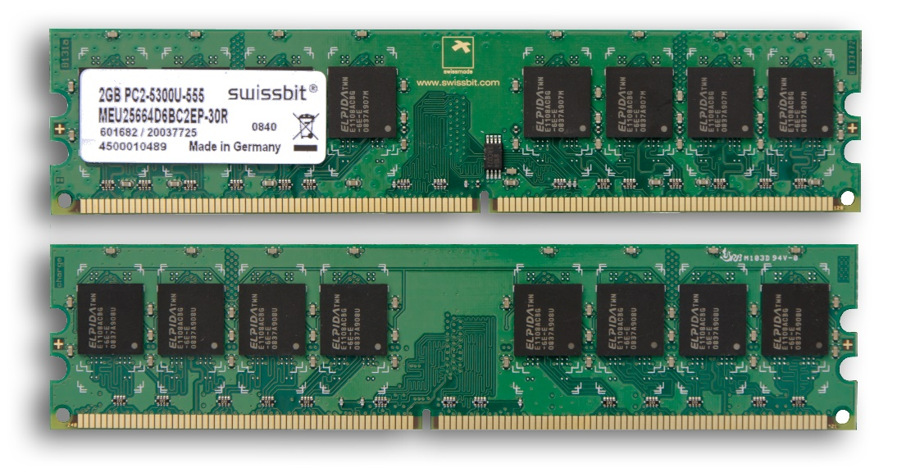
Random Access Memory (RAM)
Required 25-30 GB RAM.
Preferred RAM type DDR4 – DDR5.
On my System RAM : 48 GB DDR4.

Slide 5
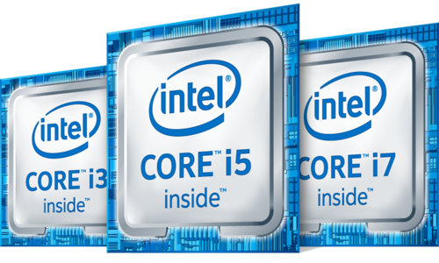
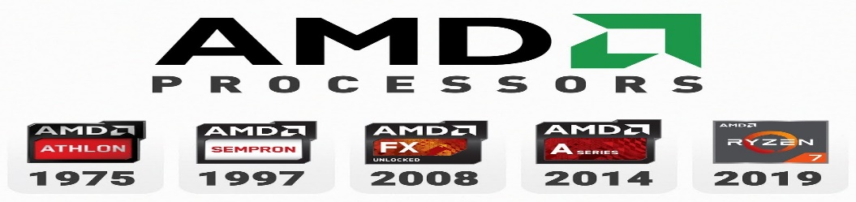
Processor
4 Core Processor.
Preferred Processor: (Intel or AMD).
On my system Processor: Intel® Core™ i7-8700 CPU @ 3.20 GHz

Slide 6
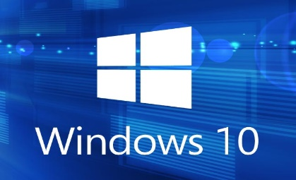
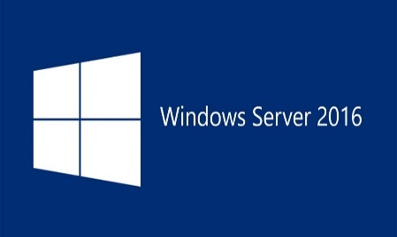
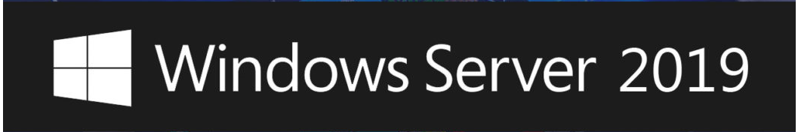

Operating System Required
Base system with (window 10 – window 8.1)
On virtualization below mention are the required operating system to install.
Window Server 2019 : https://www.microsoft.com/en-us/evalcenter/evaluate-windows-server-2019
Window Server 2016 : https://www.microsoft.com/en-in/evalcenter/evaluate-windows-server-2016
Window 10
Kali Linux : https://www.kali.org/downloads/

Slide 7



Virtualization Platform
Vmware or Virtual Box.
Preferred virtualization platform : Vmware Workstation.
On my system virtualization platform: Vmware Workstation 15 and hyper v.

Slide 8

Linkedin link URL: https://www.linkedin.com/in/saksham-dixit-a025a72a/
Blog URL : https://www.sakshamdixit.com

