Slide 1


Architecture of Lab

Slide 2
Architecture of Lab
Domain controller
Server
Desktop
Attacker System
Base System

Slide 3


Domain Controller
Operating System : Window server 2019
Configuration 4 GB RAM , 60 GB Storage.
Virtualization Platform: Hyper-V
2 Forest , 2 Domain Controller 1 Sub-Domain Controller. (DOM1 , DOM2 , DOM3)

Slide 4
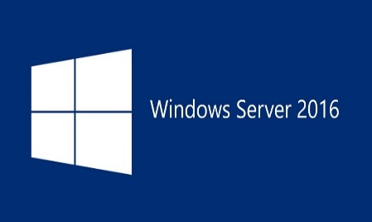
Server
Operating System : Window server 2016.
Configuration : 2 GB RAM , 30 GB Storage.
Virtualization Platform: Hyper-V
3 Window Server (SRV1 , SRV2 , SRV3)

Slide 5

Desktop
Operating System : Window 10
Configuration : 4 GB RAM , 40 GB Storage.
Virtualization Platform: Hyper-V
2 Desktop System (Win1 , Win2)

Slide 6

Attacker System
Operating System : Kali Linux.
Configuration : 8 GB RAM , 50 GB Storage.
Virtualization Platform: Hyper-V
1 Attacker System (kali)

Slide 7
Base System
Operating System : Window 10.
Configuration : 48 GB RAM , 1000 GB Storage.
Base Host system.
Install Vmware workstation on base host system.
In Vmware workstation install window 10.
Configuration of virtual desktop 25 – 30 GB RAM and 400 – 500 Gb Storage.
Install Hyper-V inside the Virtual desktop of window 10.
Install rest setup on Hyper-V (DOM1 , DOM2 , DOM3 , SRV1 , SRV2 , SRV3 , WIN1 , WIN2 , KALI).

Slide 8
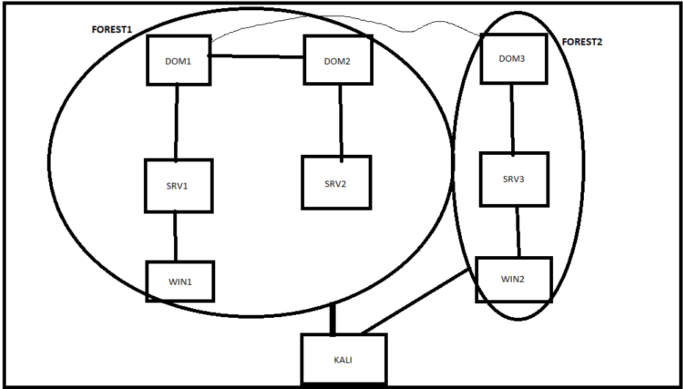
Architecture Diagram

Slide 9

Linkedin link URL: https://www.linkedin.com/in/saksham-dixit-a025a72a/
Blog URL : https://www.sakshamdixit.com

