Slide 1


Installation of Domain Controller

Slide 2
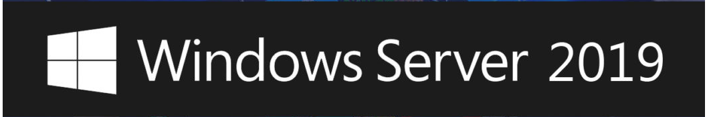
Description
Install Vmware workstation free edition on host system (Window 10).
Install Window 10 on Vmware workstation with 25-28 GB RAM and 400 – 500 GB Storage.
Make window 10 up to date with latest patches and then install Hyper-V (https://techcommunity.microsoft.com/t5/itops-talk-blog/step-by-step-enabling-hyper-v-for-use-on-windows-10/ba-p/267945)
Build Window server 2019 on hyper-v (DOM1, DOM2 , DOM3).
Configuration of the server (4 GB RAM 50 GB Storage).
DOM1, DOM2, DOM3 are the hostname of all three sever.
In case of DOM1 Domain name is lab.local.
In case of DOM2 Domain name is security.lab.local.
In case of DOM3 Domain name is cyber.local .
Link for downloading the ISO: https://www.microsoft.com/en-us/evalcenter/evaluate-windows-server-2019

Slide 3
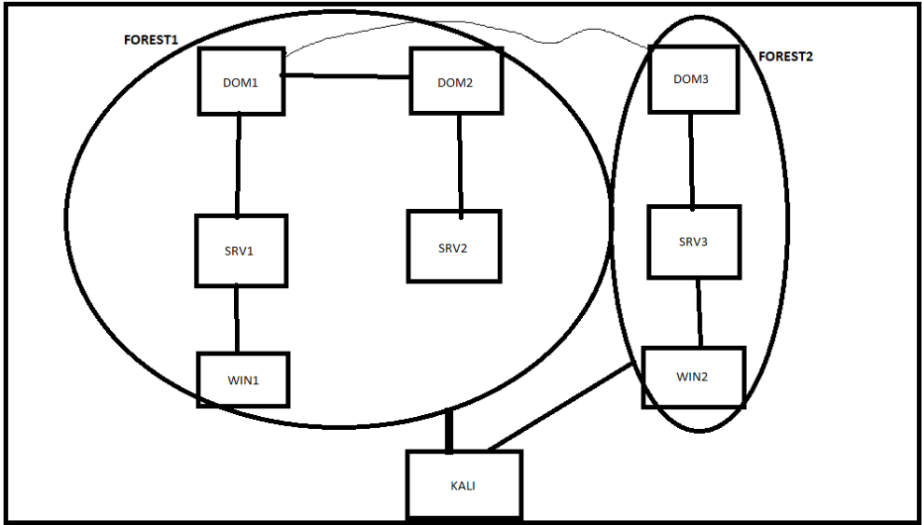
Architecture Diagram

Slide 4
Demo Time

Slide 5

Linkedin link URL: https://www.linkedin.com/in/saksham-dixit-a025a72a/
Blog URL : https://www.sakshamdixit.com

