Slide 1


Installation of Rest System in Lab

Slide 2
Description
Install 1 Window 10 on Hyper-v.
Install 3 window server 2016 on Hyper-v.
Install 1 kali linux on Hyper-v.
Hostname of window 10: win10.
Hostname of 2 server 2016: srv1, srv2, srv3.
Hostname of 1 kali linux: kali
Update all the system with latest patches.
Define the static ip address on all the systems.

Slide 3
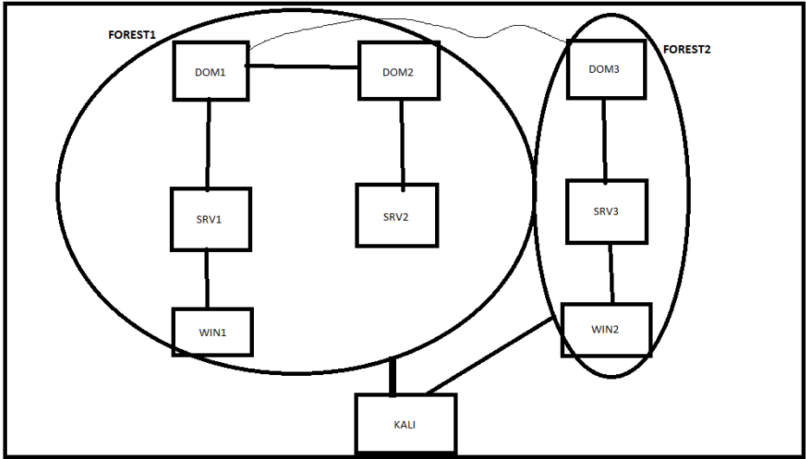
Architecture Diagram

Slide 4
Demo Time

Slide 5

Linkedin link URL: https://www.linkedin.com/in/saksham-dixit-a025a72a/
Blog URL : https://www.sakshamdixit.com

