Slide 1


Pivoting

Slide 2
Introduction To Pivoting
Pivoting is a technique that uses to route the traffic from a hacked computer toward other networks that are not accessible by a hacker machine.
Let’s take a scenario to understand how Pivoting works. Assume we have two networks −
A network with the range 192.168.1.0/24 where the hacker machine has access, and
Another network with the range 10.10.10.0/24. It is an internal network and the hacker doesn’t have access to it.
The hacker will try to hack the second network this machine that has access in both networks to exploit and hack other internal machines.
In this scenario, a hacker will first break into the first network and then use it as a staging point to exploit and hack the internal machines of the second network. This process is known as pivoting because the hacker is using the first network as a pivot to get access into the second network.

Slide 3
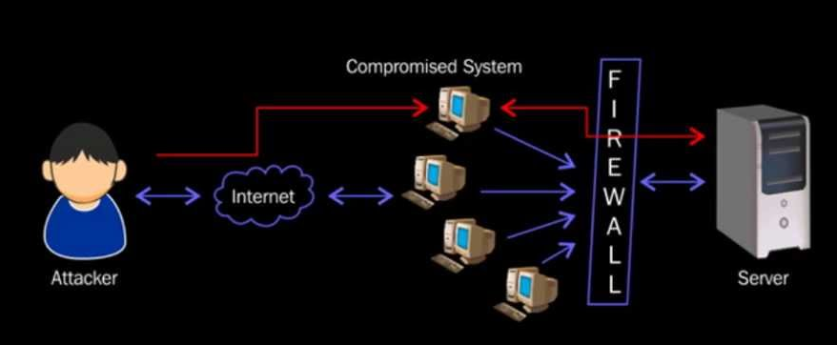
Pivoting Graphical View

Slide 4


Linkedin link URL: https://www.linkedin.com/in/saksham-dixit-a025a72a/
Blog URL : https://www.sakshamdixit.com
Youtube Link: https://www.youtube.com/channel/UCuizqimEZRXT-0yh4bJeKNw
Github Link: https://github.com/pentest-diaries

