Slide 1
Project One: FinTech Financial Programming and Quantitative Analysis
Starbucks Coffee Shop
Team:
Chad Burford
Erik McFarlane
Diego Torres

Slide 2
Project One: Starbucks Locations Analysis
Project Goals:
Find US data for all Starbucks locations
Find US census information (total population, population density, income) by city
Find Min/Max/Avg/StD. for Starbucks locations versus census information
Based on #3 determine top underserved and overserved locations on a per capita/income basis
Questions for Analysis:
Is there a correlation between the total number of stores within a city and the city's annual average income?
Is there a correlation between the total number of stores within a city and the city's population?
Are there underserved or overserved cities based on standard deviation from a mean?

Slide 3
Code Approach: Import Libraries and Datasets
Starbucks dataset ('Data_Files/starbucks_locations.csv.txt’)
Convert dataset into a Dataframe
Sanitize dataset (drop unnecessary columns)
Filter unnecessary values
Make relevant groupings in order to: get number of stores for each city and get the cities' Latitude/Longitude
Merge grouby results into Dataframe that will be merged with other datasets
U.S. income information by city ('Data_Files/kaggle_income.csv’)
Convert dataset into a Dataframe
Sanitize dataset (drop unnecessary columns)
Filter unnecessary values
Homogenize column names to merge with Starbucks dataframeMerge with Starbucks dataframe
U.S. income population by city ('Data_Files/us population with cordinates.csv.txt’)
Convert dataset into a Dataframe
Sanitize dataset (drop unnecessary columns)
Filter unnecessary values
Homogenize column names to merge with combined Income/Starbucks dataframe
Merge grouby results into final combined Dataframe

Slide 4
Code Approach: Analysis
Analysis:
Create scatter plots
Create map "heat" plots
Create standard deviation plot
Combine plots into an interactive dashboard
Number of Starbucks per city per population
Avg income per starbucks per city
U.S. income information by city
Chart/Scatter plot of locations vs. #3 (will determine which cities have too many or too few Starbucks

Slide 5
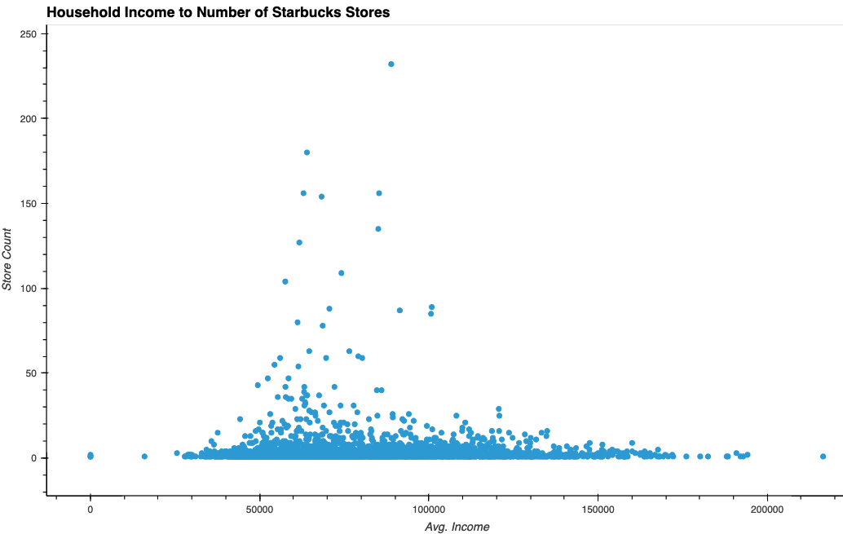
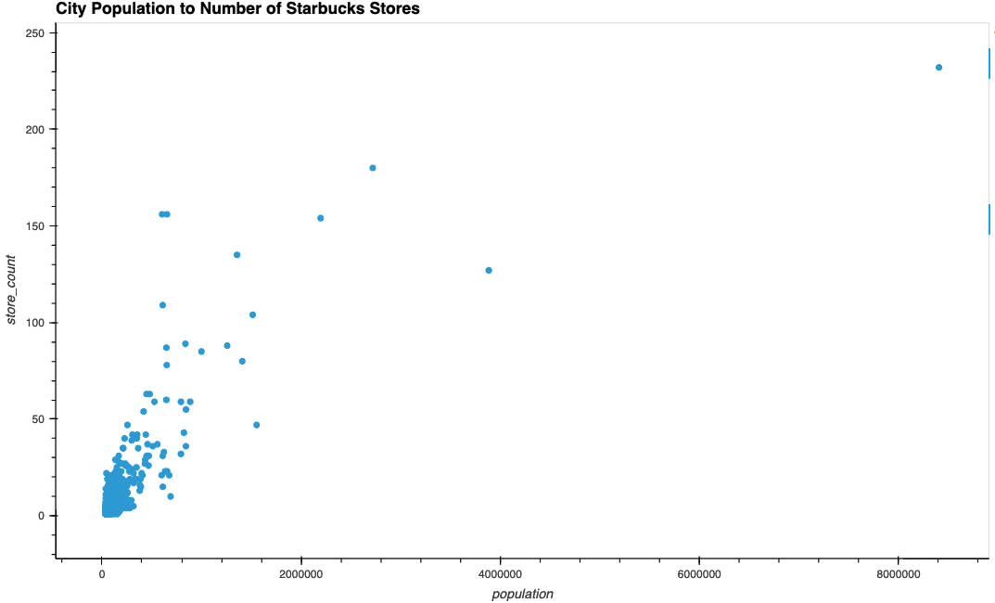
Correlation between Population / Average Income and Store Counts

Slide 6
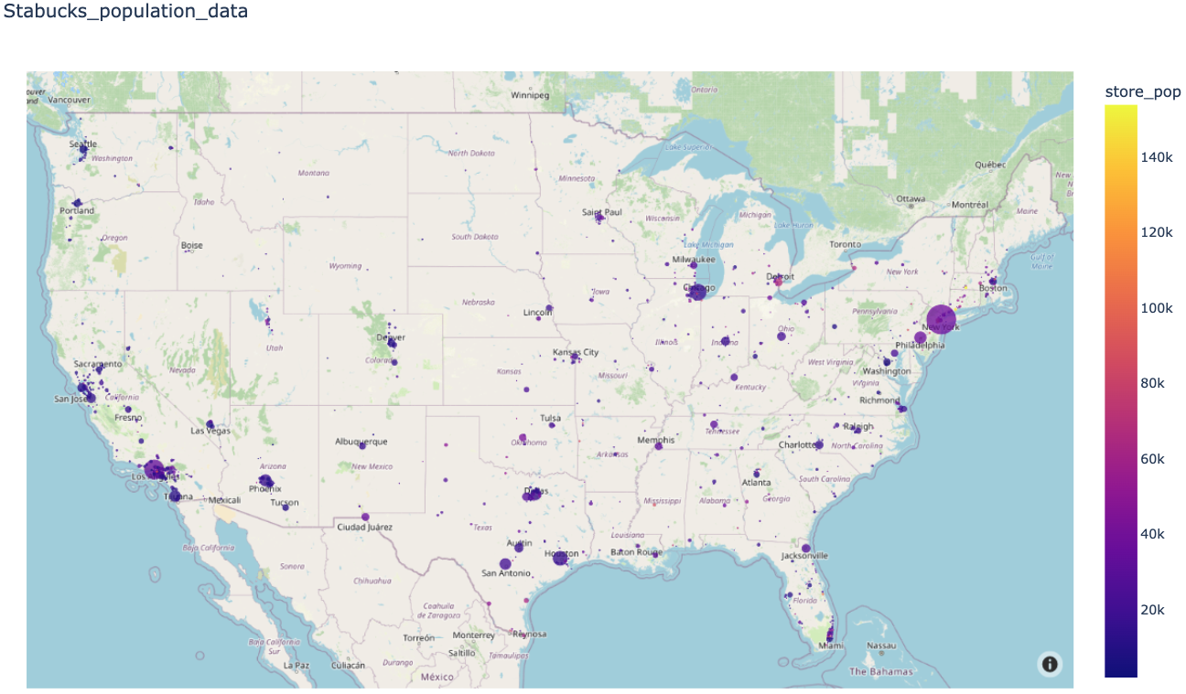
Map of City Population and Store Counts

Slide 7
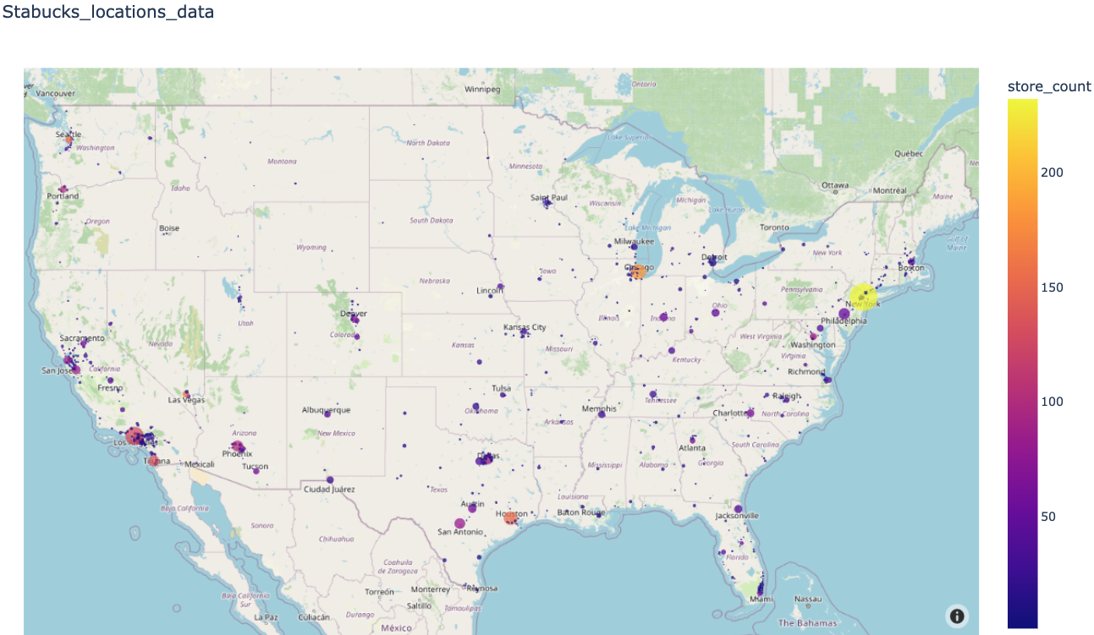
Map of City with Store Counts

Slide 8
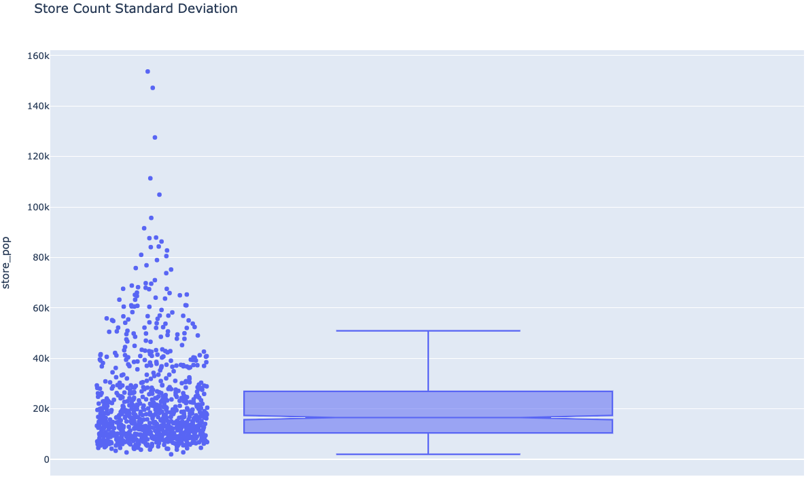
Correlation between Population / Average Income and Store Counts

