Slide 1
From wholesale prices to consumer inflation
Layered pass-through of global oil shocks in India, 1983–2026
Aniket Pandey
B.Tech + MS Economics
School Of Engineering, JNU
Supervisor: Prof. Shakti Kumar
Brent crude
Retail petrol
Wholesale prices
Consumer basket

Slide 2
Why oil-price pass-through matters for India
▪ India imports a large share of its crude oil.
▪ Crude is priced internationally, mainly in US dollars.
▪ Domestic oil pressure comes from Brent crude and INR/USD jointly.
▪ Oil moves through retail petrol, wholesale fuel, transport, and input costs.
▪ Headline CPI does not respond one-for-one with oil.
Brent crude + INR/USD
Domestic oil-cost pressure
Indian price system
Layered oil-price pass-through in India | Aniket Pandey, B.Tech + MS Economics
Slide 1 of 11
Notes:
After the title, I will first explain why this topic matters.
India imports a large share of crude oil. Crude oil is priced in US dollars, so India is affected by two things: the global Brent crude price and the rupee-dollar exchange rate.
Oil can enter the Indian price system through petrol prices, wholesale fuel prices, transport costs, and input costs. But headline CPI is a broad index. It has food, housing, services, and many non-fuel items. So my basic question is: if oil matters, why does the effect become weak in headline CPI?

Slide 3
Objective and research question
Research question
How do global oil-price shocks transmit across India’s wholesale, retail fuel, fuel-sensitive consumer, and headline consumer price layers, and where does this pass-through weaken?
Objective
Contribution
▪ Estimate short-run oil-price pass-through across multiple Indian price layers.
▪ Identify the point at which the shock attenuates before reaching headline CPI.
▪ Compare strong and weak segments of the price system, layer by layer.
▪ Treats oil pass-through as a layered transmission problem.
▪ Moves beyond a single oil-to-headline-CPI estimate.
▪ Covers five layers: WPI, WPI Fuel, retail petrol, CPI Fuel and Light, headline CPI.
▪ Tests attenuation directly on a common sample.
Layered oil-price pass-through in India | Aniket Pandey, B.Tech + MS Economics
Slide 2 of 11
Notes:
Now I move from the motivation to the exact research question.
The main objective is to estimate short-run oil-price pass-through across different Indian price layers. I am not only looking at oil and headline CPI directly. I am checking the layers in between.
The research question is: how do global oil shocks move through wholesale prices, retail fuel prices, fuel-sensitive CPI, and headline CPI, and where does the effect become weak?
My contribution is the layered view. Each layer is estimated separately, so I am not claiming one simple WPI-to-CPI causal chain.

Slide 4
Data sources and variable purpose
Series | Source | Transformation | Purpose
Brent crude price | World Bank Pink Sheet (FRED POILBREUSDM) | Monthly log difference | Global oil shock
INR/USD exchange rate | FRED EXINUS | Monthly log difference | Exchange-rate component
Rupee oil price | Brent × INR/USD | Monthly log difference | Oil shock for WPI and headline CPI
Headline WPI | OEA, chained to 2011-12 base | Monthly log difference | Wholesale headline layer
WPI Fuel and Power | OEA, chained to 2011-12 base | Monthly log difference | Wholesale fuel-sensitive layer
PPAC Delhi retail petrol | PPAC ready reckoner | Monthly log difference | Direct retail fuel layer
CPI Fuel and Light | MoSPI harmonised series | Monthly log difference | Fuel-sensitive consumer bridge
Headline CPI | MoSPI / FRED CPI source | Monthly log difference | Consumer endpoint
IIP | MoSPI | Monthly log difference | Activity control
Layered oil-price pass-through in India | Aniket Pandey, B.Tech + MS Economics
Slide 3 of 11
Notes:
Now I will explain the data used in the study.
The data are monthly. Brent crude captures the international oil shock. The exchange rate captures the rupee-dollar part. I combine Brent and the exchange rate to create the rupee oil price, which is the domestic oil-cost pressure.
For prices, I use WPI, WPI Fuel and Power, PPAC Delhi retail petrol, CPI Fuel and Light, and headline CPI. I also use IIP as an activity control.
All main variables are converted into monthly log differences. In simple terms, these can be read as approximate monthly percentage changes.

Slide 5
Short-run asymmetric ADL model
Estimating equation, by layer
Δyₜ = α + Σ φᵢ Δyₜ₋ᵢ + Σ βⱼ⁺ Δx⁺ₜ₋ⱼ + Σ βⱼ⁻ Δx⁻ₜ₋ⱼ + γʹ Zₜ + μₘ + εₜ
Model features
Reported quantities and inference
▪ Autoregressive — own lagged inflation captures persistence.
▪ Distributed lag — oil enters at lags 0–L.
▪ Asymmetric — positive and negative shocks enter separately.
▪ Short-run focus — monthly changes, no cointegration step.
▪ Controls: IIP for activity, month dummies for seasonality.
CPT⁺ — sum of positive-shock coefficients across lags
CPT⁻ — sum of negative-shock coefficients across lags
p-values — tests for CPT⁺, CPT⁻ and CPT⁺ = CPT⁻
Estimation — OLS
Inference — Newey–West HAC standard errors
Layered oil-price pass-through in India | Aniket Pandey, B.Tech + MS Economics
Slide 4 of 11
Notes:
After the data, I will explain the model in simple words.
I use a short-run asymmetric ADL model. ADL means current inflation depends on its own past values and on current and past oil shocks.
This is useful because oil-price effects may not appear fully in the same month. They may spread across a few months.
Positive and negative oil shocks are kept separate. This lets me check whether prices respond differently when oil rises and when oil falls.
The main reported numbers are CPT plus and CPT minus. They are the total response over the lag window. I use Newey-West HAC standard errors for p-values because this is monthly time-series data.

Slide 6
Main result: pass-through weakens across layers
Layer | Sample | N | CPT⁺ | p | CPT⁻ | p | Asym. p | Reading
WPI Fuel and Power | 2010-04 to 2026-03 | 186 | 0.5205 | <0.001 | 0.4195 | <0.001 | 0.1642 | Strong wholesale fuel
PPAC retail petrol | 2004-08 to 2024-12 | 245 | 0.3459 | <0.001 | 0.1912 | 0.0002 | 0.0999 | Strong direct fuel
CPI Fuel and Light | 2011-05 to 2024-12 | 164 | 0.1777 | 0.0021 | 0.1058 | 0.1741 | 0.4554 | Bridge evidence
Headline WPI | 1983-05 to 2026-03 | 515 | 0.0301 | 0.0240 | 0.0374 | 0.0012 | 0.6727 | Modest but significant
Headline CPI | 2004-08 to 2024-12 | 245 | 0.0213 | 0.1220 | 0.0006 | 0.9375 | 0.2408 | Weak, not significant
Reading
Pass-through is strongest in WPI Fuel and Power and PPAC retail petrol, smaller in CPI Fuel and Light, modest in headline WPI, and weak and statistically insignificant in headline CPI. Diagnostics pass for each claim-bearing specification (BG, HAC-RESET, recursive CUSUM).
Layered oil-price pass-through in India | Aniket Pandey, B.Tech + MS Economics
Slide 5 of 11
Notes:
Now I come to the main results table.
I will not read every number. The main pattern is more important.
Pass-through is strongest in WPI Fuel and Power, with CPT plus around 0.52. It is also strong in PPAC retail petrol, around 0.35. CPI Fuel and Light is smaller, around 0.18, but still statistically significant.
The broad headline indices are much smaller. Headline WPI is around 0.03. Headline CPI is around 0.02, but its p-value is 0.122, so it is not statistically significant.
So the main message is: strong near fuel prices, weak at headline CPI.

Slide 7
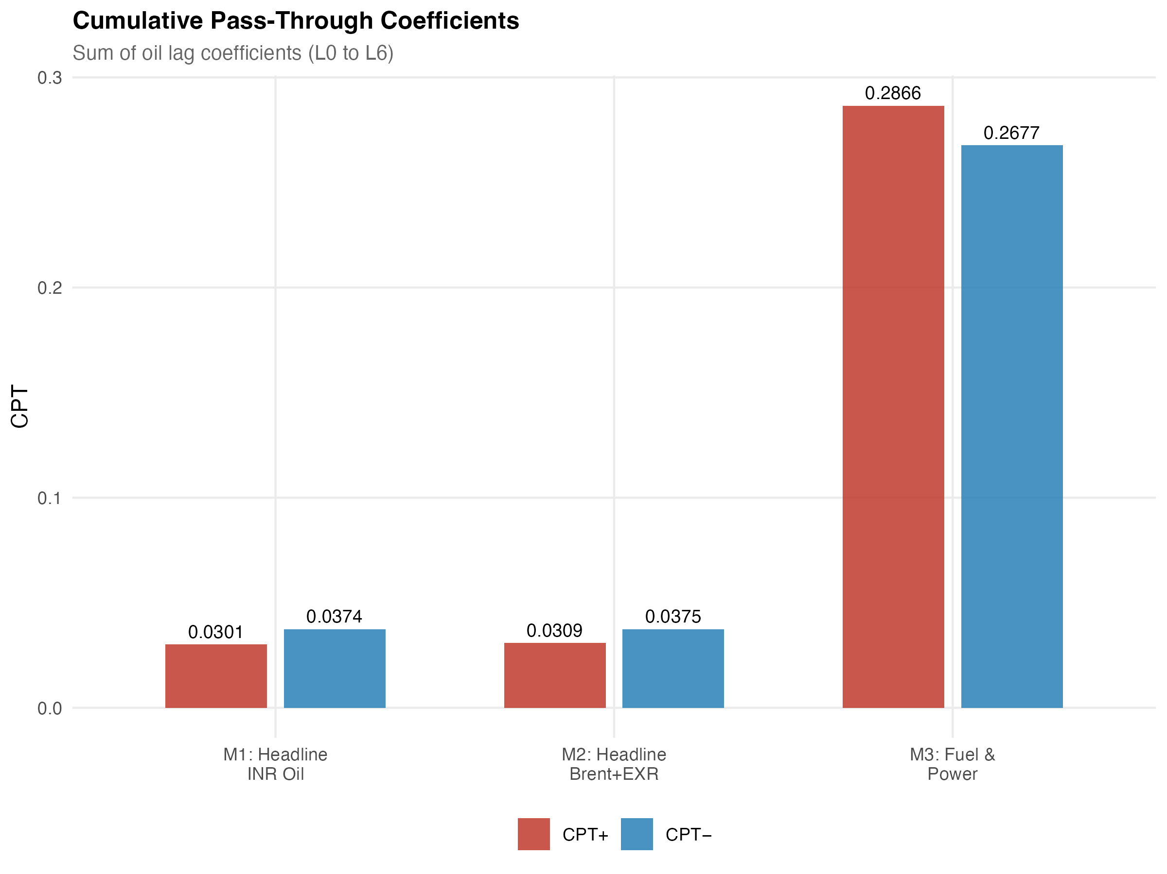
Wholesale results: WPI and WPI Fuel and Power
Headline WPI
Sample: 1983-05 to 2026-03 (N = 515)
CPT⁺ = 0.0301 p = 0.0240
CPT⁻ = 0.0374 p = 0.0012
Modest but statistically significant.
WPI Fuel and Power · preferred
Sample: 2010-04 to 2026-03, excl. Apr–Sep 2020 (N = 186)
CPT⁺ = 0.5205 p < 0.001
CPT⁻ = 0.4195 p < 0.001
Strong wholesale fuel pass-through. Post-2010 sample, COVID months excluded.
Cumulative pass-through across WPI specifications
Layered oil-price pass-through in India | Aniket Pandey, B.Tech + MS Economics
Slide 6 of 11
Notes:
Next I separate the wholesale results.
Headline WPI shows a statistically significant response, but the size is small. This is expected because headline WPI is a broad index.
WPI Fuel and Power is different. It is much closer to fuel and energy items. In the preferred post-2010 model, excluding the abnormal COVID months, the pass-through is large and statistically significant.
So the wholesale evidence says that oil is clearly visible in the fuel-sensitive wholesale layer, but it becomes smaller in the broad headline WPI.

Slide 8
Consumer fuel layers: retail petrol and CPI Fuel and Light
PPAC retail petrol · shock = Brent
Sample: 2004-08 to 2024-12 (N = 245)
CPT⁺ = 0.3459 p < 0.001 | CPT⁻ = 0.1912 p = 0.0002
Asymmetry p = 0.0999 (marginal at 10%). Strong direct fuel pass-through.
CPI Fuel and Light · shock = PPAC retail petrol
Sample: 2011-05 to 2024-12 (N = 164)
CPT⁺ = 0.1777 p = 0.0021 | CPT⁻ = 0.1058 p = 0.1741
Bridge from retail fuel to the consumer fuel basket; effect smaller than upstream petrol.
Layered oil-price pass-through in India | Aniket Pandey, B.Tech + MS Economics
Slide 7 of 11
Notes:
After the wholesale side, I move to the consumer fuel side.
Retail petrol responds strongly to Brent crude shocks. This is the direct fuel layer, so a stronger response is expected.
Then I look at CPI Fuel and Light. Here the shock variable is PPAC retail petrol. The positive pass-through is smaller than retail petrol, but it is still statistically significant.
This slide supports the bridge idea. Oil first appears strongly in retail fuel, and then a smaller part appears in the fuel-sensitive consumer category.

Slide 9
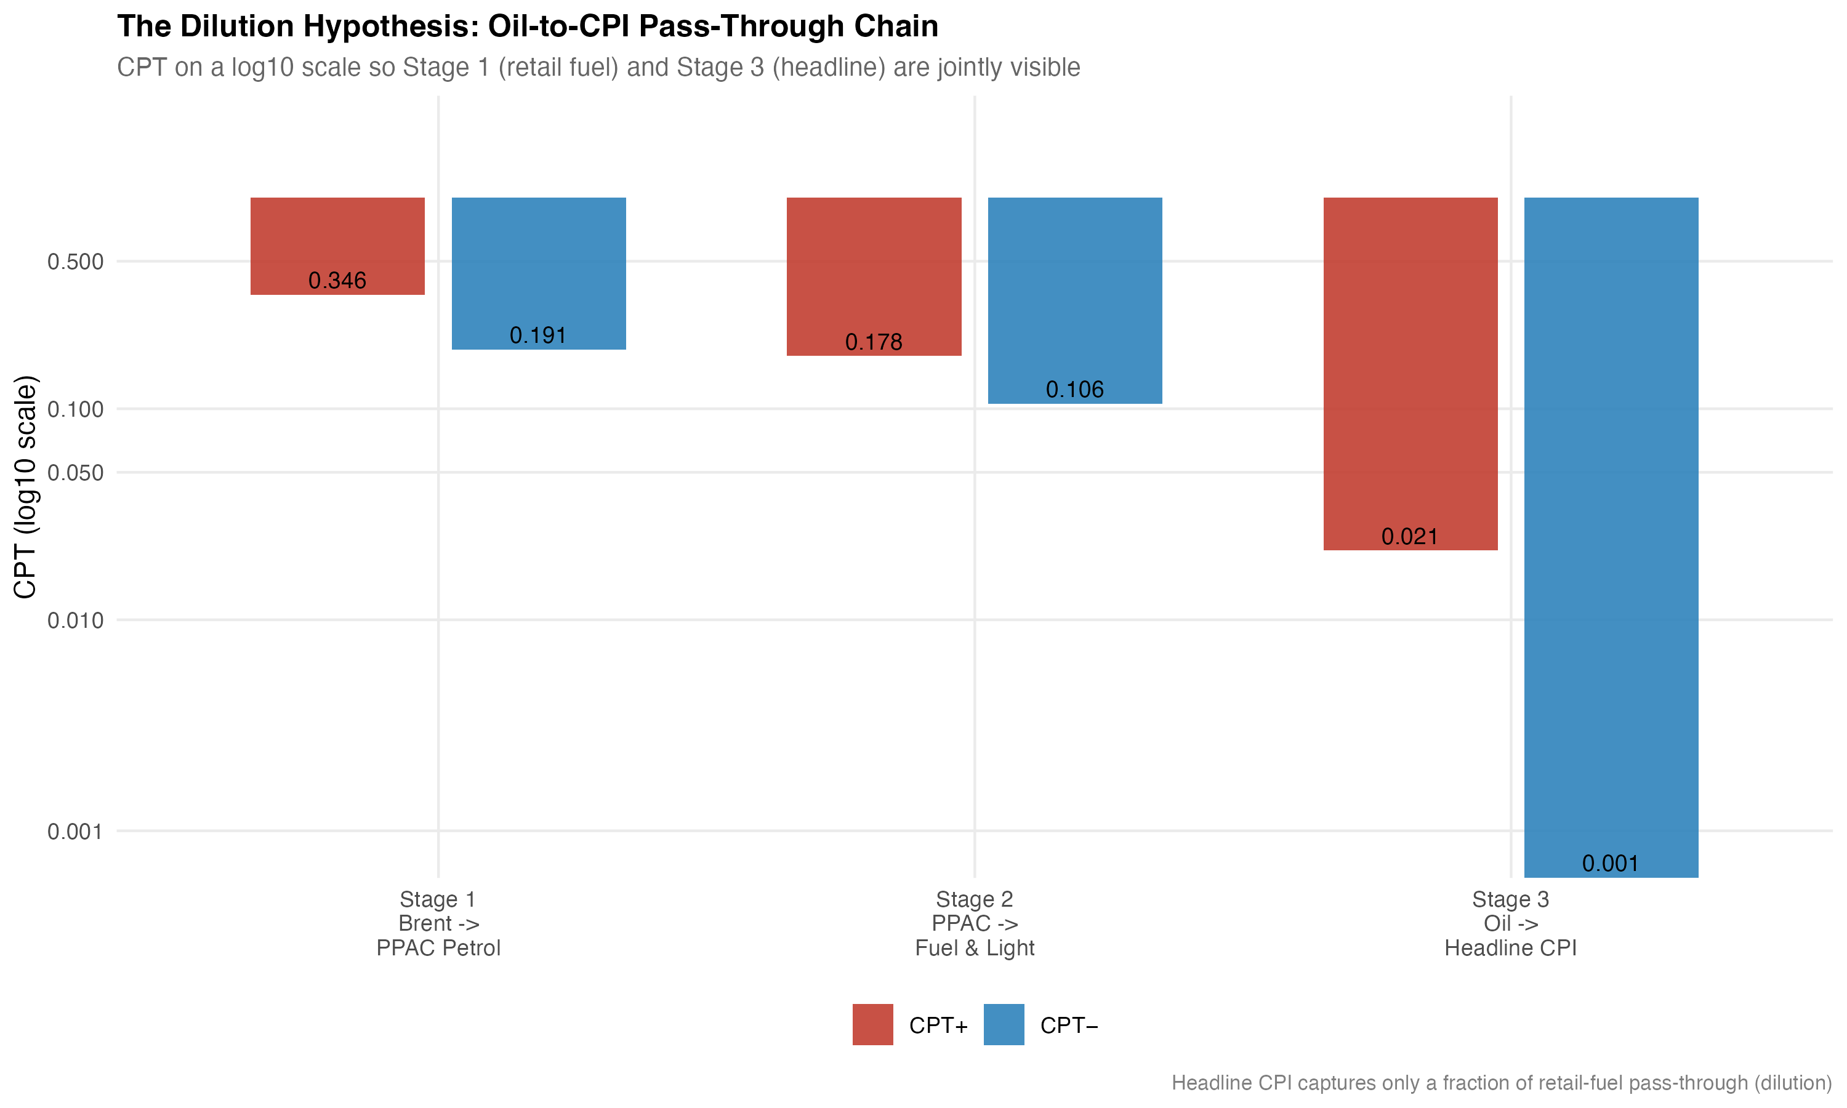
Headline CPI: where the oil signal becomes weak
Headline CPI model
Sample: 2004-08 to 2024-12 (N = 245)
CPT⁺ = 0.0213 p = 0.1220
CPT⁻ = 0.0006 p = 0.9375
Asymmetry p = 0.2408
Reading
▪ Positive CPT⁺ has the expected sign but is not significant.
▪ Headline CPI is broad and food-heavy; fuel weight is limited.
▪ Taxes, margins, and policy can absorb part of the shock.
▪ This is attenuation, not absence.
Cumulative positive pass-through across the consumer-price chain
Layered oil-price pass-through in India | Aniket Pandey, B.Tech + MS Economics
Slide 8 of 11
Notes:
Now I move to the final consumer endpoint, headline CPI.
This is an important slide because headline CPI is the main inflation measure for consumers and policy.
The positive coefficient has the expected sign, but the p-value is 0.122. So I cannot say it is statistically significant at conventional levels.
This does not mean oil is irrelevant. It means that by the time the shock reaches the broad CPI basket, the effect is weak. CPI includes many non-fuel items, and taxes, margins, and basket weights can absorb part of the oil shock.
So my safe interpretation is attenuation, not absence.

Slide 10
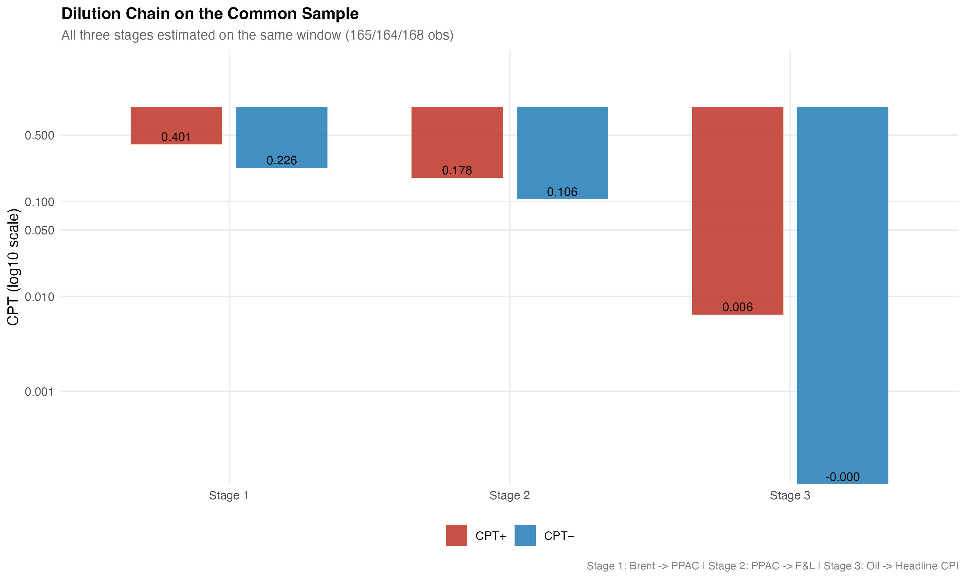
Attenuation across the consumer chain
Stage | Relationship | CPT⁺ | p
Stage 1 | Brent → PPAC retail petrol | 0.4007 | 0.0001
Stage 2 | PPAC petrol → CPI Fuel and Light | 0.1777 | 0.0021
Stage 3 | Rupee oil → Headline CPI | 0.0064 | 0.6355
Pass-through shrinks across stages
Stage 1 vs Stage 3 ratio: 0.40 / 0.006 ≈ 63× smaller
Coefficient-equality test (Stage 1 = Stage 3): F = 14.35, p = 0.0002
Equality is rejected; the headline-CPI response is significantly smaller than the upstream retail-petrol response.
Layered oil-price pass-through in India | Aniket Pandey, B.Tech + MS Economics
Slide 9 of 11
Notes:
After showing the headline CPI result, I test the attenuation pattern more directly.
Here I use a common-sample consumer chain. Stage 1 is Brent to retail petrol. Stage 2 is retail petrol to CPI Fuel and Light. Stage 3 is rupee oil to headline CPI.
The numbers fall from about 0.40 in Stage 1 to about 0.18 in Stage 2 and almost zero in Stage 3.
The Wald test compares Stage 1 and Stage 3. The p-value is 0.0002, so equality is rejected. This means the fall in pass-through is statistically supported, not just a visual pattern.

Slide 11
Discussion and policy relevance
Pass-through falls sharply: retail petrol 0.4007 → CPI Fuel 0.1777 → headline CPI 0.0064.
What the results mean
Policy focus
▪ Oil is clearly visible in fuel prices.
▪ The CPI Fuel and Light response is smaller, but still significant.
▪ Headline CPI dilutes the oil signal across a broad basket.
▪ The main result is attenuation across layers.
▪ Do not rely only on headline CPI.
▪ Track retail fuel, WPI Fuel and Power, and CPI Fuel and Light.
▪ Watch transport and input costs for second-round pressure.
▪ Fuel taxes and pricing choices can change pass-through.
Policy message: oil pressure can build in fuel layers before it appears in headline CPI.
Layered oil-price pass-through in India | Aniket Pandey, B.Tech + MS Economics
Slide 10 of 11
Notes:
After the attenuation test, I will explain what the result means.
The numbers fall sharply across the consumer chain. Retail petrol responds strongly. CPI Fuel and Light responds less, but still significantly. Headline CPI is almost zero in the common-sample chain.
This makes sense because headline CPI is a broad basket. Fuel is only one part of it. So the oil signal becomes weaker when it is mixed with food, services, housing, and other items.
For policy, the important point is monitoring. Headline CPI alone may miss pressure building in fuel-sensitive layers. Retail fuel, WPI Fuel and Power, and CPI Fuel and Light should be watched together.
The model does not prove one exact policy action. It shows that policy should separate direct fuel shocks from wider second-round inflation.

Slide 12
Conclusion: oil pass-through is layered and attenuated
Oil shocks matter in India, but their effect weakens across the price system.
Findings by layer
Takeaways
Strong — WPI Fuel and Power and PPAC retail petrol
Bridge — CPI Fuel and Light: smaller but significant
Modest — Headline WPI: small, statistically significant
Weak — Headline CPI: not statistically significant
▪ Attenuation pattern is visible at every step of the consumer chain.
▪ Stage 1 vs Stage 3 ratio: about 63× smaller; equality test rejected.
▪ Asymmetry is not the central result; only retail petrol is marginal.
▪ Fuel-only and headline-CPI views give different policy reads.
Attenuation, not absence, of oil-price transmission.
Layered oil-price pass-through in India | Aniket Pandey, B.Tech + MS Economics
Slide 11 of 11
Notes:
To conclude, the central finding is layered attenuation.
Oil shocks matter in India, but the effect is not equally strong everywhere. It is strong in WPI Fuel and Power and retail petrol. It is smaller in CPI Fuel and Light. It is modest in headline WPI. It is weak and not statistically significant in headline CPI.
The formal attenuation test also supports this result.
So my final conclusion is simple: oil-price transmission is present, but it becomes diluted before reaching headline CPI.
Thank you. I am happy to take your questions.

Slide 13
Thank you
Questions are welcome.
Aniket Pandey · B.Tech + MS Economics · School Of Engineering, JNU

