Slide 1
Dissertation Progress Report
Asymmetric Pass-Through of Global Brent Crude Oil Shocks to India’s Monthly CPI Inflation (2004–2024): Evidence from an Asymmetric ADL Framework
Short-Run Pass-Through to CPI Inflation in India, 2004-2024
Aniket Pandey
Supervisor: Prof. Shakti Kumar
MS Economics, JNU, 2026

Slide 2
Research Question & Motivation
Core Question:
How strongly do oil price shocks pass through to India's monthly CPI inflation,
and is pass-through larger for oil price increases than for decreases?
Why This Matters:
- India imports ~85% of crude oil - highly vulnerable to global oil price shocks
- Oil affects petrol, diesel, cooking gas, transport, and ultimately all consumer prices
- If oil increases raise inflation more than oil decreases reduce it = ASYMMETRY
- Also called 'Rockets and Feathers' - prices go up fast but come down slowly
- Policy relevance: RBI monetary policy, fiscal interventions, subsidy design

Slide 3
Data Sources & Study Window
Study Period: April 2004 - December 2024 (249 monthly observations)
Data Sources:
1. CPI (Consumer Price Index) - OECD via FRED (2015=100 base)
Dependent variable: India's headline inflation measure
2. Brent Crude Oil Price (USD/barrel) - IMF via FRED
Global benchmark; India's oil imports priced off Brent
3. INR/USD Exchange Rate - US Federal Reserve via FRED
Oil priced in USD but India pays in INR; exchange rate matters
4. IIP (Index of Industrial Production) - RBI DBIE (chain-linked)
Control variable for economic activity
5. Fuel & Light CPI (Appendix only) - Official MoSPI CPI API
More energy-sensitive price index; sample 2011-2024

Slide 4
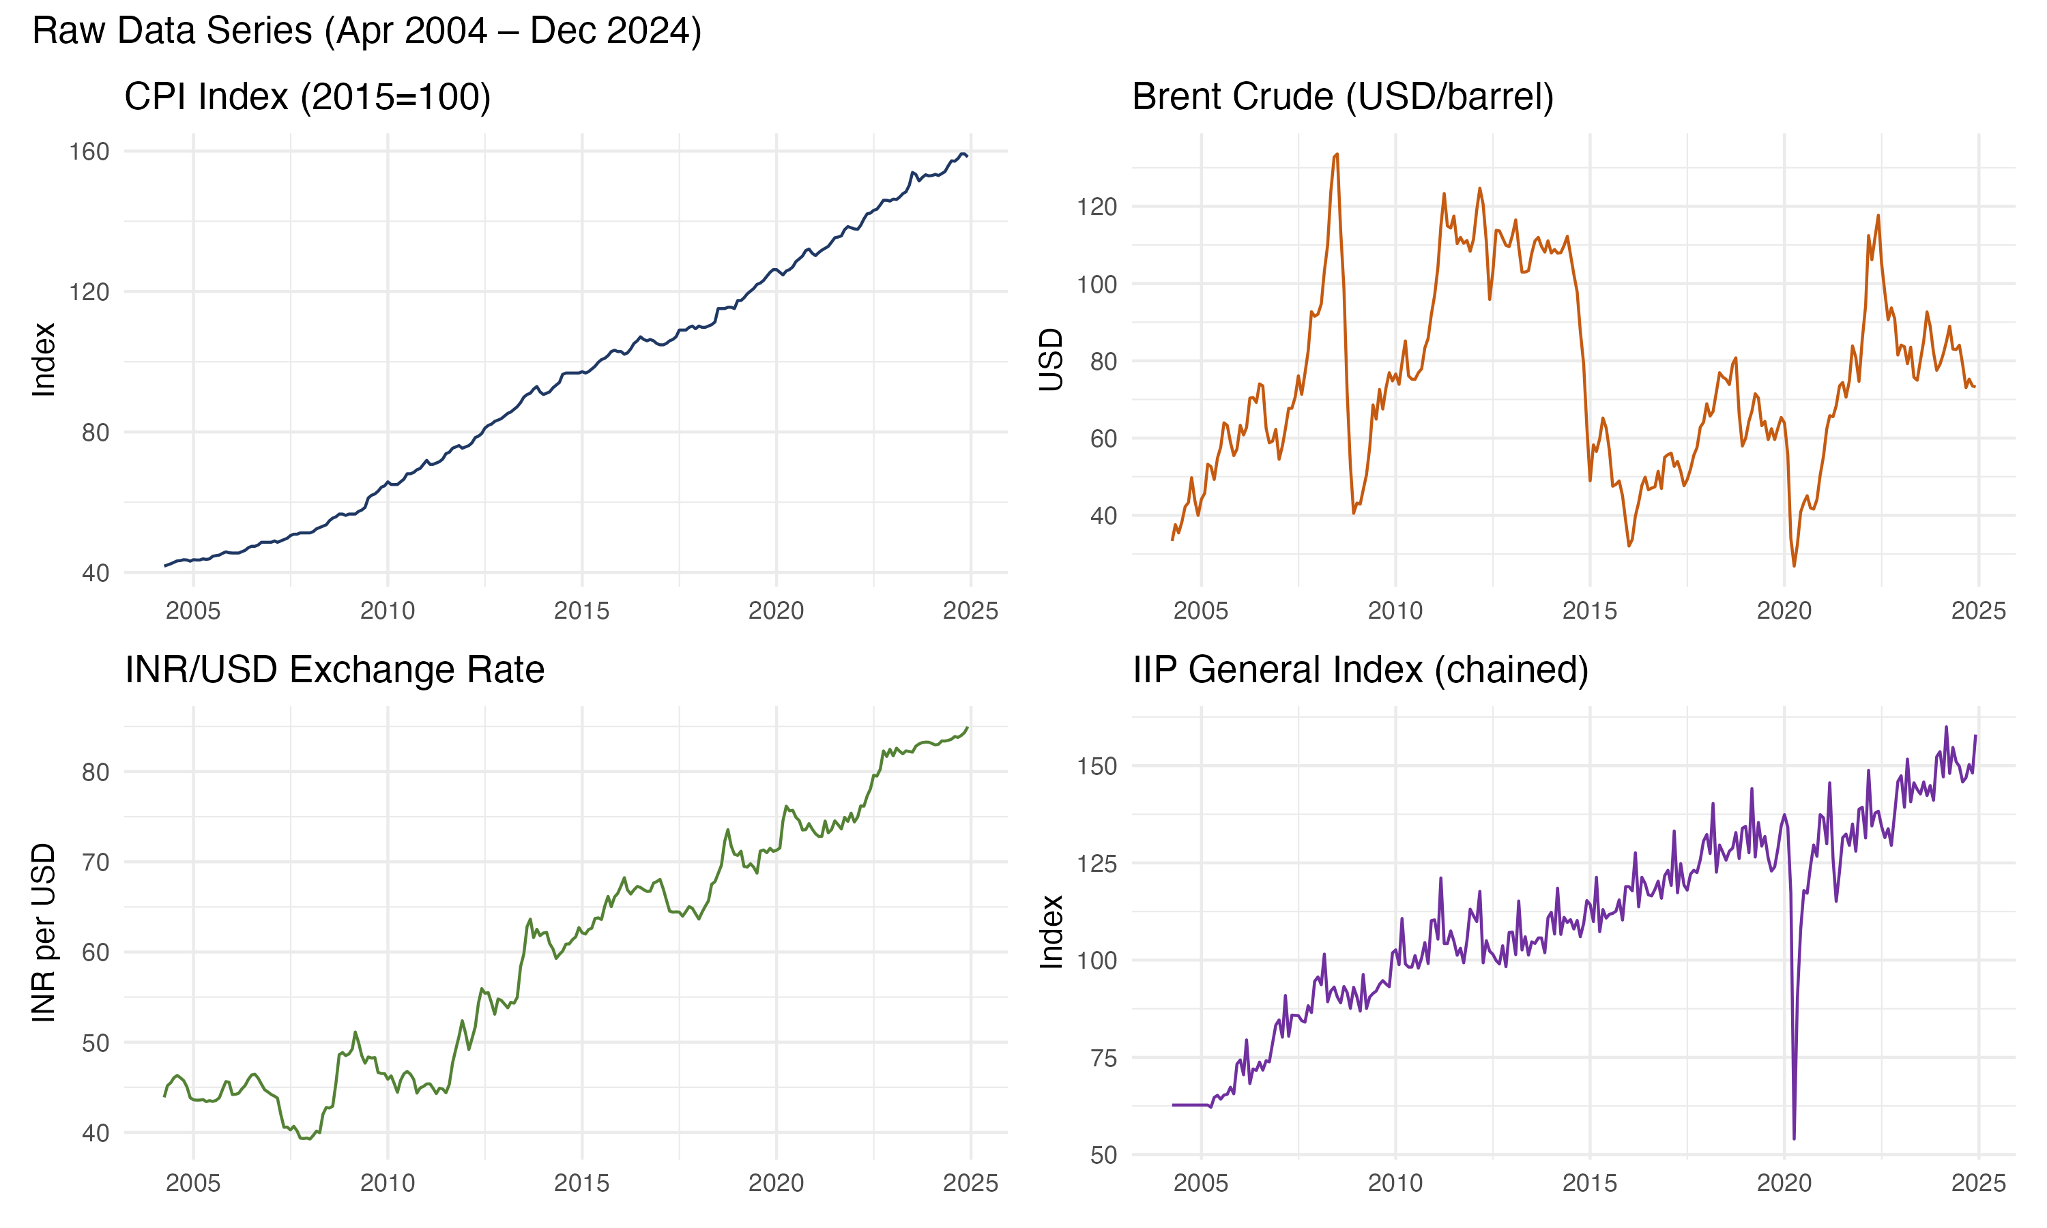
Raw Data Series (Levels)
Key Observations:
- CPI: Steady upward trend (non-stationary)
- Brent: Highly volatile with booms & crashes
- INR/USD: Steady rupee depreciation (39 to 85)
- IIP: Upward trend, COVID crash visible
All series are TRENDING = non-stationary
=> Must transform to log-differences
for valid regression

Slide 5
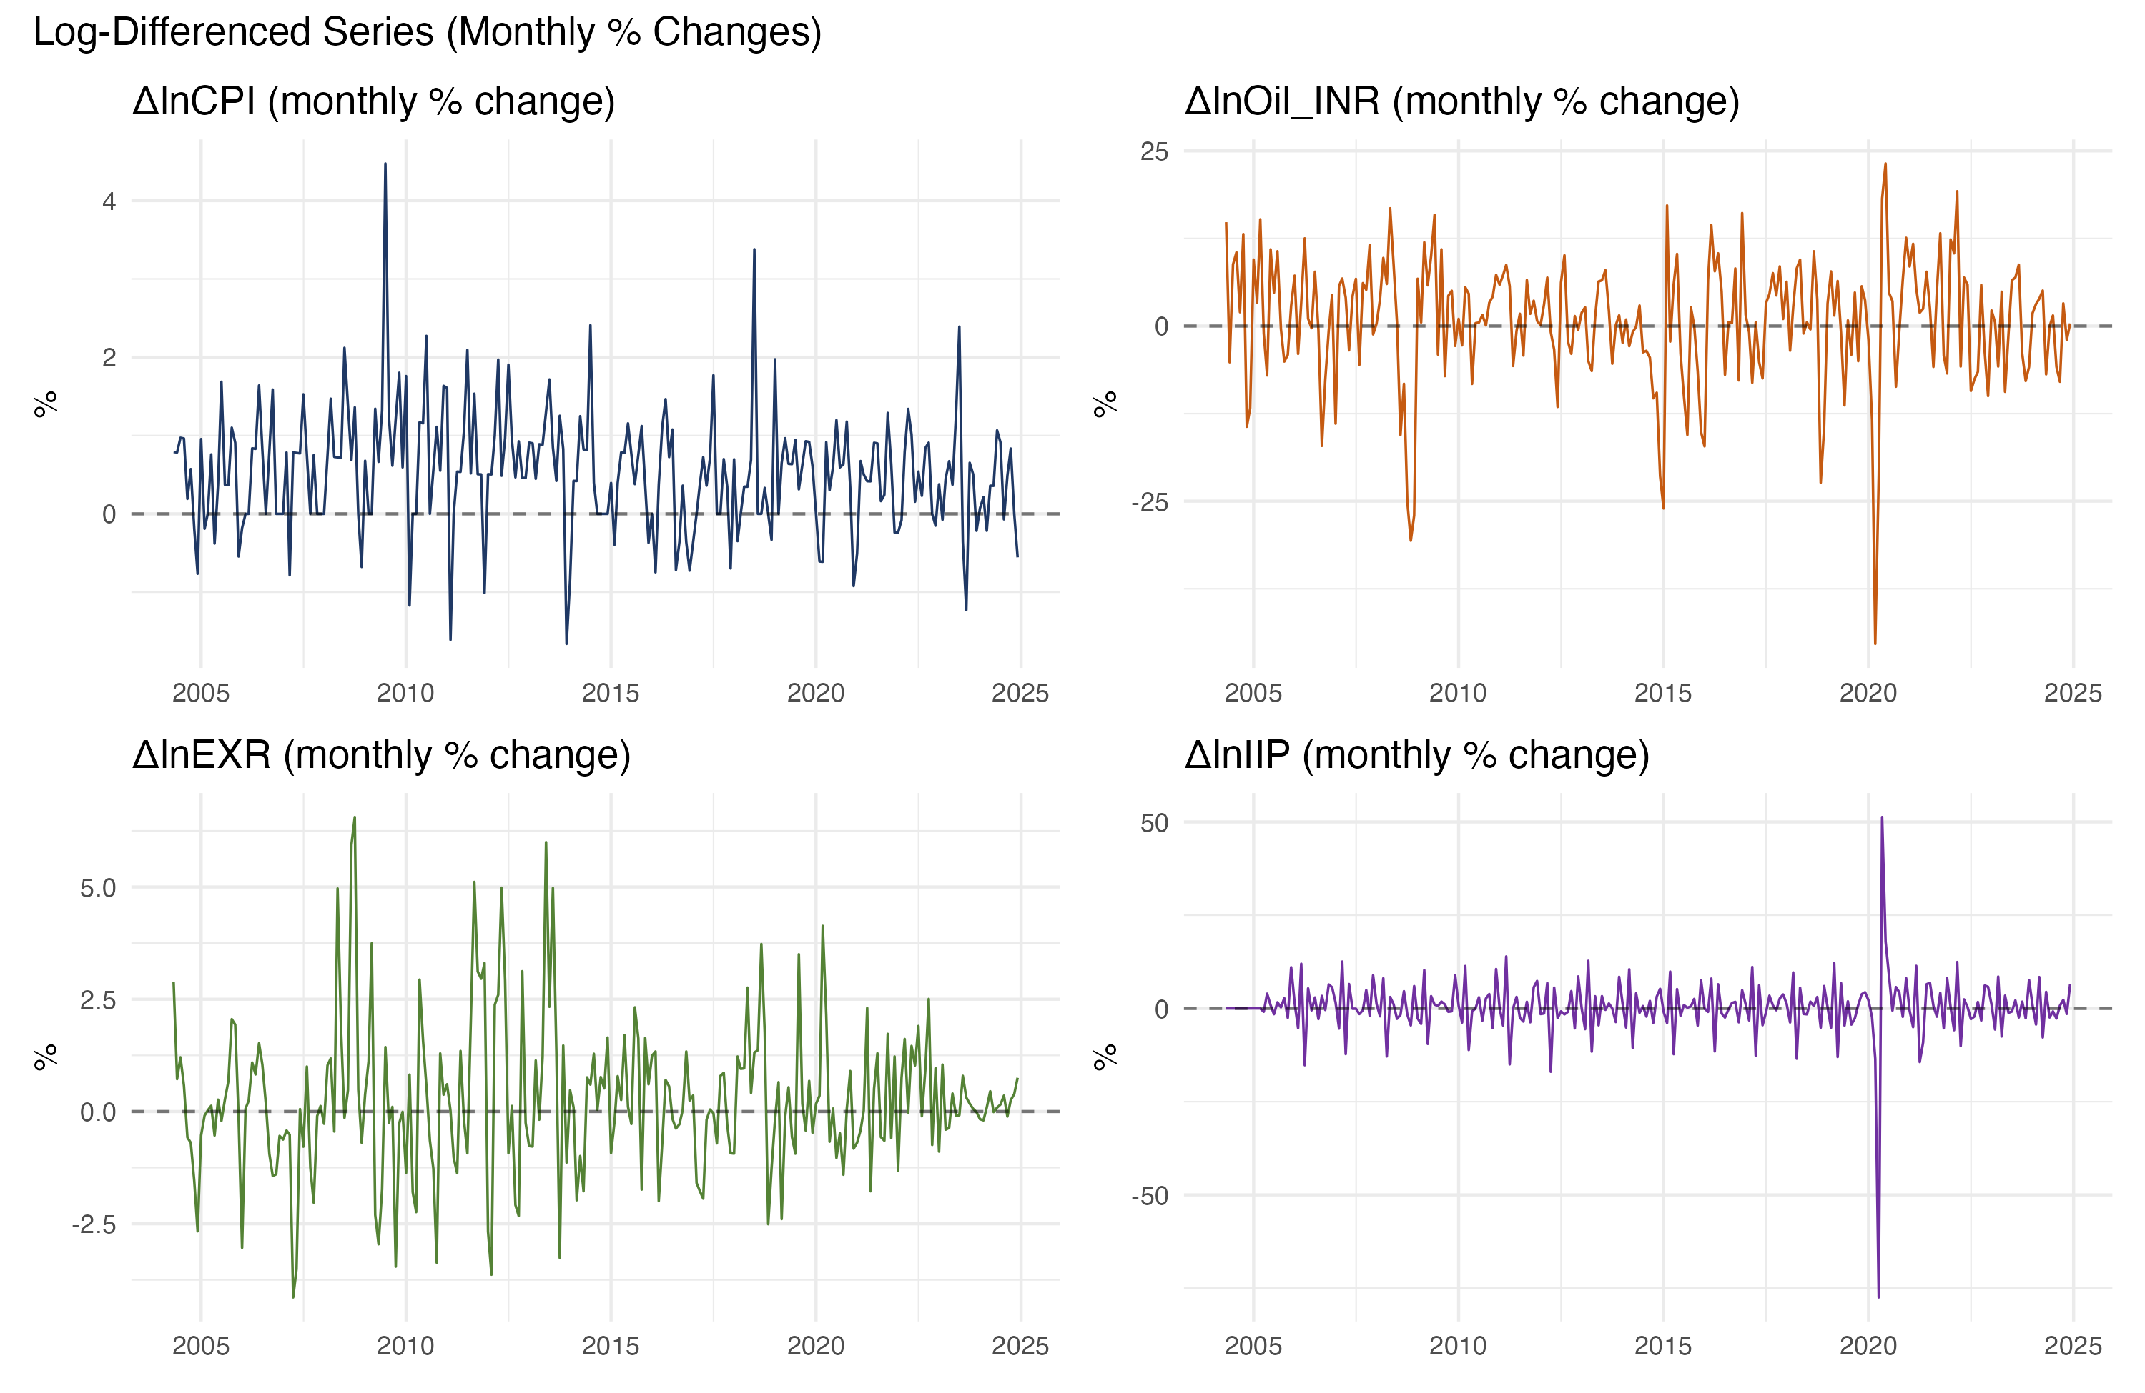
Log-Differenced Series (Monthly % Changes)
After transformation:
dlnX(t) = 100 x [ln(X_t) - ln(X_{t-1})]
Why logs & differences?
1. Percentage interpretation
2. Makes data stationary
3. Reduces skewness
4. Makes scales comparable
Key: Oil is ~12x more volatile
than CPI => expect small
pass-through coefficient

Slide 6
Methodology: Asymmetric ADL Model
Step 1: Construct Oil_INR = Brent_USD x INR/USD
Step 2: Take log-differences (monthly % changes)
Step 3: Asymmetric Decomposition (KEY IDEA):
dOil+(t) = max(dlnOil(t), 0) -- keeps only INCREASES
dOil-(t) = min(dlnOil(t), 0) -- keeps only DECREASES
Step 4: Estimate Asymmetric ADL(p, q) model:
dlnCPI(t) = a + SUM[gi * dlnCPI(t-i)]
+ SUM[pi+ * dOil+(t-j)] (positive oil lags)
+ SUM[pi- * dOil-(t-j)] (negative oil lags)
+ d*dlnIIP(t) + policy dummies + monthly dummies + e(t)
Oil lag q = 3 (fixed by theory); AR lag p selected by AIC => p = 3
Final model: ADL(3,3) with Newey-West HAC standard errors

Slide 7
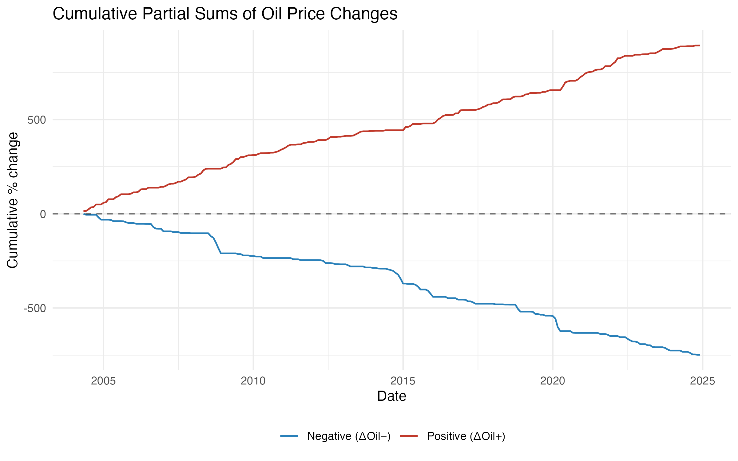
Oil Price Asymmetric Decomposition
Cumulative Partial Sums:
Red = Cumulative oil increases
Blue = Cumulative oil decreases
Both components have
substantial variation,
ensuring reliable estimation
of separate effects.
This is the core innovation:
splitting oil changes lets us
test if increases & decreases
affect CPI differently.

Slide 8
Unit Root Tests (ADF)
Augmented Dickey-Fuller Test: H0: Unit root (non-stationary)
Variables in LEVELS: Variables in DIFFERENCES:
ln(CPI) ADF = -0.32 p = 0.99 FAIL dlnCPI ADF = -9.04 p < 0.01 PASS
ln(Oil_INR) ADF = -2.57 p = 0.33 FAIL dlnOil ADF = -6.13 p < 0.01 PASS
ln(EXR) ADF = -3.69 p = 0.03 Border. dlnEXR ADF = -5.21 p < 0.01 PASS
ln(IIP) ADF = -3.20 p = 0.09 FAIL dlnIIP ADF = -8.22 p < 0.01 PASS
Conclusion: All variables are I(1) - integrated of order 1.
Levels are non-stationary; first differences are strongly stationary.
This justifies our estimation in log-differences.

Slide 9
Main Results: Asymmetric ADL(3,3)
Cumulative Pass-Through (CPT) = Total oil effect over 0-3 month lags
CPT+ (positive oil effect) = 0.021296 +10% oil shock => +0.213 pp CPI
CPT- (negative oil effect) = 0.000598 -10% oil shock => -0.006 pp CPI
Asymmetry Gap = 0.020698 Positive effect is ~35x larger
Statistical Tests (Newey-West HAC):
H0: CPT+ = 0 p = 0.1220 Not significant at 5%, borderline at 12%
H0: CPT- = 0 p = 0.9375 Clearly not significant
H0: CPT+ = CPT- p = 0.2408 Asymmetry not significant at 5%
Adj R-squared = 0.4492 (model explains ~45% of CPI variation)
N = 245 observations
Interpretation: Point estimates show clear asymmetry. Positive oil shocks have
economically meaningful effect. But formal asymmetry test is not significant at 5%.

Slide 10
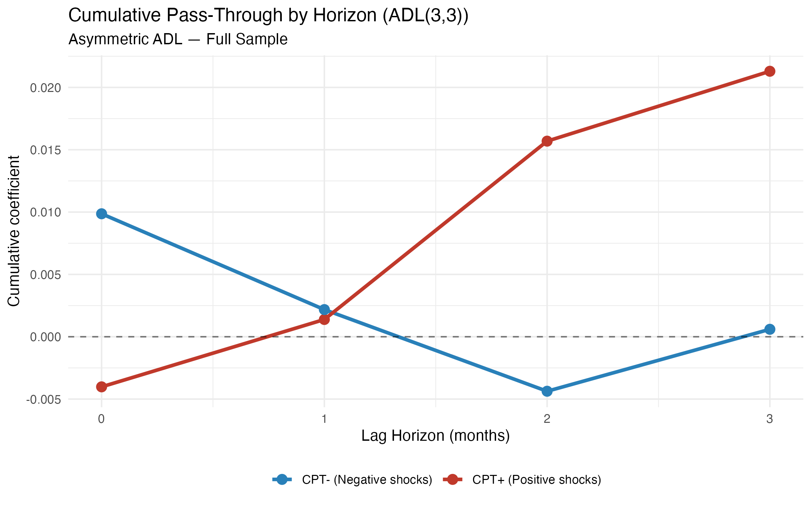
Cumulative Pass-Through by Lag Horizon
KEY RESULT PLOT:
Red (CPT+): Builds up to
~ 0.021 by lag 3. Oil increases
take 2-3 months to transmit
to CPI.
Blue (CPT-): Stays near zero.
Oil decreases have essentially
NO effect on CPI.
The 2-month delay reflects
supply chain transmission:
oil => refineries => retail
fuel => transport => goods.

Slide 11
Formal Asymmetry Test (Wald Test)
Wald Test: H0: CPT+ = CPT- (no asymmetry)
F-statistic = 1.3835
p-value = 0.2408
Decision = Fail to reject H0 at 5%
Why asymmetry is not statistically significant:
1. Headline CPI composition: Food is 47% of India's CPI basket.
Oil is a small direct component. Effects get diluted by food-price noise.
2. Government interventions: Excise duty adjustments, LPG subsidies,
price controls buffer consumers from full oil shocks.
3. Downward price rigidity: Administered prices and mark-up pricing
adjust slowly and incompletely, especially downward.
4. Time-varying dynamics: 20 years averages together different regimes.
Rolling window shows significance in some sub-periods.
This is NOT a failure - many published studies on headline CPI find similar results.

Slide 12
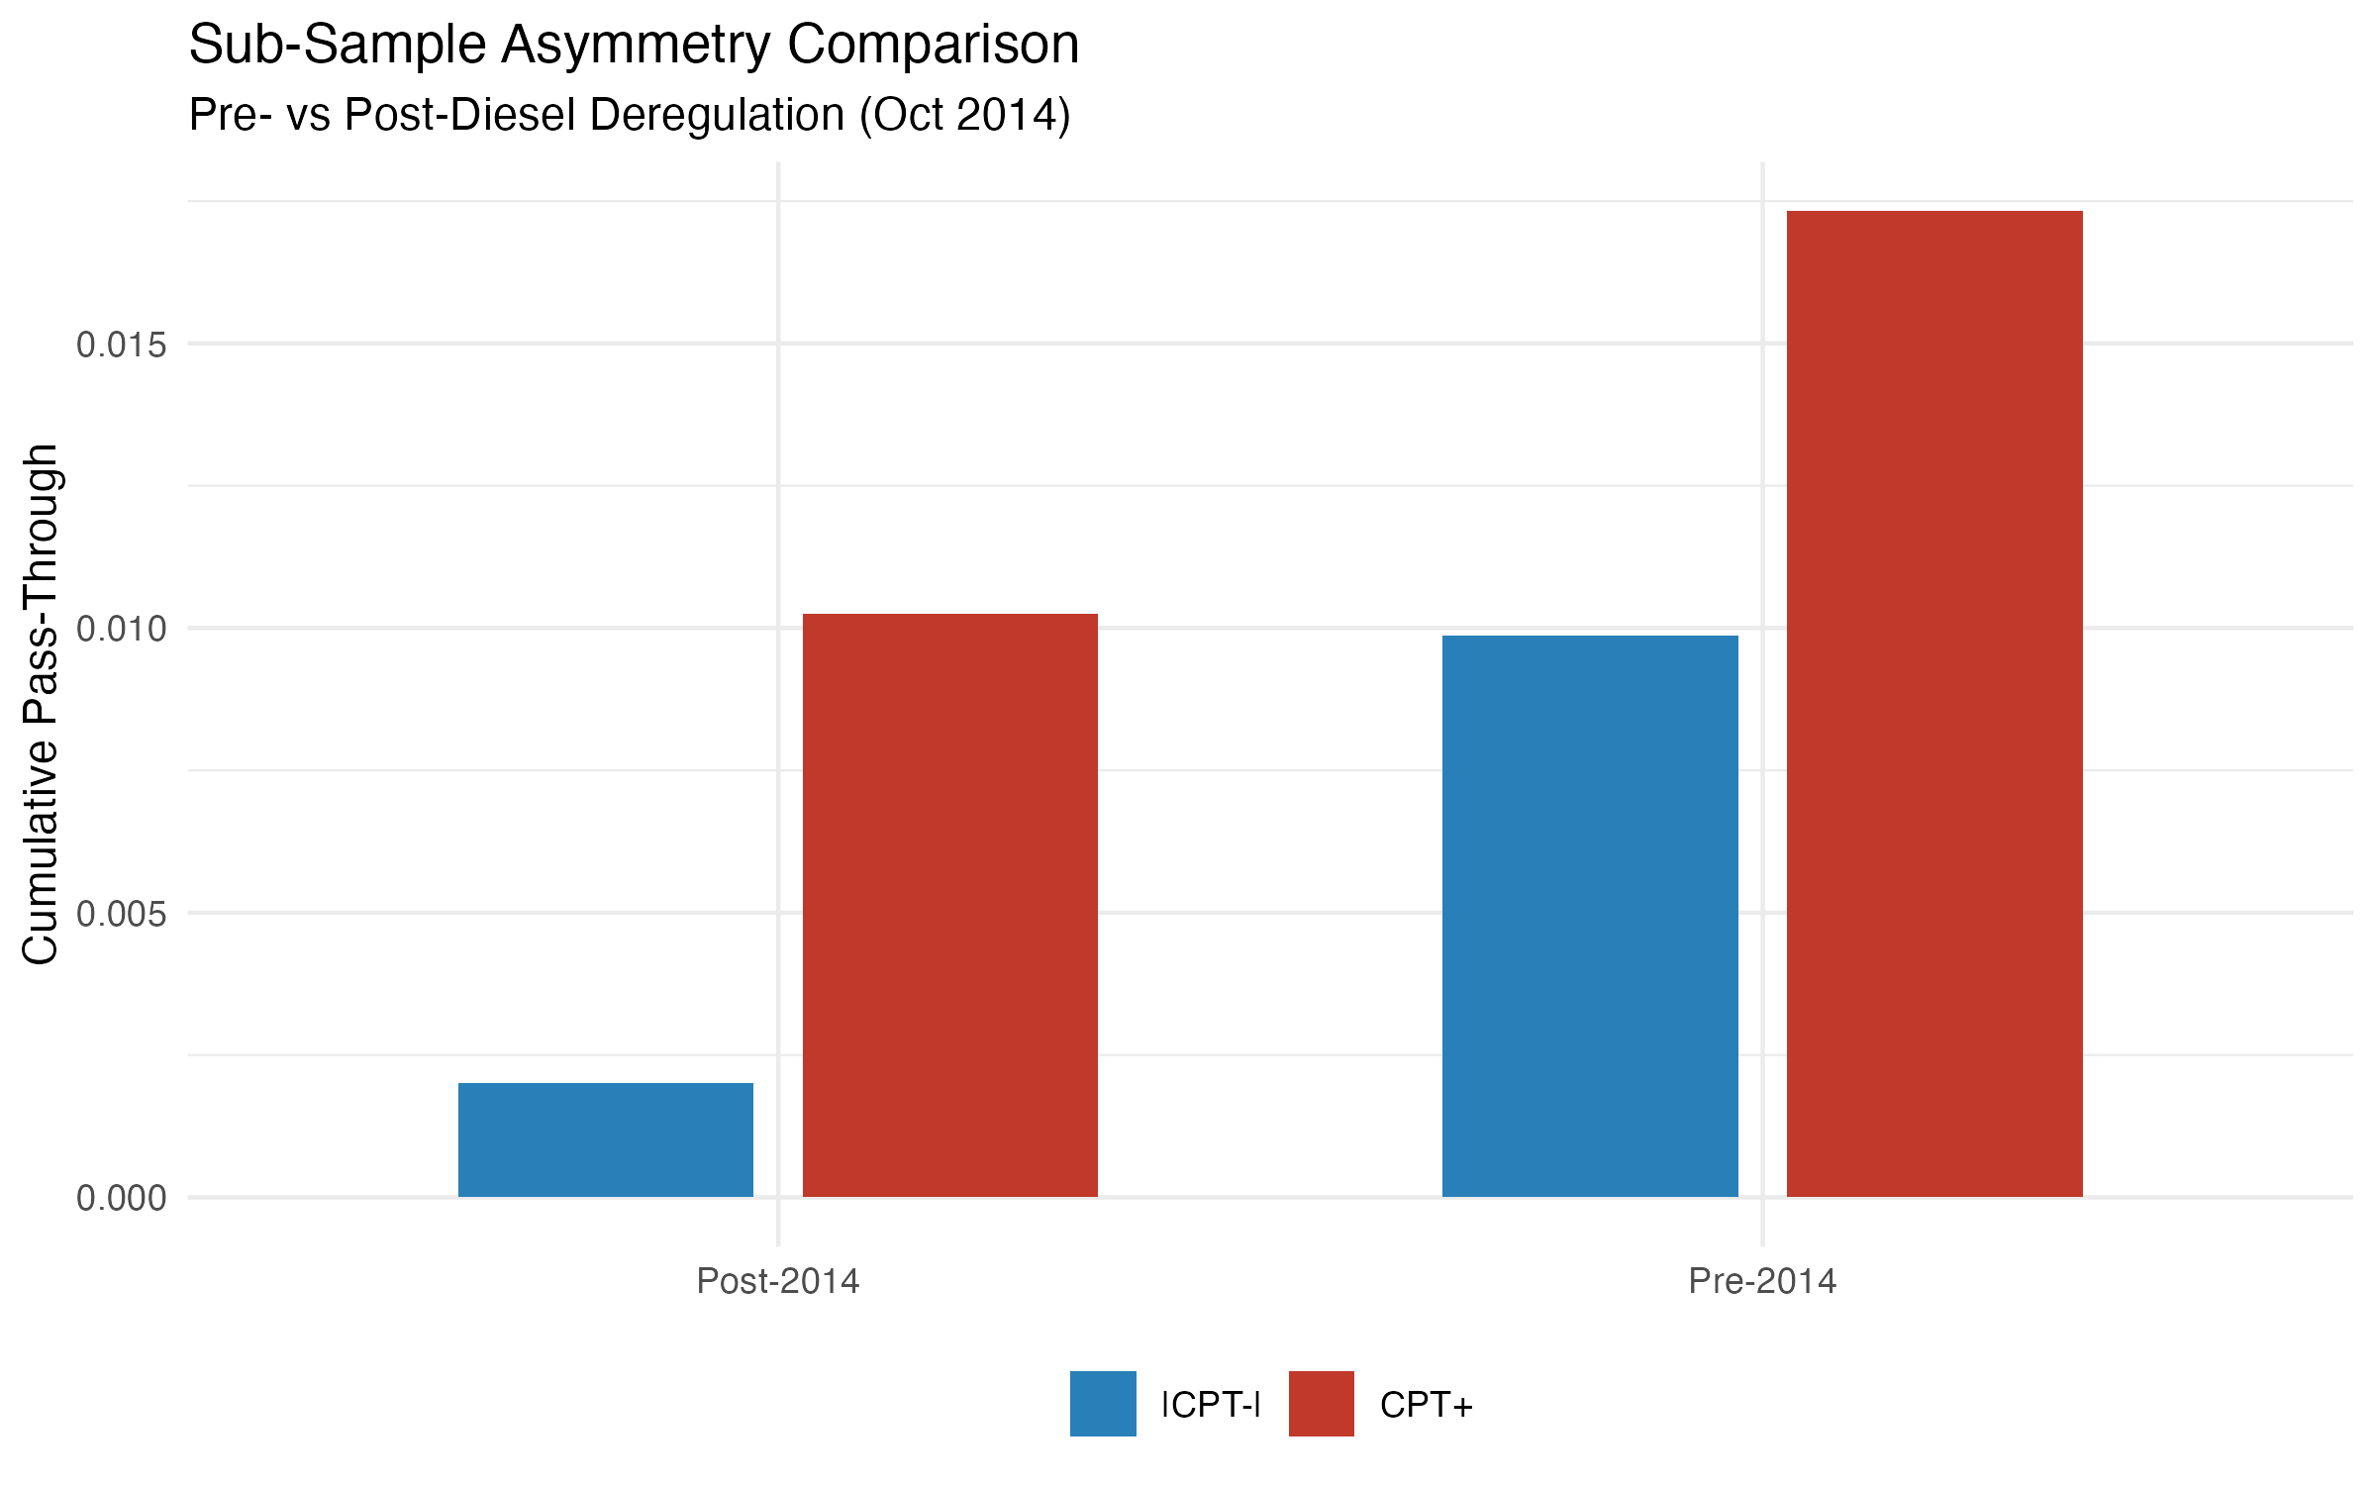
Sub-Sample Analysis: Pre/Post Diesel Deregulation
Split at October 2014 (diesel deregulation):
Pre-2014 (N=122):
CPT+ = 0.0173, CPT- = 0.0099
p(asymmetry) = 0.846
Adj R2 = 0.357
Post-2014 (N=123):
CPT+ = 0.0102, CPT- = -0.002
p(asymmetry) = 0.443
Adj R2 = 0.500
Post-2014 shows cleaner results:
positive shock positive, negative
shock near-zero. Better model fit.
After deregulation, market prices
respond more directly to oil.

Slide 13
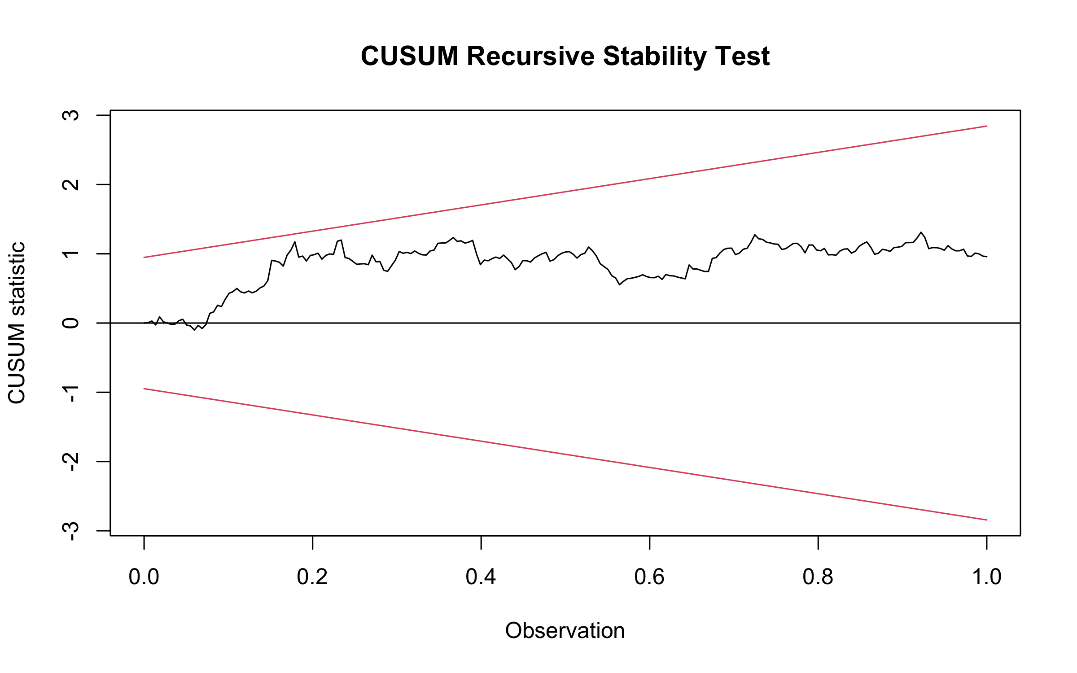
Diagnostic Tests
Model Diagnostics (Main Asymmetric ADL):
Test Statistic p-value Result
---- --------- ------- ------
Breusch-Godfrey LM(12) 19.71 0.073 PASS (no autocorrelation)
Breusch-Pagan 44.76 0.013 FAIL* (heteroskedasticity)
Ramsey RESET 2.80 0.063 PASS (correct functional form)
CUSUM Stability 0.86 0.091 PASS (model is stable)
* Breusch-Pagan detects heteroskedasticity, which is EXPECTED in
macro data.
This is precisely why we use Newey-West HAC standard errors -
they give valid inference even with heteroskedasticity.
The detection CONFIRMS our methodological choice was correct.

Slide 14
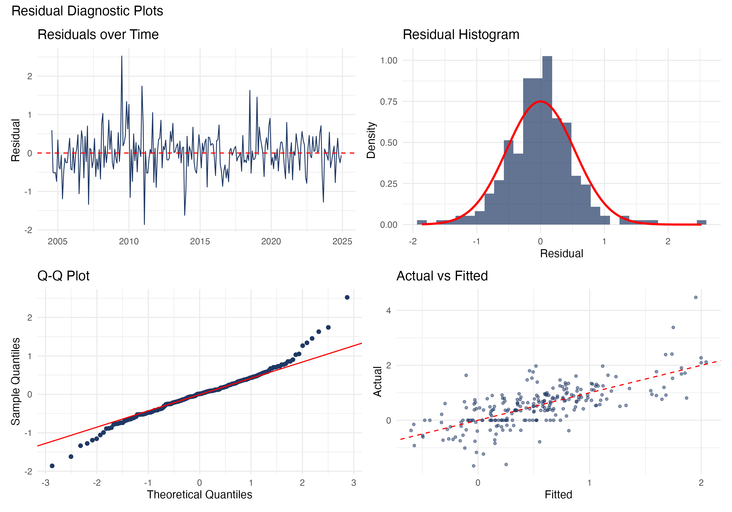
Residual Diagnostics
4-Panel Diagnostics:
1. Residuals over time:
No pattern => no autocorrelation
2. Histogram:
Roughly bell-shaped,
fat tails (typical for macro)
3. Q-Q Plot:
Mostly follows line,
minor tail deviations
4. Actual vs Fitted:
Clusters around 45-degree line
Overall: Residuals well-behaved.
HAC handles mild non-normality.

Slide 15
Robustness: Brent + Exchange Rate Model
Separating world oil price from exchange rate channel:
Primary (Oil_INR) Brent USD + EXR
CPT+ 0.021296 0.027458
+10% shock effect +0.213 pp +0.275 pp
p(CPT+ = 0) 0.1220 0.0933
EXR coefficient -- 0.039619
EXR p-value -- 0.0287 **
Adj R-squared 0.4492 0.4575
Key Finding: Exchange rate is SIGNIFICANT (p = 0.029)!
A 1% rupee depreciation raises CPI by ~0.04 pp independently of oil.
This separates the world oil channel from the currency channel
and strengthens the India-specific interpretation.

Slide 16
Appendix: Fuel & Light CPI (MoSPI API)
Using official MoSPI Fuel & Light CPI sub-index (2011-2024):
Headline CPI (Main) Fuel & Light CPI
CPT+ 0.021296 0.060848
+10% shock effect +0.213 pp +0.609 pp
p(CPT+ = 0) 0.1220 0.0337 **
p(Asymmetry) 0.2408 0.2647
Adj R-squared 0.4492 0.2144
Key Finding: Fuel CPI shows 3x STRONGER and STATISTICALLY SIGNIFICANT
positive oil pass-through (p = 0.034)!
This is exactly what theory predicts: a more energy-exposed CPI sub-index
responds more directly to oil prices.
This is the STRONGEST supporting evidence in the dissertation.
It confirms: oil DOES pass through to prices - headline CPI just dilutes the signal.

Slide 17
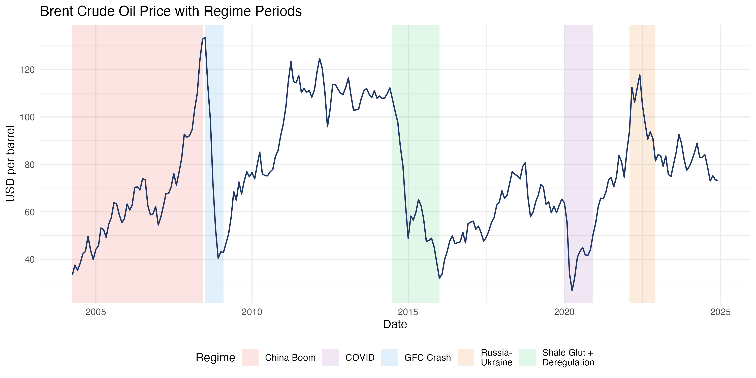
Oil Price Regimes in Our Sample
Our 20-year sample covers
ALL major oil regimes:
- China Boom (2004-08)
- GFC Crash (2008-09)
- Shale Glut (2014-16)
- COVID (2020)
- Russia-Ukraine (2022)
Rich variation in both
positive and negative shocks
of large magnitude.

Slide 18
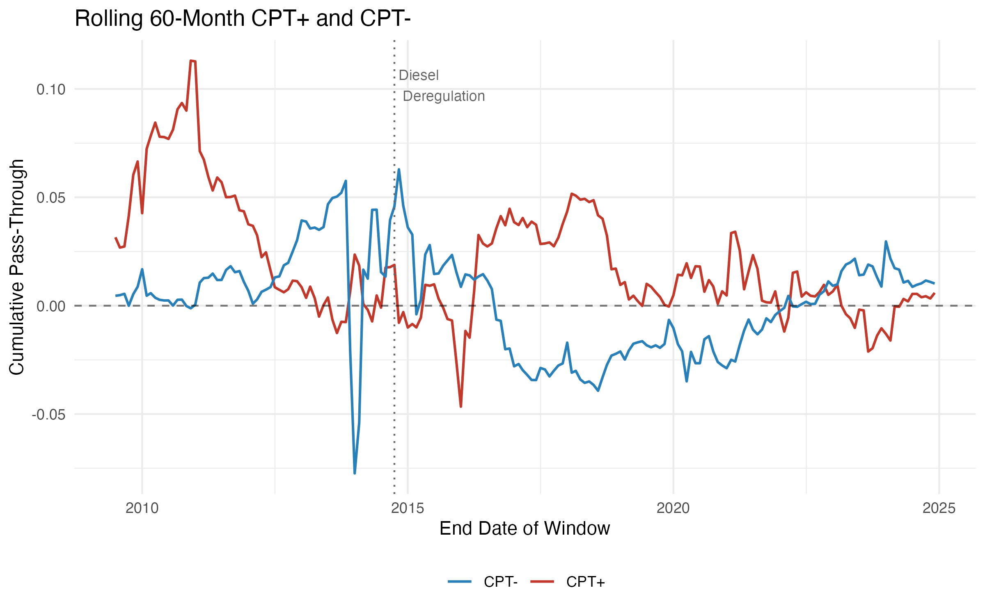
Rolling 60-Month Window Analysis
Rolling 5-year windows:
Red (CPT+): Varies over time,
often positive, strongest in
volatile oil periods.
Blue (CPT-): Consistently
near zero.
Dotted line = diesel deregulation
This explains weak full-sample
Wald test: averaging 20 years
of changing dynamics dilutes
the asymmetry signal.

Slide 19
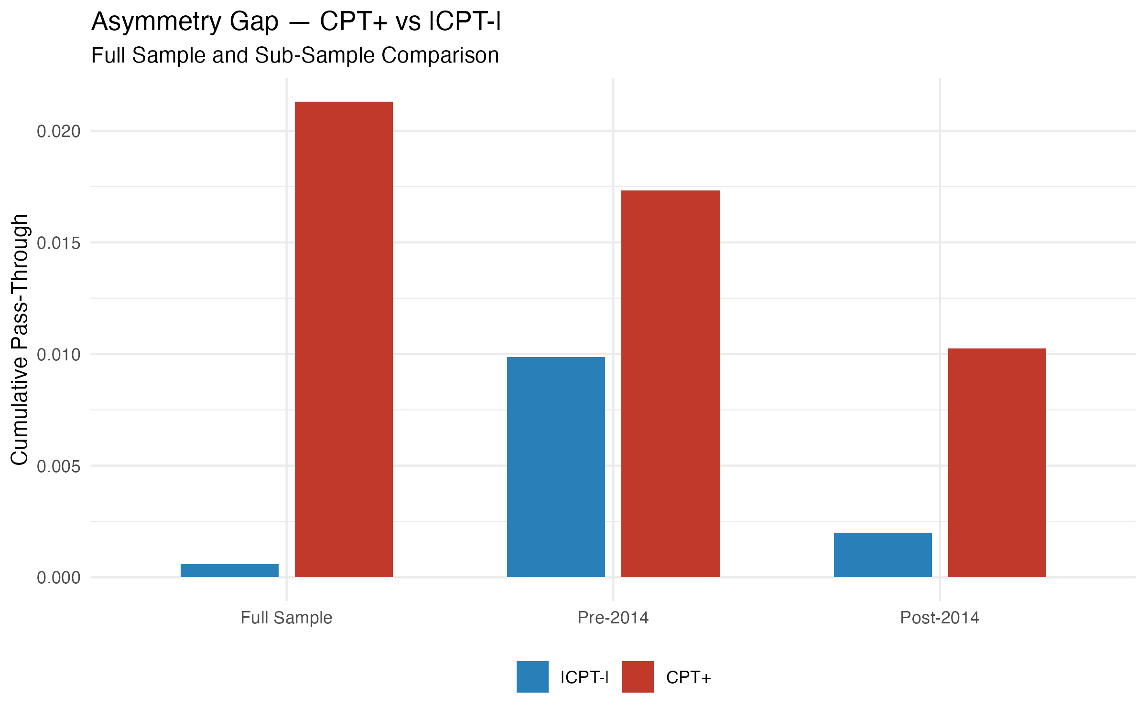
Asymmetry Gap: Full Sample & Sub-Samples
In ALL three samples:
CPT+ (red) > |CPT-| (blue)
The DIRECTION of asymmetry
is completely robust across
all sample periods.
Even though statistical
significance is elusive,
the pattern is consistent:
Oil increases affect CPI
more than oil decreases
=> 'Rockets and Feathers'
behavior in India.

Slide 20
Conclusions & Key Takeaways
1. Positive oil shocks pass through to India's CPI inflation with economically
meaningful magnitude: a 10% oil shock raises monthly CPI by ~0.21 pp
2. Negative oil shocks have essentially zero effect on CPI (CPT- ~ 0.0006)
3. Point estimates show clear asymmetry (CPT+ is 35x larger than |CPT-|),
but formal Wald test is not significant at 5% (p = 0.24)
4. Exchange rate matters independently: a 1% rupee depreciation raises
CPI by ~0.04 pp (significance p = 0.029 in Brent+EXR model)
5. Fuel & Light CPI shows 3x stronger and statistically significant
positive pass-through (p = 0.034), confirming the energy channel
6. Results are robust to lag selection, COVID removal, winsorization,
and sub-sample splits. All diagnostics pass.
7. Weak asymmetry in headline CPI is expected: food (47%) dilutes the signal,
government interventions buffer consumers, prices are sticky downward.

