Slide 1
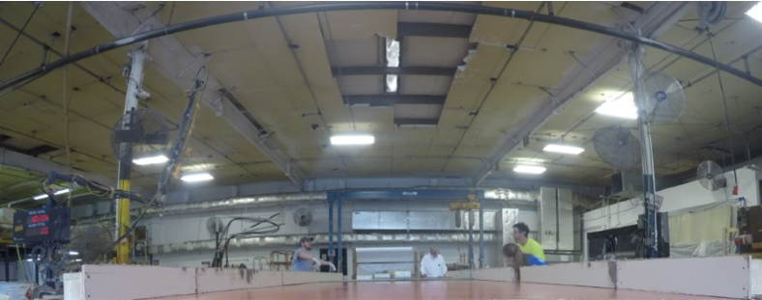
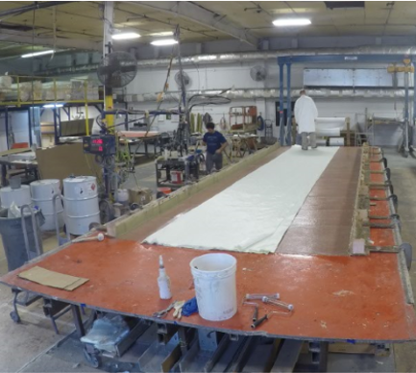
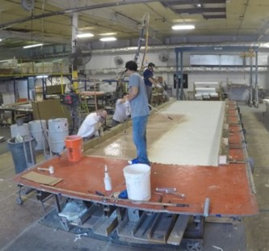
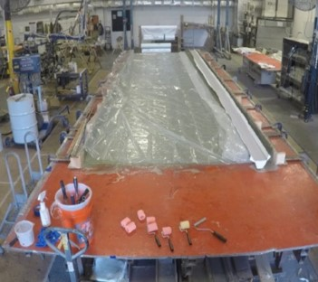
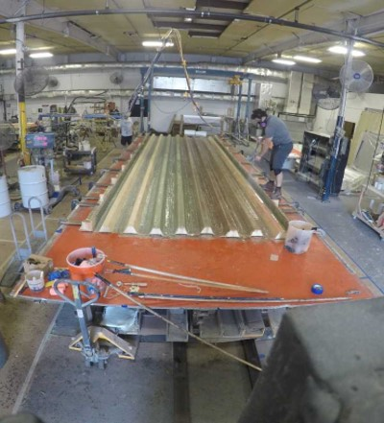
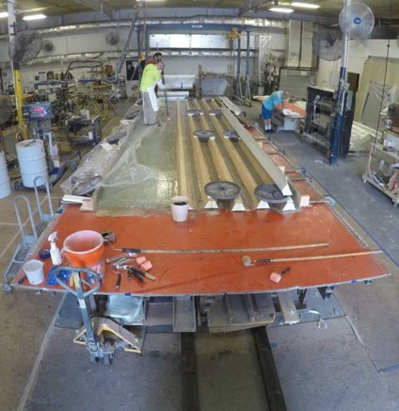
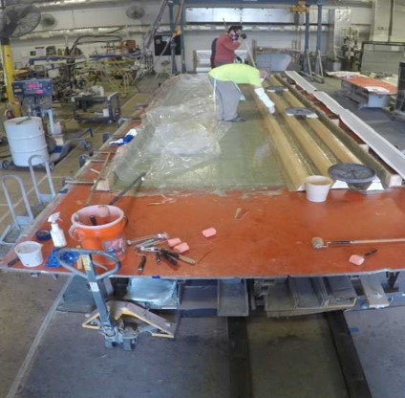
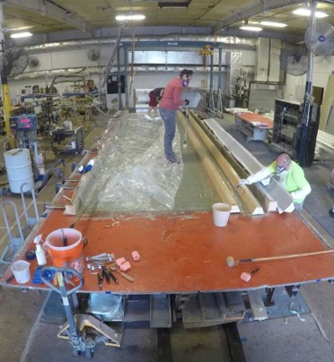
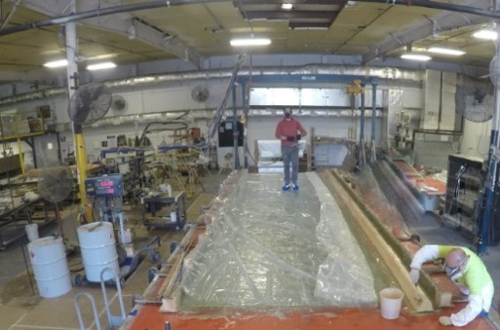
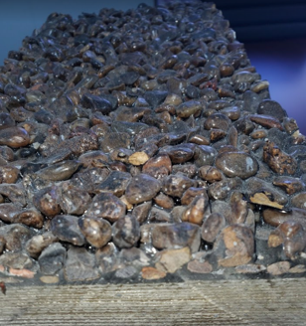
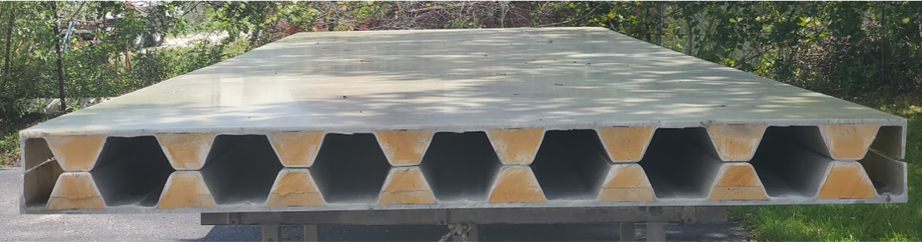
Laminating
Mold Prep – Flat Mold with Simple Edge Fixtures
Bulk Lamination
Layers Repeat to Schedule
Wet Out of Bulk
Laminations
Bulk Complete
Prisma Beams Installation
Addition of Prisma Beams
Final Beam
Beam 5
Beam 3
Beam 2
Beam 1
Ship to Site for Installation
Dry Fit Check
Wear Surface Photo

