Slide 1
Per-Olof Hedvall, Professor of Design, Mid Sweden University
Accessibility, Usability, and Universal Design Beyond “Us” and “Them”

Slide 2
  “Difference is the condition of everyone”
What does this mean?
  We’re all different. Every single I. Every single you.
  We’re all part of human variation.
Universal Design starts from that and builds for it
Two challenges to make this real
  The with-without, norm-deviation, us-them thinking
  Well done UD is often tacit

Slide 3
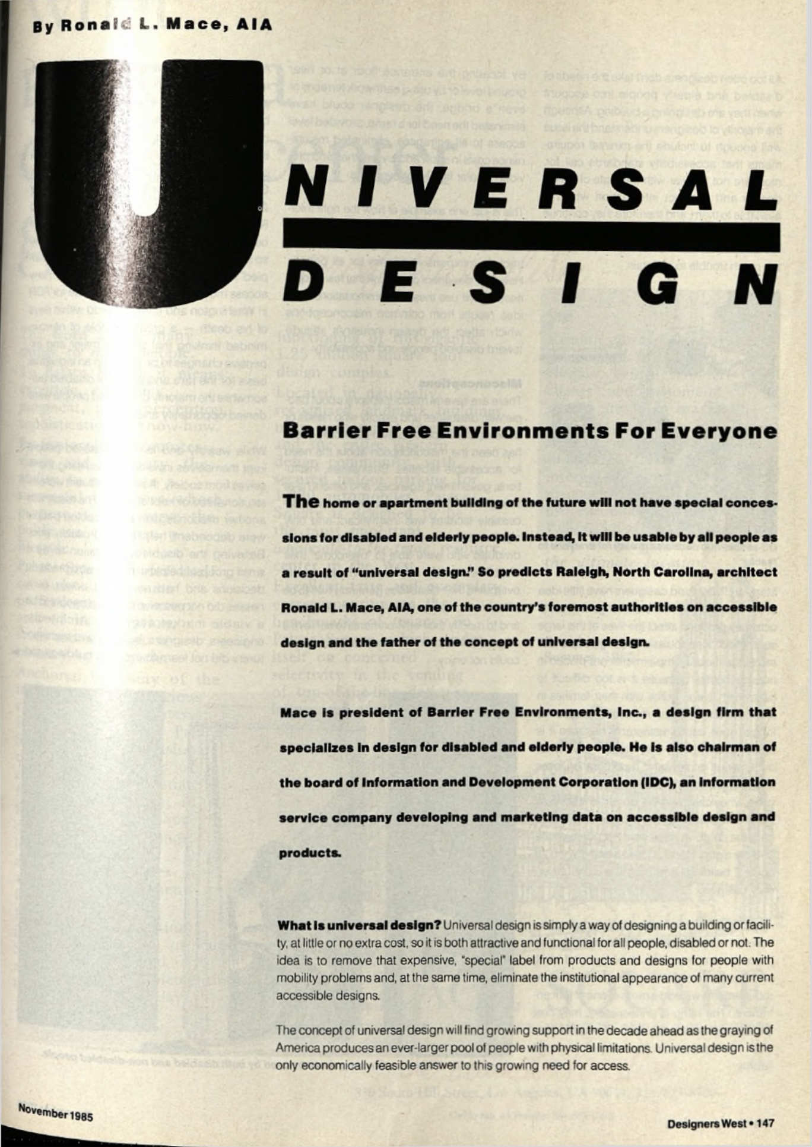
Ad fontes! To the sources!
“What is universal design? Universal design is simply a way of designing a building or facility, at little or no extra cost, so it is both attractive and functional for all people, disabled or not.”

Slide 4
The first challenge: a culture based on “us” and “them” vs. a culture based on difference
An example of ”us” and ”them” from a policy text:
“People with disabilities can move around and use all indoor and outdoor environments in the city on equal terms with others.”
The division can be avoided with a slight adjustment to the text: “All residents can move around and use all indoor and outdoor environments in the city.”
(Analysis by Prof. Stina Ericsson, The Syntax of Equality project)

Slide 5
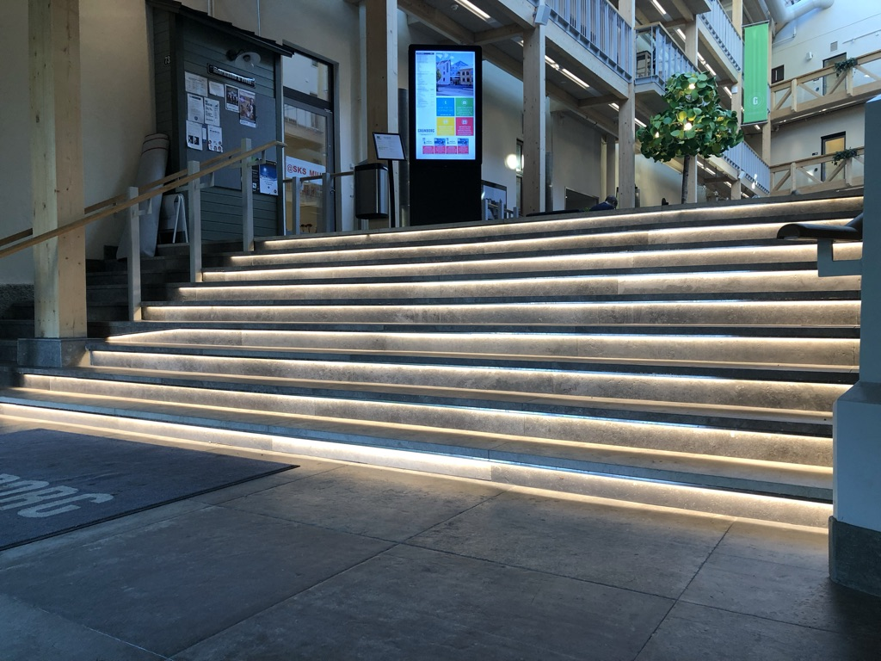
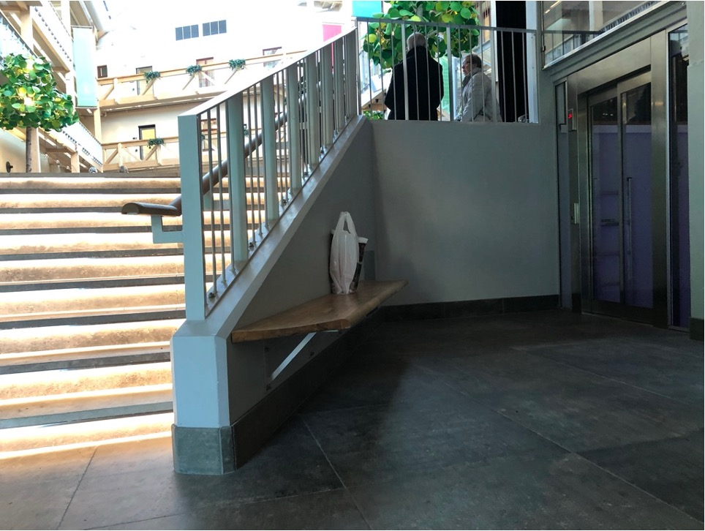
”Us” and ”them” in the built environment
Norm
Deviation
From a Universal Design perspective, there is only one population

Slide 6
Designing for difference, beyond “us” and “them”
Three ways to move beyond “us” and “them”
  Design for situations
  Categorise the environment, not the body or the person.
  Meet variation with variation
(For more examples, see nonclusive.org)

Slide 7
Shaping a future of Universal Design, a future of everyone, a future of difference
For many of the students that arrive at universities today,
it is nothing new that people are different.
  Provide chances to explore the connection between design and diversity.
  Working with their own perspective, including seeing us and them, and the tacit qualities of Universal Design.
The shift from norm and deviation to variation for an organisation is not gradual – it is a flip
For design this shift entails new questions. When you ask, “Can everyone use this?” (variation) you’re asking a different question than “Do we provide access?” (“we” who provide “them”)

Slide 8
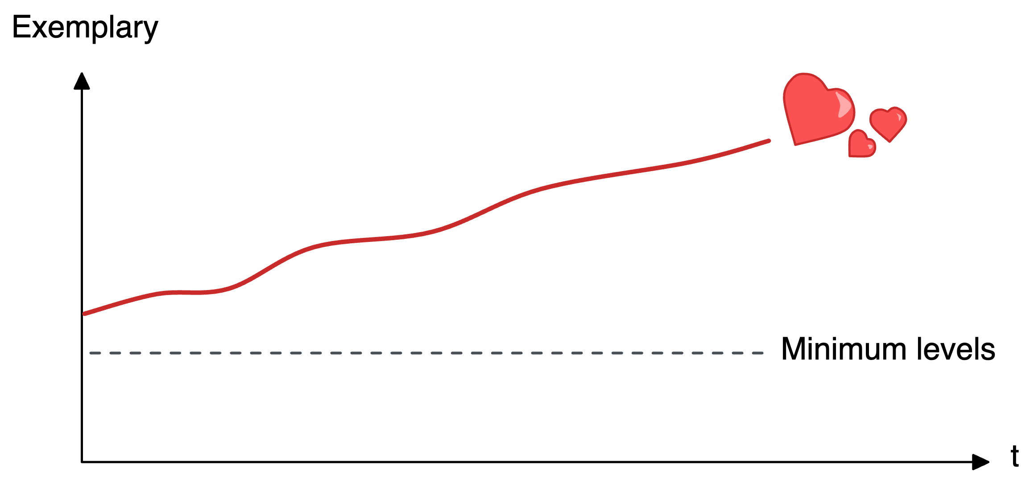
The second challenge: Universal Design is often tacit

Slide 9
Universal Design is about societal change
“Universal design is ultimately about changing attitudes throughout society, emphasizing democracy, equity, and citizenship. Universal design denotes a process more than a definite result.”
(Iwarsson and Ståhl, 2003, p.62)

Slide 10
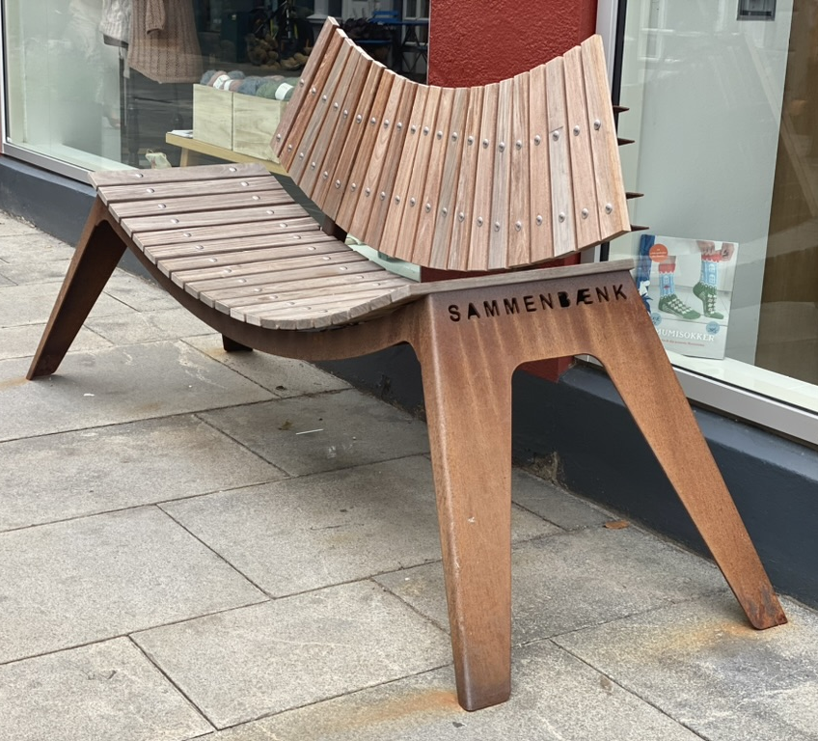
Unburdening Universal Design from compliance
What if UD and its contributions were followed on its own terms?
  Its output (what gets built or made because of UD),
  its process (how it is planned, designed and decided, and who takes part), and
  its societal impact (what it does to society over time).
Good proxy indicators for UD’s societal impact?
  Trust in other people?
  Respect for other people’s rights?
  Democratic participation?

Slide 11
What would you follow over time regarding UD’s societal impact?
Today, at 11.00, we will present our paper:
“Benchmarking Accessibility, Usability, and Universal Design – What Kind of Society Are We Building?”
Come and contribute to our workshop tomorrow afternoon, at 14:30:
“What Makes Universal Design Visible? A Workshop on Direct and Proxy Indicators”
(Both by Hedvall, Müller, McNutt, and Craddock)

Slide 12
“What kind of society are we building?”
Let’s keep this discussion going! 😊

