Slide 1
Benchmarking Accessibility, Usability, and Universal Design
– What Kind of Society Are We Building?
Per-Olof HEDVALL, Lilian MÜLLER, Larry MCNUTT, Gerald CRADDOCK

Slide 2
Agenda
Purpose and Research Questions
Introduce the Positive Peace Index
Define Accessibility, Usability, and Universal Design
Introducing the AUUD Matrix, plus some early results
Conclusion
Welcome to workshop tomorrow!

Slide 3
Do we measure what we value?
... to contribute to the UD evaluation discussion by unburdening UD from compliance and instead following UD on its own terms, focusing on the profound question:
“What kind of society are we building?”

Slide 4
Purpose and Research Questions
How can accessibility, usability and UD be evaluated together?
How can UD be evaluated on its own terms?

Slide 5
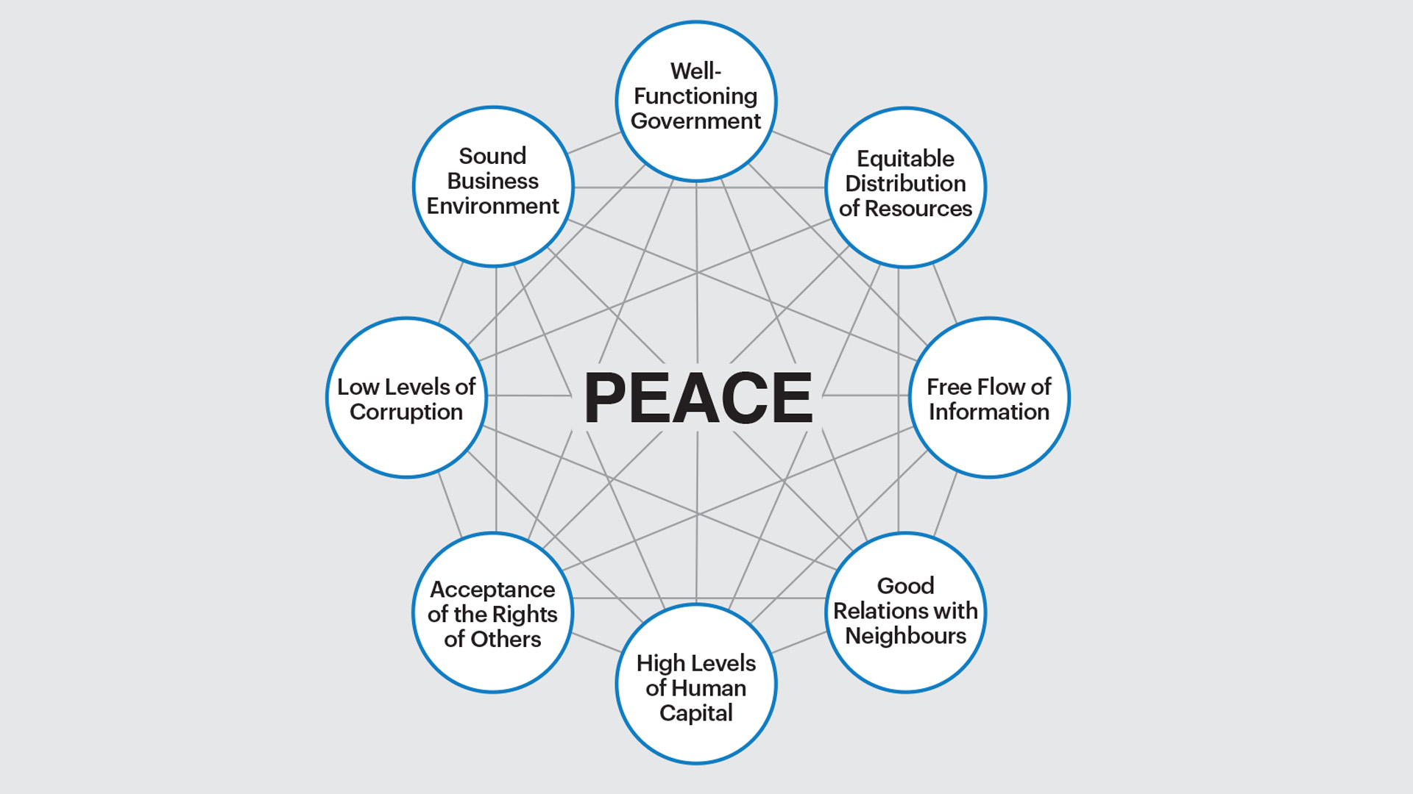
The Positive Peace Index, PPI
Source: Vision of Humanity, The eight pillars of Positive Peace (visionofhumanity.org)

Slide 6
Accessibility, Usability and Universal Design: ingredients that are part of a totality
Equity and Equality
Non-stigmatization
Intersectionality
Universal Design
Effectiveness
Efficiency
Satisfaction
Usability
Conditions for Participation
Accessibility
Access
(Hedvall, Ståhl and Iwarsson, 2025)

Slide 7
The Accessibility, Usability, and Universal Design (AUUD) Matrix
 | Accessibility | Usability | Universal Design
Output
Process
Societal impact

Slide 8
Societal Impact * Universal Design
Full participation; Flexibility (alternatives and choices);
Questions ("what is a city for all?", “what does UD contribute to?” "where do we actually know anything?", “how good is this environment?”);
Concepts (spatial capital, the three pillars, the digital democratic twin, "for more people, not more stuff"); instruments (citizen surveys, social sustainability accounting, a national public-health survey);
Socio-economic analysis; policy development (public-health goals ignore the physical environment);
Trust in others, agency; democratic participation, interaction; organisational development.

Slide 9
What would you evaluate regarding UD?
A field that refuses to benchmark what it values ends up valuing what it can benchmark.
What would you follow over time regarding Universal Design’s Societal Impact? Come and contribute to our workshop tomorrow afternoon:
“What Makes Universal Design Visible? A
Workshop on Direct and Proxy Indicators”

Slide 10
Thank You!
We hope to see you at the
workshop tomorrow!
Questions?

