Slide 1
PeopleDesk HRMS
Enterprise SaaS Human Resource Management Platform
Technical Architecture Overview
Prepared for Enterprise Architecture Review
Customer Confidential · Version 2.1 · 25 July 2026

Slide 2
Why PeopleDesk HRMS
Six positions, each grounded in the production implementation
Position | Basis
Enterprise Ready | 19 business domains · 600+ permission controls · 40+ approval workflows
SaaS Native | Tenant-partitioned with a three-level organizational hierarchy
Production Proven | 120+ live customers at multi-million-row scale
Cloud Deployable | Containerized, orchestrated, configuration injected per environment
Open and Integrable | 1,500+ documented REST endpoints plus device connectivity
Layered Security Controls | Identity, authorization, transport, data and audit
PeopleDesk HRMS · Customer Confidential · Version 2.1
1

Slide 3
Platform at a Glance
Scale of the deployed platform
Dimension | Measure
Business domains | 19
REST endpoints | 1,500+
Application screens | 750+
Standard reports | 130+
Data platform | 570+ tables · 18 schemas
Permission controls | 600+
Automated processes | 45+
Customers | 120+
PeopleDesk HRMS · Customer Confidential · Version 2.1
2

Slide 4
Product Overview
Nineteen functional domains on one platform and one permission model
▪ Core HR — Employee Management, Organizational Framework, Configuration
▪ Time & Attendance — Attendance, Leave & Movement, Roster & Shift
▪ Payroll & Benefits — Payroll & Tax, Allowances, Loan, Benefits, Retirement
▪ Talent — Recruitment, Performance, Training, Manpower Analysis
▪ Governance — Approval Workflow, Asset, Expense, Employee Self-Service
▪ Depth — 600+ permission controls · 40+ configurable approval workflows
PeopleDesk HRMS · Customer Confidential · Version 2.1
3

Slide 5
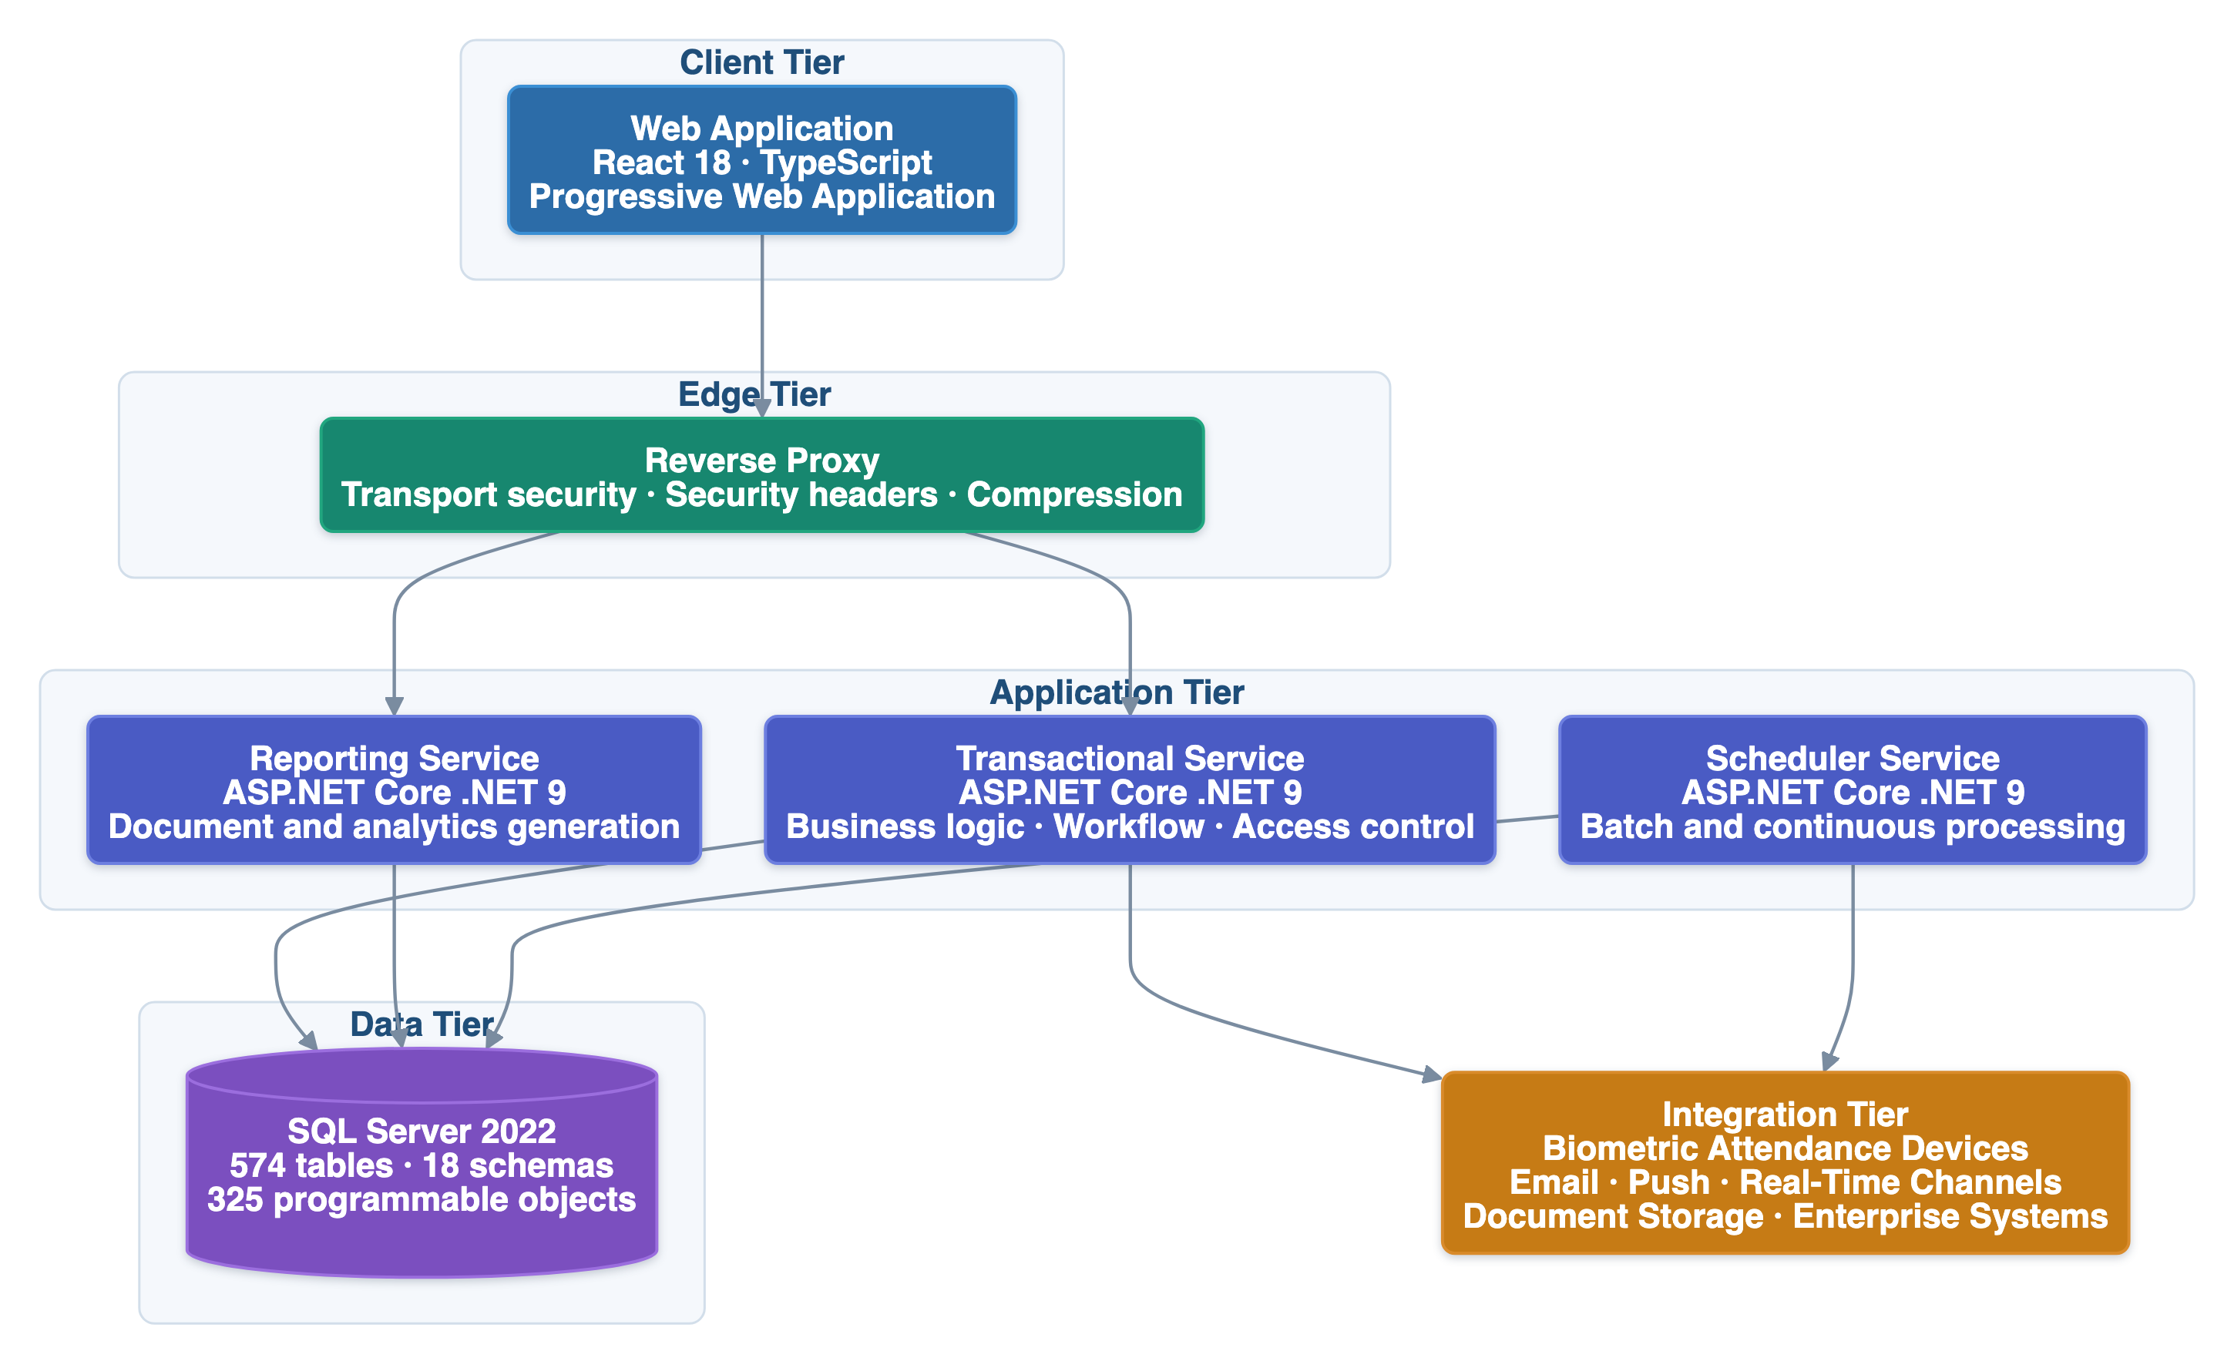
Solution Architecture
Four independently deployable services over a unified data platform — interactive, reporting and batch workloads physically separated
PeopleDesk HRMS · Customer Confidential · Version 2.1
4

Slide 6
Architecture Principles
Seven principles applied consistently across the platform
Principle | Application in PeopleDesk HRMS
Separation of Concerns | Workloads isolated by service boundary
Stateless Services | Token-based identity, no server-side session state
Configuration over Customization | Structure, roles and workflows configured per tenant
Open API Surface | Capability exposed through documented REST interfaces
Layered Security | Controls at identity, authorization, transport, data and audit
Cloud Ready | Containerized services with per-service orchestration manifests
Evidence-Based Evolution | Every change impact-analyzed against a knowledge model
PeopleDesk HRMS · Customer Confidential · Version 2.1
5

Slide 7
Why This Architecture Matters
Architectural decisions translated into business outcomes
Decision | Business Outcome
Independent service deployment | Faster feature delivery
Workload-class separation | Lower operational risk
Stateless application tier | Enterprise scalability
Modular boundaries | Easier maintenance
Dedicated reporting tier | Predictable performance
Scheduler isolation | High-availability foundation
Configuration-led tenancy | Lower onboarding cost
PeopleDesk HRMS · Customer Confidential · Version 2.1
6

Slide 8
Quality Attributes
Non-functional requirements and the design response
Quality Attribute | Design Response
Scalability | Stateless application services
Availability | Independently deployable services
Security | Layered security controls
Maintainability | Modular architecture
Extensibility | Service separation
Performance | Dedicated reporting service
Reliability | Background scheduler isolation
PeopleDesk HRMS · Customer Confidential · Version 2.1
7

Slide 9
Technology Stack
Current-generation technology across every tier
Layer | Technology
Frontend | React 18 · TypeScript · Vite 7 · Redux Toolkit
Backend | ASP.NET Core .NET 9 · MediatR · FluentValidation
Data Access | EF Core 9 (writes) · Dapper (reads) · Stored procedures
Database | SQL Server 2022
Authentication | JWT bearer · refresh-token rotation · scope claims
Reporting | RDLC · Handlebars + headless rendering · ClosedXML
Background | Quartz.NET · .NET Hosted Services
Infrastructure | Docker · Reverse proxy · Kubernetes
Selection criteria: modern · stable · long-term supported · enterprise proven · cloud compatible
PeopleDesk HRMS · Customer Confidential · Version 2.1
8

Slide 10
Security Architecture
Layered controls across five domains
▪ Authentication — JWT bearer with issuer and signing-key validation; server-side refresh-token rotation; federated sign-in
▪ Authorization — 600+ permission controls; role-based assignment; organizational-scope claims in the security token
▪ Application data — payload protection, declarative validation, centralized exception handling, output sanitization
▪ Transport & edge — HTTPS enforcement, HSTS, frame protection, content-type enforcement, browser feature restriction
▪ Audit — request-level audit trail; background process execution history
PeopleDesk HRMS · Customer Confidential · Version 2.1
9

Slide 11
Secure Development Practices
Security controls mapped to the OWASP Secure Coding Practices categories
OWASP Category | Implemented Controls
Input Validation | Server-side validation pipeline on every command
Output Encoding | Untrusted markup neutralized before rendering
Session Management | Token validation with server-side refresh-token rotation
Access Control | 600+ permissioned functions with organizational scope
Error Handling & Logging | Centralized handling; request-level audit trail
Communication Security | HTTPS with HSTS and the full edge header set
Database Security | Parameterized queries and stored-procedure access
System Configuration | Current supported versions; per-environment configuration
PeopleDesk HRMS · Customer Confidential · Version 2.1
10

Slide 12
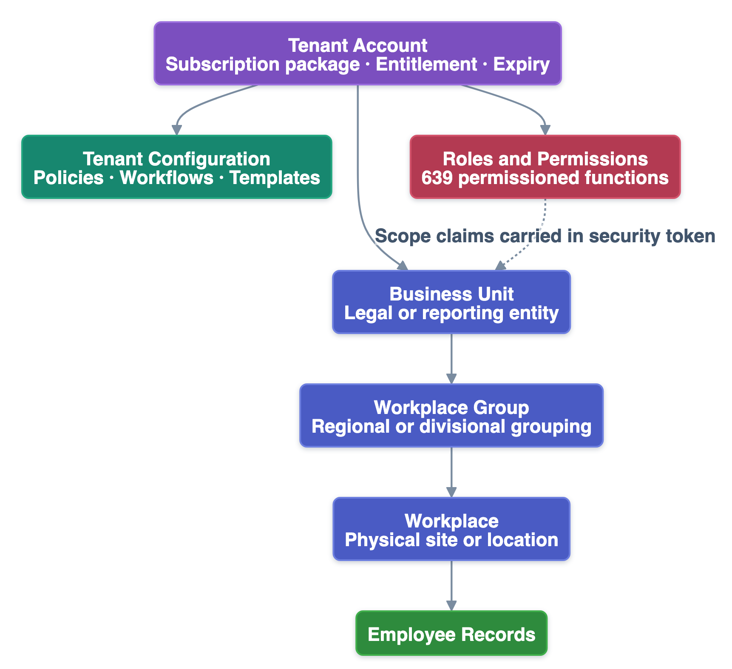
SaaS Architecture
Tenant-partitioned with enterprise organizational depth
▪ Every business record keyed to its owning tenant account
▪ Three-level hierarchy — business unit → workplace group → workplace
▪ Organizational scope carried in the security token
▪ Automated tenant provisioning with seed configuration
▪ Basic 100 · Lite 500 · Premium 50,000 seats
▪ Seat and expiry entitlements enforced automatically
PeopleDesk HRMS · Customer Confidential · Version 2.1
11

Slide 13
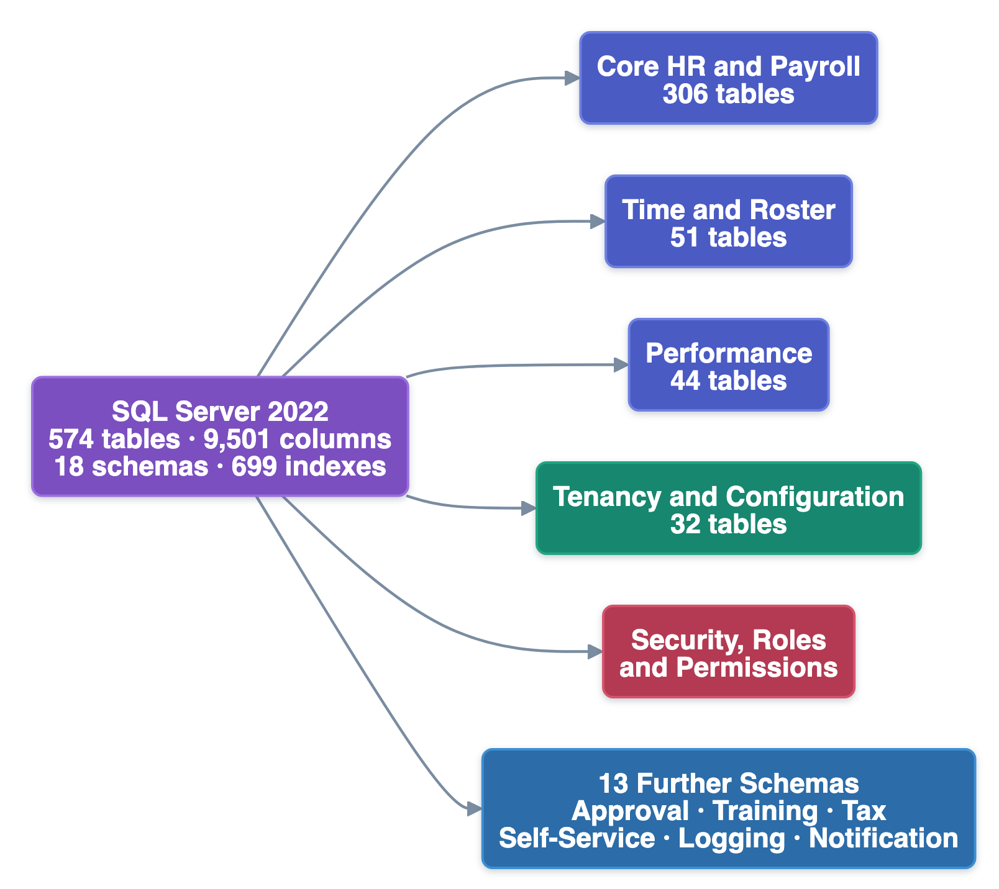
Data Architecture
570+ tables · 18 schemas · 690+ indexes — engineered for set-based processing at scale
PeopleDesk HRMS · Customer Confidential · Version 2.1
12

Slide 14
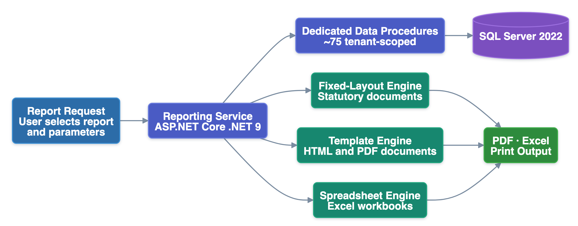
Reporting & Analytics
A separate reporting service — no contention with transactional workload
▪ 130+ standard reports served by dedicated tenant-scoped data procedures
▪ Render engine selected by output class — statutory, document, spreadsheet
▪ Organization-specific templates without forking the report catalogue
PeopleDesk HRMS · Customer Confidential · Version 2.1
13

Slide 15
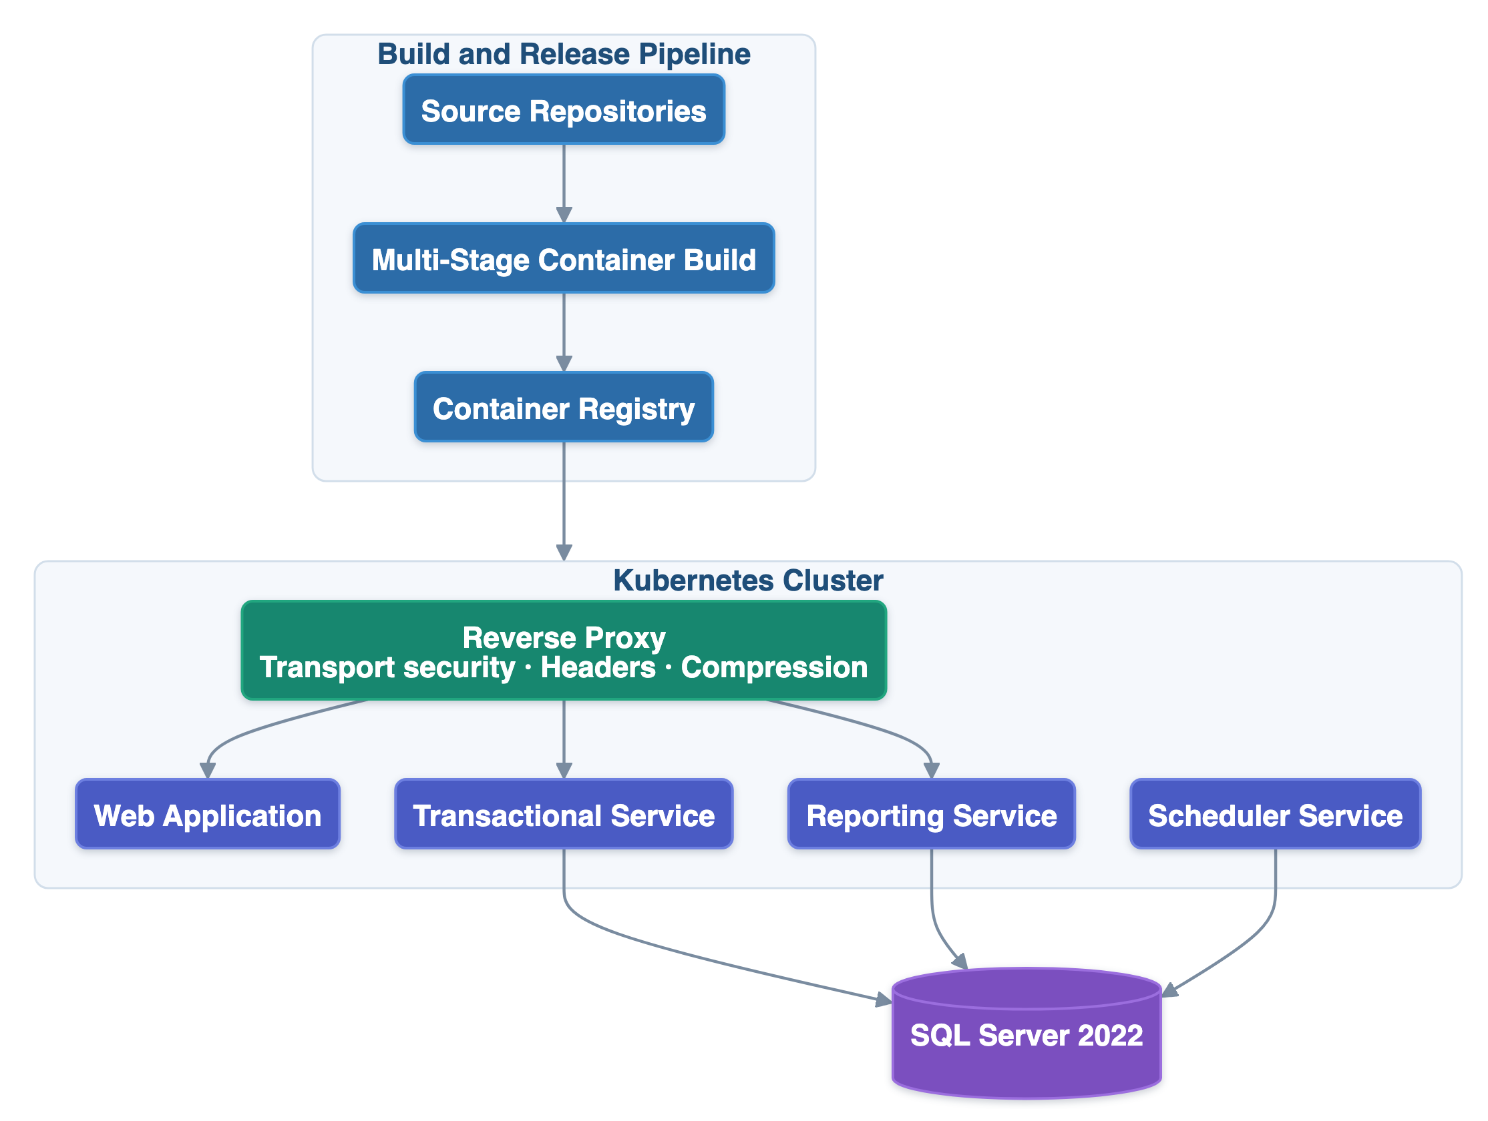
Deployment Architecture
Containerized, orchestrated, independently releasable
▪ One image promoted across environments; configuration injected per environment
▪ The artefact promoted to production is identical to the one validated in staging
PeopleDesk HRMS · Customer Confidential · Version 2.1
14

Slide 16
Scalability & Performance
Scalability designed into the workload topology
▪ Batch payroll isolated from interactive workload by service boundary
▪ Stateless authentication removes application-tier affinity constraint
▪ Set-based computation at the data tier rather than application iteration
▪ 690+ indexes across a 570+ table production schema
▪ Route-level code splitting with vendor chunk separation on the frontend
▪ Production evidence — core operational tables sustain 20–40 million+ rows
PeopleDesk HRMS · Customer Confidential · Version 2.1
15

Slide 17
Integration Ecosystem
Open interfaces and proven enterprise connectivity
▪ REST across 1,500+ endpoints with OpenAPI specification
▪ Biometric attendance devices — push-protocol capture plus 18+ scheduled collectors
▪ Real-time in-application notification channel
▪ Firebase Cloud Messaging push delivery
▪ SMTP email for notification and approval routing
▪ Azure Blob and FTP document storage · Managerium ERP integration
PeopleDesk HRMS · Customer Confidential · Version 2.1
16

Slide 18
Knowledge-Driven Engineering
How the platform evolves safely over a multi-year dependency
▪ A twelve-layer structured knowledge base is the authoritative model of the system
▪ 160+ documents · 30+ decision tables · complete inter-module dependency graph
▪ Every proposed change is impact-analyzed against the model before implementation
▪ The first two phases of this framework are in production use today
▪ Addresses what architecture alone cannot: predictable evolution over time
PeopleDesk HRMS · Customer Confidential · Version 2.1
17

Slide 19
Business Value
What the architecture delivers commercially
Benefit | Basis
Reduced implementation risk | Production-proven across 120+ enterprise customers
Lower operational cost | Configuration-led onboarding rather than code change
Independent scaling | Workload classes scale on separate boundaries
Future-ready platform | Current-generation runtimes, no end-of-life dependency
Enterprise governance | 600+ permission controls with organizational scope
High maintainability | Modular boundaries plus a structured knowledge model
PeopleDesk HRMS · Customer Confidential · Version 2.1
18

Slide 20
Technical Position Summary
PeopleDesk HRMS at a glance
Dimension | Position
Architecture | Four services, workload-class separation, unified data platform
Technology | .NET 9 · React 18 · SQL Server 2022 — no end-of-life dependency
Security | Layered controls mapped to the OWASP Secure Coding Practices
SaaS | Tenant-partitioned, three-level organizational hierarchy
Scale | Production-validated at multi-million-row operational volume
Integration | Open REST plus proven enterprise and device connectivity
PeopleDesk HRMS · Customer Confidential · Version 2.1
19

Slide 21
Thank You
PeopleDesk HRMS · Customer Confidential · Version 2.1

