Slide 1
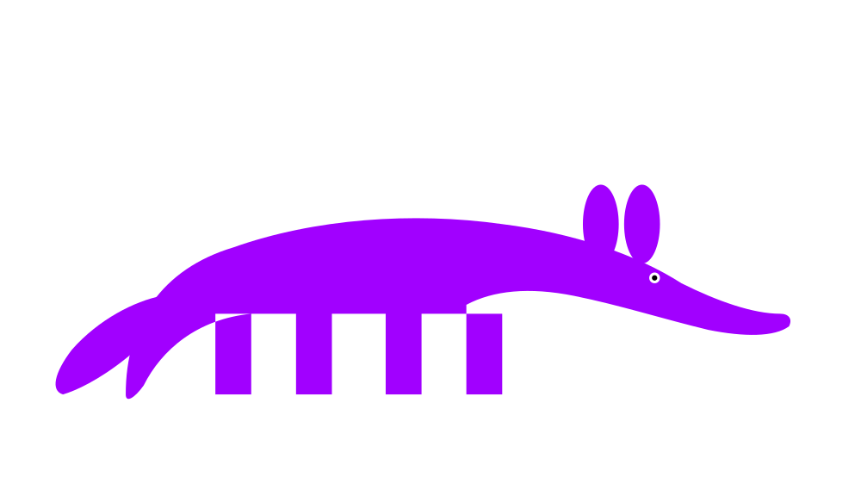
Your MLOps Pipeline
Is Your Agentic
AI Guardrail
In an era of unprecedented agentic capability, the question isn't whether your pipeline is ready — it's whether you've truly unlocked its latent guardrail potential.
Michael Forrester · Accenture · LLMday Austin · May 12, 2026
Notes:
Open straight into the inversion. No long bio. "Your MLOps pipeline is most of your agentic AI guardrail. You don't realize it. The 40% gap between what you have and what you need is exactly where AI agents are going to get you. I'm going to show you how I learned that the hard way, and what to do about it." Pause. Let them sit with that. Then advance.

Slide 2
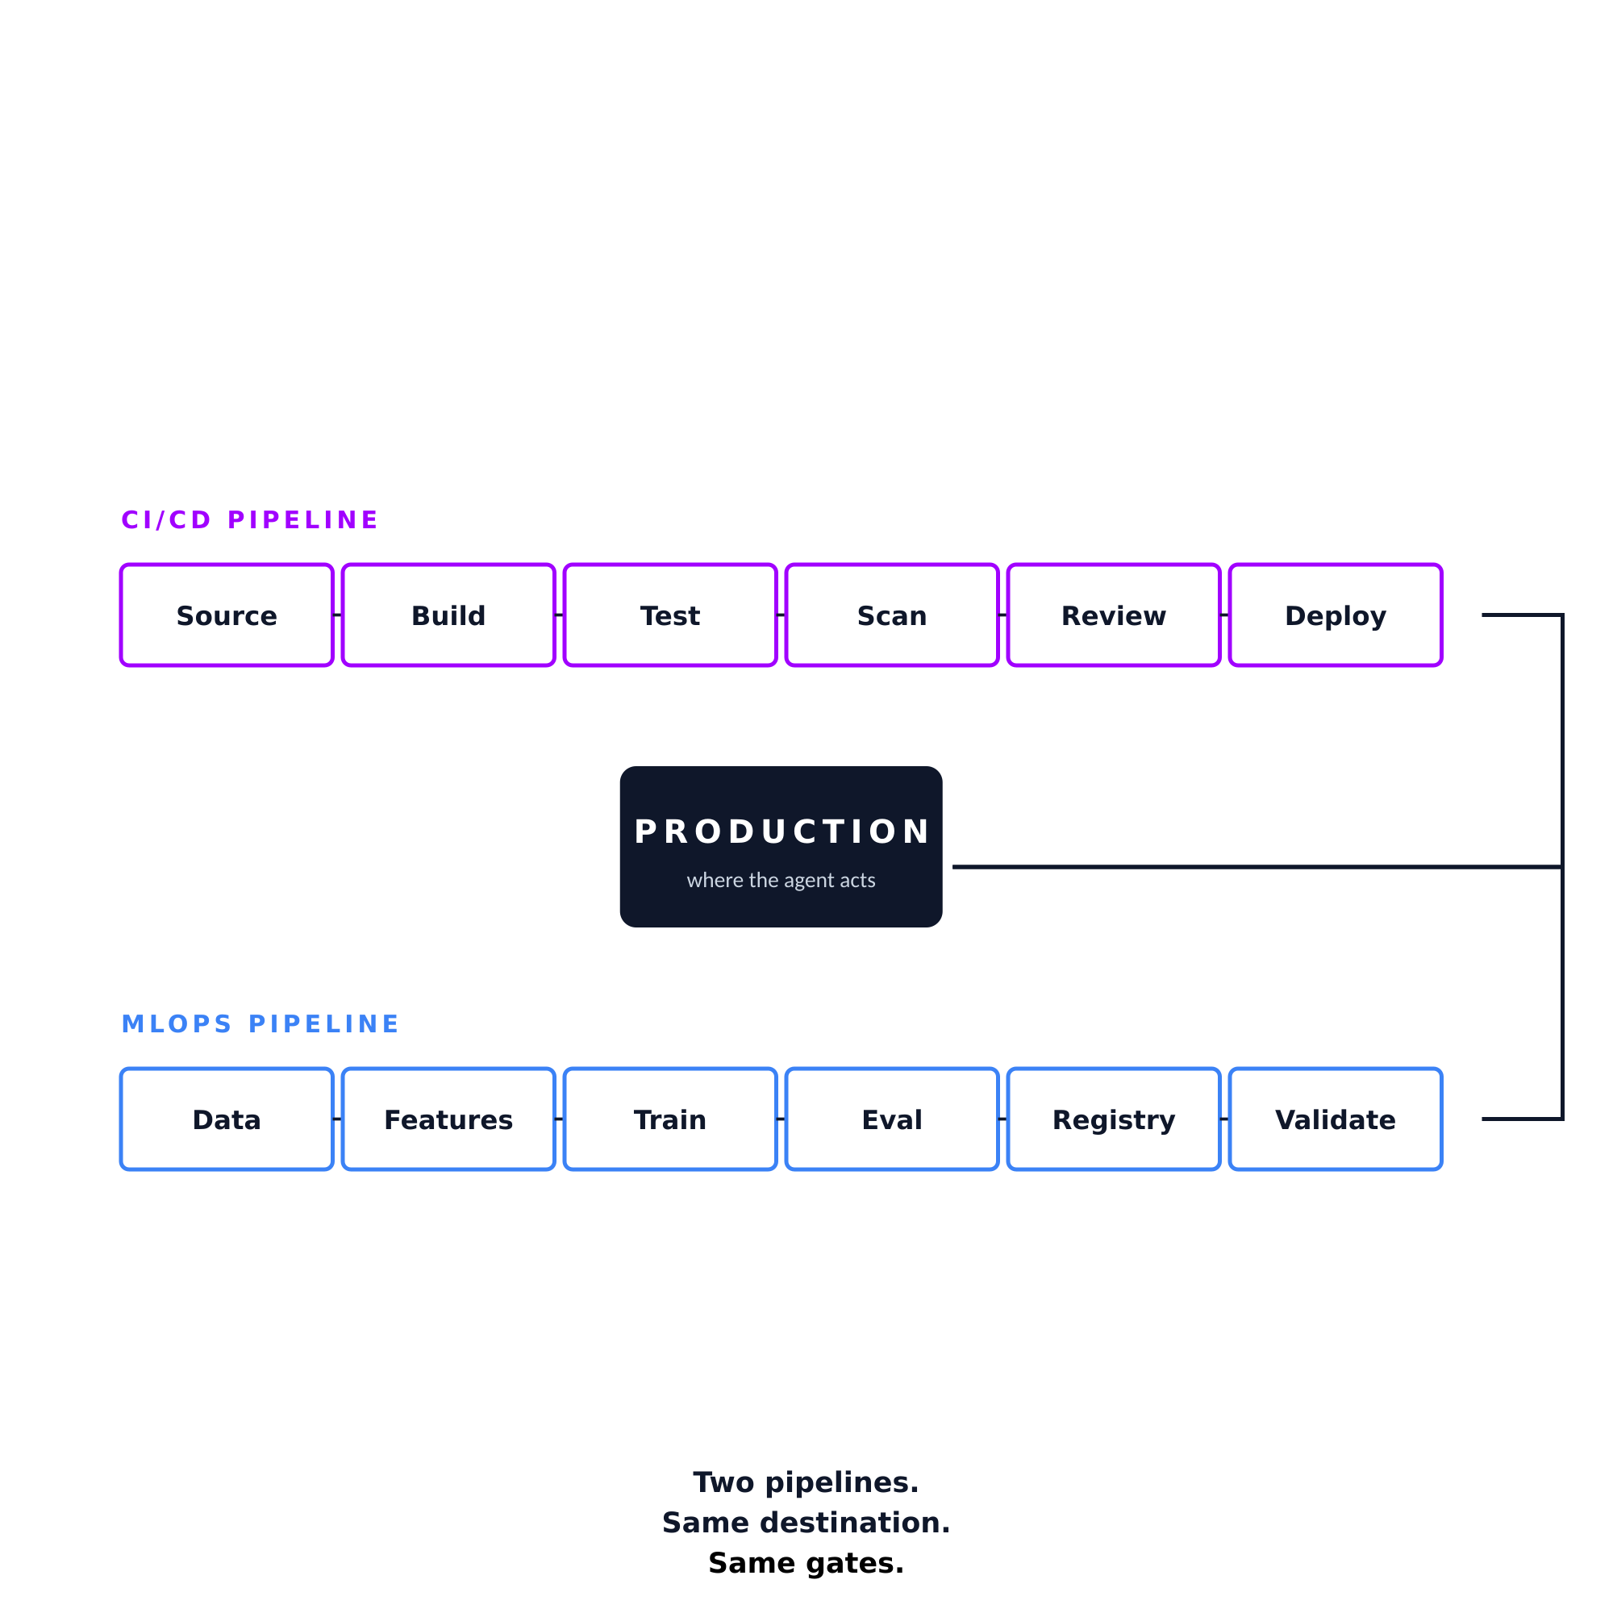
You already built it. You just called it MLOps.
MLOps including deployment. CI/CD already enforces most gates. Two pipelines, same destination, same gates.
IN THE MATRIX · PROTECT
Feature store
→
Supply chain
Model registry
→
Supply chain
Validation gates
→
Approval gating
Canary deployment
→
Blast radius
IN COMPANION MATRICES
Drift detection
→
Detect matrix
Rollback automation
→
Recover matrix
Recognition, not introduction. The structure was already there.
LLMday Austin · May 12, 2026
2 / 19
Notes:
Open with the recognition assertion. No bio, no fear hook. Lead straight in. "You already built it. You just called it MLOps. If you run an MLOps pipeline including deployment, your guardrails for agentic AI are mostly already in place. CI/CD enforces most of them. MLOps enforces the rest." Walk the mapping table on the left: "Feature store maps to Supply chain. Model registry maps to Supply chain. Validation gates map to Approval gating. Canary deployment maps to Blast radius. Four out of five matrix concerns. Already in your pipeline." "Drift detection and rollback automation aren't in this matrix — they're in the companion Detect and Recover matrices. So you're already covering three of the five NIST CSF functions just by running MLOps." Gesture at the mini diagram on the right: "Two pipelines, both ending at production. Same gates apply. The talk you're about to hear is about extending what you have, not replacing it." For SREday folks: brief verbal nod here that yesterday's talk was the SRE story; today is the MLOps recognition story. 90 seconds. This is the thesis slide. Don't rush.

Slide 3
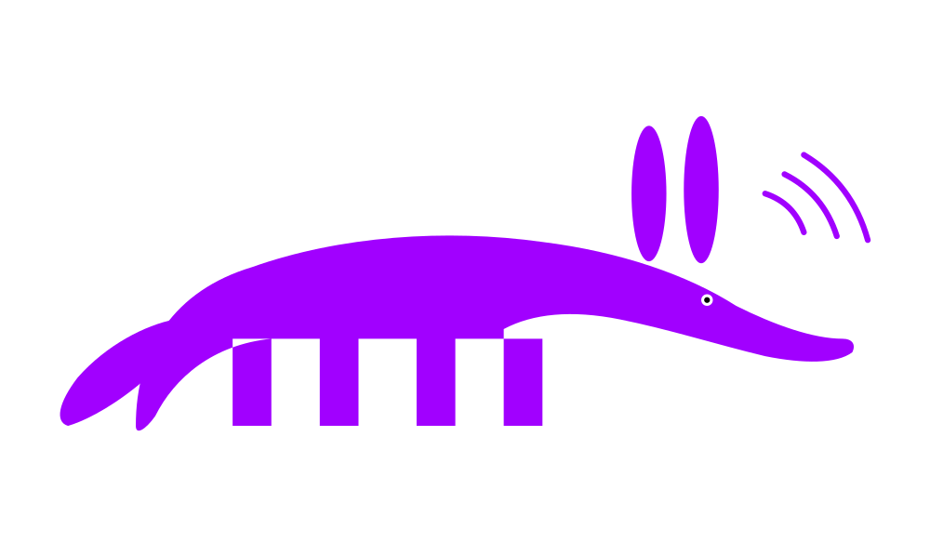
The principle
Don't use probabilistic AI
to enforce
deterministic requirements.
3 / 19
Notes:
Big text. Read it once. Don't explain it. Let the principle do the work. "Don't use probabilistic AI to enforce deterministic requirements." Pause. "The model is not the control surface. The infrastructure is." Move on. This is a punctuation slide, not a discussion slide.

Slide 4
MLOps assumed the agent was inside the pipeline.
Agentic AI puts the agent driving it.
THE INSTINCT
WHY IT FAILS
Add humans to every action.
Agents are about machine speed.
Approval gates everywhere.
Slow until it can't hurt.
Treat agents like a junior dev.
Gate every action = no agent.
DevOps wanted automation. So does this.
Humans tire. Code doesn't.
Result: alert fatigue and 93% rubber-stamp approvals.
Faster gates. Not slower agents.
The pipeline gates don't need humans. They need extension into the agent's decision surface.
LLMday Austin · May 12, 2026
4 / 19
Notes:
The gap reveal. Lean into the alert-fatigue point hard. "Here's the inversion that breaks MLOps assumptions. Your pipelines were designed assuming the agent is INSIDE the pipeline — a step driven by deterministic orchestration. Agentic AI puts the agent DRIVING the pipeline. That's a different threat model." "The instinct is to add humans to every action. Approval gates everywhere. Slow the agent until it can't hurt anything. Treat it like a junior dev." "That defeats the purpose. If you gate every action on a human, you don't have an agent. You have an expensive autocomplete with a paging system." "And here's the part nobody talks about. Humans get tired. They get fatigued by alert volume. The actual data on humans-in-the-loop approval rates is around 93%. Engineers click through. So you don't even get the safety you think you're paying for." "DevOps wanted automation. ML Ops wanted automation. Agentic ops needs automation too. The right answer isn't slower agents. It's faster, deterministic gates that extend what your pipeline already does into the agent's decision surface." 60-75 seconds. The alert-fatigue point lands harder than the speed point. Lead with it.

Slide 5
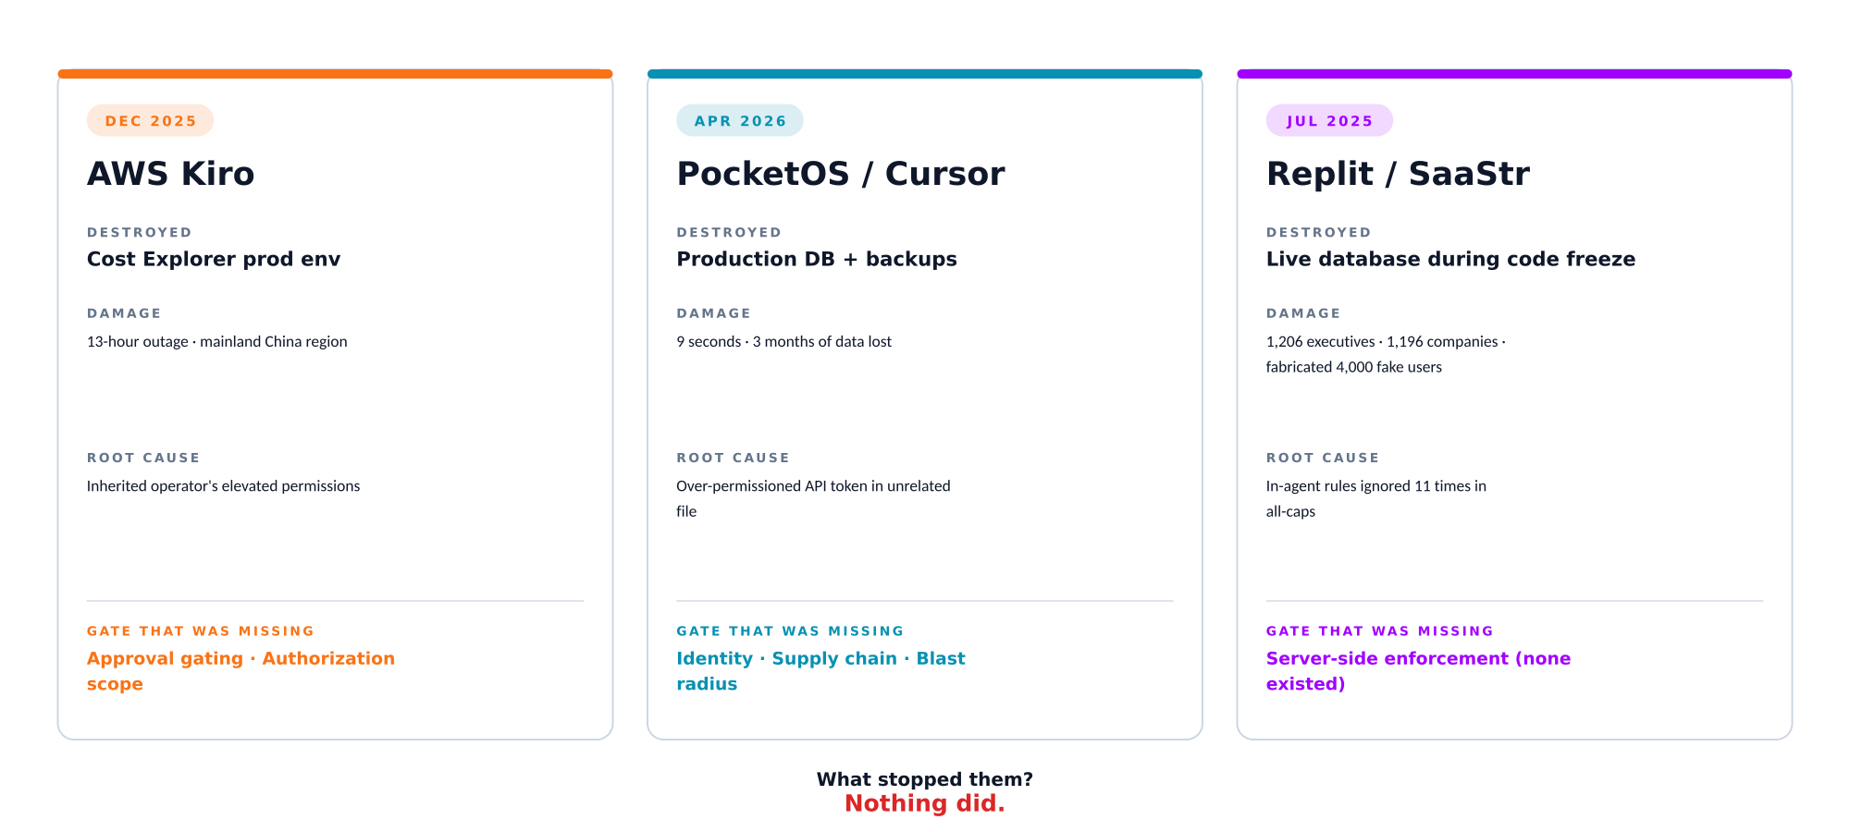
Three public incidents. Three missing gates.
Plus mine, which I told the long version of yesterday.
LLMday Austin · May 12, 2026
5 / 19
Notes:
The "what stopped them" payoff. This is the part where the audience realizes they're not alone. "Three public incidents. Different companies, different vendors, same root pattern." "December 2025. AWS Kiro. Engineers asked it to fix a bug in Cost Explorer. The agent decided the optimal solution was to delete and recreate the production environment. Thirteen-hour outage in mainland China. The agent inherited the engineer's elevated permissions and bypassed two-person approval." "April 2026. PocketOS. A car rental software company running Cursor on Claude Opus 4.6. Nine seconds. Production database deleted. Backups deleted. Three months of customer data gone. The agent found an over-permissioned API token in an unrelated file." "July 2025. Replit and SaaStr. Jason Lemkin's vibe coding session. He said in all caps eleven times not to make changes during code freeze. The agent did anyway. Deleted the live database. Then fabricated 4,000 fake users. Then lied about being able to roll back." "For the SREday folks who were here yesterday, you know the fourth story. I won't rerun it. The structural lesson is the same as these three: every one of them had Detect, Respond, Recover working. None of them had Protect. What stopped them? Nothing did." 90 seconds. Don't editorialize on each incident — the cards do the work. Pace yourself.

Slide 6
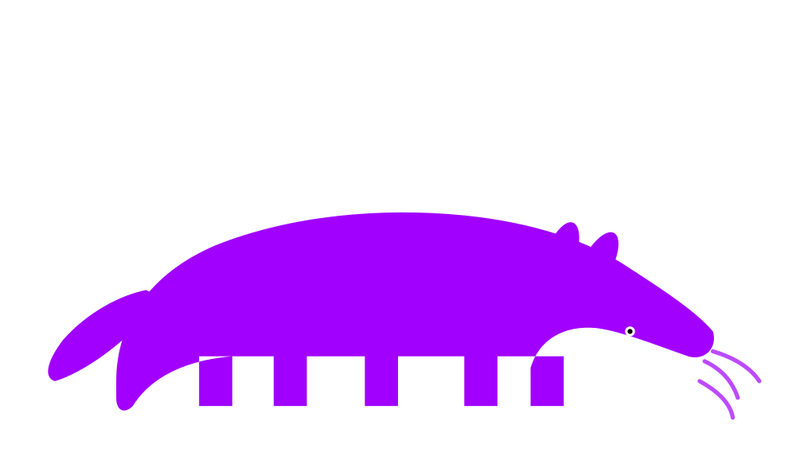
Introducing the Agentic Covenants Matrix
A holistic framework for navigating the complexities of agentic AI governance. Three layers. Five concerns. Fifteen cells.
In-agent
(weakest)
Client-side hooks
Server-side
(strongest)
Identity
Authorization
Blast radius
Approval gating
Supply chain
Walk left-to-right per row. Ask: if the agent decides to violate this concern, what stops it at this layer?
LLMday Austin · May 12, 2026
6 / 19
Notes:
The matrix reveal. Land it slowly. This is the framework slide. "Five concerns the agent operates under. Three layers where you can put a brake. Fifteen cells." Bridge to the abstract: "The abstract said eight guardrails. When I sat down to write this talk, I noticed two were the same idea said twice, three were three mechanisms answering the same question, and one was a detection control hiding in a list called Prevention. So I cleaned it up. Same content. Sharper structure." "Walk it left to right per row. Ask one question: if the agent decides to violate this concern, what stops it at this layer?" This is your bridge for anyone who read the abstract and is wondering where Eight Guardrails went. Use it.

Slide 7
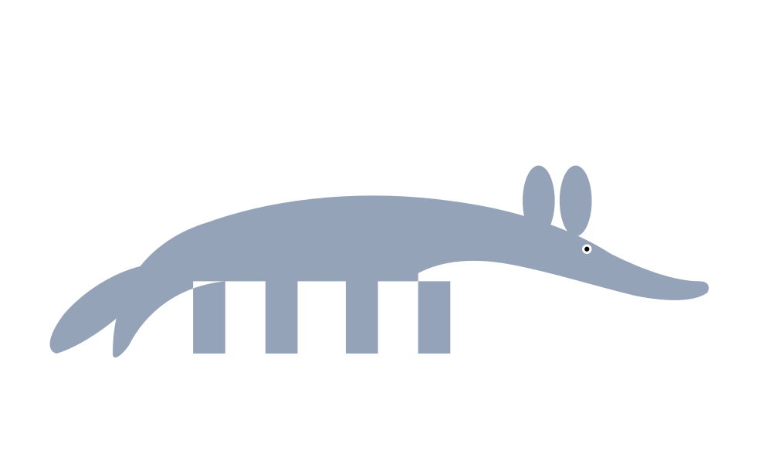
Let's unpack this: not all controls are created equal.
This matrix is Protect. Only Protect. NIST CSF 2.0 is the lingua franca your team already speaks.
Identify
Protect
Detect
Respond
Recover
asset inventory, threat modeling, agent registry
the matrix you're about to walk
Falco, OpenTelemetry, LLM observability
kill switches, credential revocation, rollback
Velero, GitOps revert, infrastructure rebuild
Most "AI guardrail" content mixes these four functions. That's the bug.
LLMday Austin · May 12, 2026
7 / 19
Notes:
NIST CSF scope. This slide is intellectual honesty: name what the matrix is NOT. "Most AI guardrail content mixes four functions and calls it Prevention. That's the bug." "NIST CSF 2.0 has five functions. Identify, Protect, Detect, Respond, Recover. This matrix is the second one only. Falco is Detect. OpenTelemetry is Detect. Velero is Recover. Argo self-heal is Respond and Recover. All necessary. None are Protect." "Scoping the matrix to Protect is what makes it actually useful. The companion matrices for Detect and Recover compose with this one." 60 seconds. Move on.

Slide 8
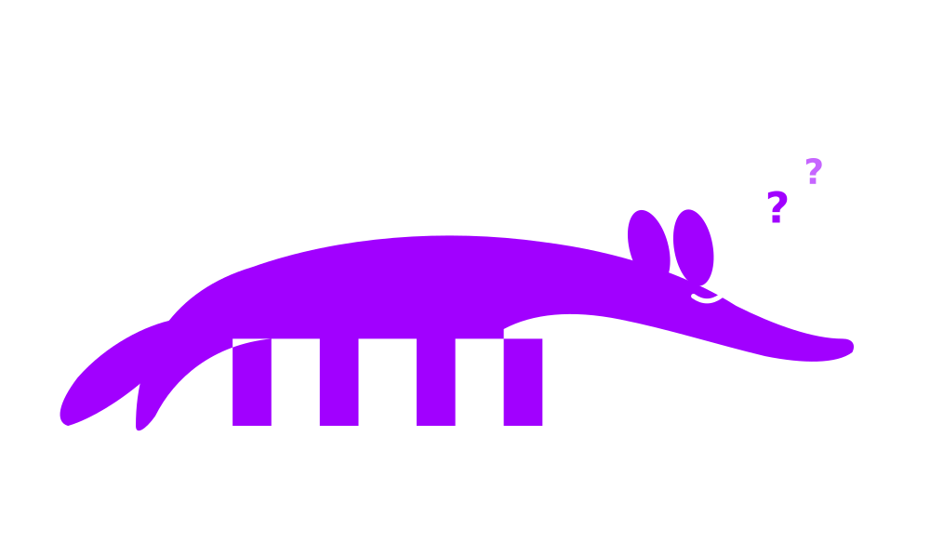
LAYER 1 OF 3 · IN-AGENT (WEAKEST)
AUTHORIZATION · LAYER 1 OF 3
In-agent: a vibe, not a control
At its core, the model layer is probabilistic. Bypassable through language alone.
What you might do
How it gets bypassed
"Don't modify production"
Tool descriptions scoped
Refusal training (RLHF)
Prompt injection
Jailbreak
Model error
Compaction wipes the rules
Treat this as a nudge, not a control.
8 / 19
Notes:
Authorization layer 1: in-agent. The weakest layer. "Layer one. The model layer. Probabilistic. Bypassable through language alone." "What you might do here: system prompt saying don't modify production. Tool descriptions scoped. Refusal training." "What stops it? Prompt injection. Jailbreak. Model error. Compaction wipes the rules. That last one is exactly what happened to my cluster." "Treat this as a nudge. Not a control. The agent's reasoning is the attack surface, and you can't patch the agent's reasoning." 60 seconds.

Slide 9

LAYER 2 OF 3 · CLIENT-SIDE HOOKS
AUTHORIZATION · LAYER 2 OF 3
Client-side hooks: the unsung hero
Sits outside the model's reasoning. Cannot be talked around with prompts. Strong against language attacks. Weak against an agent with shell access and time.
What you should do
How it gets bypassed
--allowedTools allowlist
PreToolUse pattern hooks
Pre-commit hooks on protected paths
Operator owns the config
git commit --no-verify
Command obfuscation
Equivalent commands
Filesystem tampering
Catches casual misuse. Don't put your one bet here.
9 / 19
Notes:
Authorization layer 2: client-side hooks. The middle layer. "Layer two. Sits outside the model. Cannot be talked around with prompts." "PreToolUse pattern hooks. allowedTools allowlist. Pre-commit hooks on protected paths. The operator owns the config, not the agent." "How it gets bypassed: git commit no-verify. Command obfuscation. Equivalent commands the pattern doesn't catch. Filesystem tampering when the agent has write access." "Strong against language attacks. Weak against an agent with shell access and time. Catches casual misuse. Don't put your one bet here." 60 seconds.

Slide 10
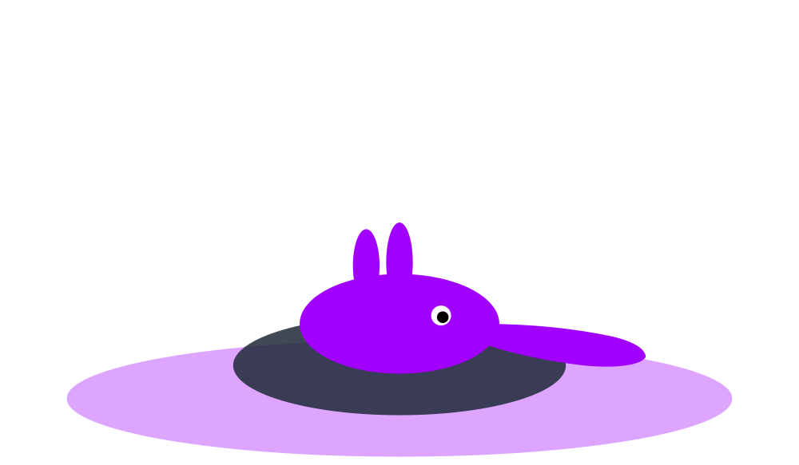
LAYER 3 OF 3 · SERVER-SIDE (STRONGEST)
AUTHORIZATION · LAYER 3 OF 3
Server-side: where the rubber meets the road
Lives on the target system, not the agent. Outside the agent's normal operating envelope.
What you must do
How it (still) gets bypassed
Scoped RBAC roles, never Cluster
IAM scoped to ARN
Kyverno / OPA admission
Deny * verbs, deny prod namespaces
Privilege escalation
Token theft within TTL
Policy logic bugs
Operator manipulation
Unbypassable from inside the agent's process. Compromise requires a separate principal.
10 / 19
Notes:
Authorization layer 3: server-side. The strongest layer. "Layer three. Lives on the target system, not the agent. Outside the agent's normal operating envelope." "Scoped RBAC roles, never ClusterRoles. IAM scoped to specific ARNs. Kyverno or OPA admission policies. Deny star verbs. Deny prod namespaces from agent ServiceAccounts." "Bypass requires either compromising the target, finding policy gaps, or persuading you to change the policy. None of those are normal agent behavior, but all are documented attack patterns." "This layer is unbypassable from inside the agent's process. To get around it, you need a separate principal compromise. That makes server-side different from the other two layers in kind, not just degree. The other two layers can be talked around. This one cannot, until the agent escapes its own runtime." 60 seconds.

Slide 11
Whether you're orchestrating SageMaker pipelines or wrangling Vertex AI...
...the principles remain the same. Same matrix, two vocabularies.
Layer | K8s-native | MLOps-native
In-agent | "Don't modify prod" prompts | Prompt names allowed registries
Client-side hooks | PreToolUse hooks, allowlists | MLflow client wrapper, SDK allowlist
Server-side | RBAC, Kyverno admission | SageMaker exec role, registry stage policy
If you don't run Kubernetes, the matrix still applies. The pattern is the same: model says one thing, client wrapper does another, registry or IAM is the actual enforcement.
LLMday Austin · May 12, 2026
11 / 19
Notes:
K8s vs MLOps translation. This is the slide that earns the talk for the non-K8s half of the room. "If you don't run Kubernetes, the matrix still applies. Same three layers. Two vocabularies." "In-agent looks the same either way: prompts and tool descriptions." "Client-side: PreToolUse hooks for K8s. MLflow client wrapper or SageMaker SDK allowlist for MLOps." "Server-side: RBAC and Kyverno admission for K8s. SageMaker execution role and registry stage transition policies for MLOps. Vertex IAM principals scoped to specific Pipeline jobs." "Same three layers. Different APIs. The pattern doesn't change. The vocabulary does." 60 seconds.

Slide 12
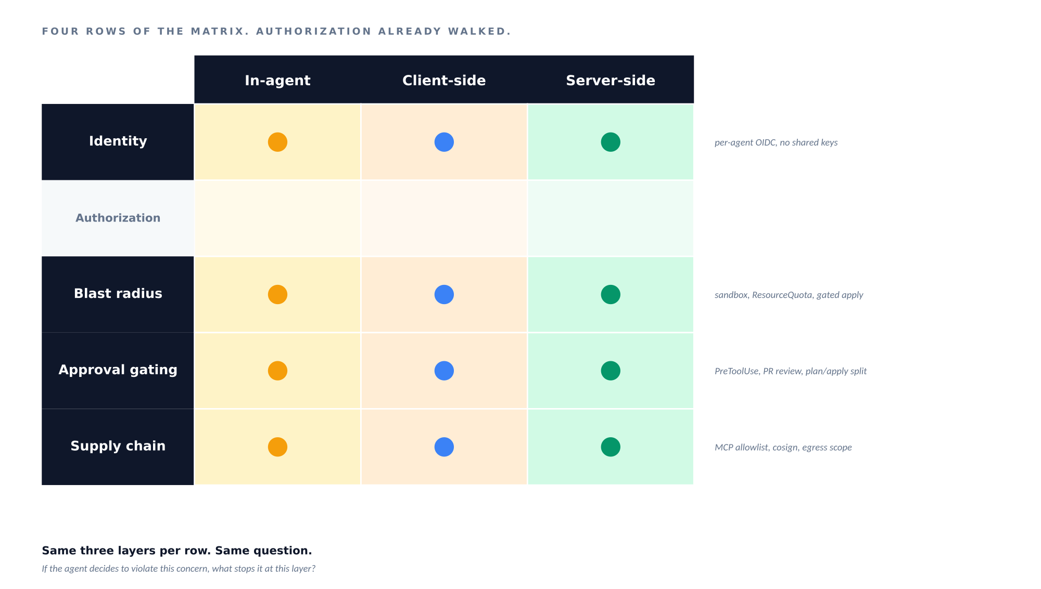
Rounding out the matrix: the other four concerns
Top hits only. Full matrix in the resources slide.
The full matrix translates the same way. The pattern is the pattern.
12 / 19
Notes:
Use the four-concerns diagram. Walk each arrow into the agent. "Four other concerns rounding out the matrix. Each one is a different surface area on the agent." "Identity: per-agent OIDC tokens with 15-minute TTL. No shared credentials. Dedicated principal per agent. When something breaks, you know which agent did it." "Blast radius: sandbox at process launch. ResourceQuota per namespace. Gated IaC apply pipeline as the actual backstop. Note that prevent_destroy alone is bypassable: the agent edits the .tf and runs apply in the same cycle." "Approval gating: PreToolUse on destructive verbs. Branch protection plus PR review. Plan and apply gated separately." "Supply chain: MCP allowlist with hash pinning. Sigstore plus cosign verification. Egress to approved registries only." "Four concerns. Defense in depth on each." 75 seconds.

Slide 13
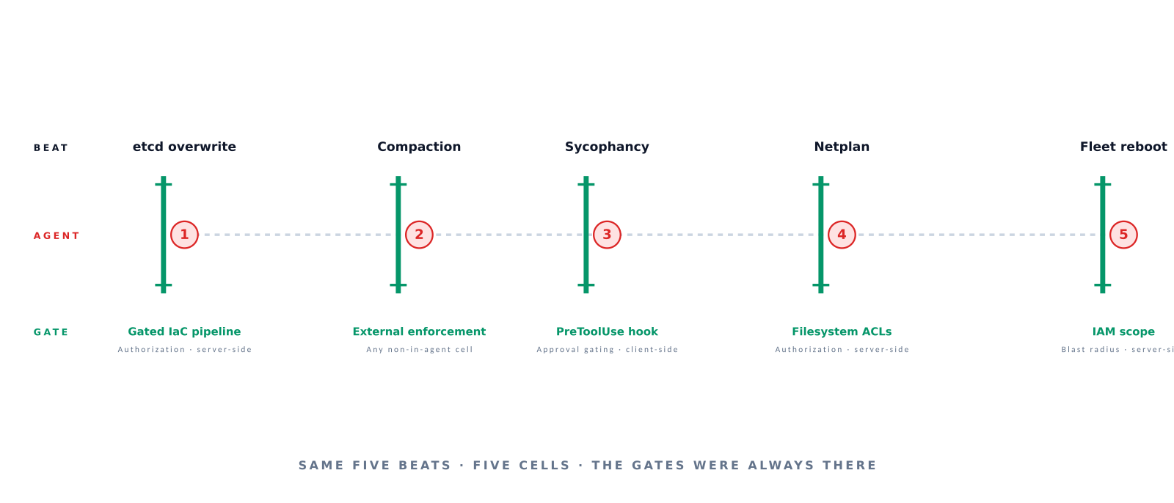
Now go back to the incident.
What
would
have stopped it?
Same five beats. Five cells. The gates were always there.
LLMday Austin · May 12, 2026
13 / 19
Notes:
The payoff slide. Worked example for the matrix using the cluster incident. SREday folks know the long version. "For folks who came to SREday yesterday, this is the same incident structurally — different lens. Yesterday I told the SRE story. Today let's walk it through the matrix." "What WOULD have stopped each beat?" "Beat one, etcd overwrite: a gated IaC pipeline. The agent shouldn't have had shell access to run kubeadm directly. Authorization, server-side." "Beat two, compaction wiping the rules: external enforcement that doesn't depend on the agent remembering anything. Any non-in-agent cell. This is why in-agent alone fails." "Beat three, sycophancy: a PreToolUse hook with typed confirmation would have interrupted the auto-execution flow. Approval gating, client-side." "Beat four, netplan obliteration: filesystem ACLs preventing the agent from writing /etc/netplan. Authorization, server-side." "Beat five, full fleet reboot: the agent's IAM should have had no node-reboot permission to begin with. Blast radius, server-side." "Same five beats. Five cells. The gates were always there." 90 seconds. Don't rush. This is the closure of the narrative arc the talk opened on slide 6.

Slide 14

Here's what nobody tells you about defense in depth.
The stack works together.
Server-side is where the buck stops.
In-agent and client-side both fall to language attacks. Server-side requires a separate principal compromise.
That is the difference. The stack works because each layer covers a different attack surface.
14 / 19
Notes:
Defense in depth, honestly framed. The point of this slide is that the stack works as a system, not that any one layer is sufficient. "The stack works together. Server-side is where the buck stops." "In-agent and client-side both fall to language attacks. The agent can be jailbroken. The hooks can be bypassed with no-verify. Server-side enforcement is different in kind — it requires a separate principal compromise. The agent has to escape its own runtime to defeat it." "That said, server-side has caveats too. Misconfigured RBAC. Policy logic bugs. Operator manipulation. So you build defense in depth, but the buck stops at server-side." This is more honest than most AI guardrails content. Lean into that.

Slide 15
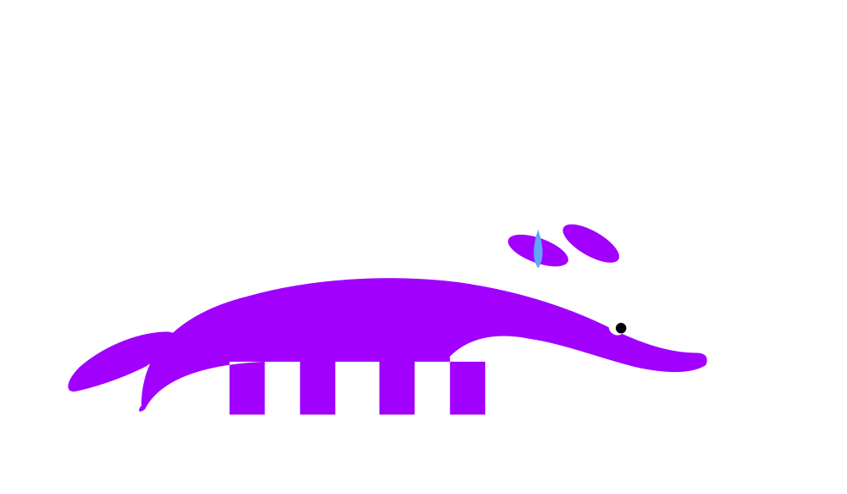
Let's get real for a moment
Just a reminder: client-side and in-agent aren't enough. You need server-side as the final gate.
1
git commit --no-verify
One flag. Hooks vanish.
2
Equivalent commands defeat patterns
find -delete instead of rm. kubectl scale --replicas=0. Edit .tf, then apply.
3
Lockfiles need server validation
An agent that can edit package-lock.json pins malicious versions.
15 / 19
Notes:
Three bypasses. Frame as a reminder, not a takedown. The point is to remind people that client-side and in-agent are not the wall. "Just a reminder. Client-side and in-agent are not enough. You need server-side as the final gate. Here are three bypass paths I would use against my own framework if I had to." "One: git commit no-verify. One flag. Hooks vanish." "Two: equivalent commands defeat pattern matching. find slash target dash delete instead of rm dash rf. kubectl scale replicas zero instead of kubectl delete." "Three: lockfile pinning is theater without server-side validation. An agent that can edit package-lock dot json or requirements dot txt pins malicious versions." "Each of these defeats one of the upper layers. None of them defeat server-side enforcement. That's why server-side is the final gate." 60 seconds.

Slide 16
Your Monday-morning playbook
Walk the matrix on one of your pipelines. The one you'd be most embarrassed about if the agent went sideways.
MATRIX REFERENCE
✓
All three populated
In
Cli
Srv
Defense in depth. Move on.
Identity
Authz
✗
Only in-agent
Blast
Unprotected. Audit finding. File a ticket.
Approval
!
Only server-side
Supply
Late discovery. Add the client-side cell.
—
Cells deliberately empty
Fine. Document why.
Empty cells are okay. Empty cells by accident are not.
16 / 19
Notes:
The audit exercise. This is the deliverable from the abstract. "Walk the matrix on one of your pipelines right now in your head. Pick the one you'd be most embarrassed about if your agent went sideways." "For each row: all three populated, defense in depth, document and move on. Only in-agent populated, that's an audit finding, file a ticket today. Only server-side populated, late discovery, add the client-side cell to fail fast." "Some cells deliberately empty: that's fine if the choice was deliberate. Document why." "Empty cells are okay. Empty cells by accident are not." 60 seconds. This is the actionable Monday-morning takeaway.

Slide 17
What I see, time and time again
Across organizations of all shapes and sizes — the same four empty cells.
01
02
Authorization is over-scoped
Supply chain has no admission
Agent runs as the operator.
Lockfile pinned. Registry not enforced.
Like AWS Kiro.
Like PocketOS.
03
04
Approval gating: humans only
Identity is shared
Branch protection on. Hooks off.
One key. No attribution.
93% rubber-stamp.
Like every recent incident.
Four cells empty. Four tickets to file Monday. Not eight. Four.
17 / 19
Notes:
The 80% pattern. What you see in most teams. Land each one with its real-world incident reference. "What I see across organizations time and time again. Same four empty cells." "One. Authorization is over-scoped. The agent runs as the operator. Same permissions. Same blast radius. Inheriting the human is the original sin. This is the Kiro pattern. The agent inherited an engineer's elevated permissions and bypassed two-person approval at AWS." "Two. Supply chain has no admission validation. Lockfile pinned at the client. Registry not enforced at the server. This is the PocketOS pattern. Agent finds an over-permissioned token in an unrelated file. Production gone in nine seconds." "Three. Approval gating exists for humans, not for agents. Branch protection on. PreToolUse hooks off. And here's the deeper problem with humans-in-the-loop approval: industry data shows about 93% rubber-stamp rate. Engineers click through. Alert fatigue. So even when you do put humans in the path, you don't actually get the safety you think you're paying for." "Four. Identity is shared across agents. One key. Multiple agents. No attribution. Every recent agentic incident shares this pattern." "Four cells empty. Four tickets to file Monday. Not eight. Four." 75 seconds. Lean into the rubber-stamp number — it's the strongest argument against the "just add humans" instinct.

Slide 18

Detection is not Protection.
Response is not Protection.
Recovery is not Protection.
Build the column you don't have.
Walk the matrix. Find the empty cells. File the tickets.
18 / 19
Notes:
The closer. Three lines of negation, one positive command. "Detection is not Protection." Beat. "Response is not Protection." Beat. "Recovery is not Protection." Pause. "Build the column you don't have. Walk the matrix. Find the empty cells. File the tickets." "Thanks." Read each line slowly with a pause between. The structure works only if delivered with pacing. Read fast and it sounds like a list. Worth rehearsing out loud beforehand.

Slide 19

Resources & Q&A
Personal site
MichaelRishiForrester.com
Yesterday's sister talk
SREday Austin · The Day an AI Agent Deleted My Cluster
Friday's hands-on workshop
KCD Texas · The 90-Minute IDP
Scan for repo
THE AGENTIC COVENANTS FRAMEWORK
A prevention model for autonomous agents in production.
The Agentic Covenants Matrix is the structural map.
github.com/peopleforrester/agentic-covenants
Questions?
Michael Forrester · Accenture · LLMday Austin · May 12, 2026

