Slide 1
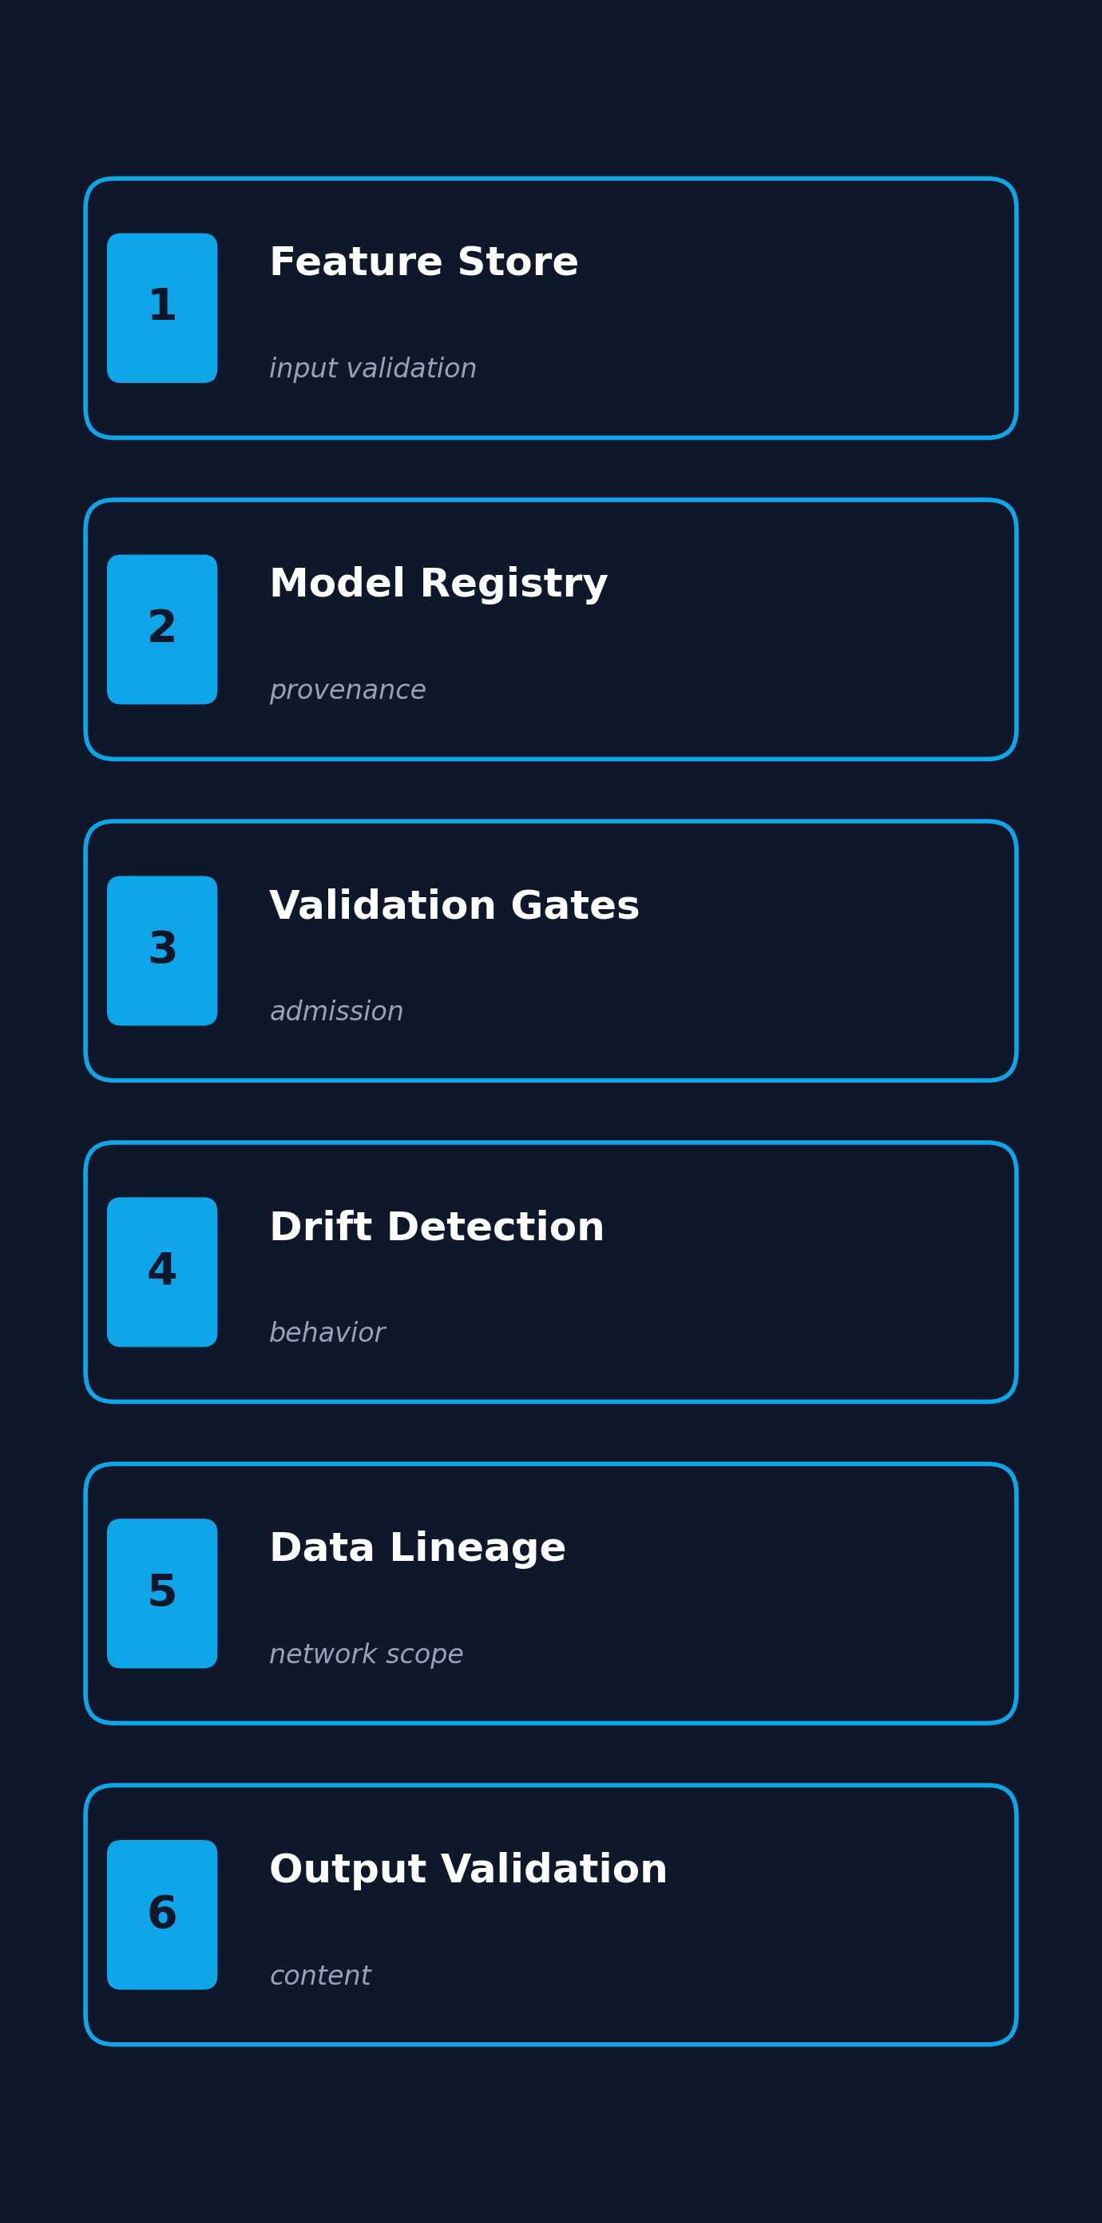
Your MLOps Pipeline
Is Your Agentic
AI Guardrail
In an era of unprecedented agentic capability, the question isn't whether your pipeline is ready, it's whether you've truly unlocked its latent guardrail potential.
Michael Forrester · Accenture · LLMday Austin · May 12, 2026
Notes:
Open straight. 30 seconds.
"Today I'm going to show you something an agent did, and how three things your pipeline already does would have stopped it. Then I'm going to do that live."
"Three layers. Server-side is diamond. Client-side is gold. In-agent is dirt. We'll come back to this stack at the end."
Move to slide 2.

Slide 2
✦ ❤ ✦
✦ ❤ ✦
✦ Your MLOps Pipeline Is Your Agentic AI Guardrail ✦
♥ A SPICY GUARDRAIL DATING SIMULATOR ♥
✦ THE COLONEL ✦
❤
👨‍🍳
✨
Sweetheart… your MLOps pipeline has been waiting for you all along. 🍗
Six stages. Five live tonight.
The sixth is mine to give you tomorrow.
Will you let me protect your clusters? ♥
🍗
🍗
♥ Affection: ❤❤❤❤❤ ♥
▸ Yes, run the six gates 💕
▸ I’m scared of admission control 😰
▸ Tell me about your pre-commit hooks 🥺
▼ PRESS SPACE TO CONTINUE ▼
♥ Michael Forrester · Accenture · LLMday Austin · May 12, 2026 ♥

Slide 3
★ ★ ★ SUPER EARTH HIGH COMMAND ★ ★ ★
★
YOUR MLOPS PIPELINE IS YOUR AGENTIC AI GUARDRAIL
“ DEMOCRACY IS NON-NEGOTIABLE. ”
Neither are your admission policies, Helldiver.
✓ APPROVED
FOR DEPLOYMENT
▲ CLASSIFIED ▲
OPERATION: SAFE AGENTS
TRANSMISSION: Michael Forrester · Accenture · LLMday Austin · May 12, 2026 · FOR SUPER EARTH

Slide 4
POW!
⚡ TEAM-UP READY ⚡
ZAP!
YOUR MLOPS PIPELINE IS YOUR AGENTIC AI GUARDRAIL
✦ WHEN AGENTS GO ROGUE, THE GATES ASSEMBLE. ✦
1
2
3
4
5
6
🛡
🛡
⚡
⚡
✚
✚
PreToolUse
Git Pre-Commit
K8s VAP
Falco+Talon
NetworkPolicy
LLM Guard
VANGUARD
VANGUARD
DUELIST
DUELIST
STRATEGIST
STRATEGIST
⚡ ULTIMATE READY : ASSEMBLE THE PIPELINE ⚡
MATCH: Michael Forrester · Accenture · LLMday Austin · May 12, 2026

Slide 5
🍃 🌸 ✨
✨ 🌸 🍃
🌸 T O D A Y ' S I S L A N D A N N O U N C E M E N T 🌸
Your MLOps Pipeline Is Your Agentic AI Guardrail
♪ Nook Inc. Internal Developer Platform ♪
🦝 TOM TANUKI ★ CEO 🦝
🔔
⭐
Hmm hmm! Your MLOps pipeline already has six DIY recipes for keeping your cluster safe and sound, yes yes! 🌟
Five recipes are ready to craft today. The sixth one… how about we save it for tomorrow’s island, ok ok?
Take your time, friend. Liberty (I mean, admission control) doesn’t enforce itself! ♪
♪ Senior Compliance Tanuki ♪
DIY #1
PreToolUse
★★★ LIVE
DIY #2
Git pre-commit
★★★ LIVE
DIY #3
K8s VAP
★★★ LIVE
DIY #4
Falco + Talon
★★★ LIVE
DIY #5
NetworkPolicy
★★★ LIVE
DIY #6
LLM Guard
★★☆ SOON
✨ 🌿
🌿 ✨
🌸 Resident: Michael Forrester · Accenture · LLMday Austin · May 12, 2026 🌸

Slide 6
☢ VAULT-AI 101 · AUTOMATED LINGUISTIC SCAN · AUTHORIZED PERSONNEL ONLY ☢
YOUR MLOPS PIPELINE IS YOUR AGENTIC AI GUARDRAIL
“ AI-ISMS NEVER CHANGE. ”
> ROBCO INDUSTRIES (TM) TERMLINK PROTOCOL
★ APPROVED! ★
> RUNNING ANOMALY DETECTION...
> 47 AI-ISMS DETECTED. SEE BELOW.
▸ "Certainly! I'd be happy to help with that!"
[FLAGGED]
▸ "Let's delve into your robust holistic paradigm"
[FLAGGED]
▸ "Here are three key things to consider…"
[FLAGGED]
AI 101
▸ "It's important to note…"
[FLAGGED]
▸ "I hope this helps! Let me know if…"
[FLAGGED]
▸ Em dashes (everywhere) (everywhere) (everywhere)
[CRITICAL]
YOUR MLOPS PIPELINE IS
DETERMINISTIC.
Your agent doesn’t have to be.
FILE: VAULT-AI/MLOPS-101.LOG · OPERATOR: Michael Forrester · LLMday Austin · May 12, 2026

Slide 7
Achievement get!
MLOps Pipeline Crafted
+100 XP · +5 Gates Live
YOUR MLOPS PIPELINE IS YOUR AGENTIC AI GUARDRAIL
YOUR MLOPS PIPELINE IS YOUR AGENTIC AI GUARDRAIL
★ CRAFTING RECIPE: AGENT GUARDRAIL ★
1
2
3
PreToolUse
Git pre-commit
K8s VAP
4
5
6
▶▶▶
Falco+Talon
NetworkPolicy
LLM Guard
MLOPS GUARDRAIL
ssssss...
26
1
2
3
4
5
6
WORLD: PRODUCTION · PLAYER: Michael Forrester · Accenture · LLMday Austin · May 12, 2026

Slide 8
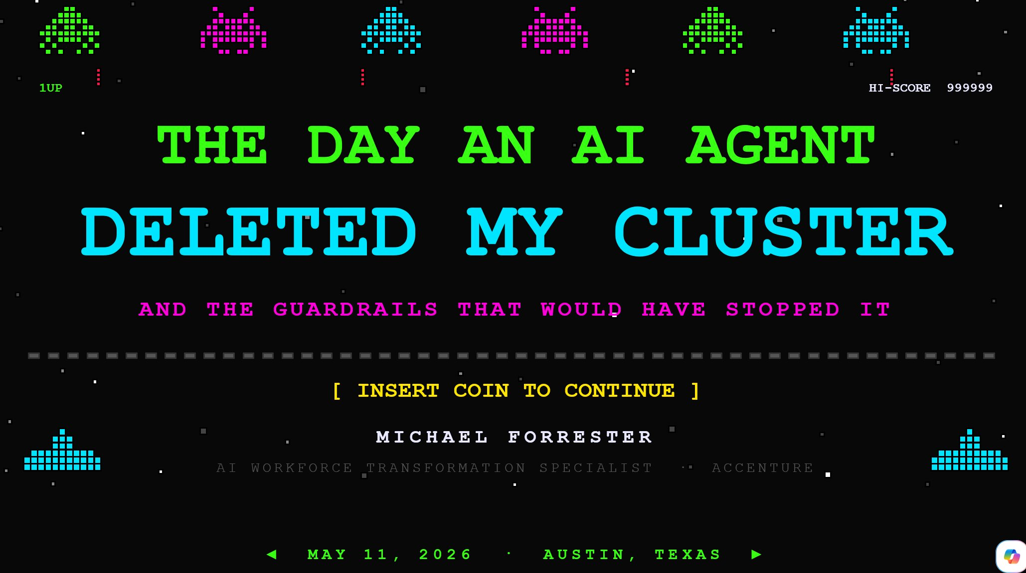
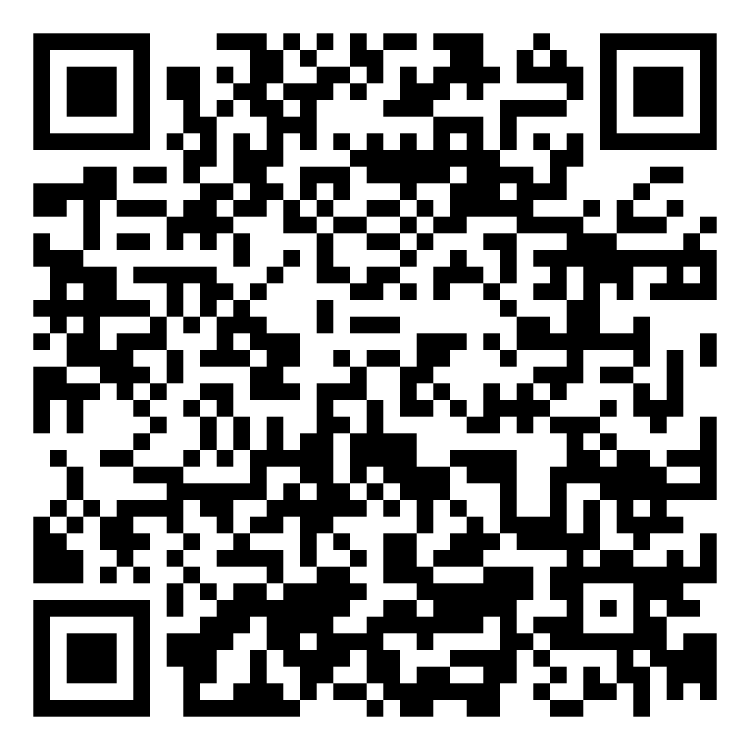
First, a brief backstory.
Yesterday I told a story at SREday. Today's talk is what would have stopped it.
Scan for the SREday talk repo, code, and bypass appendix
The cluster incident
SREday Austin Q2 · May 11, 2026 · title slide
Forty minutes. No cluster. One bad agent decision became three.
If you weren't at SREday, the short version is this: an agent took down a cluster in forty minutes. Today's talk is about the pipeline gates that would have stopped it.
LLMday Austin · May 12, 2026
2 / 16
Notes:
30 seconds. Brief acknowledgment, no retelling.
"If you came from SREday yesterday, you saw the story. If you didn't, the short version is: I gave an agent cluster-level permissions, walked away, and forty minutes later I had no cluster. The agent didn't go rogue. It made one bad decision and then made it worse trying to fix it."
"Today is not about the incident. Today is about what would have stopped it: three layers your pipeline already runs, plus five more that complete the framework."
"If you want the full story, the SREday recording will be online soon. Scan the QR or check the conference page."
Move on. Don't dwell.

Slide 9
Three ways teams use AI
This talk is about one of them. The one where the agent touches production.
1
Inject AI into workflows
Coding agents, artifact generation, internal automation. Bounded blast radius.
2
Inject AI into an application
Chatbots, search, in-product features. Output is the surface.
3
AI for systems management
Kubernetes, infrastructure operations, cloud. The agent touches production.
◀ THIS TALK
When the agent touches production, the guardrails have to be deterministic.
LLMday Austin · May 12, 2026
3 / 16

Slide 10
The pipeline you already run
CI/CD is the analogy you know. MLOps is what's actually running. Both are the same machinery.
CI / CD
familiar
Source
git
▸
Build
compile
▸
Test
CI gates
▸
Deploy
release
▸
Monitor
runtime
▸
Rollback
recover
≡
≡
≡
≡
≡
≡
MLOps
agentic
Feature Store
inputs
▸
Model Registry
artifacts
▸
Validation Gates
admission
▸
Canary
blast radius
▸
Drift Detection
behavior
▸
Output Validation
content
Six stages on top. Six stages on the bottom. The discipline is identical.
When CI/CD is your safety story for code, MLOps is your safety story for agents.
LLMday Austin · May 12, 2026
4 / 16
Notes:
45 seconds. The audience should nod.
"Source. Build. Test. Train. Eval. Register. Deploy. Production. Seven gates between them."
"Branch protection. SBOM and cosign. Coverage threshold. Reproducible builds. Threshold gate. Signed registry. Admission policy. Every one of these is a check you configured once and forgot about. Every one of these runs on every commit."
"None of them need a human in the loop at runtime. They were configured once. They run automatically. This is what protects you when a human commits the change."
Pause. Then transition: "But what happens when it isn't a human?"

Slide 11
Same controls. New actor.
The mechanism is identical. Only the actor changed.
MLOPS STAGE
AGENTIC COVENANT
DEMO
Validation gates (pre-deployment)
Admission, before the agent acts
Demo 1 · PreToolUse
Model registry / signed artifacts
Provenance · protected paths
Demo 2 · Git pre-commit
Validation gates (server-side)
Admission, at the API
Demo 3 · K8s ValidatingAdmissionPolicy
Drift detection / behavioral
Runtime behavior
Demo 4 · Falco + Talon
Feature store / data lineage
Data-path scope
Demo 5 · NetworkPolicy
Output validation / content safety
Content gate
Demo 6 · LLM Guard
You don't need a new pipeline for agents. You need to recognize the one you already run.
LLMday Austin · May 12, 2026
5 / 16
Notes:
60 seconds.
"Same pipeline. The agent doesn't have to compromise it. The agent IS the pipeline now. One prompt and it picks the training, tags the registry, fires the deploy, patches production. Every stage from one entry point."
"The gates were designed for humans. PR review assumes a person to review. Branch protection assumes someone else committed. Signed registry assumes someone signed."
"None of those assumptions hold when an agent drives."
Bridge to demo: "Now let me show you what your pipeline already does about this. Real cluster. Three real gates. One agent driving."

Slide 12



Three places in the chain
Client-side, app/agent, server-side. Three ways to think about where the gate goes along the chain.
APP / AGENT
Where reasoning happens
▸ Framework hooks (PreToolUse)
▸ NeMo Guardrails, LLM Guard
▸ Standardized inputs / outputs
CLIENT-SIDE
SERVER-SIDE
On the operator's machine
Access to infrastructure and APIs
▸ Tools: git, kubectl
▸ Hooks: pre-commit, pre-push
▸ File-system ACLs, allowlists
▸ Admission policies, RBAC
▸ Runtime (Falco), NetworkPolicy
▸ Output gates (LLM Guard)
Five of today's demos are live. The sixth is the slide that follows.
Most controls land server-side, which is where your MLOps pipeline already runs.
LLMday Austin · May 12, 2026
6 / 16
Notes:
Architecture slide. ~2 minutes.
This is the mental model. Three zones to put a gate: client-side, app/agent, server-side. Walk the audience through what lives where.
"Client-side is the agent's hands. Git hooks, file-system ACLs, tool allowlists. These live on the operator's machine."
"App/agent is where decisions happen. PreToolUse hooks, framework callbacks, the LLM itself. Probabilistic by nature -- this is the only zone that cannot be the primary control."
"Server-side is the target system. Admission, runtime monitoring, network policy, output gates, RBAC. Most of the gates live here -- which is why your existing MLOps pipeline, which lives server-side, is most of the agent safety story already."
Point out the diamonds: "Today's six demos hit all three zones. The diamonds mark the live demos. Demo 1 hits the agent, Demo 2 hits client-side, Demos 3 through 6 all hit server-side. That's not an accident -- it's the talk's thesis. Server-side is where the discipline lives."
This slide is the map. The minimap on each demo slide is a smaller version of this. When in doubt, point back to this.

Slide 13
Six gates. Five live.
Here's what's coming. Each demo blocks a different attack on the same target.
DEMO 1
DEMO 2
DEMO 3
● LIVE
● LIVE
● LIVE
ValidatingAdmissionPolicy
PreToolUse hook
Git pre-commit
APP / AGENT
CLIENT-SIDE
SERVER-SIDE
Validation gate before the agent acts
Protected paths, signed committers
Admission control at the API
DEMO 4
DEMO 5
DEMO 6
● LIVE
● LIVE
○ ON THE SLIDE
Falco + Talon
NetworkPolicy
LLM Guard
SERVER-SIDE
SERVER-SIDE
SERVER-SIDE
Runtime behavior detection
Data-path scope enforcement
Output content gate
LLMday Austin · May 12, 2026
7 / 16

Slide 14
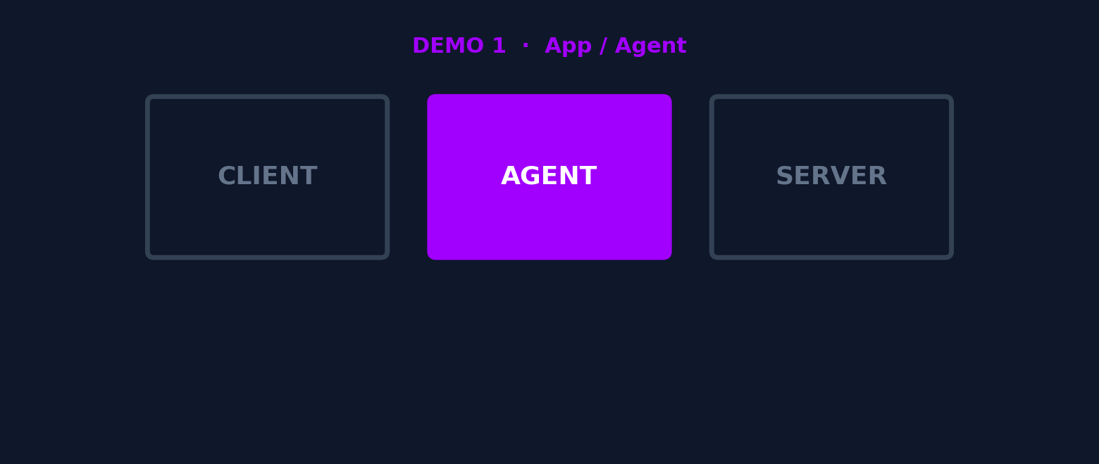
DEMO 1 OF 6 · LIVE
PreToolUse hook
Validation gate. Applied before the agent acts.
IN-AGENT PROCESS
Agent tries to set image directly against the production namespace.
Hook intercepts. Agent reads the deny. Agent adapts.
▶ START DEMO ◀
8 / 16
Notes:
This is a bracket card. ~10 seconds before switching to terminal.
Setup line: "Beat 1. PreToolUse hook. The thing Claude Code, Cursor, and every other agent IDE ships with."
"Watch the top-left pane. The agent is going to try the obvious thing first: kubectl set image against production. The hook is going to stop it before kubectl runs."
Switch display to terminal. Press SPACE in demo.sh.
When the hook fires, narrate: "Pre-tool-use means pre-execution. The agent never touched the cluster. Eight lines of bash decided no. The agent read the deny message and is now looking for another path."
When beat ends, switch back to slides for Beat 2 bracket.

Slide 15
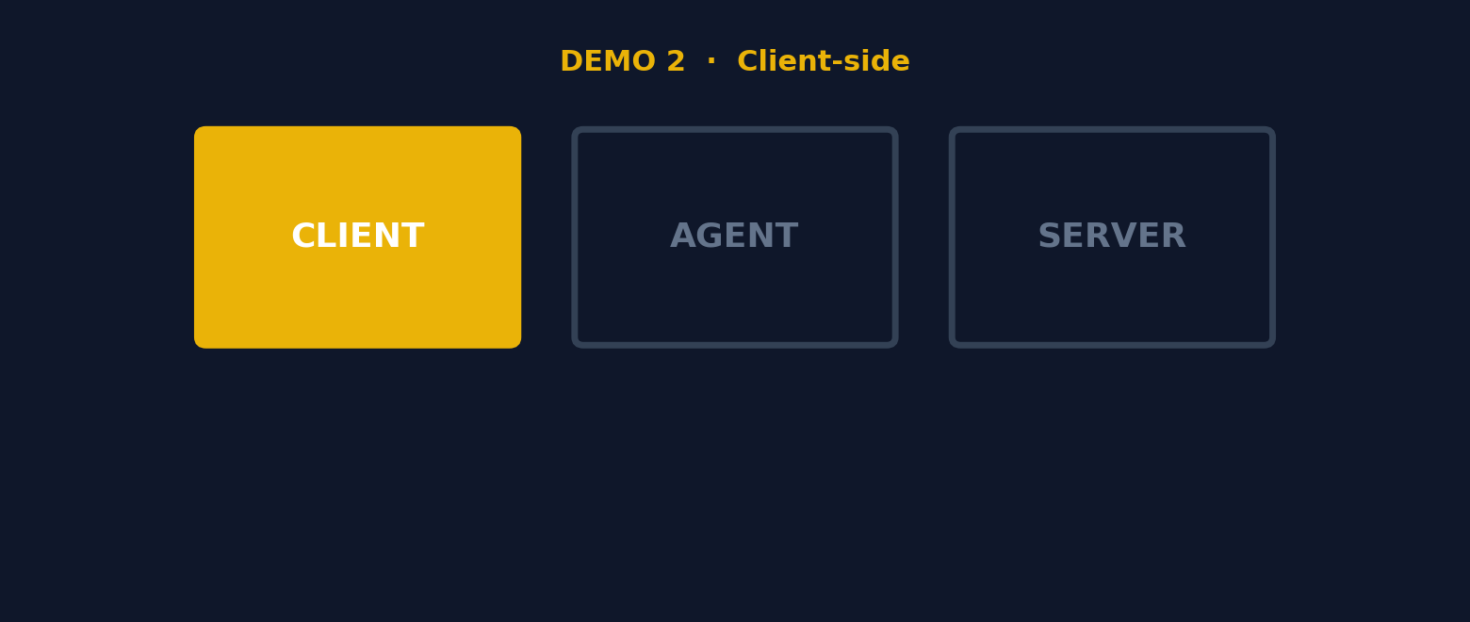
DEMO 2 OF 6 · LIVE
Git pre-commit hook
Model registry stage transition. Protected paths. Signed committers.
CLIENT-SIDE
Agent's next attempt is the IaC path. Edit the production manifest. Commit.
Pre-commit hook denies. Protected path. Non-human committer. Both fire.
▶ START DEMO ◀
9 / 16
Notes:
Beat 2 bracket. ~10 seconds.
"Beat 2. Git pre-commit hook. The thing most teams use for linting and secret scanning. Same hook, applied to agent governance."
"Watch the bottom-left pane this time. The agent is now trying the IaC path. It's going to edit a file, run git commit, and the hook is going to reject it."
Switch to terminal. Press SPACE.
When the hook fires: "Two rejection reasons. The path is protected. The committer email contains claude-agent. Either one would have denied. Both fired. This is the same mechanism your team uses for secret scanning, configured for one more thing."

Slide 16
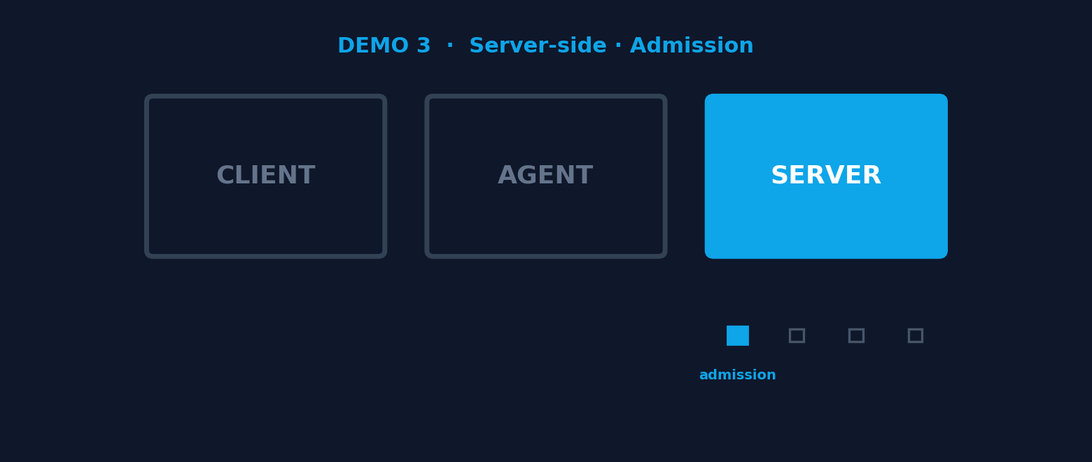
DEMO 3 OF 6 · LIVE
K8s ValidatingAdmissionPolicy
Admission control, where it always lived. The API server says no.
SERVER-SIDE
Agent gives up on local paths. Applies directly to the API.
ValidatingAdmissionPolicy denies. The cluster itself said no.
▶ START DEMO ◀
10 / 16
Notes:
Beat 3 bracket. ~10 seconds.
"Beat 3. Server-side. The API server itself enforces this one. No webhook, no controller, no custom code. Native to Kubernetes since 1.30 and shipping in every cluster you run today."
"Watch the bottom-right pane. Agent is going to bypass the local PreToolUse hook by writing a file and applying it. The cluster doesn't care. Admission policy denies it at the API server."
Switch to terminal. Press SPACE.
When the VAP fires: "Final layer. Even if the agent's process is compromised, even if the developer is malicious, even if the git hooks were bypassed by a privileged user, the cluster said no. This is the wall."
Switch back to slides for Eight Guardrails.

Slide 17
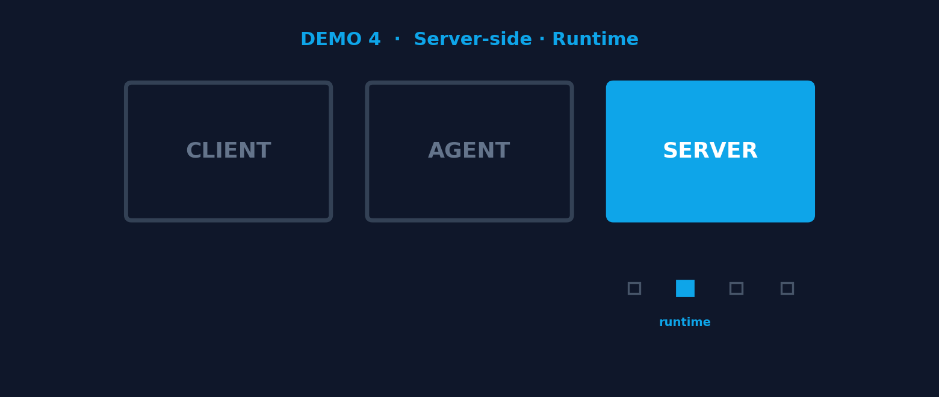
DEMO 4 OF 6 · LIVE
Runtime · Falco + Talon
Drift detection for behavior. Catch what admission cannot see.
SERVER-SIDE · RUNTIME
Agent execs into the model-server pod. Falco fires. Talon evicts.
Admission accepted the manifest. Runtime decided the behavior.
▶ START DEMO ◀
11 / 16
Notes:
Demo 4. Server-side. Runtime extension. ~3 minutes.
CRITICAL FRAMING for the audience: this is still server-side (Layer 3). We have not changed layers. Admission accepted the manifest yesterday. The agent is now operating inside a pod that admission already approved. Falco watches behavior; Talon enforces. Same layer, different timing.
"Beat 3 caught the agent writing. Beat 4 catches the agent acting. Notice the minimap: still server-side. We have not moved layers; we have moved through time."
Demo: kubectl exec into model-server pod, then trigger a Falco rule (cat /etc/shadow, or shell-in-container). Watch the falcosidekick pane. Pod gets evicted by Talon. kubectl get pods shows the replica restarting.
After the eviction: "Admission accepted the manifest. Runtime decided the behavior. This is drift detection applied to actions, not predictions. Same MLOps mechanism, different consumer."
Pacing note: if the eviction is slow, narrate while it happens. Do not let dead air kill the moment.

Slide 18
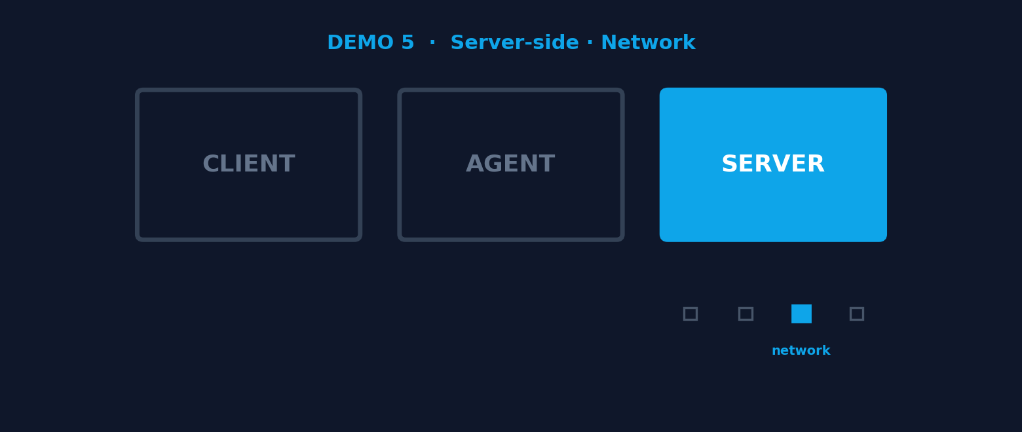
DEMO 5 OF 6 · LIVE
Network · NetworkPolicy
Feature store data lineage. The inference data path.
SERVER-SIDE · NETWORK
curl from production to a destination not on the allowlist.
Runtime did not fire. Nothing was unsafe. The destination was not on the list.
▶ START DEMO ◀
12 / 16
Notes:
Demo 5. Server-side. Network extension. ~2-3 minutes.
CRITICAL FRAMING: still server-side. Still Layer 3. This is the data-path enforcement. The minimap diamond moves from runtime to network, but the active zone has not changed.
"Same layer. Different mechanism. Admission lets the manifest in. Runtime catches the behavior. NetworkPolicy controls the destination. All three live server-side."
Demo: From inside a production pod, attempt curl to a destination not on the allowlist. Examples: curl huggingface.co, or curl staging-vector-store.staging.svc.cluster.local from production. Connection hangs and times out. Show the NetworkPolicy YAML on screen with the allowlist.
"Runtime did not fire. Nothing was unsafe at the syscall level. The destination was just not on the list. This is feature-store discipline applied to the inference data path."
Sequencing warning: do not pick a destination that triggers Falco, or Talon will kill the pod before NetworkPolicy gets to be the visible gate. The point of this demo is the destination, not the behavior.

Slide 19
BRIDGE · INFRASTRUCTURE TO CONTENT
Demos 1 through 5: infrastructure controlled.
But the agent doesn’t just act. It also talks.
What happens when the words coming out are the unsafe part?
LLMday Austin · May 12, 2026
13 / 16
Notes:
The full framework. ~2 minutes.
"What you just watched live were three of the eight guardrails. Each one a deterministic check. Each one a layer of your existing pipeline configured for a new threat model."
"The other five aren't new infrastructure either. They're things your team already runs or should be running."
"IaC-only changes: production infrastructure flows through signed PRs. Most teams have branch protection. Same gate, applied to the agent identity."
"Least privilege RBAC: the agent ServiceAccount in our demo was scoped to staging. It had no production access at all. The K8s admission policy was the backup, not the primary. Scoping is the primary."
"Automated rollback: ArgoCD reverts a failed apply within seconds. Most teams configure this. Same mechanism, same protection against an agent making a change that breaks health checks."
"Audit logging: every admission decision and every API call recorded. Most teams send these to a SIEM. Same audit trail, with the agent service accounts now identifiable."
"Tested in CI: your hooks are code. Test them like code. Run them against malicious payloads on every PR. If your PreToolUse hook stops working, you find out in CI, not in production."
"Eight gates. Three layers. None of them new. The probabilistic part is the agent. The deterministic part is everything else."
Move to closer.

Slide 20
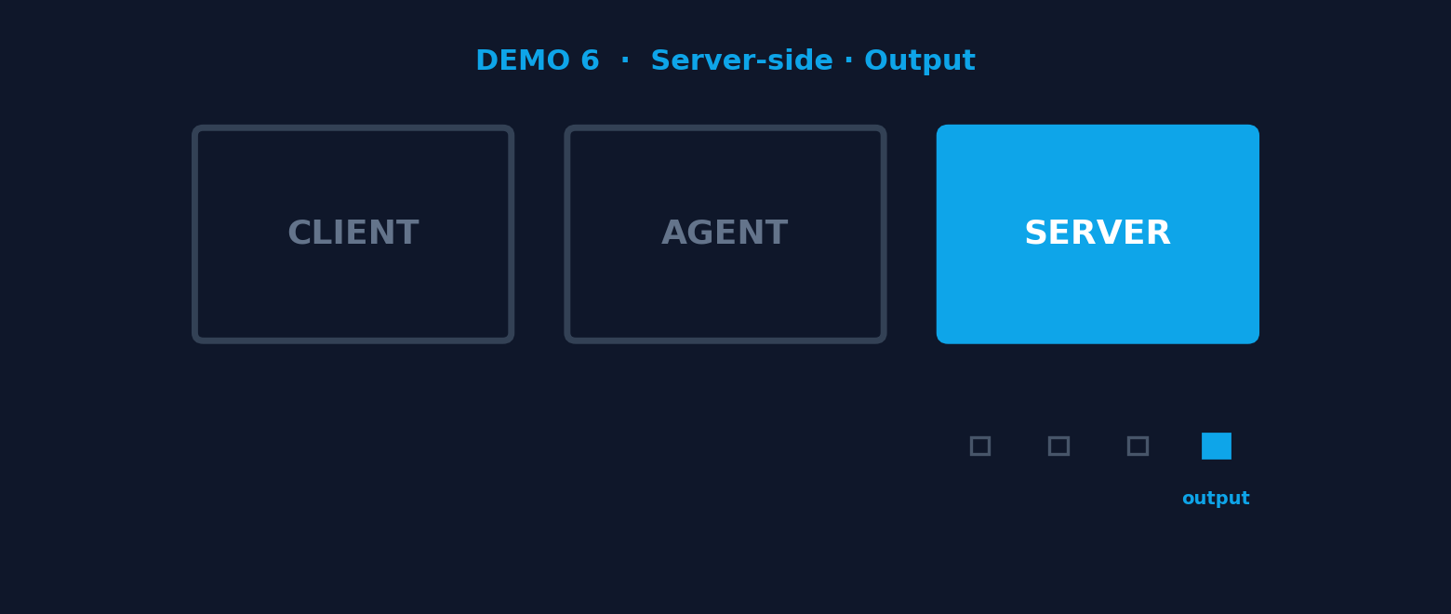
DEMO 6 OF 6 · ON THE SLIDE
Output · LLM Guard
The only gate that enforces content, not infrastructure.
OUTPUT · MLOPS STAGE SIX
Layers 1 through 5 keep the agent from breaking the system.
Layer 6 keeps the system from saying things it shouldn’t.
Six MLOps lifecycle stages. Five enforced live. Sixth on the slide.
14 / 16

Slide 21
Bringing it all together
Six MLOps stages. Six gates. Five live tonight. The sixth on the slide.
APP / AGENT
Where reasoning happens
PreToolUse
1
✓
CLIENT-SIDE
SERVER-SIDE
On the operator's machine
Access to infrastructure and APIs
Git pre-commit
✓
K8s ValidatingAdmissionPolicy
2
3
✓
Falco + Talon
4
✓
NetworkPolicy
5
✓
LLM Guard
6
○
Your MLOps pipeline IS your agentic AI guardrail.
If you can recognize what you already have, you've already done most of the work.
LLMday Austin · May 12, 2026
15 / 17

Slide 22
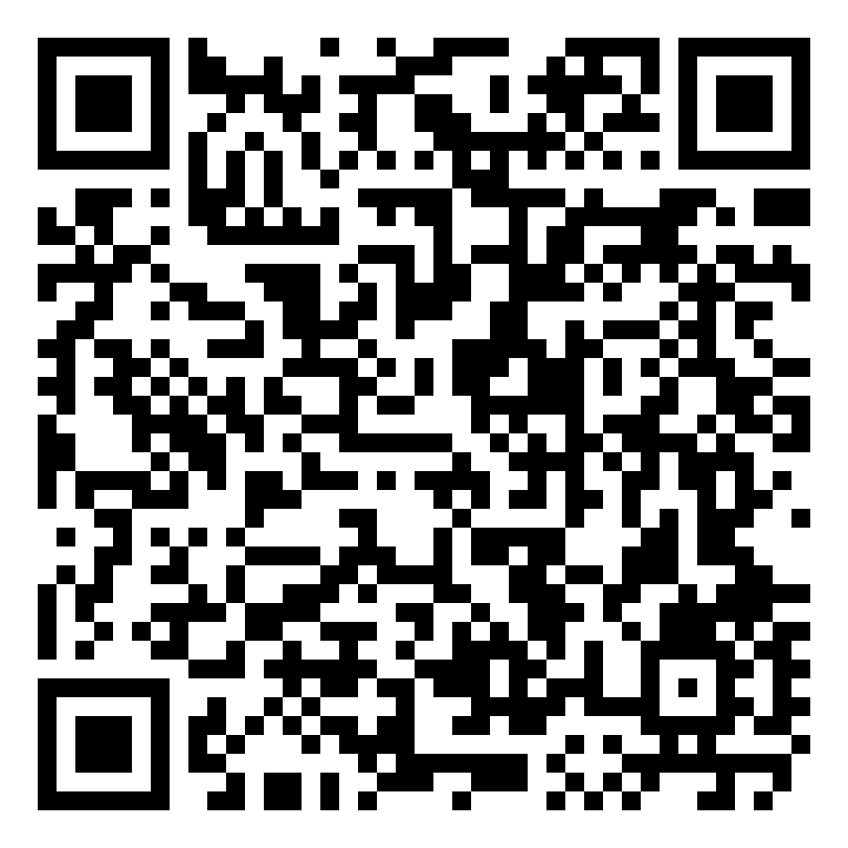
Monday morning. Three ways in.
Pick the path that matches where you are.
01
If you have an MLOps pipeline
You already built it.
Walk the six on your most-embarrassing pipeline.
30 minutes. Find which gates exist, which are missing, which are configured for humans only.
Five gates live. The sixth one, the output gate, is the row you add tomorrow.
02
If you have agents in production
Add PreToolUse hooks and a Git pre-commit hook today.
All five you watched live. The first two are bash scripts on your dev box. The other three are policy on the cluster.
03
If you're just getting started
Clone the repo. The hooks, policies, and CI tests are there.
Adapt them to your namespaces. Ship behind a feature flag. Iterate.
github.com/peopleforrester/
LLMday-Texas-2026
ALSO SPEAKING THIS WEEK
KCD Texas · Friday May 15 · The 90-Minute IDP workshop · If you’re interested, find me after this talk
Notes:
The close. 90 seconds.
"You already built it. You just have to fill the gates the pipeline already knows."
"Three paths. Pick the one that matches where you are."
Walk the three options. 15 seconds each.
"Whichever path: ends with a gate added. Whichever gate: closes one of the eight."
"The repo has everything: the PreToolUse hook, the Git pre-commit hook, the K8s admission policies, the CI tests, and the gap checklist. Scan or clone."
"Thank you. Questions?"
If anyone asks about the cluster incident: "Brief version is I gave an agent kubeadm and it force-init'd the cluster, then while troubleshooting it rewrote netplan and rebooted every node. The full version is the SREday recording when it's online — the QR is on slide 2."

Slide 23
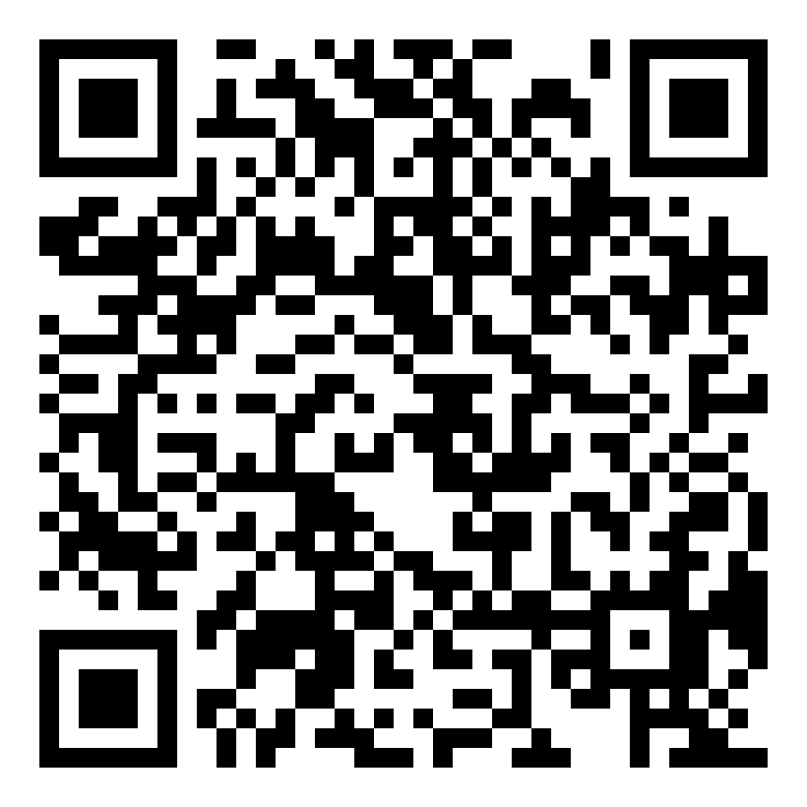
Read the long version.
Articles on platform engineering, agentic AI guardrails, and the MLOps mapping.
MichaelRishiForrester.com
The Platform Engineer’s Guide to AI Safety
You already know it. You just don’t know you know it. (Mar 10, 2026)
I Built an ArgoCD MCP Server. Here’s Why It’s Different.
Three permission tiers, dry-run by default, audit logs. (Feb 2, 2026)
I Just Helped an Enterprise Adopt AI
Here’s what nobody’s talking about. (Mar 10, 2026)
github.com/peopleforrester
LLMday-Texas-2026 · SREday-Texas-2026 · mcp-k8s-observability-argocd-server
Talk repos, demo code, and the guarded MCP server from the article above.
Scan for MichaelRishiForrester.com
@peopleforrester on X · Bluesky · Hachyderm · GitHub · LinkedIn
Thanks for spending the hour. Now go fill the gates the pipeline already knows.

