Slide 1

n8n Meetup Atlanta
"I Don't Know
What to Post"
LIVE BUILD SESSION
April 22, 2026
5:30 – 8:30 PM
ATDC · Atlanta, GA
Fixed with Automation
Nina Thomas
AI Strategist & Educator · n8n Community Ambassador · Miro Hero Ambassador
Founder, People in the Loop
peopleintheloop.app/n8n_0422

Slide 2


Nina Thomas
AI Strategist & Educator
▪ n8n Community Ambassador
▪ Miro Hero Ambassador
▪ Founder, People in the Loop
▪ 20+ years in IT and project management
▪ 15+ years in Brand Marketing
▪ Atlanta, GA (Smyrna)
ninathomas.ai
She teaches people to build automations that work while they sleep.
Tonight, you're going to do exactly that.
linkedin.com/in/ninathomas
peopleintheloop.app · n8n Meetup Atlanta · April 22, 2026

Slide 3
MEET YOUR DEMO BRAND
Peaches 404
An Atlanta restaurant where everything has peaches in it.
The Voice
The Setup
• Playful, Southern, unapologetically Atlanta.
RSS Feed (UGA Peach Blog):
site.extension.uga.edu
/peaches/feed/
• Everything is better with peaches. They will tell you why.
• Farm-to-table storytelling. Proud of their Georgia suppliers.
Backup URL:
...peaches/?feed=rss2
• Never takes itself too seriously. Every post is Instagrammable.
Poll: Every Hour
Output: 3 posts (IG, LinkedIn, X)
peopleintheloop.app · n8n Meetup Atlanta · April 22, 2026

Slide 4
What You Need.
Before we touch any nodes, confirm you have these.
01
n8n account
Create a free account at n8n.io
02
Anthropic API key
console.anthropic.com -- setup steps on the next slide
03
Gmail account
any Google account works -- we'll connect it in the next step
04
RSS feed URL
site.extension.uga.edu/peaches/feed/ (or use your own)
peopleintheloop.app · n8n Meetup Atlanta · April 22, 2026

Slide 5
Set Up Your Credentials
Two things to connect. Do this before you add any nodes.
Anthropic API Key
Gmail / Google OAuth2
1
Go to console.anthropic.com
1
Add a Gmail node to your canvas
2
Sign up or log in
2
Under Credential → Create New
3
Click API Keys → Create Key
3
Select Gmail OAuth2 API
4
Copy the key (starts with sk-ant-...)
4
Click Connect My Account
5
In n8n: Credentials → New → Anthropic API
5
Sign in to Google → Allow
6
Paste your key → Save
6
Close the dialog → credential saved
New to Anthropic? Free credits on signup -- enough for dozens of test runs.
Any Google account works -- personal or work Gmail.

Slide 6

Let's Build.
Level 1.
RSS feed in. Social posts out. Automatic.

Slide 7
LEVEL 1
Beginner Build
01
RSS Feed Trigger
02
Write Social Posts (Claude)
03
Send Content Email (Gmail)
n8n-nodes-base.rssFeedReadTrigger
@n8n/n8n-nodes-langchain.chainLlm + lmChatAnthropic
n8n-nodes-base.gmail
Paste the RSS feed URL
Set poll time to Every Hour
Fires automatically every time a new article publishes
Two nodes: Chain + Claude Model
Prompt uses {{ $json.title }} and {{ $json.contentSnippet }}
Writes Instagram, LinkedIn, and X posts
Operation: Send Message
sendTo: your email address
Subject includes article title as variable
Body renders the posts Claude wrote
TIP: UGA Peach Blog:
site.extension.uga.edu/peaches/feed/
TIP: Connect your Anthropic API key to the Claude Model node
TIP: Connect Gmail OAuth2. Update the sendTo email before testing.
peopleintheloop.app · n8n Meetup Atlanta · April 22, 2026

Slide 8
Two Ways to Use Claude in n8n
We built with the Chain Node tonight. Here's how they compare.
CHAIN NODE
WHAT WE BUILT TONIGHT
AGENT NODE
WHAT'S POSSIBLE NEXT
Input → Claude writes → Output
Input → Claude thinks → Claude acts → Output
✓ Single input-output cycle
○ Loops until task is complete
✓ No memory between runs
○ Has memory across steps
✓ No external tool calls
○ Calls tools (search, APIs, code)
✓ Deterministic -- same prompt, same structure
○ Adaptive -- changes plan as needed
✓ Fast to build and easy to debug
○ More complex to build and tune
Best for: content generation, summarization, formatting. Anything with a clear input and a clean output.
Best for: research, triage, multi-step decisions, anything that needs reasoning before acting.
peopleintheloop.app · n8n Meetup Atlanta · April 22, 2026

Slide 9
Let's Build.
Level 2.
Brand Voice.
One thing changes in the Claude Model node.

Slide 10
LEVEL 2
The Upgrade: Brand Voice
One thing changes.
Level 1 -- Claude Model node
Level 2 -- Claude Model node
No system prompt.
System message = your brand voice.
Claude is a blank slate. It writes like a generic content tool. Output: Technically correct. Not distinctly you.
Claude knows who you are. It writes with your tone, your rules, your voice. Output: Posts that sound unmistakably like you.
→
Where to add it: Claude Model node → System Message field → paste your completed brand voice prompt
peopleintheloop.app · n8n Meetup Atlanta · April 22, 2026

Slide 11
Your Brand Voice Prompt
Fill it out once. Paste it into the Claude node. Every post sounds like you from that point on.
01
Who I Am
02
My Audience
03
My Tone
Role, background, years of experience.
Be specific. 2-3 sentences.
Who reads your content, their goals,
their level of sophistication.
Warm, direct, funny, formal, casual?
Describe how you actually sound.
04
Words I Use
05
Words I Avoid
06
Example Posts
5-10 phrases that are distinctly yours.
Specific language you return to.
Anything off-brand or off-limits.
Jargon you hate. Tropes you avoid.
Paste 1-3 real posts you love.
This is the most powerful field.
→ claude-brand-voice-prompt.md · available at peopleintheloop.app/n8n_0422 · fill every field in brackets before pasting

Slide 12
Which Tool for Which Job?
All four use Claude. The choice is about triggers, integrations, and how much reasoning you need.
n8n
Claude
Agents
Claude
Code
Claude
Cowork
Think of it as...
A scheduler that connects your apps
A scheduler with AI decision-making
Script runner + IDE
AI teammate you delegate to
Runs automatically
Yes -- set a schedule or respond to events
Yes -- natural language triggers
Needs external scheduler
Needs external trigger
Connects to apps
400+ native nodes
Growing connector set
Whatever you code
Configured tools + MCPs
Predictable?
Deterministic -- every step visible
Adaptive -- reasons before acting
Flexible -- you write the logic
Adaptive -- judgment calls
Best for
Recurring pipelines, high volume
Scheduled AI reasoning + enrichment
One-off scripts, building tools
Human-in-the-loop decisions
Tonight: n8n watches RSS → Claude writes posts → Gmail delivers. Automatic. Three services. Zero code.
peopleintheloop.app · n8n Meetup Atlanta · April 22, 2026

Slide 13
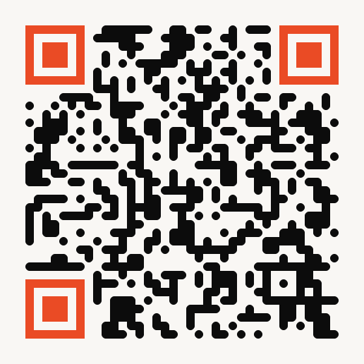
What You Walk Away With
Grab Your Resources
1
Level 1 Workflow
level1-rss-to-email.json
2
Level 2 + Brand Voice
level2-brand-voice-rss-to-email.json
3
Brand Voice Template
claude-brand-voice-prompt.md
4
n8n Assistant Prompt
claude-skill.md
peopleintheloop.app/n8n_0422
People in the Loop · Atlanta, GA

