Slide 1



NPC
More NP-Complete Problems

Slide 2
Introduction
Objectives:
  To introduce more NP-Complete problems.
Overview:
  3SAT
  CLIQUE & INDEPENDENT-SET
  SUBSET-SUM

Slide 3
Method
How to show a problem is in NPC?
  First show it’s in NP
  Then reduce some NP-Hard problem to it.

Slide 4
New Base Problems
The only NP-Complete problem we currently know of is SAT.
Unfortunately, it’s not very comfortable to work with.
Thus we’ll start by introducing several useful variants of SAT.
We’ll use them as our base problems.

Slide 5
3SAT
Instance: a 3CNF formula
Problem: To decide if the formula is satisfiable.
A satifiable 3CNF formula
(x∨y∨¬z)∧(x∨¬y∨z)
An unsatifiable 3CNF formula
(x∨x∨x)∧(¬x∨¬x∨¬x)

Slide 6

3SAT is NP-Complete
SIP 259-260
3SAT is a special case of SAT, and is therefore clearly in NP.
In order to show it’s also NP-Complete, we’ll alter the proof of SAT’s NP-Completeness,
so it produces 3CNF formulas.
Why would that be enough?

Slide 7
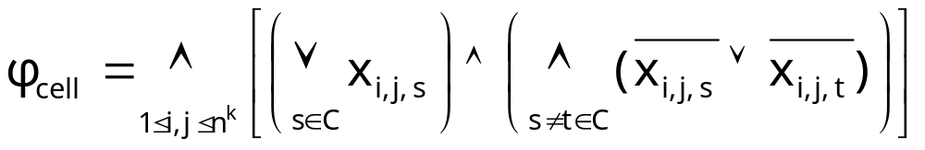
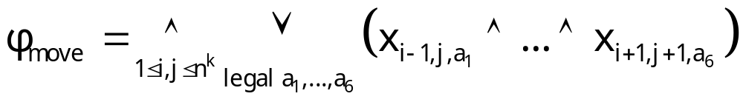
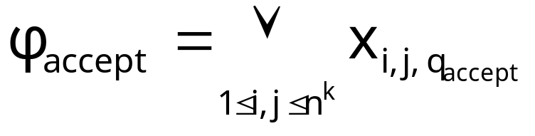
Revisiting SAT’s NP-Completeness Proof
Given a TM and an input we’ve produced a conjunction of:

Slide 8
Transforming the Formula into a CNF Formula
All the sub-formulas, but φ_{move}, form a CNF formula.
Using the distributive law we can transform φ_{move} into a conjunction of clauses.
The formula stays succinct (check!).

Slide 9
CNF → 3CNF
(x∨y)∧(x₁∨x₂∨... ∨x_{t})∧...
clauses with 1 or 2 literals
clauses with more than 3 literals
replication
split
(x∨y∨x)
(x₁ ∨ x₂ ∨ c₁₁)∧(¬c₁₁∨ x₃ ∨c₁₂)∧... ∧(¬c_{1t-3}∨ x_{t-1}∨x_{t})

Slide 10
3SAT is NP-Complete
Since we’ve shown a reduction from any NP problem to 3SAT,
and 3SAT is in NP,
3SAT is NP-Complete. 

Slide 11
CLIQUE
Instance: A graph G=(V,E) and a threshold k.
Problem: To decide if there is a set of nodes C={v₁,...,v_{k}}⊆V, s.t for any u,v∈C: (u,v)∈E.

Slide 12
CLIQUE is in NP
On input G=(V,E),k:
Guess C={v₁,...,v_{k}}⊆V
For any u,v∈C: verify (u,v)∈E
Reject if one of the tests fail, accept otherwise.
The length of the certificate: O(n) (n=|V|)
Time complexity: O(n²)

Slide 13

CLIQUE is NP-Complete
SIP 251-253
Proof: We’ll show 3SAT≤_{p}CLIQUE.
≤_{p}
k

Slide 14
The Reduction
for any clause (α∨β∨γ)
⇒|V| = formula’s length
α
β
γ
K=
no. of clauses
connected iff α≠¬δ
δ

Slide 15
Proof of Correctness
NOT connected!
1
.
.
.
k
a clique of size k must contain one node from every layer.

Slide 16
Correctness
given a k-clique, assign x TRUE or FALSE according to whether x or ¬x is in the clique; this satisfies the formula
.
.
.
given a satisfying assignment, a set comprising of one satisfied literal of each clause forms a k-clique.

Slide 17
INDEPENDENT-SET
Instance: A graph G=(V,E) and a goal k.
Problem: To decide if there is a set of nodes I={v₁,...,v_{k}}⊆V, s.t for any u,v∈I: (u,v)∉E.

Slide 18
INDEPENDENT-SET ∈ NP
On input G=(V,E),k:
Guess I={v₁,...,v_{k}}⊆V
For any u,v∈C: verify (u,v)∉E
Reject if one of the tests fail, accept otherwise.
The length of the certificate: O(n) (n=|V|)
Time complexity: O(n²)

Slide 19
INDEPENDENT-SET is NPC
Proof: By the previous claim and a trivial reduction from CLIQUE. 
there’s a clique of size k in a graph
there’s an IS of size k in its complement
IFF

Slide 20


SUBSET-SUM
Instance: A set of numbers denoted S and a target number t.
Problem: To decide if there exists a subset Y⊆S, s.t Σ_{y∈Y}y=t.
13
16
8
21
3
1
6
11

Slide 21
SUBSET-SUM is in NP
On input S,t:
Guess Y⊆S
Accept iff Σ_{y∈Y}y=t.
The length of the certificate: O(n) (n=|S|)
Time complexity: O(n)

Slide 22
SUBSET-SUM is NP-Complete
SIP 269-271
Proof: We’ll show 3SAT≤_{p}SUBSET-SUM.
≤_{p}
t

Slide 23
Satisfying Clauses
digit per clause
c₁ c₂ …… c_{k}
number per variable x_{i} assigned true:
y_{i}
number per variable x_{i} assigned false:
z_{i}
1 if x_{i} is in c_{j}
0 otherwise
1 if ¬x_{i} is in c_{j}
0 otherwise

Slide 24
Achieving Target
digit per clause
c₁ c₂ …… c_{k}
0<d<4
target:

Slide 25
Achieving Target
digit per clause
c₁ c₂ …… c_{k}
1
1
target:
3

Slide 26
Achieving Target
c₁ c₂ … c_{k}
y₁
z₁
…
y_{l}
z_{l}
1 | 0 |  | 0
0 | 0 |  | 0
1 | 0 |  | 1
1 | 1 |  | 0
. . .
make sure a good subset contains exactly one of y_{i} and z_{i}
1 | 0 |  | 0
1 | 0 |  | 0
0 | 0 |  | 1
0 | 0 |  | 1
. . .
3
3
3

Slide 27
Imposing Consistency
c₁ c₂ … c_{k}
y₁
z₁
…
y_{l}
z_{l}
1 | 0 |  | 0
0 | 0 |  | 0
1 | 0 |  | 1
1 | 1 |  | 0
1 | 0 |  | 0
1 | 0 |  | 0
0 | 0 |  | 1
0 | 0 |  | 1
. . .
1 | 0 |  | 0
1 | 0 |  | 0
0 | 0 |  | 1
0 | 0 |  | 1
. . .
1
1
1
3
3
3

Slide 28
Succinctness
l
k
2l
2k

Slide 29
Completeness
If there is a satisfying assignment, build the subset as follows:
  If the i-th variable is assigned TRUE, take y_{i}, else take z_{i}.
  Add as many auxiliary numbers as needed.
⇒ 1 in the leftmost l digits
satisfiablity ⇒ 3 in the rightmost k digits

Slide 30
Soundness
If there is a subset which sums up to the target, construct an assignment as follows:
  If y_{i} is in the subset, assign TRUE to the i-th variable.
  If z_{i} is in the subset, assign FALSE to the i-th variable.

Slide 31
Observation: No Carry
c₁ c₂ … c_{k}
All digits are either 0 or 1.
Each column contains at most five 1’s.
Hence, a “carry” into the next column never occurs.
1
0
0
1
0
0
y₁
z₁
…
y_{l}
z_{l}
1
0
0
0
0
0
0
0
1
1
0
1
0
0
1
1
1
0
1
0
0
1
0
0
0
0
1
0
0
1
1
1
1
3
3
3

Slide 32
Consistency
c₁ c₂ … c_{k}
Thus, to get 1 in the rightmost l digits, our subset necessarily contains either y_{i} or z_{i} (Not both!).
y₁
z₁
…
y_{l}
z_{l}
1
0
0
1
0
0
1
0
0
0
0
0
0
0
1
1
0
1
0
0
1
1
1
0
1
0
0
1
0
0
0
0
1
0
0
1
1
1
1
3
3
3

Slide 33
Satisfiablity
c₁ c₂ … c_{k}
In each column, at most 2 can come from the auxiliary numbers, so all clauses are satisfied.
1
0
0
1
0
0
y₁
z₁
…
y_{l}
z_{l}
1
0
0
0
0
0
0
0
1
1
0
1
0
0
1
1
1
0
1
0
0
1
0
0
0
0
1
0
0
1
1
1
1
3
3
3

Slide 34
Summing Up
SUBSET-SUM is in NP
3SAT≤_{p}SUBSET-SUM
Thus SUBSET-SUM is NP-Complete

Slide 35
Summary
In this lecture we’ve added many new problems to our NPC “bank”.
Interestingly, NPC contains over 1000 different problems !
◉

Slide 36
Appendix

Slide 37
Dictionary
negation: not (¬)
conjunction: and (∧)
disjunction: or (∨)
literal: (negated or not) Boolean variable
Examples: x, ¬x
clause: several literals connected with ∨
Example: (x∨¬y∨z)
CNF (Conjunctive Normal Form): several clauses connected with ∧
Example: (x∨ y)∧(x∨¬y∨z)
3CNF: a CNF formula with three literals in each clause.
Example: (x∨y∨¬z)∧(x∨¬y∨z)

