Slide 1
Deep Learning for Happy vs. Not Happy Facial Expression Recognition in Video
Jose Carlos Alania Aguero
ECE-533 Image Processing 2026
University of New Mexico
1

Slide 2
Outline
Introduction & Motivation
Background (Classical Methods)
Current Deep Learning Systems
Proposed Pipeline (Your System)
Validation & Testing Setup
Results & Observations
Emerging Systems
Future Directions
Conclusions
2

Slide 3
Introduction & Motivation
Why this problem matters
Emotion recognition enables:
Human-computer interaction
Mental health monitoring
Affective AI systems
Video-based analysis captures temporal facial dynamics
Deep learning enables automatic feature extraction
Why it is still relevant
Real-world deployment still unreliable
Domain shift (datasets ≠ real life)
Class imbalance issues remain unsolved
Need for lightweight models (edge devices)
2

Slide 4
Background (Classical Methods)
Older approaches (not used in this work)
HOG (Histogram of Oriented Gradients)
LBP (Local Binary Patterns)
SVM / KNN / Random Forest classifiers
Hand-crafted facial features
Limitations
Poor generalization
Sensitive to lighting & pose
No temporal modeling
Manual feature engineering required
3

Slide 5
Current Systems (Deep Learning Baseline)
Modern standard approach
CNN-based models:
VGG
ResNet
MobileNet
Typical pipeline
Face Detection → CNN → Softmax Classification
Characteristics
Automatic feature learning
Strong spatial representation
Still mostly frame-based (no time modeling)
3

Slide 6
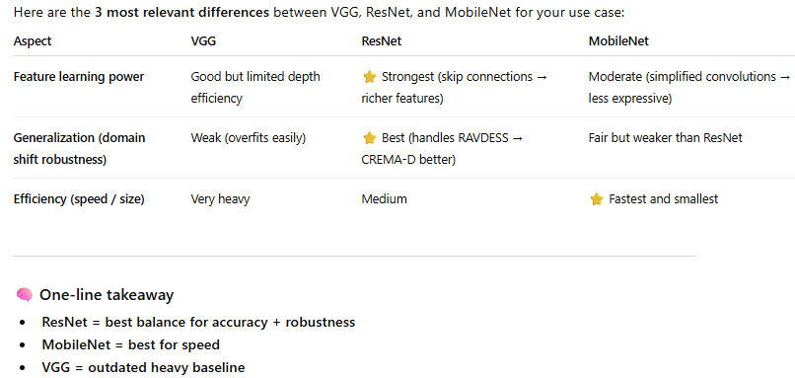
Current Systems (Deep Learning Baseline)
3

Slide 7
Proposed System
System Architecture
Video → Frame Extraction → Preprocessing → ResNet18 → Classification
Key Components
ResNet18 (transfer learning)
CrossEntropy Loss
Adam optimizer
K-Fold Cross Validation
Early stopping
Output Classes
Happy (1)
Not Happy (0)
3

Slide 8
Validation & Testing Setup
Dataset Strategy
RAVDESS → Training
CREMA-D → Validation
AFEW → Testing
Why this design matters
Tests cross-dataset generalization
Simulates real-world conditions
Reduces overfitting risk
Metrics Used
Accuracy
Precision
Recall
F1-score
ROC Curve
3

Slide 9
Results & Observations
Validation Results
Accuracy: 82.82%
Precision: 0.00
Recall: 0.00
F1-score: 0.00
Testing Results
Accuracy: 82.62%
Similar failure pattern across datasets
Key Insight
Model predicted mostly:
Not Happy
due to class imbalance.
3

Slide 10
Results & Observations
ROC Curve (Top Graph)
An ROC curve measures how well a model separates positive and negative classes.
AUC = 0.55: Shows almost zero predictive power.
Baseline comparison: Random guessing gives an AUC of 0.50.
Diagonal line: Your curve closely hugs the random line.
Conclusion: The model cannot reliably distinguish classes.
📉 Precision-Recall Curve (Bottom Graph)
This curve evaluates performance when dealing with imbalanced datasets.
Flat line: Precision stays constant near 0.20.
Class imbalance: The positive class likely represents 20% of data.
High recall trap: Increasing recall does not improve precision.
Conclusion: The model behaves like a random classifier.
3

Slide 11
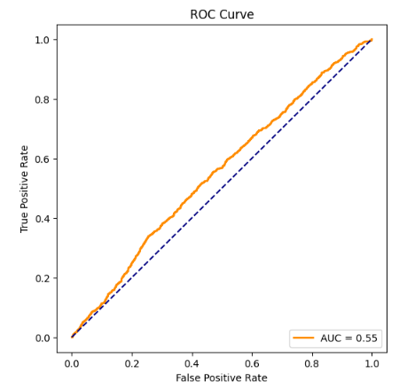
Results & Observations
3

Slide 12
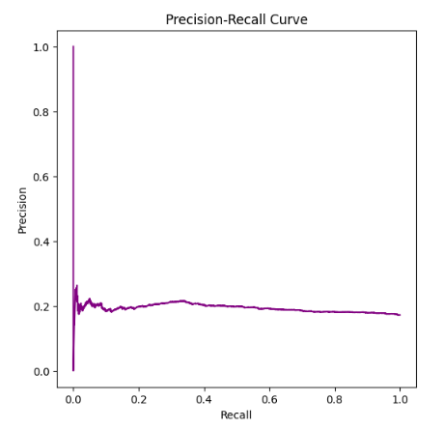
Results & Observations
3

Slide 13
Recommended Next Steps
To improve these results:
Feature engineering: Add more informative predictive variables.
Fix imbalance: Use oversampling (SMOTE) or undersampling.
Model tuning: Adjust hyper-parameters or try different algorithms.
Check labels: Ensure training data targets are correct.
3

Slide 14
Emerging Systems
CNN + LSTM (temporal modeling)
Transformer-based vision models
Multimodal systems (video + audio + EEG)
Attention-based facial analysis
3

Slide 15
Future Directions
Class balancing (weighted loss)
Focal Loss
Temporal modeling (ResNet + LSTM)
Domain adaptation techniques
3

Slide 16
Conclusion
What was achieved
End-to-end deep learning pipeline built
ResNet18 applied to video emotion recognition
Cross-dataset evaluation implemented
Model limitations identified
Open Problems
Dataset imbalance
Domain shift between datasets
Lack of temporal modeling
Final Insight
Deep learning works well, but real-world emotion recognition still requires better generalization and temporal understanding.
3

Slide 17
Conclusion
THANKS!!
3

